Slide 1



Using Blockchain for Medical Data Sharing
Author: Diego Andres Yave Guzman
Tutor: Sergio Paraíso Medina
Notes:
(Present myself first) Hola, Hi, this is Diego.
The presentation will be in English so that it could be according to the slides and documentation.
But we can switch to Spanish for the questions.
The title of my work is… Using Blockchain for Medical Data Sharing.

Slide 2
Objective
Introduce blockchain into the medical context
Study blockchain
Implement with a framework
Medical case of study
Notes:
Blockchain technology continues causing impact not only in financial services but also on healthcare.
So our objective is.
---------------------
So, the goal is to introduce blockchain into the medical context.
The intermediate objectives are:
Study blockchain
Implementation with a framework
which is Hyperledger Fabric.
Medical case of study
Design and implementation of case of study
XXXXXXXXXXXXXX
blockchain can be seen as a different approach

Slide 3
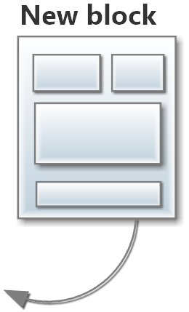
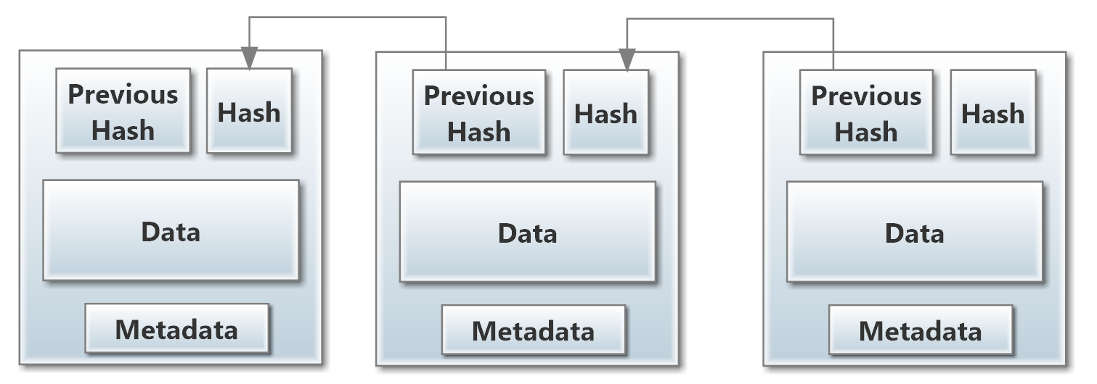
Blockchain
Is a growing list of records (blocks)
Blocks are linked using a hashes
Hash Function
Deterministic
Notes:
Hashes are string of letters and numbers and are calculated by a hash function.
A hash function is deterministic.
So this is how blocks are linked and thanks to hashes blockchains are immutable, are very secure, and difficult to tamper.
-------------------
Blockchain was originally presented as a part of Bitcoin so it’s the beginning to study blockchain.
Bitcoin is a cryptocurrency.
Blockchain is a growing list of records or blocks
Blocks are linked using hashes.
A hash is like and ID. It is a calculated string of letters and numbers generated by a hash function.
Hash Function: receives as an input some string, and returns a fixed output, which is a hash.
This function is deterministic so the same input will always produce the same output
XXXXXXXXXX
Each block has
A hash
A copy of the previous hash
Some data
And metadata, such as the timestamp.
Thanks to the copy of the previous hash, the blocks are linked.
The hashes makes blockchain structure very secure. Computationally it’s not possible to tamper

Slide 4

Blockchain Evolution
Originally presented as a part of Bitcoin
Several frameworks
Permissionless
Public
Any node can participate
Proof of work
Examples: Bitcoin, Ethereum
Permissioned
Consortium
More control of participants
Notes:
>>>>>> Be more concise here
Blockchain was originally presented as a part of Bitcoin
And from there several frameworks have emerged.
The feature permissionless VS permissioned helps to decide which framework to choose.
…
On the contrary, permissioned is managed by a consortium that has control of the participants.
-----------------------
Nowadays there are several implementations of blockchain, cryptocurrencies, frameworks.
An important feature to consider is between permissionless vs permissioned.
Permissionless means
it’s public
any node can participate
but the need a proof of work, which is solving computational puzzles or exercises to demonstrate its identity.
Ethereum, and Bitcoin are some examples.
[Being public has implications of performance and confidentiality]
On the other hand, a permissioned blockchain
has more control over the participants, which is done by a consortium.
A permissioned blockchain has an approach more focused to enterprise use. So we will be working with a permissioned blockchain.

Slide 5
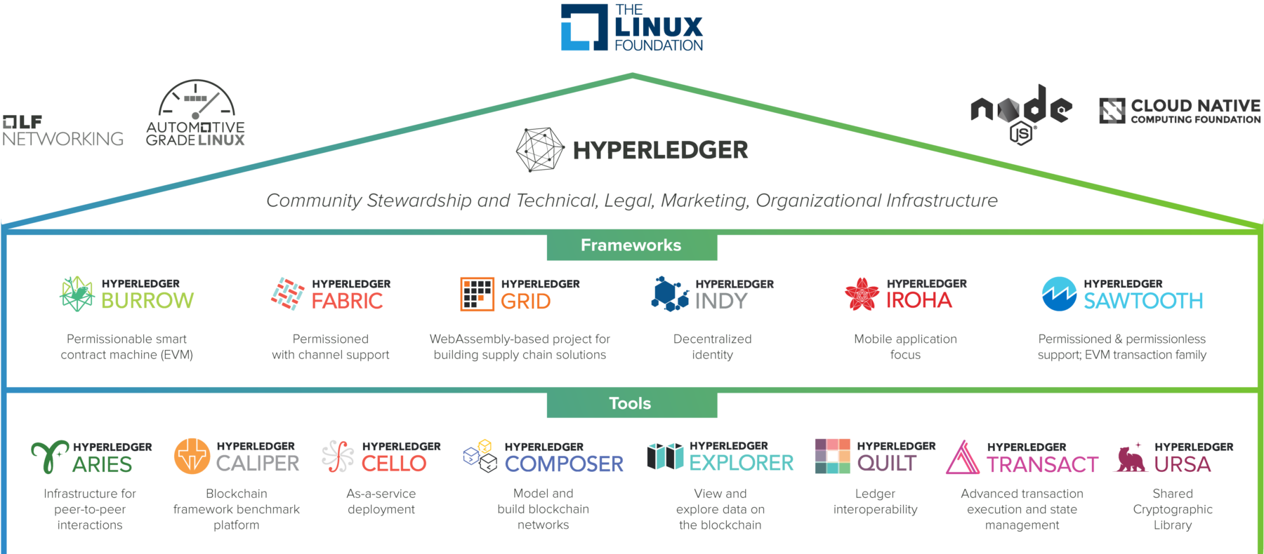
Hyperledger Project
Notes:
Talking about a permissioned, let’s review Hyperledger Project.
It has several frameworks and tools.
Project started by Linux Fundation, but it’s a global collaboration.
We will focus on Fabric, which is one of the most important blockchain frameworks nowadays.
------------------
Hyperledger Project has several tools and frameworks.
Blockchain projects
Global collaboration
Hosted by The Linux Foundation
Fabric is the most important.
This is the chosen blockchain framework for this work.
Fabric is contributed by IBM
Is one of the most important blockchain frameworks today
And it’s permissioned, so it’s not public like Bitcoin.
Fabric is for enterprise use.

Slide 6
Clinical Models
Various Models
Some of them more than just models
OMOP model
The simplest one but yet widely used
Notes:
We will be back with Fabric later, so let’s review Clinical models first.
There are various models
And some of them are more than just models.
They are standards, protocols or even have its implementation.
For this work, we are going to use OMOP model.
It’s the simples one but yet widely used

Slide 7
Case of Study
Based on OMOP data tables
person
observation_period
drug_exposure
About
Medical examination of a patient
Prescription of drugs
Medical Examination
Patient name
Date of birth
Ethnicity
Date of death
Gender
Doctor
Examination Id
Date
Drug Exposure
Drug name
Dose
Diagnosis
Drug start date
Drug end date
quantity
Notes:
The case of study is about the medical examination of a patient.
More precisely about prescription drugs. Prescriptions drugs legally requires a medical prescription to be dispensed.
So basically the input data will be
The medical examination
personal data
the doctor
dates
Drug exposure
drug names
dates
dose

Slide 8
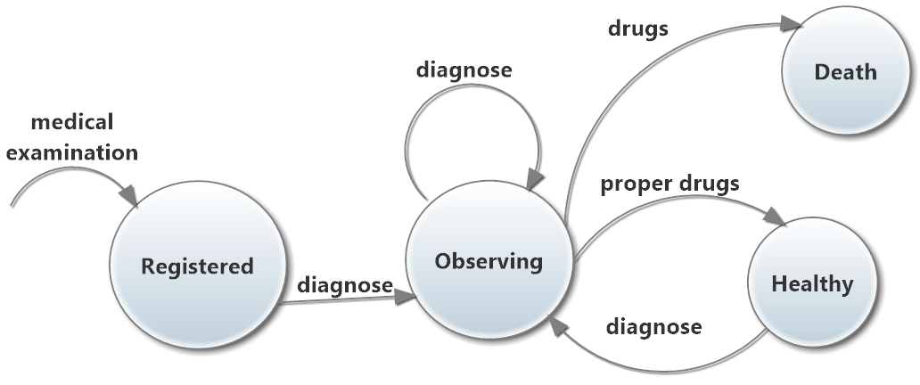
Case of Study
Notes:
Medical examination data is the input
so it’s on the registered stated
After that, the diagnose data leads to the observing state.
And finally, the drugs can lead the patient to be healthy or sometimes the process can end of with the death of the patient.
---------------
This state diagram shows the process.
The input data is the medical examination.
After that, when the patient is being diagnosed, it’s under observation.
Later, the patients was prescribed some drugs to be healthy.
However, there is the case where the patient gets sick again, and dies despite the medications.
As can be see, this process is simple and it’s for the specific case of prescription drugs.

Slide 9
Prior Work
Prior Work about using blockchain in the medical context
Encryption for sharing health records
MedRec
Blockchain system that integrates existing medical systems
ProvChain
Data provenance
Notes:
Encryption for sharing health records in a secure way
MedRec is another remarkable work about a blockchain system that integrates existing medical systems.
ProvChain, which is about data provenance
----------------
The reviewed prior work related to the application of blockchain to the medical context is the following.
Blockchain encryption
To encrypt health records
Index construction
Low level, it’s not our purpose
[Uses Ethereum]
MedRec
Data access (incentivizes medical stakeholders to participate)
It integrates with an existing medical system
It’s implemented in Ethereum, so it’s permissionless. Our system will be permissioned.
ProvChain
Less approach in medical context but data provenance is useful for our context
It uses several software components for the implementation. We will only use Fabric only.
[All of the are permissionless (public), which is different because our proposal will be permissioned.]

Slide 10
Implementation

Slide 11
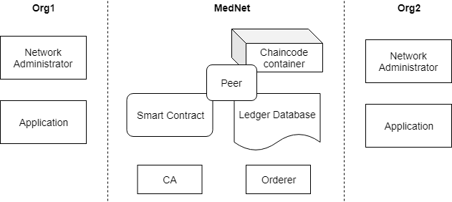
Architecture Overview
Notes:
On the left side we have Organization 1, on the right side we have Organization 2.
Both organizations have the same. A network administrator and an application.
In the middle there is MedNet, the blockchain network.
It contains
chaincode container to deploy smart contract
the peer, a network node
smart contract
ledger
CA
orderer, which is a point of network administration
------------------
Architecture Overview
In the left side, we have organization 1, which represents a Hospital.
In the right side, there is the organization 2, which represents another Hospital that is going to contribute.
Both organizations have the same components. They consist of two components: Network administrator and the Application.
So the network administrator consists of all those tasks related to configure the network.
And the application is a client application that is going to interact with the blockchain network.
In the center is the medical network, which is a Fabric’s blockchain network.
It consists of:
Certificate Authority(CA)
is used to dispense identities in the network
Orderer
a network administration point
Peer
Network entity(node) maintained by org
Chaincode
is a container to deploy smart contracts.
Smart Contract and Ledger
Are going to be described next.

Slide 12
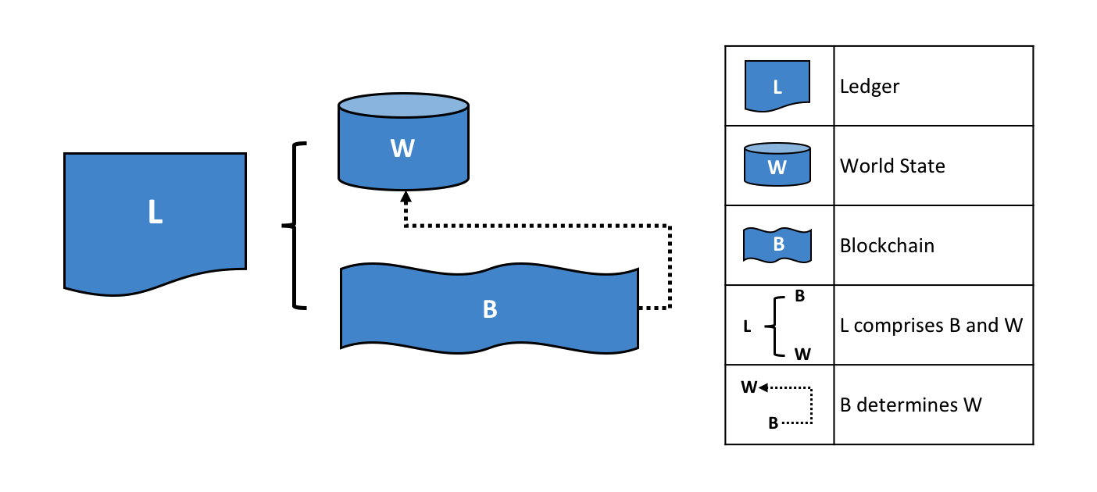
Architecture Overview: Ledger
Notes:
A ledger comprises two parts: the Blockchain and the World State
The blockchain stores all the transactions whether they are valid or not.
And those transactions that are valid update the world state. So the world state contains the updated values.
------------------
A ledger comprises two parts: World State (represented in the figure with a W) and a Blockchain.
The Blockchain
contains the transaction logs
whether a transaction is valid or not, is going to be registered in the blockchain
a blockchain is immutable (that’s to say records cannot be deleted or updated. Just new ones can be appended)
The World State
contains the current values of the business object
So using the blockchain history transaction log, we can determine the current values. But instead of calculating all the time. The world state has the current values in a handy way.
XXXXXXX
it would be cumbersome to traverse the entire blockchain to calculate an object’s current value
you just get it directly from the world state.

Slide 13
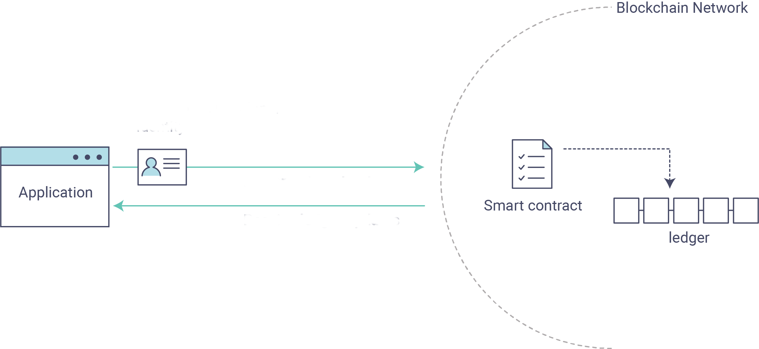
Architecture Overview: Smart Contract
Notes:
So let’s review the interaction with the smart contract.
The application sends the transactions to the blockchain network.
And the smart contract is where the actual definitions of the transactions are.
The smart contract defines the business rules between the organizations.
And the data is stored on the ledger.
---------------------
This shows better the interaction between application, the smart contract and the ledger.
The application sends the transaction requests to the blockchain network.
In the smart contract is defined the logic of transactions.
Defines the rules between organizations
Whether the transactions are valid or not, all of them are going to be registered in the ledger.
But only the valid ones will update the ledger’s world state.
XXXXXXXXXXXXX
Ledger and the smart contract are the hearth of Fabric.

Slide 14
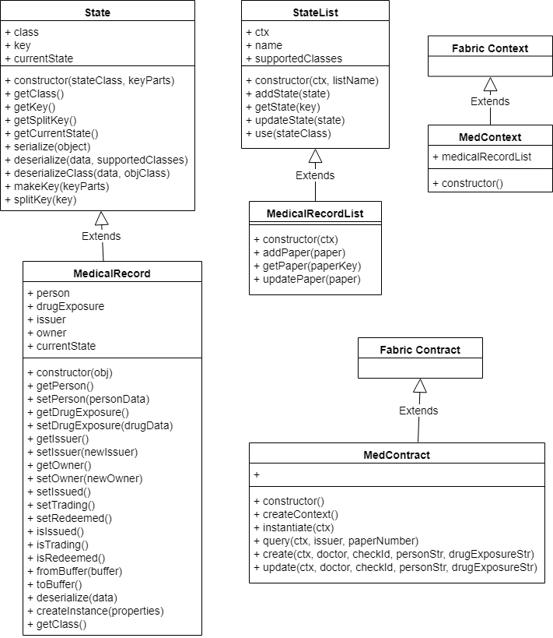
Smart Contract Class Diagram
Notes:
The implementation of the smart contract was done using the language Node JS.
This is the class diagram.
On the right we have MedContext, which inherits from Fabric Context.
And MedContract which inherits from Fabric Contract. Here is where is defined the smart contract transactions.
------------------
On the top are the State and StateList, which are super classes for the interaction with the ledger API and Fabric interface.
MedicalRecord inherits from State.
Here is the medical data.
MedicalRecordList inherits from StateList.
Besides that we have
MedContract which inherits from Fabric Contract set of classes. Here is the code that defines the transactions.
MedContext, which inherits from Fabric Context.
XXXXX
MedicalRecord has the properties person and drugExposure and the respective getters and setters.
MedicalRecordList is the list of medical records.

Slide 15
Results

Slide 16
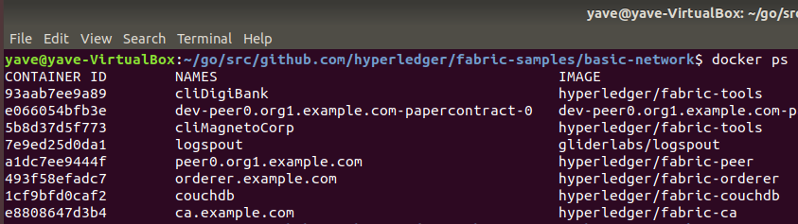
Configurations
Blockchain network configured
Fabric components
Docker containers
Notes:
>>>> Be more concise here
Instead of using many virtual machines, we used Docker containers.
So the heavy task was configuring the network by setting up Docker containers.
------------
Docker make it easier the installations and configurations of environments.
Instead of using virtual machines, in the same machine it was configured Docker containers.
As a result, 8 containers were created for our network.
XXXXXXXXXXXXXXXXXXXXXX
It was installed most important Hyperledger framework, and most important Hyperledger tool: Fabric and Composer.
Hyperledger Composer, which is a Hyperledger tool, was installed and tested but that was discarded because the project is discontinued.
And developer are focusing on putting more feature directly to Fabric.

Slide 17
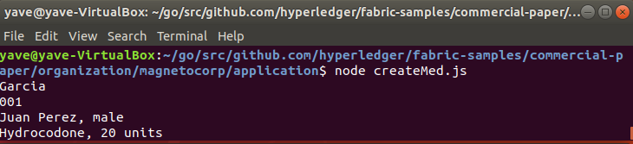
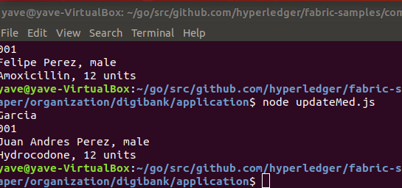
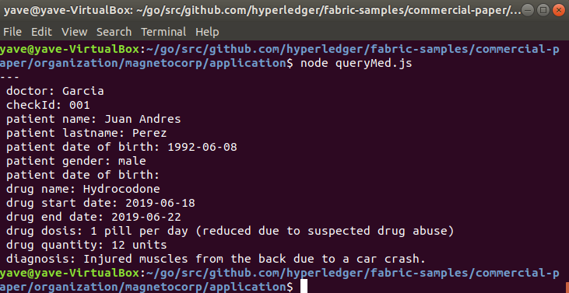
Execution
Notes:
The app1 execute a nodejs application that builds the transaction and sends to the network.
It’s sending the transaction to create the medical records.
The app2 is sending the transaction to update the medical record.
Here can happen that app1 updates it again, and app 2 updates again .
But only the application 1 can review the record by querying it.
This may seem simple but behind the scenes is happing a lot.

Slide 18

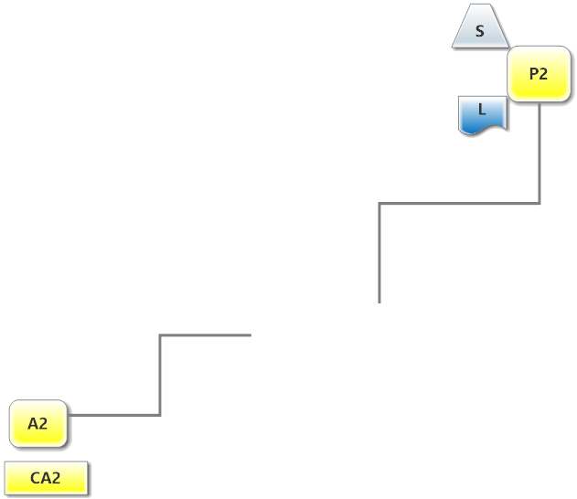
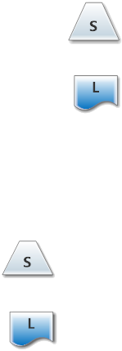
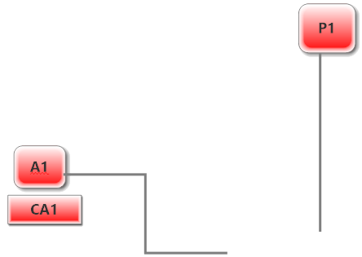
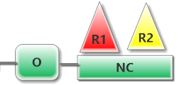
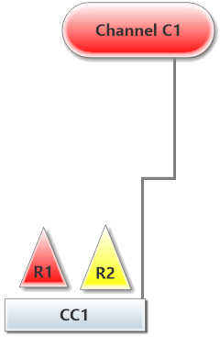
Network
A : Application
C : Channel
CA : Certificate Authority
L : Ledger
NC : Network Configuration
O : Ordering Service
P : Peer Node
R : Organization
S : Smart Contract
1 refers to Org1 (Hospital 1)
2 refers to Org2 (Hospital 2)
Notes:
Network admin and some organizations decide to launch the network.
R1 and R2 conform the consortium under NC, which is the network configuration.
These organizations are capable of creating many channel but in this case we only need one.
Where participate org1 and org2.
This is the basic network configuration but it doesn’t have any functional yet.
---
Here the network admin1 needs to configure the components for organization1.
Here is gonna be configured A1 and P1 with the appropriate certicates.
After that, the smart contract needs to be installed on peer1.
And p1 needs a copy of the ledger.
Also, the channel needs the smart contract to be instantiated and has a copy of the ledger.
Admin2 needs to do the same for Organization 2.
Once we have that, the network is ready to go.
This is when app1 sends the transaction of creating a medical record.
That’s going to be arrive to the channel, which will execute the smart contract and register on the ledger whether the transaction is valid or invalid.
With the communication with orderer node, they will replicate the changes to p1 and p2 so that they have the ledger updated.
That’s from the application 1 side.
From the app2 side, it’s the same. App1 will send a transaction to update and the same will happen.
----------------------
This is the resultant network. And here is what happened behind the scenes.
On the left side we have the applications and the certificate authorities. One for each organization.
The smart contract is installed on the peer and instantiated on the channel.
All of this needs to be configured by the network admins, and that is started from the orderer node.

Slide 19
Conclusions
Blockchain
keeps evolving and continues causing impact
can be permissionless or permissioned
The case of study
based on OMOP model
2 organizations
Notes:
Blockchain
We chose Fabric framework, which is permissioned
Hyerledger Fabric
is permissioned
was used in this work
to configure a netwok
and to implement the console applications
and to implement the smart contract
The case of study
simple with 2 organizations so that it can be implemented with Fabric
XXXX
Applications are consoles (don’t have graphical interface)

Slide 20
Conclusions
Fabric offers
decentralization
flexibility
scalability
confidentiality
Fabric is complex from the points of view of
learning
application
development
To be make it worthwhile it’s expected
medium or large medical contexts
several interactions among staff and organizations
Notes:
Fabric offers so much: decentralization, flexibility, scalability, performance and confidentiality.
Although it has an enterprise use,
XXXXXXXXXXXXXX
The roles of developer, operator and architect were covered by one person. However, for a more real example, it will be required smart contracts developers, client applications developers, solution architects, networks operators and business professionals.

Slide 21
Further Work
Complement the case of study
Complete data provenance
Fabric Shim
Deployment in a production environment
Notes:
Complement the case of study with
more participant organizations
other scenarios with consensus
more complex case of study
Data Provenance partially implemented
Querying works but the historical retrieving not.
Use Fabric Shim, which is the low level Fabric API

Slide 22
Thanks

