Slide 1
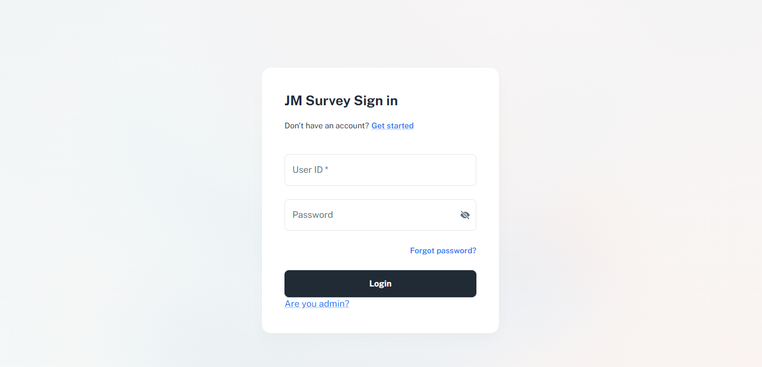

Web Site URL :
https://jmleadership.pythonanywhere.com/
STEP 1:
[FIRST PAGE]

Slide 2
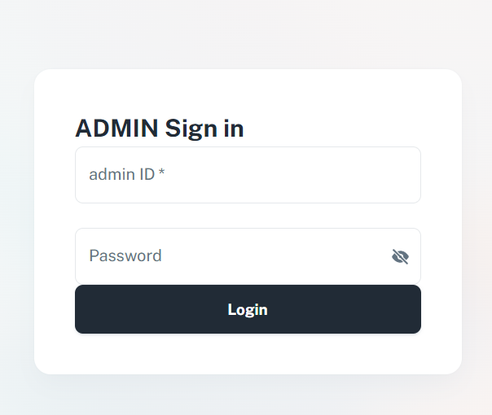
Web Site URL :
https://jmleadership.pythonanywhere.com/
STEP2 :
[Admin LOGIN PAGE]
> 아이디 : adminchoi
> 비밀번호 : adminchoi

Slide 3
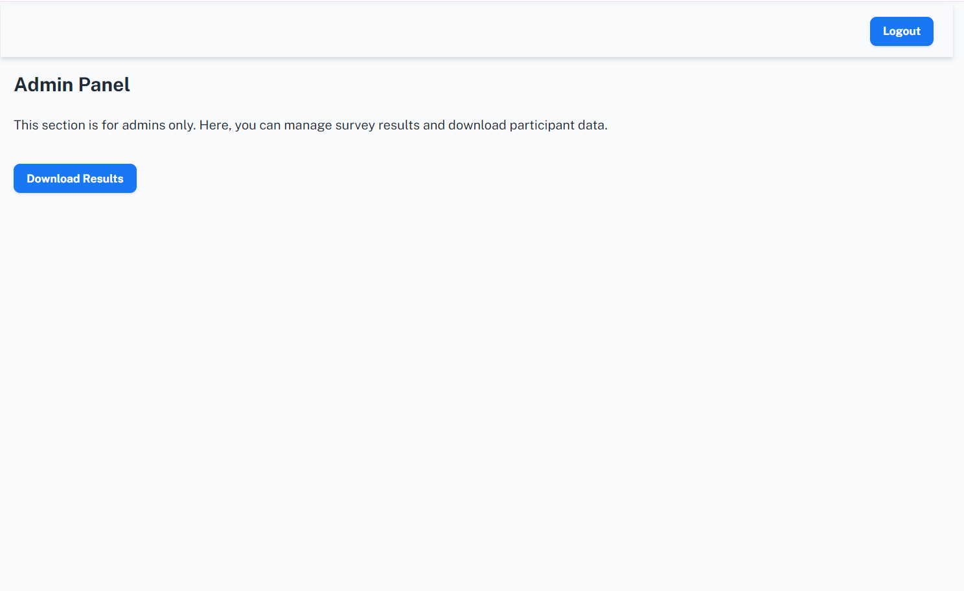
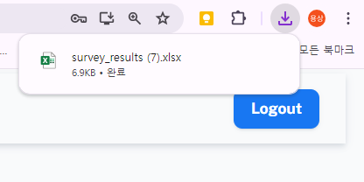
Web Site URL :
https://jmleadership.pythonanywhere.com/
STEP 3 : Download Response Data (excel FILE)
> 아이디 : adminchoi
> 비밀번호 : adminchoi

Slide 4
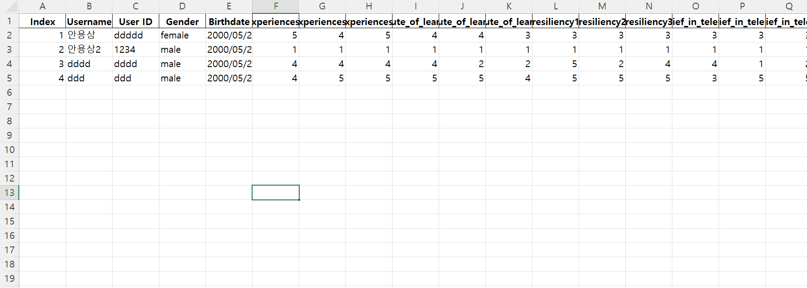
Web Site URL :
https://jmleadership.pythonanywhere.com/
STEP 4 : Analysis data
> 아이디 : adminchoi
> 비밀번호 : adminchoi

