Slide 1
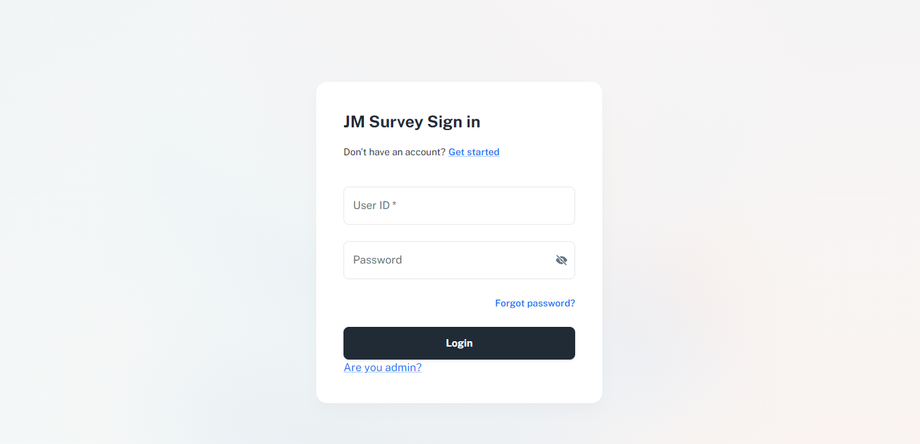
Web Site URL :
https://jmleadership.pythonanywhere.com/
[FIRST PAGE]

Slide 2

Web Site URL :
https://jmleadership.pythonanywhere.com/
[Survey 참여자 입장에서]
STEP 1 : 첫 화면

Slide 3
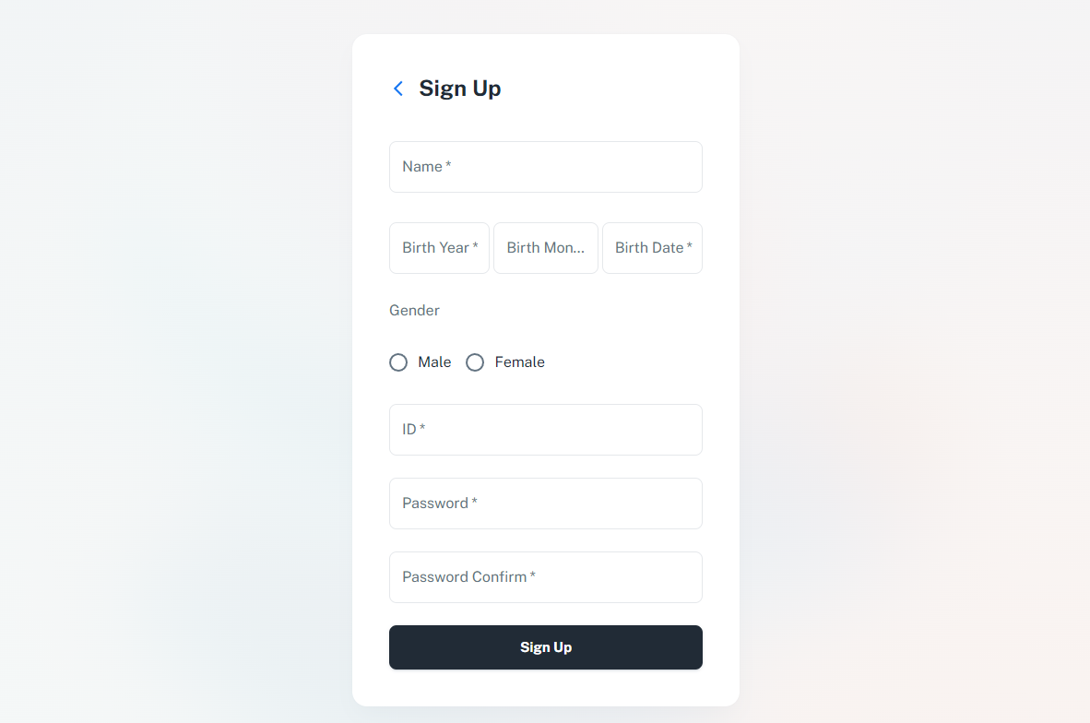
Web Site URL :
https://jmleadership.pythonanywhere.com/
[Survey 참여자 입장에서]
STEP 2 : 회원가입

Slide 4
Web Site URL :
https://jmleadership.pythonanywhere.com/
[Survey 참여자 입장에서]
STEP 3 : 로그인

Slide 5
Web Site URL :
https://jmleadership.pythonanywhere.com/
[Survey 참여자 입장에서]
STEP 4 : 로그인

Slide 6
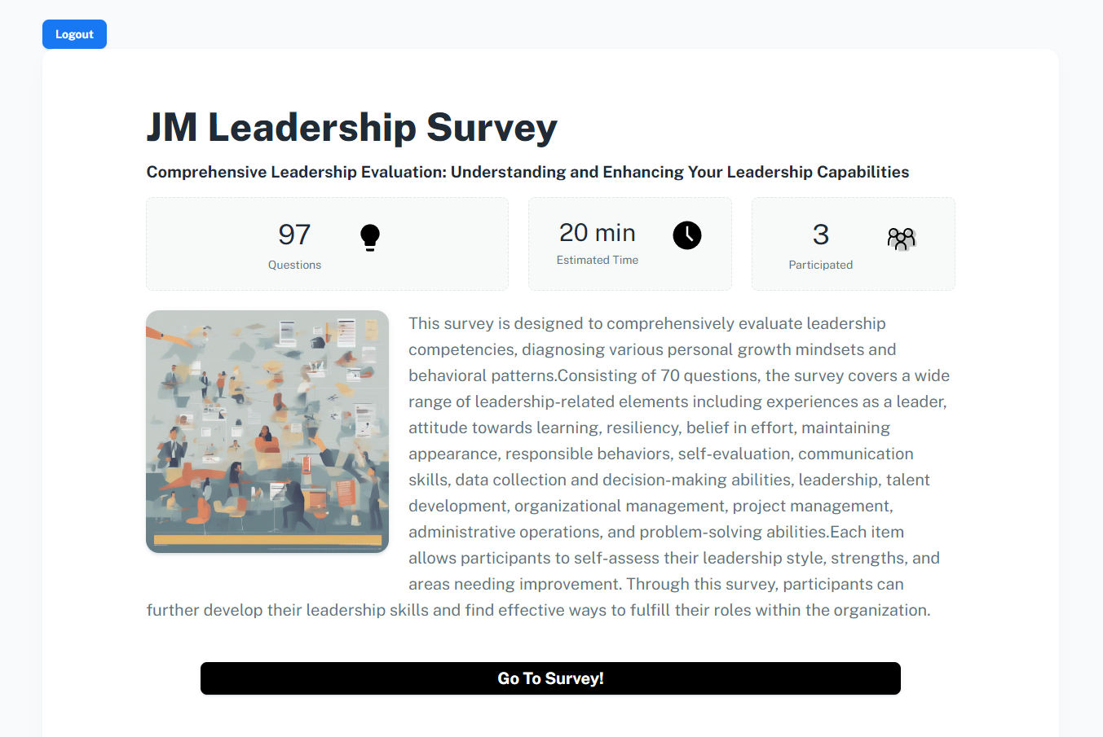
Web Site URL :
https://jmleadership.pythonanywhere.com/
[Survey 참여자 입장에서]
STEP 5 : 설문 시작

Slide 7
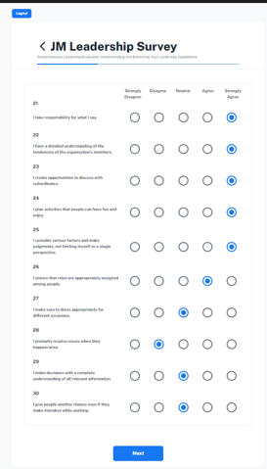
Web Site URL :
https://jmleadership.pythonanywhere.com/
[Survey 참여자 입장에서]
STEP 5 : 설문 진행

Slide 8
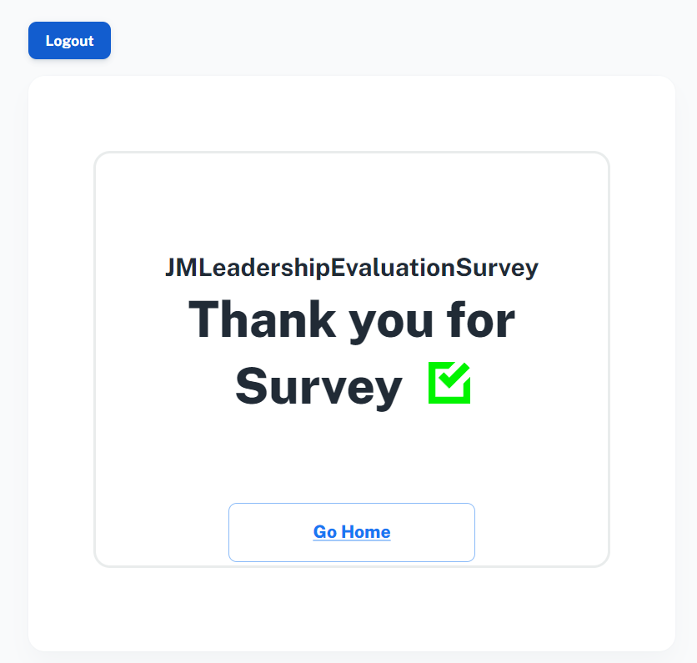
Web Site URL :
https://jmleadership.pythonanywhere.com/
[Survey 참여자 입장에서]
STEP 6 : 설문 완료

