Slide 1
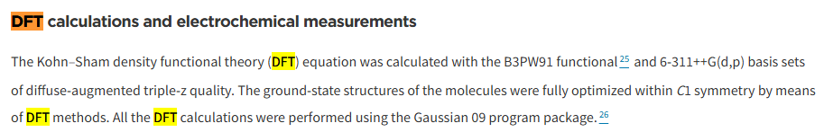
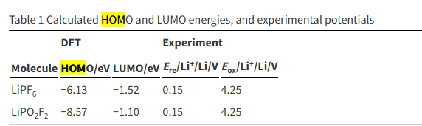
HOMO/LUMO validation Data
Article Title : Improving the cyclability performance of lithium-ion batteries by introducing lithium difluorophosphate (LiPO₂F₂) additive†
https://pubs.rsc.org/en/content/articlehtml/2017/ra/c7ra03926c
Our result
vs
B3LYP, def-TZVF, D4, CPCM(water 수용액상태 환경)

Slide 2




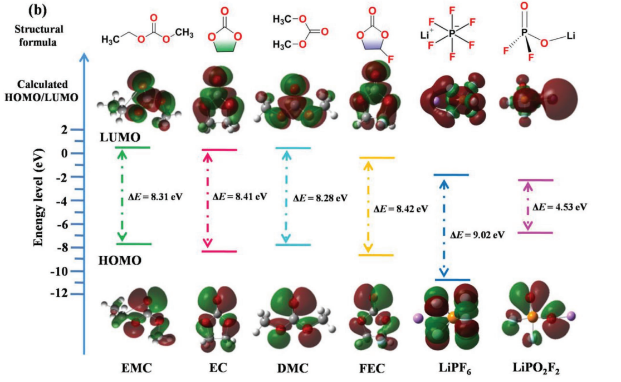
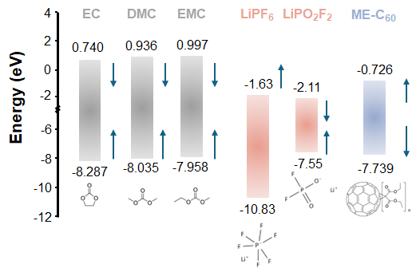
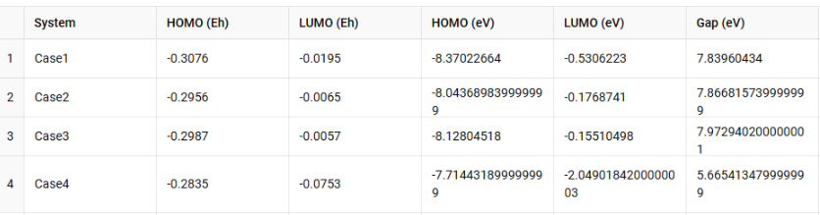
EC
EMC
DMC
LiPO2F2

