Slide 1
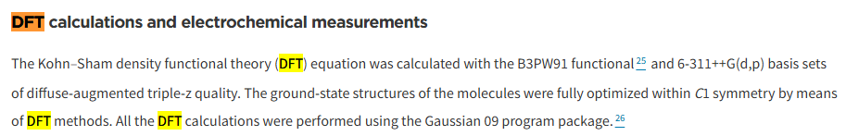
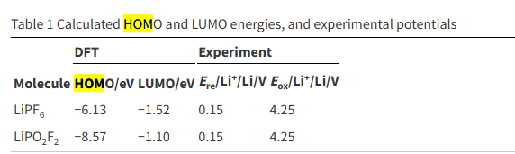
HOMO/LUMO validation Data
Article Title : Improving the cyclability performance of lithium-ion batteries by introducing lithium difluorophosphate (LiPO₂F₂) additive†
https://pubs.rsc.org/en/content/articlehtml/2017/ra/c7ra03926c
Our result
vs
B3LYP, def-TZVF, D4, CPCM(water 수용액상태 환경)

Slide 2





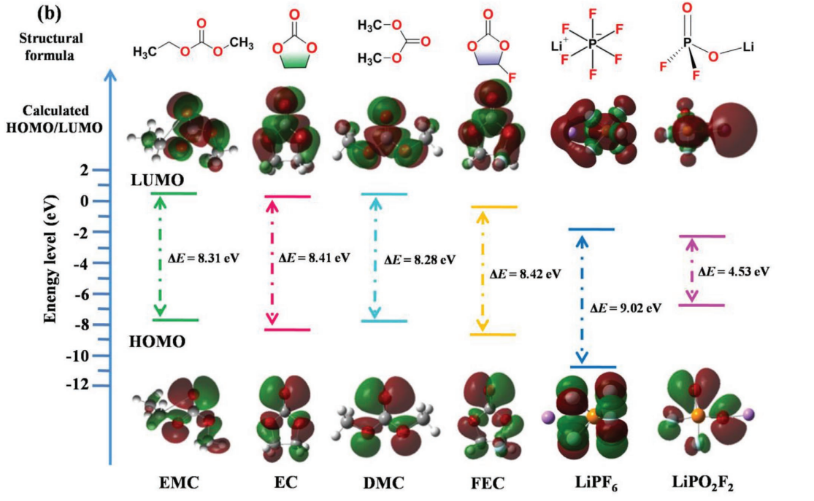
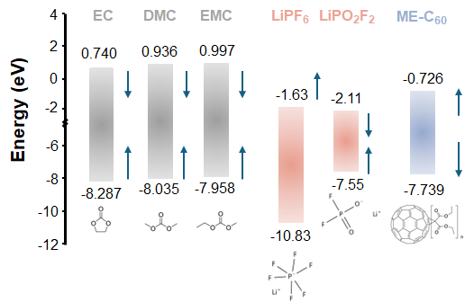
EC
EMC
DMC
LiPO2F2
DVS
 | LUMO | HOMO | LUMO | HOMO
EC | -0.0195 | -0.3076
DMC | -0.0065 | -0.2956
EMC | -0.0057 | -0.2987
LiPF6
LiPO2F2 | -0.0753 | -0.2835
DVS | -0.0717 | -0.2967

