Slide 1
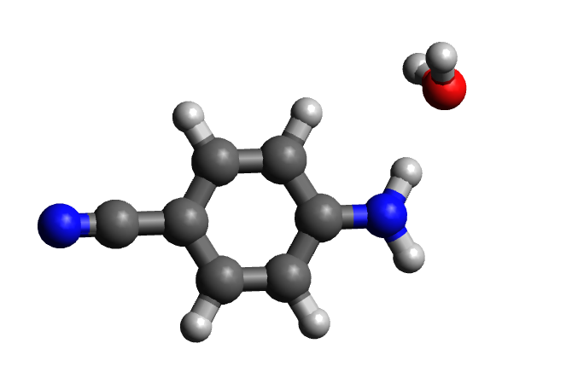
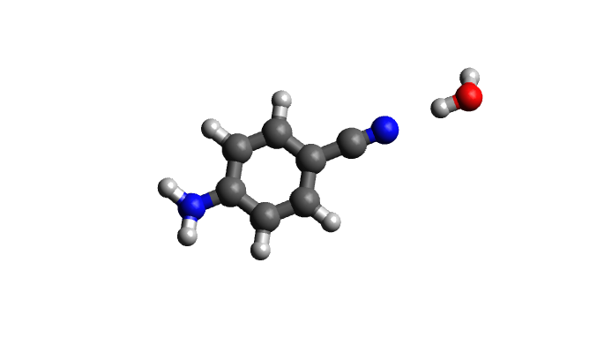
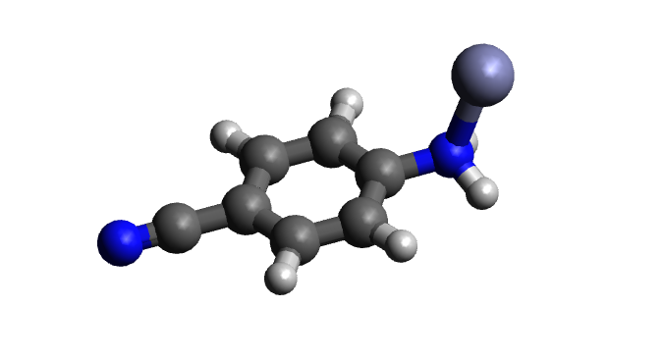
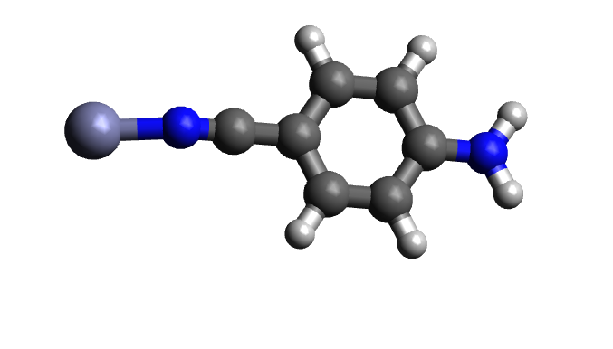
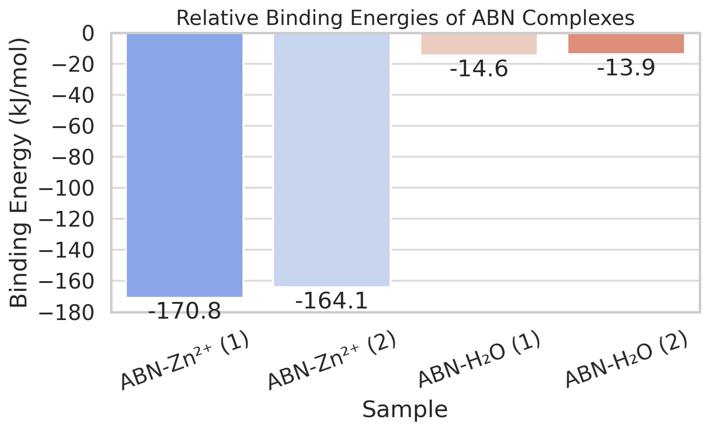
20250723 | ABN
시스템 | 폴더 경로 | 에너지 (Hartree)
ABN | ABN/input.xyz | -379.8145477
Zn²⁺ | Zn2+/input.xyz | -1778.94615
H₂O | H2O/input.xyz | -76.43706245 | Binding Energy (Ha) | Binding Energy (kJ/mol)
ABN-Zn²⁺ (1) | ABN_Zn2+/01/input.xyz | -2158.82538 | -0.064682309 | -170.7612962
ABN-Zn²⁺ (2) | ABN_Zn2+/02/input.xyz | -2158.822865 | -0.06216764 | -164.1225687
ABN-H₂O (1) | ABN_water/01/input.xyz | -456.2571323 | -0.005522133 | -14.57843072
ABN-H₂O (2) | ABN_water/02/input.xyz | -456.2568634 | -0.005253262 | -13.86861155

