Slide 1
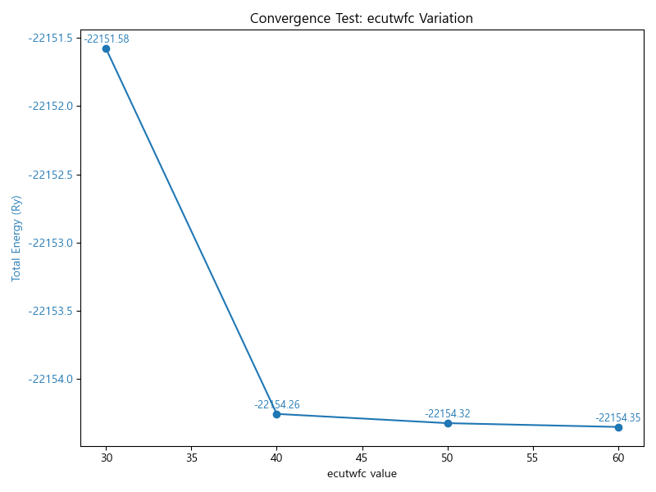
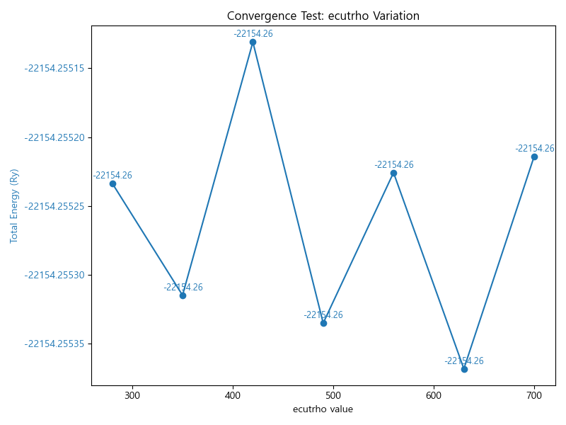
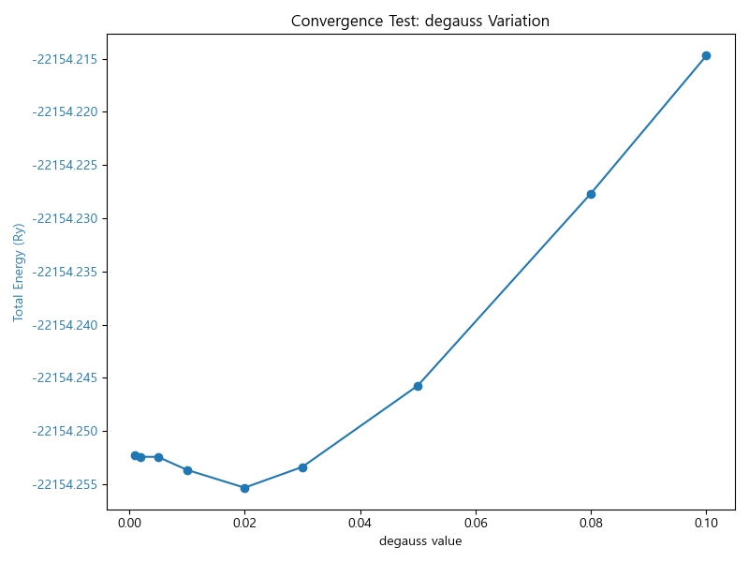
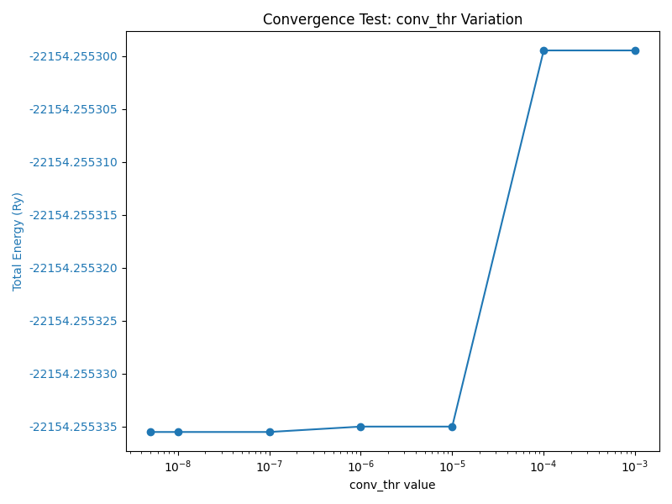
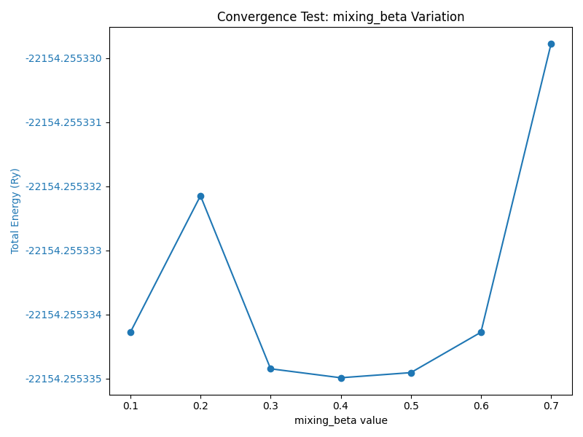
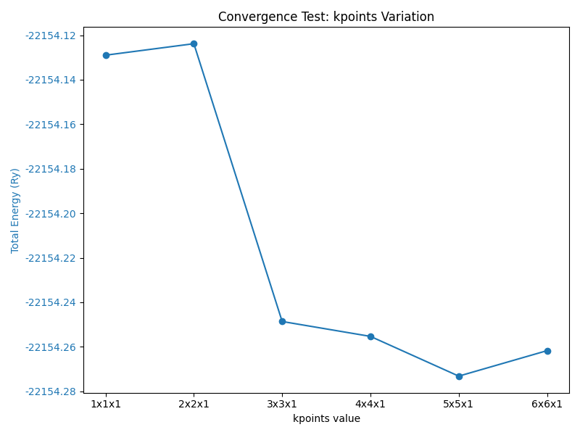
Figure Sx.
Preliminary convergence test results for plane-wave DFT calculations. The parameters tested include wavefunction cutoff energy (ecutwfc), charge density cutoff energy (ecutrho), electronic smearing width (degauss), self-consistent field convergence threshold (conv_thr), mixing parameter (mixing_beta), and k-point mesh settings (a–f). Each parameter was systematically varied to determine its impact on the total energy convergence and calculation stability.
(a)
(b)
(c)
(d)
(e)
(f)

