Slide 1
MIPS Pipeline Simulator
ECE 5367 – Juan Aguilar

Slide 2
Table of Contents
Introduction
Pipeline Hazards
Code
Simulation and Results
Conclusion

Slide 3
Introduction
Pipeline Overview | Implementations

Slide 4
Introduction
Pipeline Overview:
5-stage pipeline with data and control hazard control.
Comprised of registers, memory, and instructions.
C++ simulation.
Implementations:
I/O reading and writing.
Logic for detecting hazards through stalling or flushing.
Intuitive, easy to use console interface.

Slide 5
Goals
Goal:
Proper input/output production
Detection of hazards with logic
Ease of use
Key Details:
Input Parsing
Proper reading of current instruction implementation
Tracking of the pipeline

Slide 6
Pipeline Hazards
Logic

Slide 7
Data Hazards
I-Type or R-Type instruction.
Created when previous instructions are yet to write to a register that is needed for the current instruction (write back).
Is often dealt with by adding stalls to the current instruction.
Consists of instructions such as ADD, SUB, LW, ADDI.
Can also be fixed with forwarding.

Slide 8
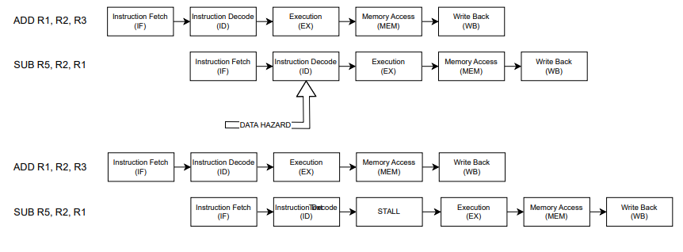
Data Hazards

Slide 9
Control Hazards
I-Type instruction.
Created when branching is unresolved, leading to incorrect instructions to flow.
Is often dealt with by making predictions on whether the branch is executed and flushing if the branch is executed in execution stage.
Consists of instructions such as BNE, BEQ, BLT.

Slide 10
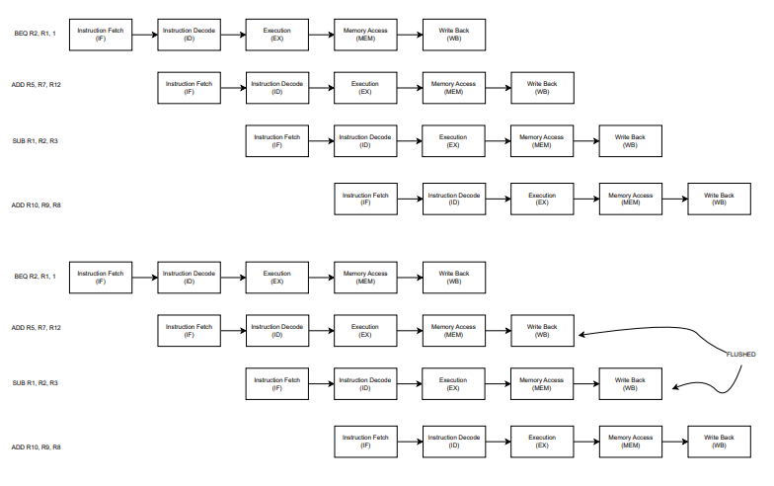
Control Hazards

Slide 11
Code
C++ Syntax and Logic

Slide 12
Definition of Registers, Memory, and Instructions
Registers are used to store values and addresses
Memory is utilized for the instruction SW, which saves a register value into a memory address.
Instructions are stored in 32-bit binary strings comprised of opcode, destination registers, source registers, functions, and immediate values.

Slide 13
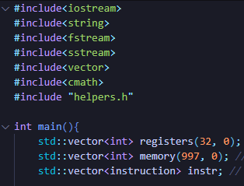
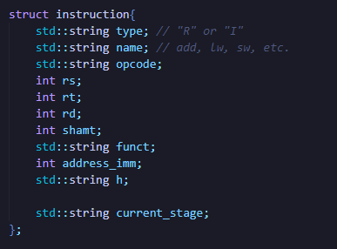
Definition of Registers, Memory, and Instructions

Slide 14
Input File Parsing
Checks for data type (Registers, Memory, Code).
Splits the register name and value to store in the registers vector.
Uses the memory location and value to store in the memory vector.
Will decode the binary string by seeking a certain number of indexes, and is stored into the structure defined vector

Slide 15
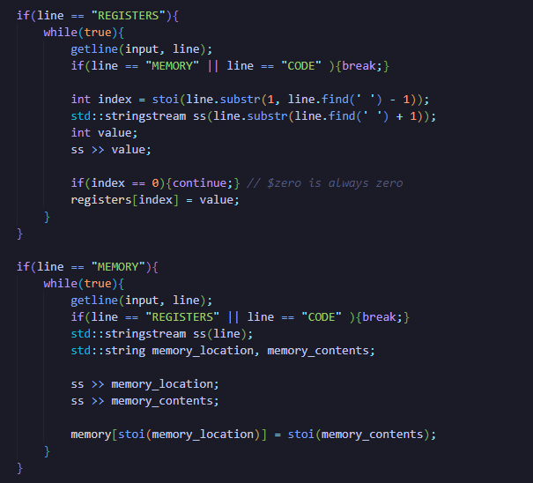
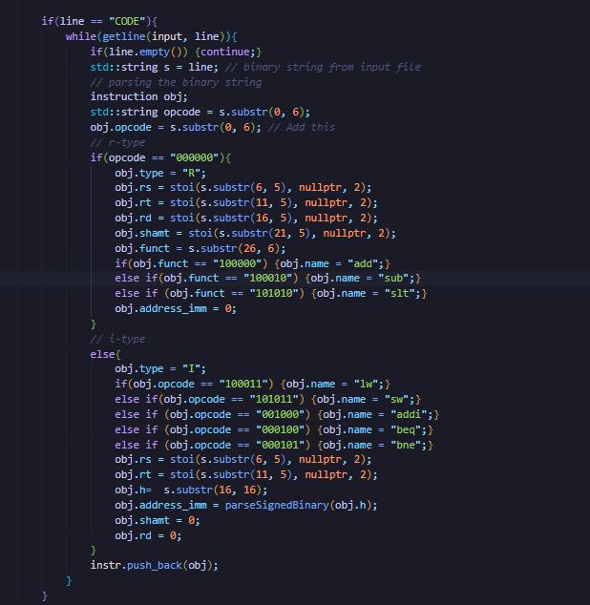
Input File Parsing

Slide 16
Pipeline Logic
Account for data hazards by checking previous instruction.
Keep count of the type of instruction and how it affects future instructions
Deal with control hazards by keeping track of the instructions that get executed while branch is being resolved.
Execute the instructions accordingly and storing them if needed.

Slide 17
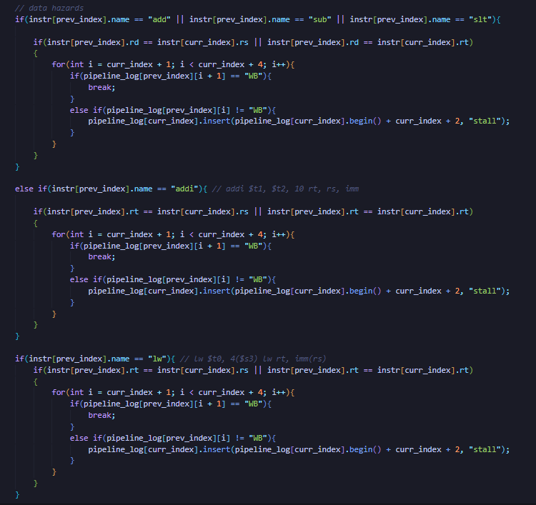
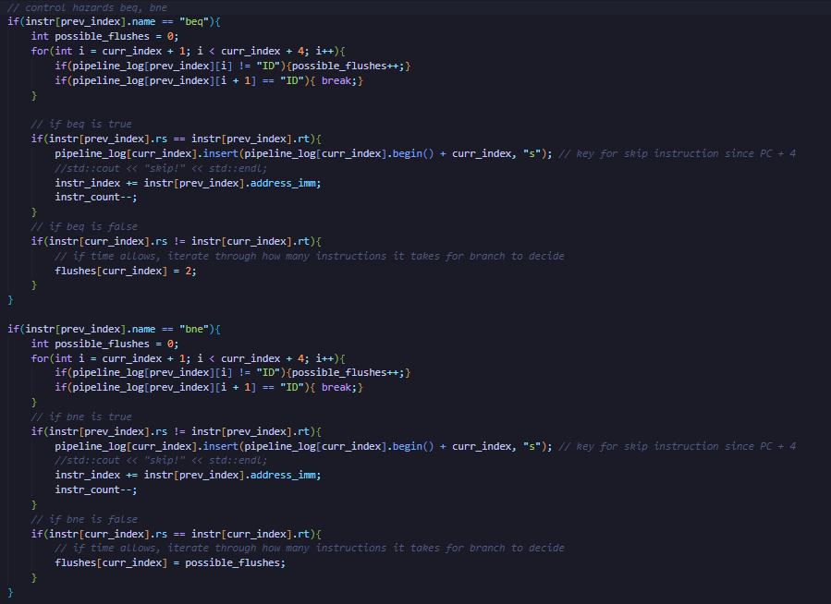
Pipeline Logic

Slide 18
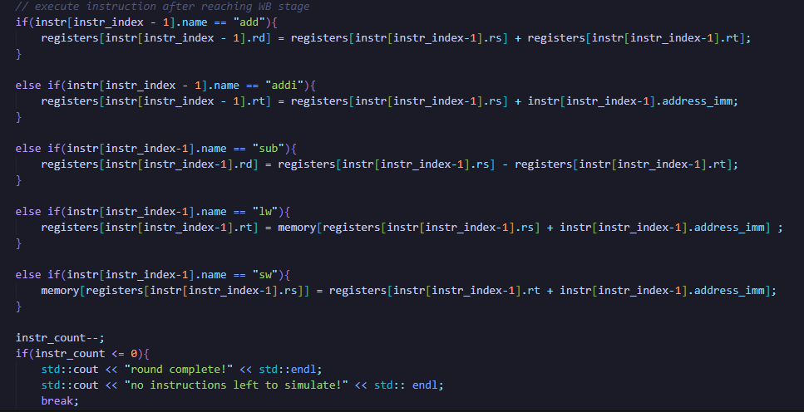
Pipeline Logic

Slide 19
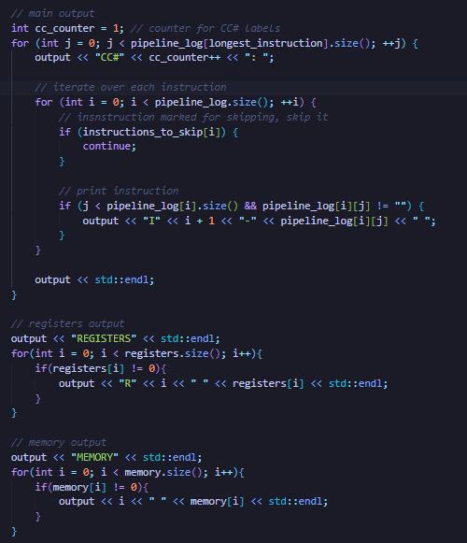
Final Checks/Output
Checks for a marked instruction and skips (branching).
Ensures only instructions executed are accounted for.
Outputs register and memory values that are not zero.

Slide 20
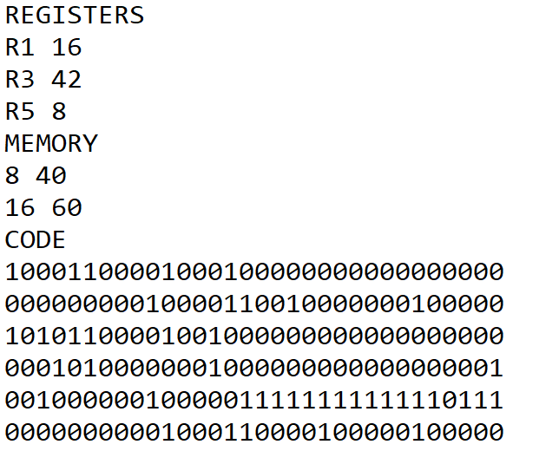
Instructions and Input File
Instruction 1: LW R2, 0(R1)
Instruction 2: ADD R4, R2, R3
Instruction 3: SW R4, 0(R1)
Instruction 4: BNE R4, R0, 1
Instruction 5: ADDI R1, R2, -9
Instruction 6: ADD R1, R1, R3

Slide 21
Simulation and Results
C++ | Simulation

Slide 22
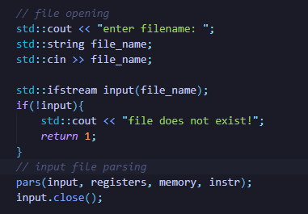
Input Reading
User is asked to input the file name.
If the input file is not found, then the program stops.
Otherwise, it will parse the file, and then close

Slide 23
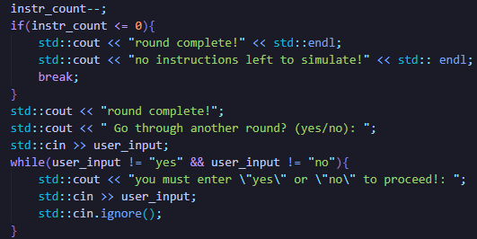
Simulation Checkpoints
User is asked for another simulation round
Based on the input, the program will go through output process, or it will continue the simulation.
If the program no longer has any instructions to run, it will continue with the output process.

Slide 24
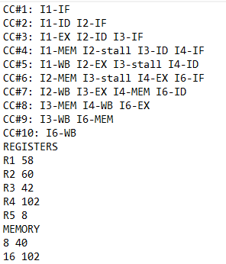
File Output (Complete Simulation)
Each instruction is processed.
Since the branch is executed, instruction five is skipped.
Registers and Memory are written from their respective vectors.

Slide 25
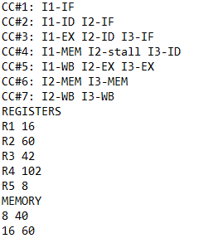
File Output (Partial Simulation)
Two rounds of simulation.
Only covers instructions 1-3.
Leads to different pipeline results.
Leads to different register and memory results

Slide 26
Conclusion
Simulation Discussion

Slide 27
Conclusion
For the full simulation, the code seems to handle instruction updating with control and data hazards.
Tracing the input file by hand leads to the same results as that of the simulation, proving a successful project.
Since only BEQ and BNE branches were accounted for, it does not account for all MIPS instructions.
Console output is user friendly and is trivial to understand.

Slide 28
Conclusion
For the partial simulation, the code seems to handle instruction updating with control and data hazards.
Since it does not finish, it may not output stalls nor may it flush instructions properly.
It is expected to get incorrect results at some point since some instructions don’t get to be executed.

Slide 29
Future Considerations
Cover a wider range of instructions.
Simulate an ARM CPU.
Implement the pipeline using Verilog.
Verify project with System Verilog.

Slide 30
End of Presentation

