Slide 1
Street-Scene Intelligence
A Multi-Stage Pipeline for Traffic-Scene Detection, Brand Recognition, and Natural-Language Explanation
Dongyuan Gao · Solène Cosandey
Notes:
This is our computer-vision project: a multi-stage pipeline that turns raw dashcam video into structured, narrated, and queryable street understanding.
dongy introduction

Slide 2
Our demo pipeline bridges the gap between raw detection and human trust.
How do we improve trust
in self-driving cars?
In the next 15 minutes: Detect → Enrich → Explain
Notes:
Attention: Self-driving cars detect every obstacle — but passengers still don't know why the car braked.
Benefit: One pipeline turns raw dashcam video into a marketing-ready story — boxed objects, named brands, plain-language captions — so any viewer can follow what the car sees.
Credibility: 4 stages across 3 sections · YOLO26s · CLIP · VLM · SegFormer — all running locally.
Destination: In the next 15 minutes: Detect → Enrich → Explain.
introduction-dongy

Slide 3
Three Sections
1
2
3
Detect
Enrich
Explain
Find and segment objects
Add fine-grained identity
Turn everything into a story
Notes:
The talk follows the actual data flow of the pipeline: first we find and segment objects, then we add fine-grained identity, then we turn everything into a story any viewer can follow.
introduction-dongy

Slide 4
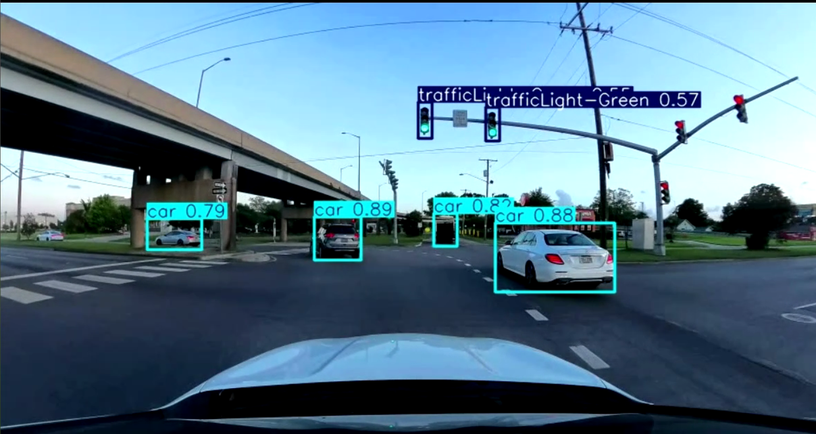
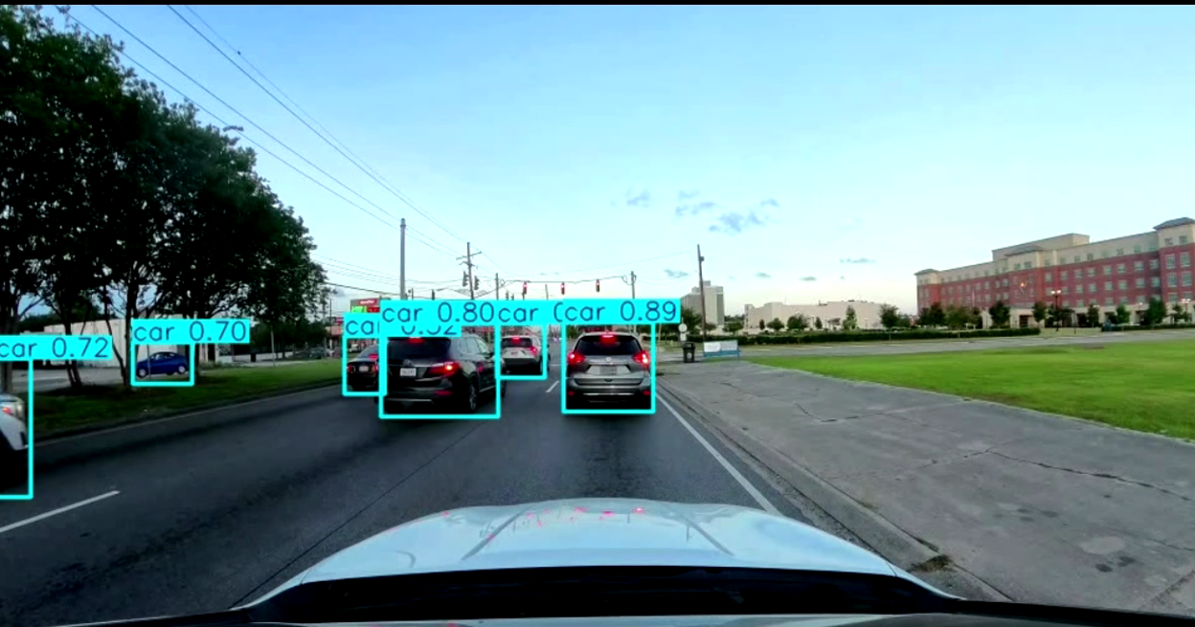
Finding objects is step one — we also need to see the whole scene.
YOLO26s detection overlay — frame 1
YOLO26s detection overlay — frame 2
Notes:
Both frames are extracted from the YOLO26s annotated video output (other_document/video archive/output video/10.05.2026/annotated_video_yolo.mp4). Frame 1 and Frame 2 show detection on different street scenes — YOLO locates cars, pedestrians, traffic lights, and trucks in real driving conditions. But knowing 'car' is not enough: a car has a brand. And the scene is more than objects — it is road, sidewalk, sky. We need detection at two levels: objects and geometry.
detect-solene-enrich

Slide 5
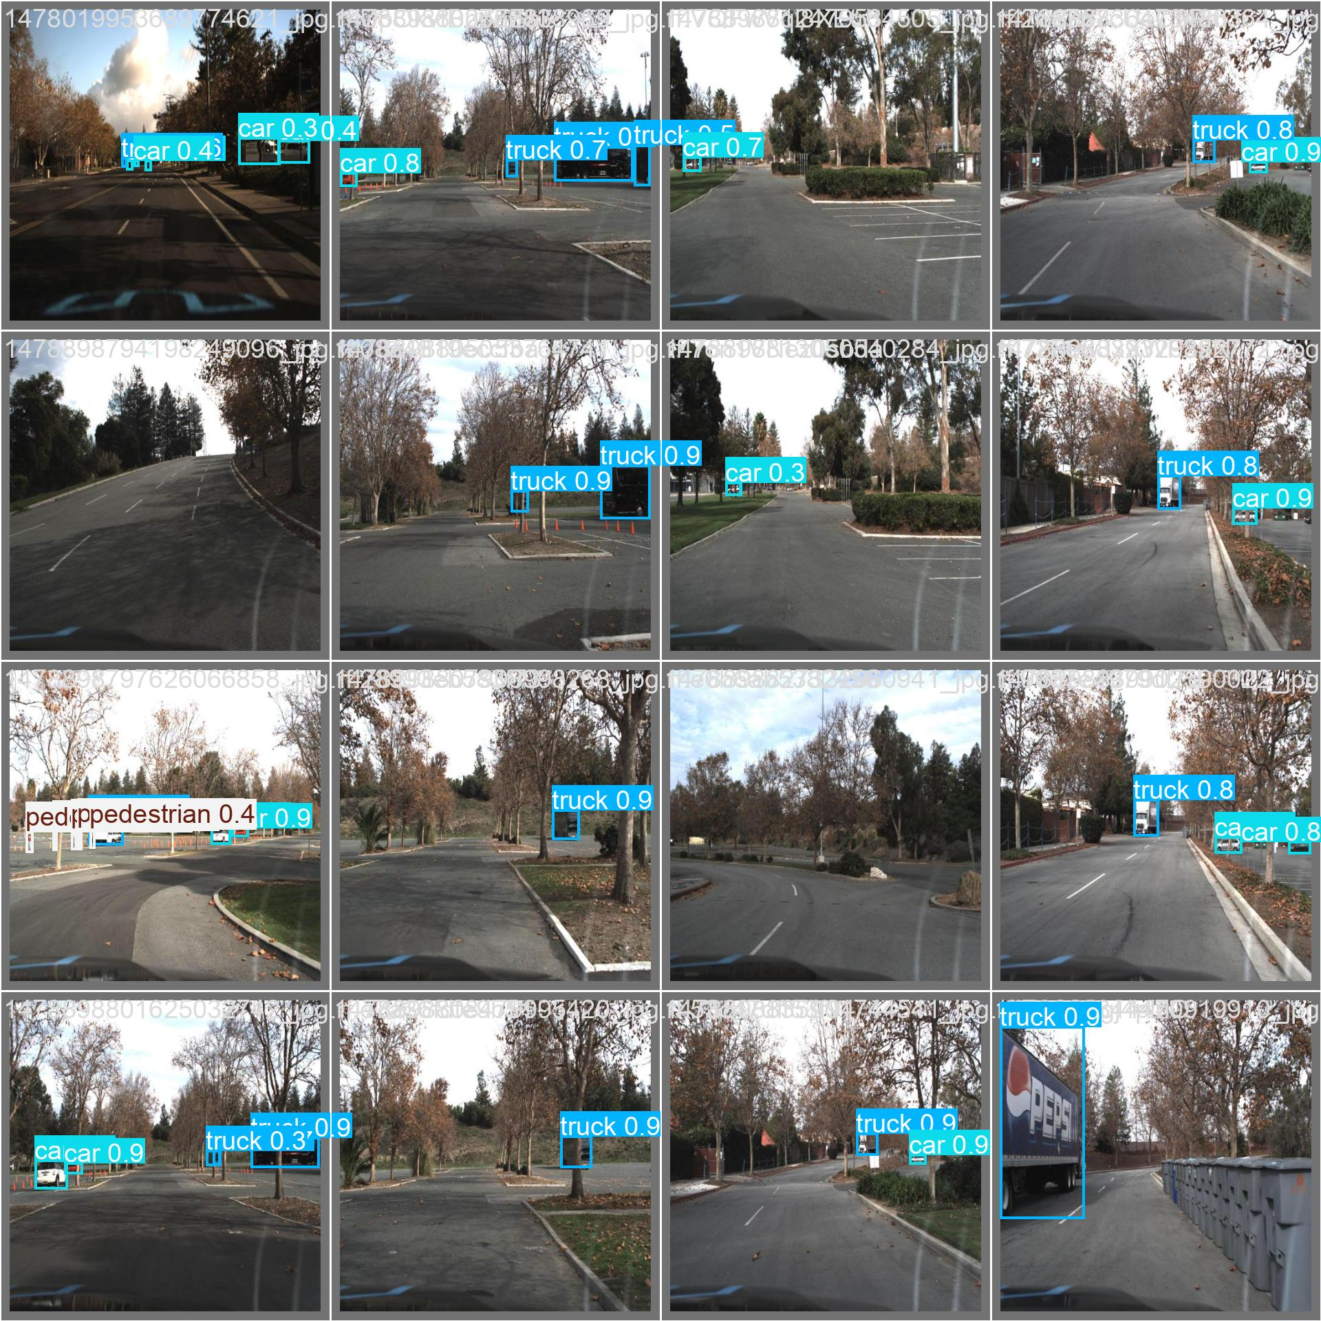
YOLO26s — fast object detection
11 classes · 512 px · 30 epochs · mAP@0.5 = 0.842 · mAP@0.5:0.95 = 0.515
11
Classes
512 px
Image Size
30
Epochs
Upgraded from YOLOv10n → YOLO26s: +24.7% mAP@0.5, +32.7% mAP@0.5:0.95, +26.1% recall (11-class Self-Driving-Car-3, 30 epochs).
Notes:
YOLOv10n baseline: P=0.801, R=0.598, mAP@0.5=0.675, mAP@0.5:0.95=0.388. YOLO26s: P=0.874, R=0.754, mAP@0.5=0.842, mAP@0.5:0.95=0.515. The ~10.0 M parameter backbone with C2PSA blocks delivers a significant accuracy lift — especially on recall and strict mAP. Pedestrian remains the hardest class (mAP 0.692) due to scale and occlusion. The dataset covers 11 street classes including nuanced traffic-light states.
detect-solene-enrich

Slide 6
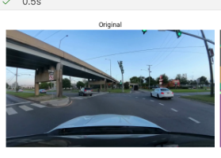
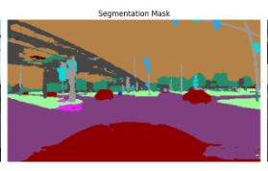
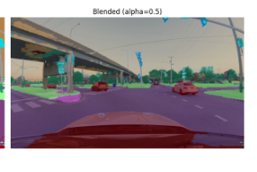
SegFormer-B5 — pixel-level scene understanding
Cityscapes · 19 classes · 84 % mIoU
Original
Mask
Overlay (α=0.5)
Nearest-neighbor upsampling preserves boundaries; 2,516 frames at ~5 it/s (~8 min) — quality demo, not real-time.
Notes:
Our newest stage answers the same question as YOLO, but at the pixel level: what is in this scene? Road (purple), vegetation (green), vehicles (dark blue / navy), sky (light blue) — scene geometry, not just boxes. SegFormer-B5 is pretrained on Cityscapes (84% mIoU) and generalises directly to our dashcam domain without any fine-tuning.
Key insight: the road mask forms a coherent drivable corridor in the lower-center of the frame — essential for understanding free space. Vehicle pixels are coloured dark blue (car) or navy (truck), giving precise footprints rather than rectangular approximations.
Limits: small objects like distant pedestrians and traffic lights may be mislabeled or smeared; per-frame inference causes temporal jitter without optical-flow smoothing; and the fixed 19-class ontology has no category for potholes or construction zones. Safety-critical detection still belongs to YOLO.
detect-solene-enrich

Slide 7
02
SECTION 2
Enrich
2 of 3
Notes:
So we can detect cars and map the scene. But knowing that it's a car isn't enough — what kind of car is it?
detect-solene-enrich

Slide 8
YOLO says 'car.' We want to say 'Volkswagen.'
YOLO box
High-res car crop
Use case: fleet analytics, insurance claims, recall targeting, customer trust.
Notes:
Detection gives us generic classes. Enrichment gives us identity — turning 'car' into 'Toyota' so the viewer knows the system truly understands, not just locates.
detect-solene-enrich

Slide 9
Frozen backbone + a learned linear probe
OpenCLIP ViT-B-32 (frozen) + nn.Linear(512 → 20) = 20-brand classifier
OpenCLIP
ViT-B-32
(frozen)
nn.Linear
(512 → 20)
20 brands
Trained on Kaggle car images; 70/15/15 stratified split; early stopping at patience 7.
Notes:
We freeze CLIP's general car knowledge and learn a lightweight 512→20 probe on top. This yields strong brand discrimination without overfitting.
detect-solene-enrich

Slide 10
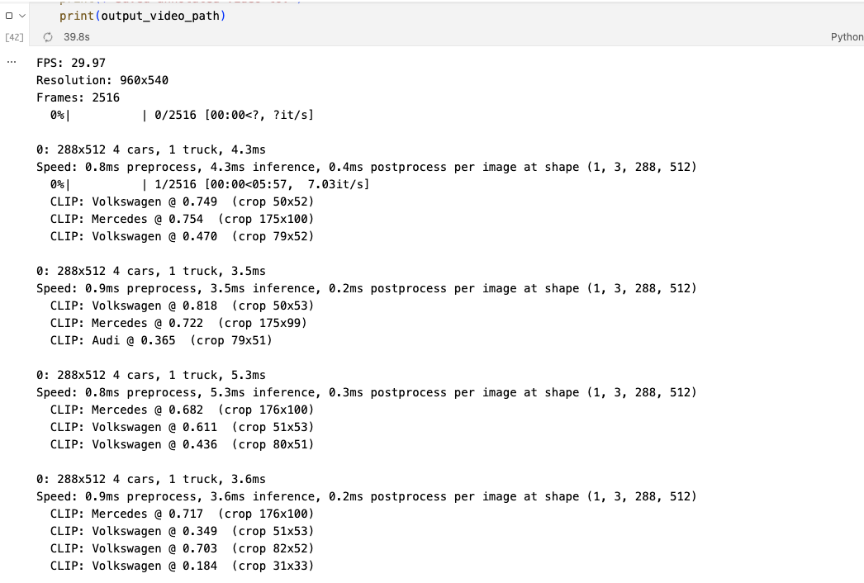
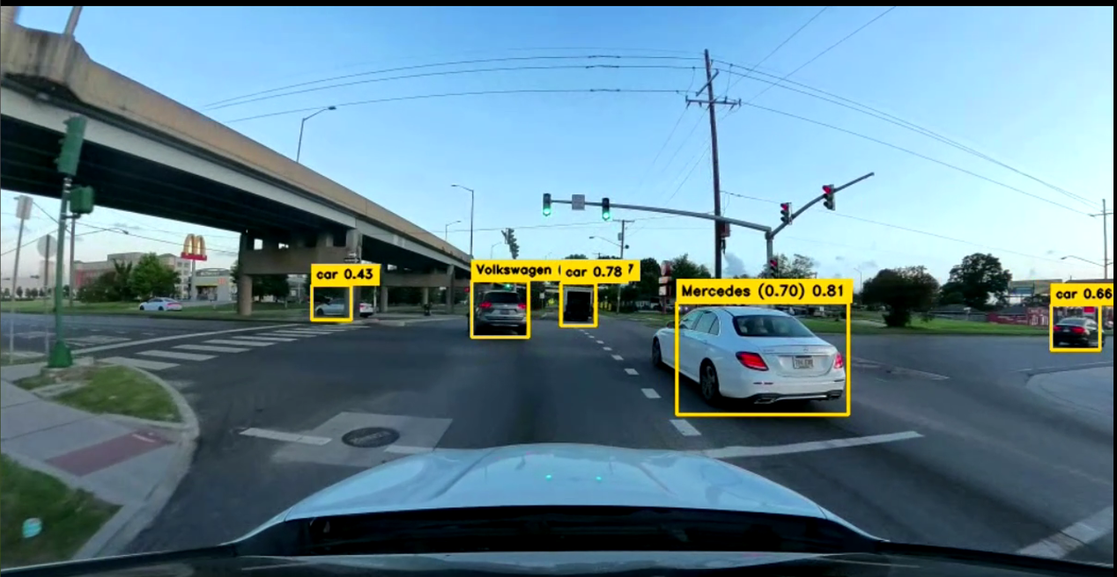
Brands drawn live on the video
Car-only crops · 80×80 min · trucks excluded by design
Single-frame check
Video frame output
Frame
YOLO crop
CLIP
softmax
label
Real output: YOLO26s boxes + CLIP brand chips (BMW, Peugeot …) on both single-frame checks and running video. Trucks excluded by design — car-only probe.
Notes:
Two real outputs from Stage 2b. Left: a single-frame validation check. Right: a frame extracted from the actual annotated video output. In both, YOLO26s detects the cars (YOLO conf=0.2); CLIP crops each car, runs it through the frozen ViT-B-32 backbone and the learned 512→20 linear probe, and overlays the top-1 brand with confidence. We only run CLIP on car crops above 80×80 px. Trucks are intentionally skipped — the probe was trained on car-only images and would miscalibrate on truck crops. Brand confidence is currently not thresholded (a known limit).
detect-solene-enrich

Slide 11
03
SECTION 3
Explain
3 of 3
Notes:
We can locate and name every car. Now: how do we tell the story to a human who doesn't read bounding boxes?
explain-dongy

Slide 12
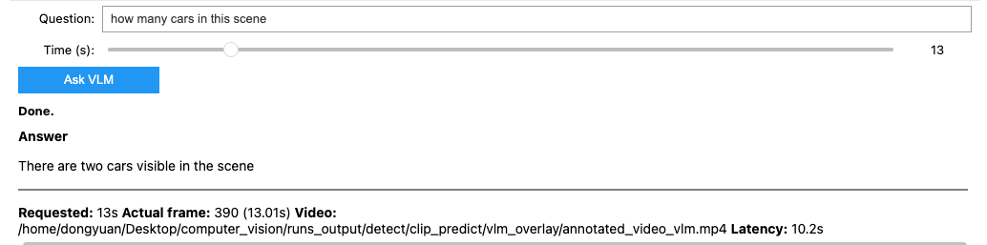
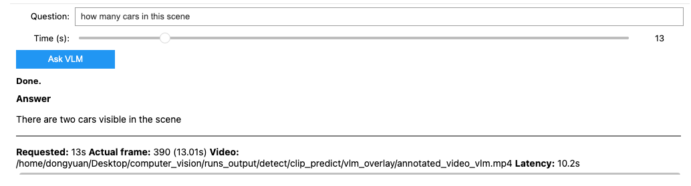
The ultimate interface is plain language — adaptive and audience-ready
Qwen3-VL:4b via Ollama · adaptive gating · diff ≥ 12 · min interval 5 s
"A red car is driving down a wet road in the rain, approaching a traffic light."
"A white truck and a pedestrian are crossing the road at a pedestrian crossing..."
Captions fire only when the scene actually changes — no redundant narration. Any viewer can follow what the car sees.
Notes:
This is the Explain stage in action. Two real frames from Stage 3 showing adaptive captioning: the left triggers a 'rainy driving' caption; the right triggers a 'pedestrian crossing' caption — because the scene changed enough (diff ≥ 12) and the minimum 5-second interval elapsed. YOLO sees 'car, trafficLight' — the VLM narrates 'A red car is driving down a wet road in the rain...' Boxes and brands are intermediate outputs. The real product is a sentence any human can read. That's what a customer demo needs.
explain-dongy

Slide 13
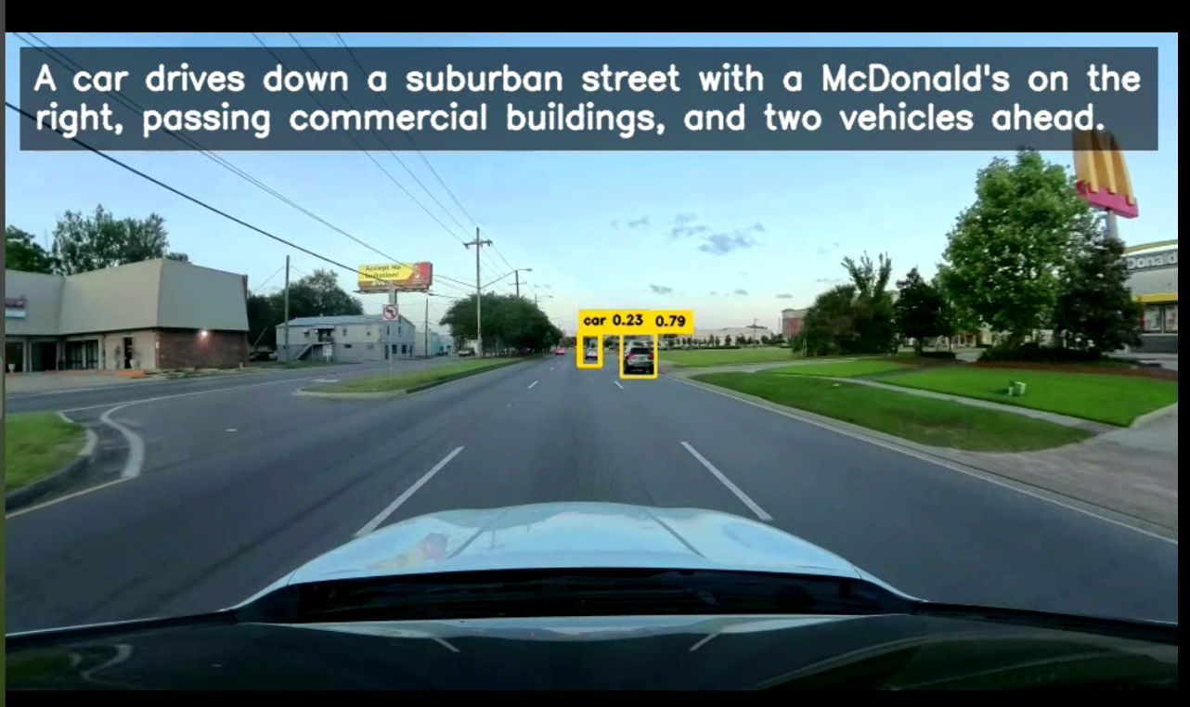
Frame-based Q&A — ask what you see
Pause any frame, type a question, and the VLM answers with evidence — turning a black-box detector into an explainable system.
Notes:
This is a real Q&A output from Stage 3. The user paused a frame and asked a question about the scene; the VLM (Qwen3-VL:4b) responds with a direct answer grounded in what it sees. No pre-scripted responses — every answer is generated on-the-fly for that specific frame. This is the difference between a detection system and an explainable one.
explain-dongy

Slide 14
Four stages · one coherent story
The main pipeline runs end-to-end; SegFormer runs alongside, independently.
Raw
Video
YOLO26s
Detection
CLIP Brand
Probe
VLM Caption
& Q&A
Structured
Understanding
SegFormer
Segmentation
Standalone quality demo — shares the input video,
but feeds no downstream stage.
Speed: YOLO is fast · CLIP is moderate (one crop at a time) · SegFormer & VLM are slow, selective, or offline-only.
Notes:
This is the full stack. Detect gives us structure. Enrich adds identity. Explain produces the narrative. SegFormer shares the same input video but runs on its own — it's a quality demo, not part of the live pipeline. Three sections, four stages, one demo video.
summary workflow-dongy

Slide 15
Results & Key Metrics
Detection
Enrichment
Segmentation
Narration
P = 0.874
R = 0.754
mAP@0.5 = 0.842
mAP@0.5:0.95 = 0.515
Probe accuracy ≈ 80 %
20 brands
(79.8 % on test split)
19 Cityscapes classes
84 % mIoU (pretrained)
Adaptive captioning
local inference
All four capabilities run on a single local GPU — no cloud dependency. YOLOv10n → YOLO26s: +24.7% mAP@0.5, +32.7% strict mAP, +26.1% recall. Hardest class: pedestrian (mAP 0.692).
Notes:
Detection: YOLOv10n (P=0.801, R=0.598, mAP@0.5=0.675, mAP@0.5:0.95=0.388) upgraded to YOLO26s (P=0.874, R=0.754, mAP@0.5=0.842, mAP@0.5:0.95=0.515) — a substantial accuracy lift across all metrics. The C2PSA backbone (~10.0 M params) generalises well on 11 dashcam classes; pedestrian remains hardest due to scale and occlusion. Enrichment: Brand recognition jumps from 55% zero-shot to 80% with the probe — a 25-point gain from a single linear layer on frozen embeddings. Segmentation leverages a pretrained SOTA model for immediate quality.
closing and limitation, metrics etc-solene

Slide 16
From pixels to plain language —
and next, to real-time edge deployment.
· Multi-camera fusion
· On-device quantization for edge speed
· Temporal tracking to reduce flicker
Notes:
The pipeline works end-to-end on a local GPU. The next step is shrinking it: TensorRT, ONNX, and temporal smoothing so it runs on an embedded dashcam unit. Thank you — we're happy to take questions.
closing and limitation, metrics etc-solene

