Slide 1
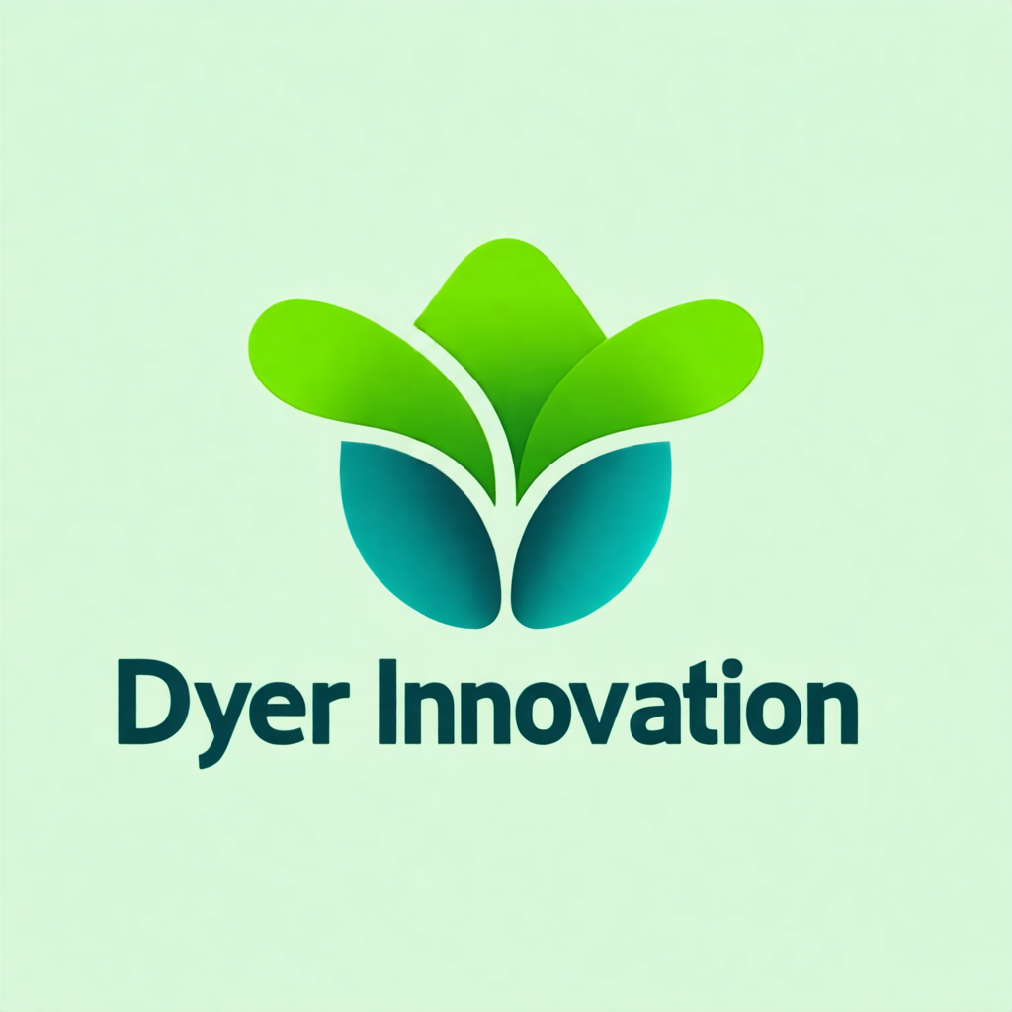
Welcome to Claude Certified Architect – Foundations
Lecture 1.1 • Section 1 — Course Introduction & Exam Strategy
Notes:
If you're watching this, you're preparing for one of the most interesting certification exams in AI right now.
The Claude Certified Architect Foundations exam tests something most exams don't — judgment.
Not memorization. Not syntax recall. Judgment about *when* to use which pattern, and *why*.
That's what this course is built around.
---

Slide 2
Who This Course Is For
This course is for solution architects and senior engineers building production AI systems with Claude.
You should have basic familiarity with LLM APIs — calling an endpoint, parsing a response, that kind of thing.
Notes:
This course is for solution architects and senior engineers building production AI systems with Claude.
You should have basic familiarity with LLM APIs — calling an endpoint, parsing a response, that kind of thing.

Slide 3
Who This Course Is For (cont.)
You don't need deep Anthropic SDK experience. But if you've never made an API call at all, pair this course with the Anthropic quickstart guide first.
What you don't need: machine learning theory, Claude training internals, or neural network knowledge. Those topics are completely out of scope for this exam.
--
Notes:
You don't need deep Anthropic SDK experience. But if you've never made an API call at all, pair this course with the Anthropic quickstart guide first.
What you don't need: machine learning theory, Claude training internals, or neural network knowledge. Those topics are completely out of scope for this exam.
---

Slide 4
What This Course Covers
This course follows the exam structure directly.
Section 1 — where you are now — covers exam strategy and orientation.
Sections 2 through 6 go deep on each of the five domains, in exam-weight order. The most heavily weighted domain comes first.
Notes:
This course follows the exam structure directly.
Section 1 — where you are now — covers exam strategy and orientation.
Sections 2 through 6 go deep on each of the five domains, in exam-weight order. The most heavily weighted domain comes first.

Slide 5
What This Course Covers (cont.)
Section 7 dissects all six exam scenarios. Section 8 walks through every official sample question. And Section 9 is your last-night cram guide — the 20 things you must know cold.
--
Notes:
Section 7 dissects all six exam scenarios. Section 8 walks through every official sample question. And Section 9 is your last-night cram guide — the 20 things you must know cold.
---

Slide 6
What You'll Be Able to Do After This Course
By the end of this course, you'll understand exactly how Claude's agentic loop works — and precisely what breaks it.
You'll be able to design tool interfaces that Claude reliably selects, and write error responses that guide the agent to recover correctly.
You'll know how to configure Claude Code for a multi-developer team environment, not just for personal use.
And you'll have analyzed all 12 official sample questions from Anthropic's exam guide — including every distractor and why it fails.
--
Notes:
By the end of this course, you'll understand exactly how Claude's agentic loop works — and precisely what breaks it.
You'll be able to design tool interfaces that Claude reliably selects, and write error responses that guide the agent to recover correctly.
You'll know how to configure Claude Code for a multi-developer team environment, not just for personal use.
And you'll have analyzed all 12 official sample questions from Anthropic's exam guide — including every distractor and why it fails.
---

Slide 7
EXAM TIP
Exam Tip
The Trap
Correct Approach
Here's the most important thing to understand about this exam before you start studying. The exam doesn't test trivia. It tests judgment. Every question gives you a scenario and asks you to choose t
Notes:
Here's the most important thing to understand about this exam before you start studying.
The exam doesn't test trivia. It tests judgment.
Every question gives you a scenario and asks you to choose the *best* architectural decision. The wrong answers aren't obviously wrong — they're decisions that would be correct in a different context.
So your study goal is not to memorize API parameters. It's to understand the principles well enough to apply them to scenarios you've never seen before.
---

Slide 8
What to Remember
This exam tests judgment about *when* to use each pattern — not syntax recall
Domain 1 (Agentic Architecture) at 27% is your biggest lever — start there
Wrong answers are carefully designed distractors — understanding why they fail is as important as knowing the right answer
Notes:
- This exam tests judgment about *when* to use each pattern — not syntax recall
- Domain 1 (Agentic Architecture) at 27% is your biggest lever — start there
- Wrong answers are carefully designed distractors — understanding why they fail is as important as knowing the right answer

