Slide 1
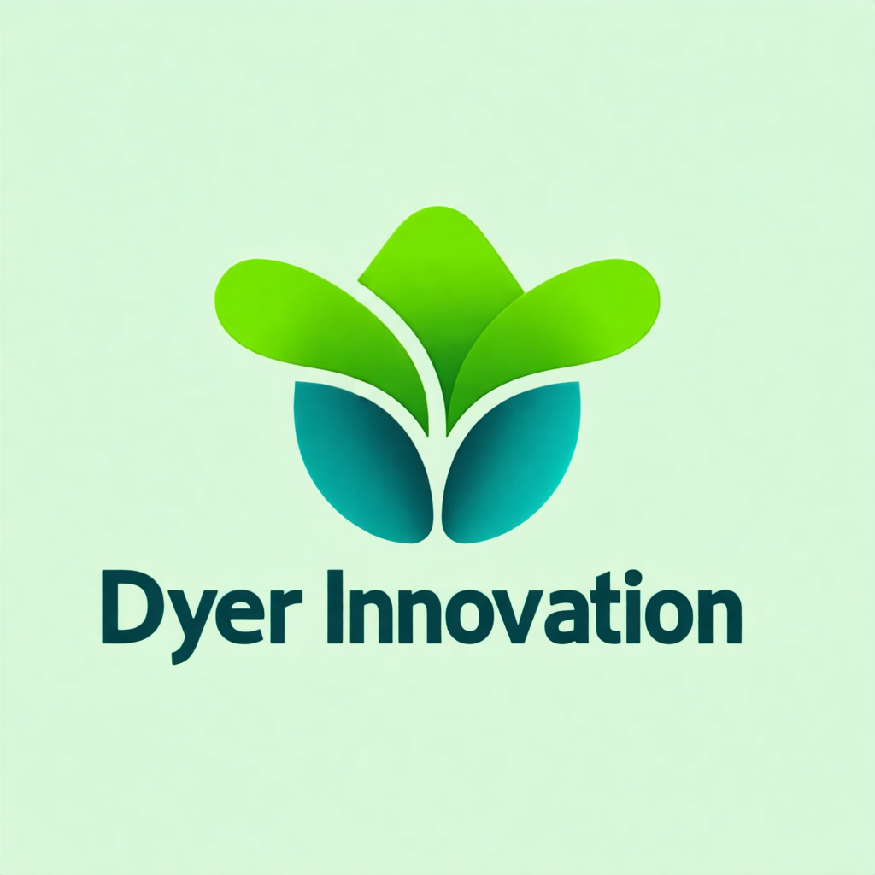
The 6 Scenarios Are the Frame for Everything
Here's what makes the CCA-F exam structurally different from most certification exams.
The exam isn't just a list of questions. It's organized around six real-world use cases called scenarios.
Every question on the exam is framed around one of these six scenarios.
And here's the catch: four of the six scenarios will appear on your exam. You don't know which four. Anthropic picks them.
So you must know all six — well.
--
Notes:
Here's what makes the CCA-F exam structurally different from most certification exams.
The exam isn't just a list of questions. It's organized around six real-world use cases called scenarios.
Every question on the exam is framed around one of these six scenarios.
And here's the catch: four of the six scenarios will appear on your exam. You don't know which four. Anthropic picks them.
So you must know all six — well.
---

Slide 2
The 6 Scenarios at a Glance
Let me walk through all six scenarios so you know what you're preparing for.
*Scenario 1: Customer Support Resolution Agent** — a multi-turn agent that handles customer inquiries, routes to tools, and escalates to humans. Primary domains: 1 (Agentic Architecture) and 5 (Context and Escalation).
*Scenario 2: Code Generation with Claude Code** — using Claude Code in a developer workflow. Primary domain: 3 (Claude Code Configuration).
Notes:
Let me walk through all six scenarios so you know what you're preparing for.
**Scenario 1: Customer Support Resolution Agent** — a multi-turn agent that handles customer inquiries, routes to tools, and escalates to humans. Primary domains: 1 (Agentic Architecture) and 5 (Context and Escalation).
**Scenario 2: Code Generation with Claude Code** — using Claude Code in a developer workflow. Primary domain: 3 (Claude Code Configuration).

Slide 3
The 6 Scenarios at a Glance (cont.)
*Scenario 3: Multi-Agent Research System** — a coordinator spawning specialized subagents. Primary domain: 1 (Agentic Architecture), touching 5 (Context Reliability).
*Scenario 4: Developer Productivity with Claude** — designing tools for software engineers. Primary domain: 2 (Tool Design and MCP).
*Scenario 5: Claude Code for CI/CD** — running Claude non-interactively in pipelines. Primary domain: 3 (Claude Code Config) and 4 (Prompt Engineering).
*Scenario 6: Structured Data Extraction** — using JSON schemas and batch APIs. Primary domain: 4 (Prompt Engineering).
--
Notes:
**Scenario 3: Multi-Agent Research System** — a coordinator spawning specialized subagents. Primary domain: 1 (Agentic Architecture), touching 5 (Context Reliability).
**Scenario 4: Developer Productivity with Claude** — designing tools for software engineers. Primary domain: 2 (Tool Design and MCP).
**Scenario 5: Claude Code for CI/CD** — running Claude non-interactively in pipelines. Primary domain: 3 (Claude Code Config) and 4 (Prompt Engineering).
**Scenario 6: Structured Data Extraction** — using JSON schemas and batch APIs. Primary domain: 4 (Prompt Engineering).
---

Slide 4
Why Scenarios Matter for Study Strategy
Knowing domain theory isn't enough to pass this exam.
You need to know how to *apply* domain concepts to specific scenarios.
For example: the `stop_reason` control flow from Domain 1 applies differently in a Customer Support agent (where escalation to human is a real exit) than in a Research Pipeline (where the coordinator needs to aggregate before stopping).
Notes:
Knowing domain theory isn't enough to pass this exam.
You need to know how to *apply* domain concepts to specific scenarios.
For example: the `stop_reason` control flow from Domain 1 applies differently in a Customer Support agent (where escalation to human is a real exit) than in a Research Pipeline (where the coordinator needs to aggregate before stopping).

Slide 5
Why Scenarios Matter for Study Strategy (cont.)
The scenario-aware candidate can answer questions that ask "In the Customer Support scenario, when should the agent escalate?" The domain-only candidate might know escalation rules in the abstract, but hesitate when the question is framed around a specific context.
That's the gap this course closes. Every domain section explicitly ties back to which scenarios use that concept.
--
Notes:
The scenario-aware candidate can answer questions that ask "In the Customer Support scenario, when should the agent escalate?" The domain-only candidate might know escalation rules in the abstract, but hesitate when the question is framed around a specific context.
That's the gap this course closes. Every domain section explicitly ties back to which scenarios use that concept.
---

Slide 6
Scenarios and Domain Coverage — The Matrix
Each scenario primarily tests 2-3 domains. Here's how they map.
Scenario 1 (Customer Support) hits Domains 1 and 5 hardest — agentic loop control and escalation decision-making.
Scenario 3 (Research System) is almost pure Domain 1 — multi-agent coordination, subagent spawning, parallel execution.
Notes:
Each scenario primarily tests 2-3 domains. Here's how they map.
Scenario 1 (Customer Support) hits Domains 1 and 5 hardest — agentic loop control and escalation decision-making.
Scenario 3 (Research System) is almost pure Domain 1 — multi-agent coordination, subagent spawning, parallel execution.

Slide 7
Scenarios and Domain Coverage — The Matrix (cont.)
Scenarios 2 and 5 both feature Claude Code, but they test different things: Scenario 2 tests development workflow (Domain 3), while Scenario 5 tests CI/CD integration (Domain 3 + 4).
Scenarios 4 and 6 pull in Domain 2 and 4 respectively — tool design and prompt engineering with structured output.
The takeaway: if Domains 1, 3, and 4 are your strengths, you're well-positioned regardless of which four scenarios appear.
--
Notes:
Scenarios 2 and 5 both feature Claude Code, but they test different things: Scenario 2 tests development workflow (Domain 3), while Scenario 5 tests CI/CD integration (Domain 3 + 4).
Scenarios 4 and 6 pull in Domain 2 and 4 respectively — tool design and prompt engineering with structured output.
The takeaway: if Domains 1, 3, and 4 are your strengths, you're well-positioned regardless of which four scenarios appear.
---

Slide 8
How to Use Scenarios in Your Study
Here's how to actually use the scenarios during preparation.
First: learn each scenario's context. What system are we building? Who's the end user? What constraints apply? The scenario details matter for answer evaluation.
Notes:
Here's how to actually use the scenarios during preparation.
First: learn each scenario's context. What system are we building? Who's the end user? What constraints apply? The scenario details matter for answer evaluation.

Slide 9
How to Use Scenarios in Your Study (cont.)
Second: for each concept you learn in a domain section, ask yourself which scenarios it applies to. When you learn about programmatic vs. prompt enforcement in Domain 1, connect it to Scenario 1 (where workflow order matters) and Scenario 3 (where subagent coordination matters).
Notes:
Second: for each concept you learn in a domain section, ask yourself which scenarios it applies to. When you learn about programmatic vs. prompt enforcement in Domain 1, connect it to Scenario 1 (where workflow order matters) and Scenario 3 (where subagent coordination matters).

Slide 10
How to Use Scenarios in Your Study (cont.)
Third: practice the judgment call. For any decision pattern, be able to articulate: "In this scenario, I would use X instead of Y because..."
Section 7 of this course is entirely dedicated to this third step.
--
Notes:
Third: practice the judgment call. For any decision pattern, be able to articulate: "In this scenario, I would use X instead of Y because..."
Section 7 of this course is entirely dedicated to this third step.
---

Slide 11
Which Scenarios to Study Hardest
If you must prioritize, here's a practical ranking.
*Tier 1 — Study most deeply**: Scenarios 1 (Customer Support) and 3 (Research System). Both test Domain 1 extensively, which is your biggest exam lever. Together these two scenarios could represent half your exam.
Notes:
If you must prioritize, here's a practical ranking.
**Tier 1 — Study most deeply**: Scenarios 1 (Customer Support) and 3 (Research System). Both test Domain 1 extensively, which is your biggest exam lever. Together these two scenarios could represent half your exam.

Slide 12
Which Scenarios to Study Hardest (cont.)
*Tier 2 — Study thoroughly**: Scenarios 5 (CI/CD) and 6 (Structured Data Extraction). These pull from Domains 3 and 4, the two 20%-weight domains.
*Tier 3 — Study confidently**: Scenarios 2 (Code Generation) and 4 (Developer Productivity). These are more domain-specific (Domain 3 and 2) and may be easier to prep quickly if you have real-world Claude Code or tool design experience.
--
Notes:
**Tier 2 — Study thoroughly**: Scenarios 5 (CI/CD) and 6 (Structured Data Extraction). These pull from Domains 3 and 4, the two 20%-weight domains.
**Tier 3 — Study confidently**: Scenarios 2 (Code Generation) and 4 (Developer Productivity). These are more domain-specific (Domain 3 and 2) and may be easier to prep quickly if you have real-world Claude Code or tool design experience.
---

Slide 13
EXAM TIP
Exam Tip
The Trap
Correct Approach
The most dangerous assumption is "I'll skip Scenario X because I'm weak in that domain." You don't get to choose. The exam chooses. A candidate who skips preparing for Scenarios 5 and 6 might walk i
Notes:
The most dangerous assumption is "I'll skip Scenario X because I'm weak in that domain."
You don't get to choose. The exam chooses.
A candidate who skips preparing for Scenarios 5 and 6 might walk into an exam where both appear. Prepare for all six at least to a level where you can handle questions about them.
The minimum for each scenario: know its primary system, its main domain, and the two or three key architectural decisions it tests.
---

Slide 14
What to Remember
Six scenarios are defined; exactly four will appear on your exam
You don't choose — prepare for all six
Every question is framed around a specific scenario context
Scenarios 1 and 3 test Domain 1 (27%) — study these deepest
Section 7 of this course does a full scenario-by-scenario deep dive
Notes:
- Six scenarios are defined; exactly four will appear on your exam
- You don't choose — prepare for all six
- Every question is framed around a specific scenario context
- Scenarios 1 and 3 test Domain 1 (27%) — study these deepest
- Section 7 of this course does a full scenario-by-scenario deep dive

