Slide 1
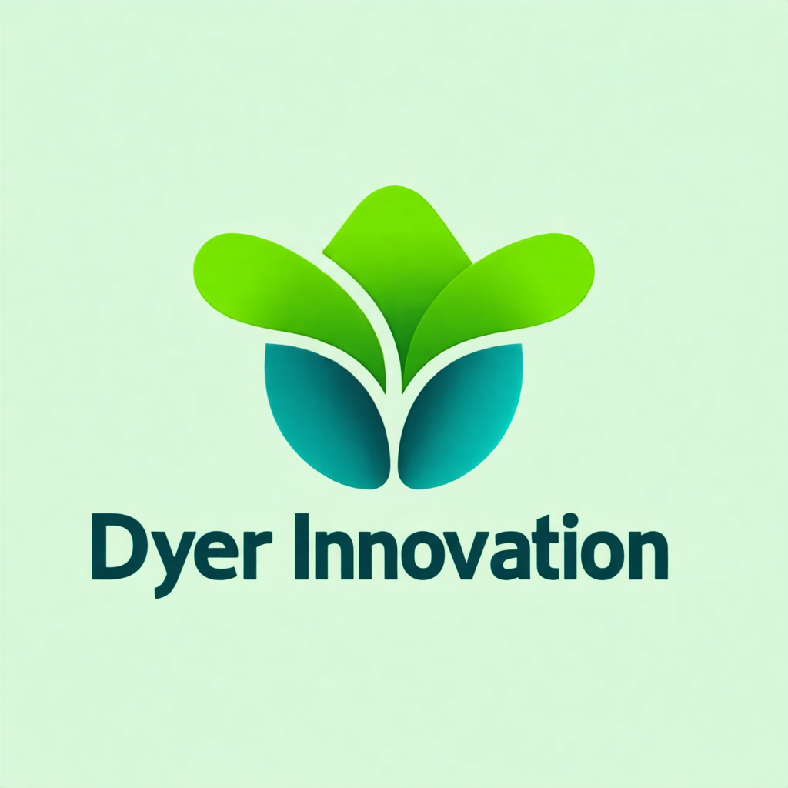
The Two Paths Every Response Takes
Option A
Option B
In the previous lecture, we looked at the overall agentic loop.
Now let's go deeper into the two branches — what happens in each one, and what specific patterns each enables.
Because the difference between these two paths isn't just "keep going" versus "stop."
It's about what you do with the response content, how you structure the conversation history, and what control flow patterns you can build on top of each.
--
Notes:
In the previous lecture, we looked at the overall agentic loop.
Now let's go deeper into the two branches — what happens in each one, and what specific patterns each enables.
Because the difference between these two paths isn't just "keep going" versus "stop."
It's about what you do with the response content, how you structure the conversation history, and what control flow patterns you can build on top of each.
---

Slide 2
The tool_use Path — Step by Step
When you receive a response with `stop_reason = "tool_use"`, here's the exact sequence.
Step one: extract the tool_use blocks from the content array. A single response can contain multiple tool_use blocks — Claude can call several tools in one turn.
Notes:
When you receive a response with `stop_reason = "tool_use"`, here's the exact sequence.
Step one: extract the tool_use blocks from the content array. A single response can contain multiple tool_use blocks — Claude can call several tools in one turn.

Slide 3
The tool_use Path — Step by Step (cont.)
Step two: execute each tool. This means running your actual function — querying a database, calling an API, reading a file — whatever the tool does.
Notes:
Step two: execute each tool. This means running your actual function — querying a database, calling an API, reading a file — whatever the tool does.

Slide 4
The tool_use Path — Step by Step (cont.)
Step three: package the results. Each result goes into a `tool_result` block with the matching `tool_use_id`, the content (the actual result data), and an `is_error` flag if the tool failed.
Notes:
Step three: package the results. Each result goes into a `tool_result` block with the matching `tool_use_id`, the content (the actual result data), and an `is_error` flag if the tool failed.

Slide 5
The tool_use Path — Step by Step (cont.)
Step four: append the original assistant response to messages, then append a new user message containing all the tool results. Then call the API again.
--
Notes:
Step four: append the original assistant response to messages, then append a new user message containing all the tool results. Then call the API again.
---

Slide 6
The end_turn Path — What It Actually Means
`"end_turn"` doesn't always mean the task is complete and everything is fine.
It means Claude has decided to stop generating — for whatever reason.
Notes:
`"end_turn"` doesn't always mean the task is complete and everything is fine.
It means Claude has decided to stop generating — for whatever reason.

Slide 7
The end_turn Path — What It Actually Means (cont.)
The three typical reasons for `"end_turn"` are: the task is complete (most common), Claude determined it cannot proceed and is returning an explanation, or the context got close to the limit.
In your control flow, you should inspect the response content after an `"end_turn"` to understand *why* Claude stopped — especially in error-prone workflows.
But critically: do not loop on `"end_turn"`. Whatever the reason, Claude has made a decision. Return the response and let the calling code or user handle it.
--
Notes:
The three typical reasons for `"end_turn"` are: the task is complete (most common), Claude determined it cannot proceed and is returning an explanation, or the context got close to the limit.
In your control flow, you should inspect the response content after an `"end_turn"` to understand *why* Claude stopped — especially in error-prone workflows.
But critically: do not loop on `"end_turn"`. Whatever the reason, Claude has made a decision. Return the response and let the calling code or user handle it.
---

Slide 8
Model-Driven vs Pre-Configured Decision Trees
Option A
Option B
There are two philosophies for how to route between tools in an agentic workflow.
In the **model-driven** approach, you give Claude a full set of tools and let it decide which to call and in what order. The tool_use loop handles sequencing automatically. Claude's judgment is the routing logic.
Notes:
There are two philosophies for how to route between tools in an agentic workflow.
In the **model-driven** approach, you give Claude a full set of tools and let it decide which to call and in what order. The tool_use loop handles sequencing automatically. Claude's judgment is the routing logic.

Slide 9
Model-Driven vs Pre-Configured Decision Trees (cont.)
Option A
Option B
In the **pre-configured** approach, your code has explicit decision trees. Certain tools can only be called after others complete. You inspect intermediate results and decide what to do next.
For exam purposes: model-driven is the default for flexible workflows. Pre-configured (programmatic enforcement) is the right choice for **hard constraints** — things that must happen in a specific order for safety or correctness reasons.
The customer support scenario uses this explicitly: you can't process a refund before looking up the customer order. That order enforcement is programmatic, not left to Claude's judgment.
--
Notes:
In the **pre-configured** approach, your code has explicit decision trees. Certain tools can only be called after others complete. You inspect intermediate results and decide what to do next.
For exam purposes: model-driven is the default for flexible workflows. Pre-configured (programmatic enforcement) is the right choice for **hard constraints** — things that must happen in a specific order for safety or correctness reasons.
The customer support scenario uses this explicitly: you can't process a refund before looking up the customer order. That order enforcement is programmatic, not left to Claude's judgment.
---

Slide 10
Handling Multiple Tool Calls in One Response
tool_results = [] for block in response.content: if block.type == "tool_use": result = execute_tool(block.name, block.input) tool_results.append({ "type": "tool_result", "tool_use_id": block.id, # Must match Claude's request ID "content": result }) # All results go back in a single user message messages.append({ "role": "user", "content": tool_results })
Notes:
Claude can issue multiple tool calls in a single response turn.
When this happens, all the `tool_use` blocks appear together in the content array. Your code must process all of them before sending the next request.
[CODE BLOCK]
Don't send partial results. Don't process tools one at a time with individual API calls. Process all tool calls from a single response in one batch, then send one combined user message.
---

Slide 11
Tool Results in the Conversation History
The conversation history is how Claude maintains context across an agentic loop.
Every message matters. Claude uses the full history to understand what it's already tried, what the results were, and what to do next.
Notes:
The conversation history is how Claude maintains context across an agentic loop.
Every message matters. Claude uses the full history to understand what it's already tried, what the results were, and what to do next.

Slide 12
Tool Results in the Conversation History (cont.)
The pattern for the history looks like this: a user message (the initial request), followed by an assistant message containing tool_use blocks, followed by a user message containing the corresponding tool results, followed by the next assistant response.
This alternating pattern — user, assistant, user, assistant — must be maintained. The API will reject requests that violate turn order.
The tool results are framed as user messages because they represent information coming *from* the external environment *to* Claude.
--
Notes:
The pattern for the history looks like this: a user message (the initial request), followed by an assistant message containing tool_use blocks, followed by a user message containing the corresponding tool results, followed by the next assistant response.
This alternating pattern — user, assistant, user, assistant — must be maintained. The API will reject requests that violate turn order.
The tool results are framed as user messages because they represent information coming *from* the external environment *to* Claude.
---

Slide 13
EXAM TIP
Exam Tip
The Trap
Correct Approach
sending incomplete tool results (only some of the batch) and expecting Claude to work with partial information. Always send all tool results in one user message before calling the API again. ---
Notes:
The exam will test whether you know the correct message role for tool results.
Tool results go in **user** messages — not assistant messages.
This trips candidates up because intuitively, "I just ran Claude's tool, so I'm sending back to Claude" feels like the assistant providing output. But the message structure is from Claude's perspective: user messages are what Claude receives from the outside world.
A second exam trap: sending incomplete tool results (only some of the batch) and expecting Claude to work with partial information. Always send all tool results in one user message before calling the API again.
---

Slide 14
What to Remember
`"tool_use"` path: extract blocks → execute tools → append both assistant msg AND tool results → loop
`"end_turn"` path: do not loop — inspect content to understand completion state, then return
Tool results belong in **user** messages (not assistant messages)
Multiple tool calls in one response → process all, send one combined user message
Model-driven routing: Claude decides tool order; use for flexible workflows
Programmatic enforcement: your code enforces order; use for hard constraints (safety, workflow requirements)
Notes:
- `"tool_use"` path: extract blocks → execute tools → append both assistant msg AND tool results → loop
- `"end_turn"` path: do not loop — inspect content to understand completion state, then return
- Tool results belong in **user** messages (not assistant messages)
- Multiple tool calls in one response → process all, send one combined user message
- Model-driven routing: Claude decides tool order; use for flexible workflows
- Programmatic enforcement: your code enforces order; use for hard constraints (safety, workflow requirements)

