Slide 1
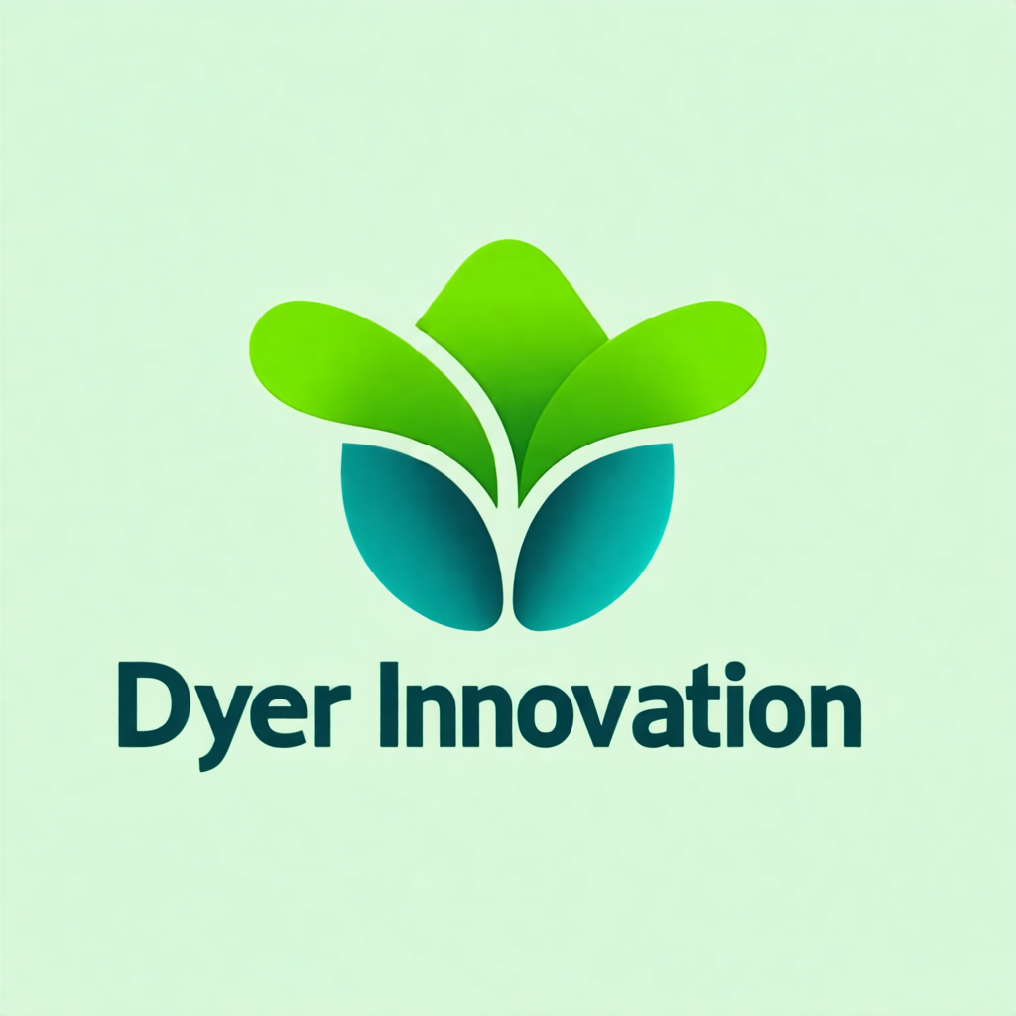
When One Agent Isn't Enough
Option A
Option B
Single agents are powerful. But they have limits.
They operate in a single context window. They can only do one thing at a time. And complex tasks — research, code review, customer support pipelines — often need multiple specialized capabilities running in parallel.
Multi-agent systems solve these problems. But they introduce coordination challenges.
The architecture that the CCA-F exam focuses on is hub-and-spoke — a central coordinator managing multiple specialized subagents.
--
Notes:
Single agents are powerful. But they have limits.
They operate in a single context window. They can only do one thing at a time. And complex tasks — research, code review, customer support pipelines — often need multiple specialized capabilities running in parallel.
Multi-agent systems solve these problems. But they introduce coordination challenges.
The architecture that the CCA-F exam focuses on is hub-and-spoke — a central coordinator managing multiple specialized subagents.
---

Slide 2
Hub-and-Spoke — The Core Structure
The hub-and-spoke pattern has one defining rule: **all communication flows through the coordinator**.
The coordinator — the hub — receives the original task. It decomposes it. It assigns work to subagents. It collects results. It aggregates. And it produces the final output.
Notes:
The hub-and-spoke pattern has one defining rule: **all communication flows through the coordinator**.
The coordinator — the hub — receives the original task. It decomposes it. It assigns work to subagents. It collects results. It aggregates. And it produces the final output.

Slide 3
Hub-and-Spoke — The Core Structure (cont.)
The subagents — the spokes — only ever communicate with the coordinator. They never talk directly to each other.
This is not a limitation. It's a deliberate design choice that gives you centralized observability, consistent error handling, and predictable control flow.
If subagents communicated directly, you'd have a mesh topology — harder to debug, harder to monitor, and harder to reason about when something goes wrong.
--
Notes:
The subagents — the spokes — only ever communicate with the coordinator. They never talk directly to each other.
This is not a limitation. It's a deliberate design choice that gives you centralized observability, consistent error handling, and predictable control flow.
If subagents communicated directly, you'd have a mesh topology — harder to debug, harder to monitor, and harder to reason about when something goes wrong.
---

Slide 4
The Coordinator's Three Jobs
The coordinator has exactly three jobs: decompose, delegate, and aggregate.
*Decompose**: break the original task into pieces that subagents can handle independently. Good decomposition means each subagent has a clear, bounded responsibility with no implicit dependencies on what other subagents are doing.
Notes:
The coordinator has exactly three jobs: decompose, delegate, and aggregate.
**Decompose**: break the original task into pieces that subagents can handle independently. Good decomposition means each subagent has a clear, bounded responsibility with no implicit dependencies on what other subagents are doing.

Slide 5
The Coordinator's Three Jobs (cont.)
*Delegate**: spawn each subagent with its specific task and the context it needs. This means explicit context passing — subagents don't inherit the coordinator's history. Each one starts fresh.
Notes:
**Delegate**: spawn each subagent with its specific task and the context it needs. This means explicit context passing — subagents don't inherit the coordinator's history. Each one starts fresh.

Slide 6
The Coordinator's Three Jobs (cont.)
*Aggregate**: collect all the subagent outputs, synthesize them into a coherent response, and handle any failures gracefully. The coordinator is responsible for catching subagent errors and deciding whether to retry, skip, or surface the failure.
--
Notes:
**Aggregate**: collect all the subagent outputs, synthesize them into a coherent response, and handle any failures gracefully. The coordinator is responsible for catching subagent errors and deciding whether to retry, skip, or surface the failure.
---

Slide 7
Subagent Context Isolation
Option A
Option B
One of the most important things to understand about subagents: they don't inherit the coordinator's conversation history.
Each subagent starts with a completely fresh context.
Notes:
One of the most important things to understand about subagents: they don't inherit the coordinator's conversation history.
Each subagent starts with a completely fresh context.

Slide 8
Subagent Context Isolation (cont.)
Option A
Option B
This means the coordinator must be explicit about what information each subagent needs. If the research pipeline has already found key facts, and the synthesis subagent needs those facts, the coordinator must explicitly include them in the synthesis subagent's task prompt.
Nothing flows implicitly. Everything that matters must be passed explicitly.
This is why the exam asks about "explicit context passing" — it's the mechanism that makes multi-agent systems actually work.
--
Notes:
This means the coordinator must be explicit about what information each subagent needs. If the research pipeline has already found key facts, and the synthesis subagent needs those facts, the coordinator must explicitly include them in the synthesis subagent's task prompt.
Nothing flows implicitly. Everything that matters must be passed explicitly.
This is why the exam asks about "explicit context passing" — it's the mechanism that makes multi-agent systems actually work.
---

Slide 9
The Task Tool — Spawning Subagents
In Claude's agent framework, coordinators spawn subagents using the `Task` tool.
A Task call has three key parameters: the task description (what to do), the instructions (context and constraints), and `allowedTools` (what tools the subagent is permitted to use).
Notes:
In Claude's agent framework, coordinators spawn subagents using the `Task` tool.
A Task call has three key parameters: the task description (what to do), the instructions (context and constraints), and `allowedTools` (what tools the subagent is permitted to use).

Slide 10
The Task Tool — Spawning Subagents (cont.)
The `allowedTools` parameter is an exam favorite. For a subagent to receive and process its task, `allowedTools` must include `"Task"`. Without it, the subagent can't properly accept the task specification.
Think of it this way: the Task tool is how an agent formally accepts an assignment. No Task in allowedTools means no assignment accepted.
--
Notes:
The `allowedTools` parameter is an exam favorite. For a subagent to receive and process its task, `allowedTools` must include `"Task"`. Without it, the subagent can't properly accept the task specification.
Think of it this way: the Task tool is how an agent formally accepts an assignment. No Task in allowedTools means no assignment accepted.
---

Slide 11
Parallel vs Sequential Subagent Execution
The hub-and-spoke architecture supports both sequential and parallel execution.
Sequential: the coordinator spawns one subagent, waits for the result, then spawns the next. Use this when subagent B depends on subagent A's output.
Notes:
The hub-and-spoke architecture supports both sequential and parallel execution.
Sequential: the coordinator spawns one subagent, waits for the result, then spawns the next. Use this when subagent B depends on subagent A's output.

Slide 12
Parallel vs Sequential Subagent Execution (cont.)
Parallel: the coordinator spawns multiple subagents in a **single response turn**. This is the key phrase for the exam. All parallel subagent spawning happens in one coordinator turn — multiple Task calls in one response. The coordinator then waits for all results before continuing.
Parallel execution is the right choice when tasks are independent. The multi-agent research pipeline spawns document analysis, web search, and source verification subagents in parallel because their work doesn't depend on each other.
--
Notes:
Parallel: the coordinator spawns multiple subagents in a **single response turn**. This is the key phrase for the exam. All parallel subagent spawning happens in one coordinator turn — multiple Task calls in one response. The coordinator then waits for all results before continuing.
Parallel execution is the right choice when tasks are independent. The multi-agent research pipeline spawns document analysis, web search, and source verification subagents in parallel because their work doesn't depend on each other.
---

Slide 13
EXAM TIP
Exam Tip
The Trap
Correct Approach
Two patterns the exam tests heavily in the hub-and-spoke context. First: parallel subagent spawning happens in **one** coordinator response. The exam will offer an answer where the coordinator spawns
Notes:
Two patterns the exam tests heavily in the hub-and-spoke context.
First: parallel subagent spawning happens in **one** coordinator response. The exam will offer an answer where the coordinator spawns subagents sequentially across multiple turns. That's slower and misses the point of parallelism.
Second: direct subagent-to-subagent communication is **always wrong** in this architecture. If an answer choice has subagents sharing information directly, it's violating hub-and-spoke. In hub-and-spoke, everything goes through the coordinator.
---

Slide 14
What to Remember
**All communication flows through the coordinator** — subagents never talk directly to each other
The coordinator's three jobs: **Decompose → Delegate → Aggregate**
Subagents have **no inherited context** — coordinator must pass everything explicitly
`allowedTools` must include `"Task"` for a subagent to accept its assignment
**Parallel spawning = all subagents spawned in one coordinator response turn**
Hub-and-spoke is used in Scenarios 1 (Customer Support) and 3 (Research System)
Notes:
- **All communication flows through the coordinator** — subagents never talk directly to each other
- The coordinator's three jobs: **Decompose → Delegate → Aggregate**
- Subagents have **no inherited context** — coordinator must pass everything explicitly
- `allowedTools` must include `"Task"` for a subagent to accept its assignment
- **Parallel spawning = all subagents spawned in one coordinator response turn**
- Hub-and-spoke is used in Scenarios 1 (Customer Support) and 3 (Research System)

