Slide 1
NASDAQ Composite compared to individual stocks 2016-2021
Isaiah Dyer

Slide 2
Introduction
This analysis explores the question: How do individual stocks relate to the NASDAQ Composite?
Individual stocks analyzed are Apple, Amazon, Microsoft
Data is from 2016 to 2021
Additional questions explored
What is the correlation of trading volume and stock price
How volatile are these stocks, and how do they compare?

Slide 3
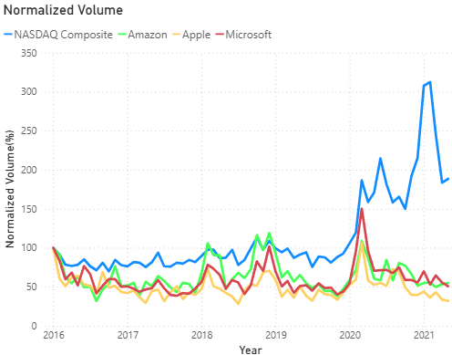
Trading Volume Analysis
Individual stocks show strong correlation with each other in terms of volume
The NASDAQ Composite trends differ from individual stocks
NASDAQ Composite shows an overall upward trend while the individual stocks remain relatively flat

Slide 4
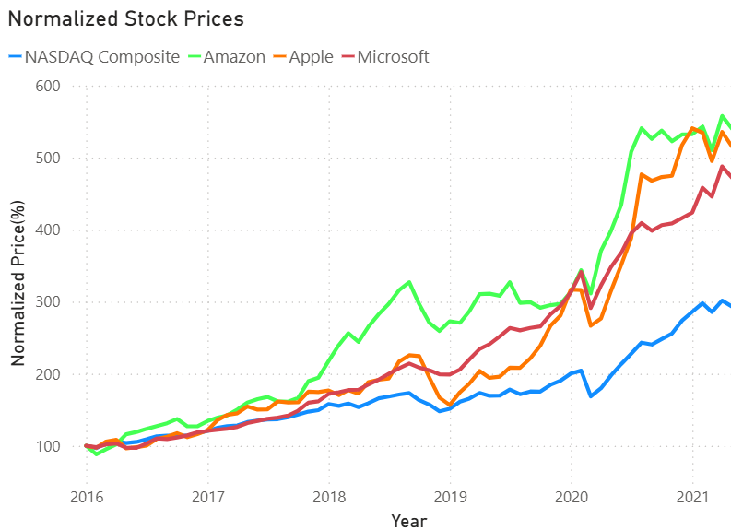
Stock Price Analysis
NASDAQ Composite and individual stocks show a moderate correlation
All stocks show upward trends
Individual stocks shows steeper growth than the NASDAQ composite

Slide 5
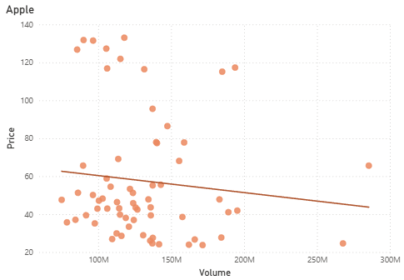
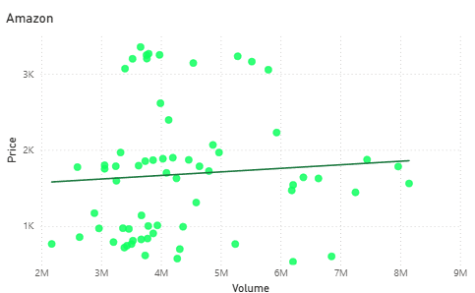
Volume and Stock Price Correlation (Apple and Amazon)
Both Amazon and Apple show little correlation between trading volume and stock price
Lower volume points tends to cluster more than high volume points on both graphs

Slide 6
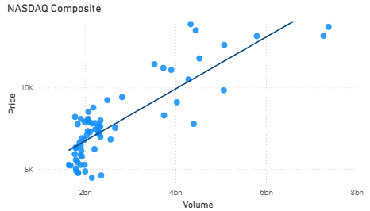
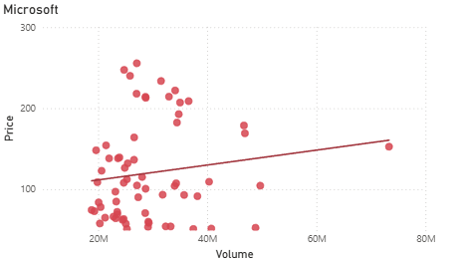
Volume and Stock Price Correlation (NASDAQ Composite and Microsoft
Microsoft shows little correlation between stock price and volume
NASDAQ Compositre shows strong correlation between stock price and volume
Points cluster more at lower trading volumes

Slide 7
Correlation Coefficients of Trading Volume and Stock Price
Stock | Correlation
NASDAQ Composite | 0.84
Apple | -0.1
Amazon | 0.07
Microsoft | 0.14
Individual stocks have almost no correlation between trading volume and stock price
NASDAQ Composite shows a very strong correlation between trading volume and stock price

Slide 8
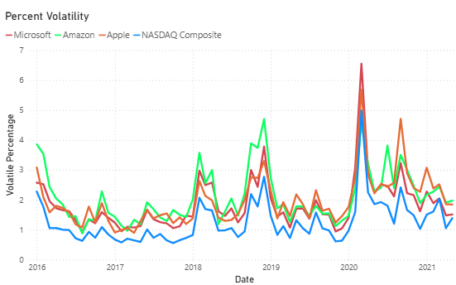
Comparing Volatility
Volatility has a strong correlation between individual stocks and NASDAQ Composite
Volatility remains relatively low between all stocks
NASDAQ Composite consistently has the lowest volatility

Slide 9
Average Volatile Percentage
Stock | Volatile Percentage
NASDAQ Composite | 1.26%
Apple | 1.96%
Amazon | 2.11%
Microsoft | 1.85%
All stocks have low volatile percentages
NASDAQ Composite has considerably lower average volatility than individual stocks
All stocks have very close Volatility

Slide 10
Conclusion
NASDAQ Composite does not correlate with individual stock volume but does correlate with stock price
For individual stocks trading volume and price do not correlate but volume and price do correlate when it comes to NASDAQ Composite
NASDAQ Composite and individual stock volatility do correlate but NASDAQ Composite has lower average volatility

