Slide 1
OpenMP

Slide 2
Why are parallel programs important?
Moore‘s Law -> Alle 18 Monate verdoppelt sich die Transistoren-Dichte in Chips & Prozessoren
Höherer Leistungsbedarf für Chips und mehr Wärmeentwicklung
Noch mehr Leistung?
Höhere Frequenz => kürzere Lebensdauer der Prozessoren
Oder eben: mehr Prozessoren!

Slide 3
Automotive as an OpenMP Application
A vehicle has an increasing amount of software tasks
C/C++ are the standard in low-level programming and especially in cars
The clock rate of processors cannot be increased at will

Slide 4
Automotive as an OpenMP Application
A vehicle has an increasing amount of software tasks
C/C++ are the standard in low-level programming and especially in cars
The clock rate of processors cannot be increased at will
→ Multicore Systems

Slide 5
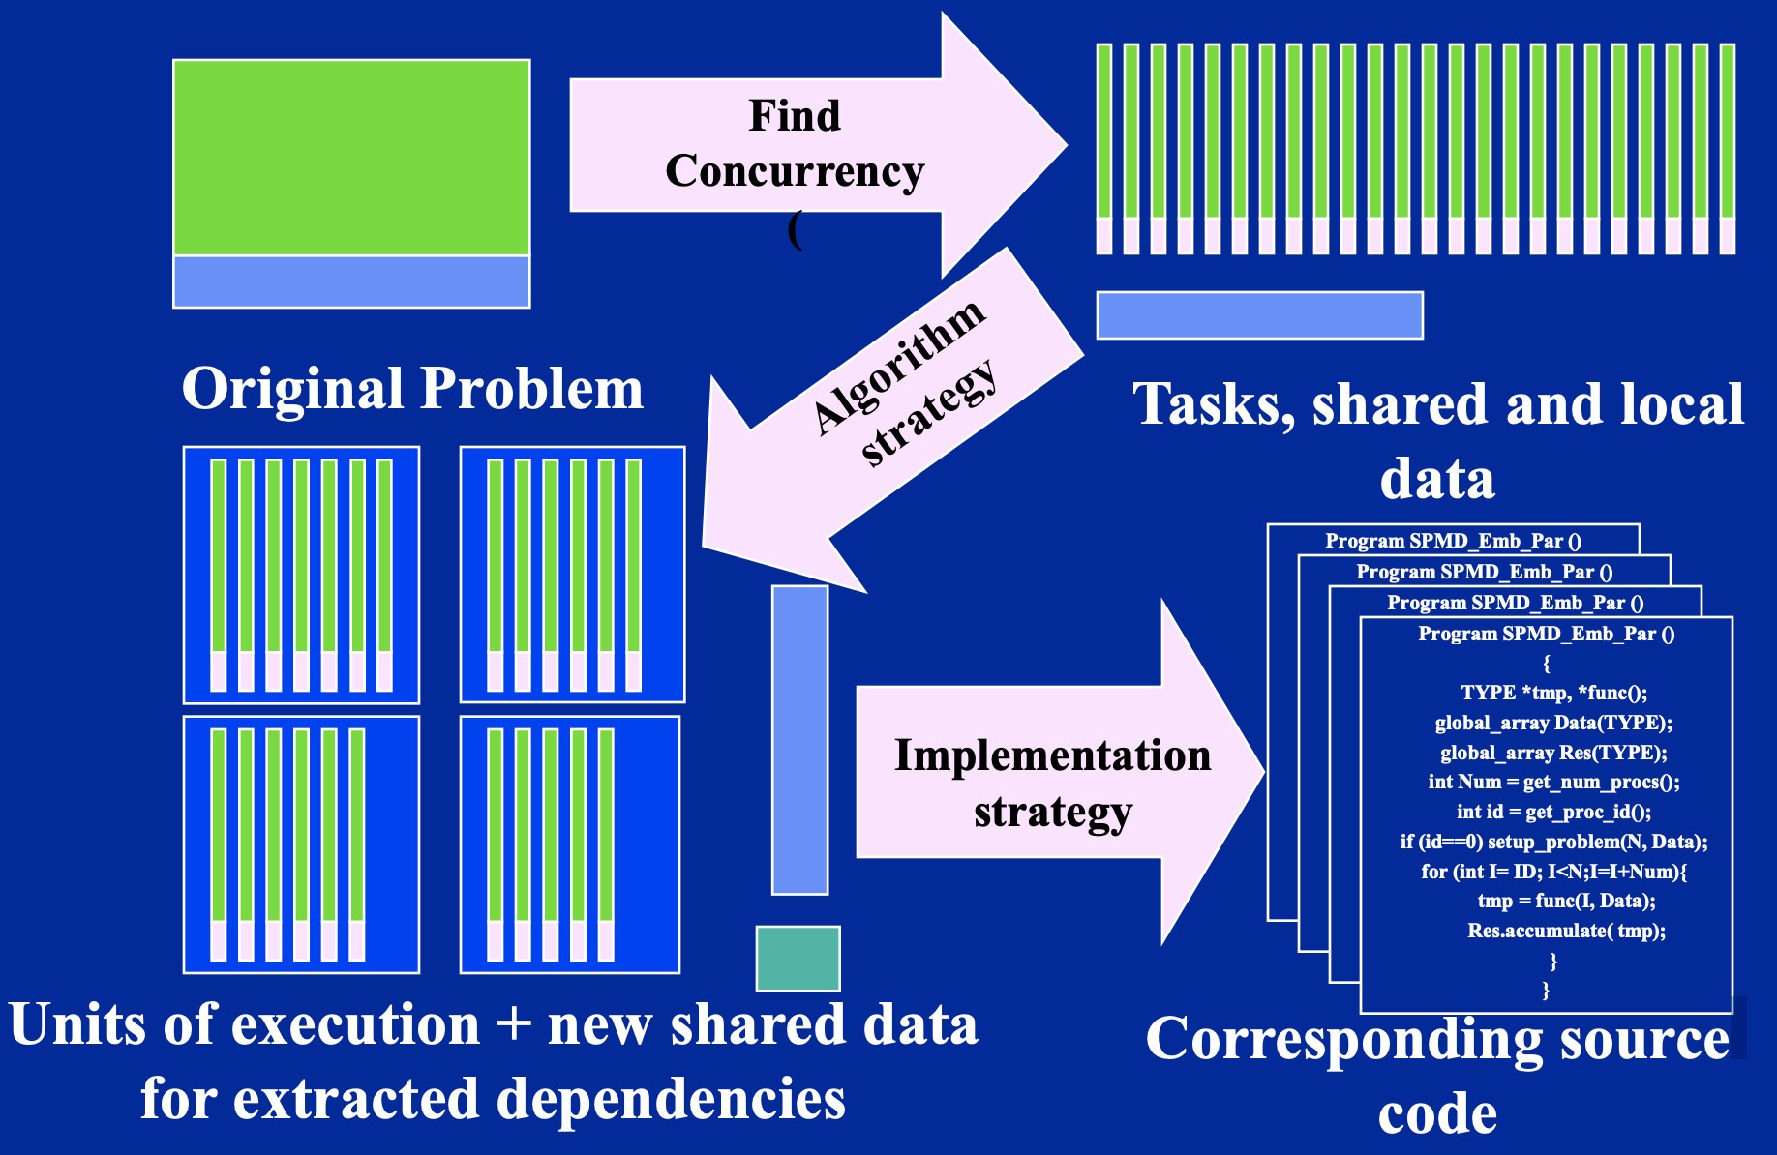

Slide 6
What is OpenMP
Open Specifications for Multiprocessing since 1997
API for Shared-Memory programming in C++, C and Fortran
Broadly supported by compiler manufacturers
Not applicable on systems with distributed memory architectures
No runtime checks regarding the correctness of the directives

Slide 7
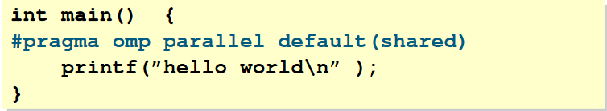
Application
OpenMP relevant Pragmas: #pragma omp
Pragmas are ignored by compilers without OpenMP support
OpenMP directives are associated with the following structural block

Slide 8
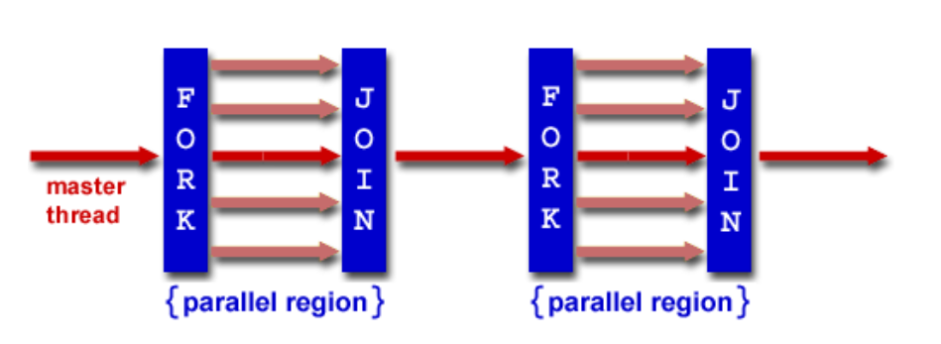
Fork/Join Model
Starts as a single thread (master)
Additional thread are created through regions

Slide 9
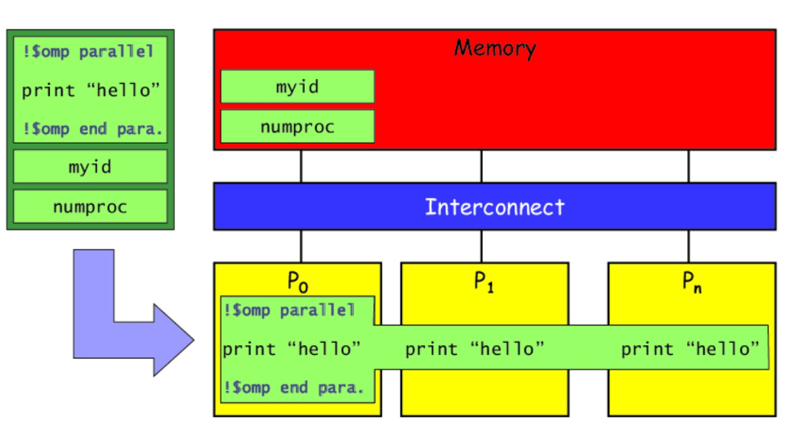
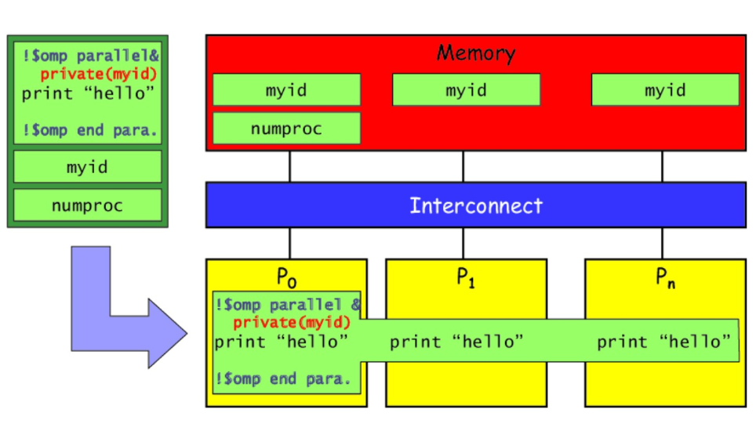
Data environment
Data is divided into sections:
Private Data
Shared Data (default)
Notes:
Gemeinsame Daten:
sind allen Threads bekannt und von diesen zugreifbar
alle Threads, die auf diese Daten zugreifen, greifen auf die selbe Speicherstelle zu
Threads kommunizieren miteinander oder synchronisieren sich über gemeinsame Daten
Private Daten:
jeder Thread legt seine eigene private Kopie an
jeder Thread greift nur auf seine eigene Speicherstelle in seinem Ausführungskontext zu
nicht zugreifbar für andere Threads
existiert nur während der Ausführung einer parallelen Region
Wert beim Eintritt und Austritt in die parallele Region undefiniert

Slide 10
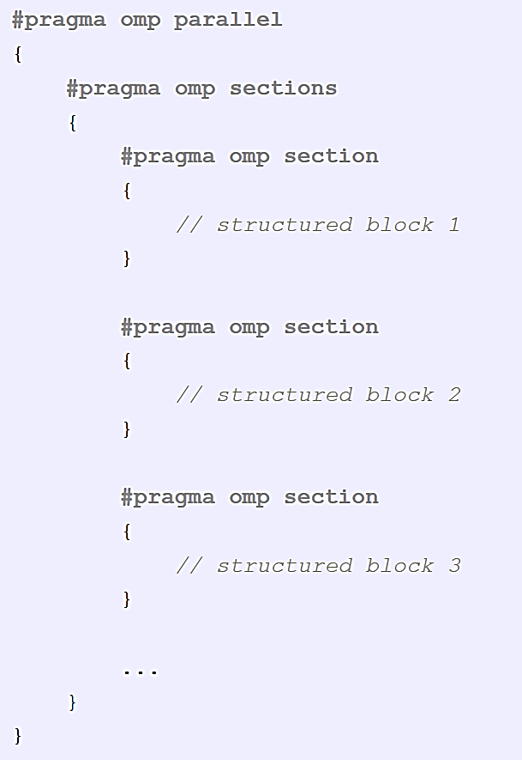
OpenMP - Sections
Distribution of tasks into different threads

Slide 11
OpenMP
Advantages:
Parallelization of serial code via directives
Easy and fast implementation
Code remains clear
Disadvantages:
Specialized Compiler
Only with shared memory architectures
Communication between threads is implicit
Difficult to understand

Slide 12
Exercises

Slide 13
Exercise 1 Parallelization of Addition
Why is there the same performance in the Release configuration?
Are there differences between the results with a Debug and a Release build?
How many resources are occupied by your system during execution?

Slide 14
Exercise 2 Game of Life
Which approach seemed to work best when optimizing?
Which problems may occur while optimizing?
Is the example visually enough?

Slide 15
Exercise 3 Quicksort Parallelization of Sections
 | 1000 | 10000 | 50000 | 100000 | 500000
Normal | 217 | 2692 | 15487 | 33254 | 191251
OpenMP | 435 | 2495 | 13362 | 28526 | 155192
Why is the parallelized version only as fast as the normal quicksort?

Slide 16
Comparisons and other Benchmarks

Slide 17
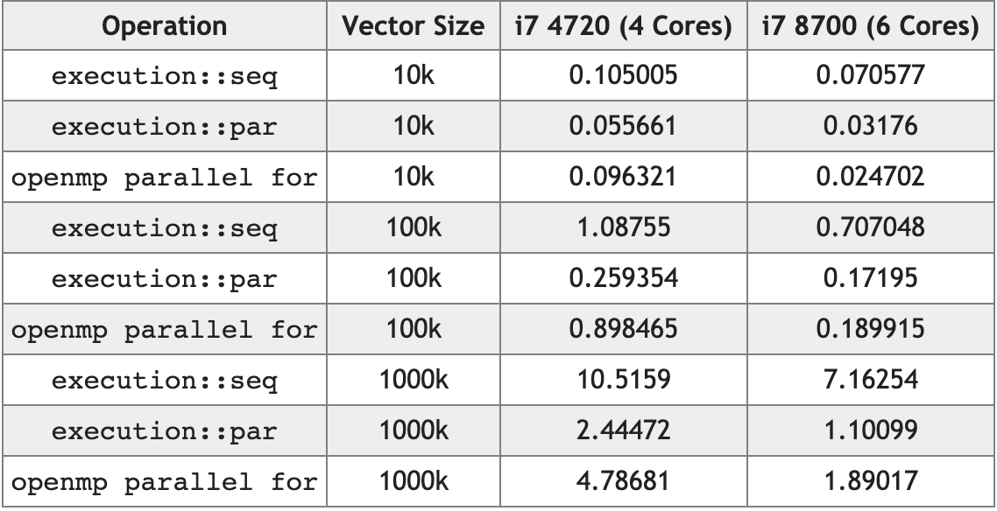
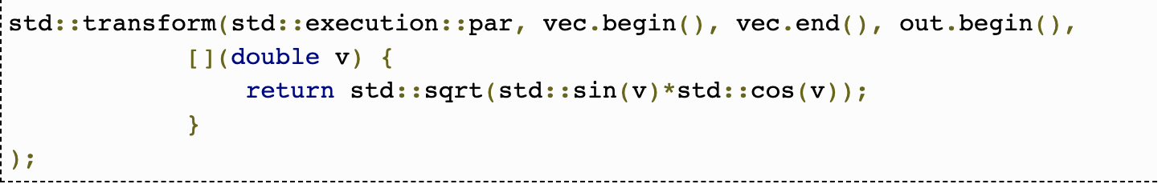
How does C++17 perform in comparison to OpenMP?
https://www.bfilipek.com/2018/11/parallel-alg-perf.html

Slide 18
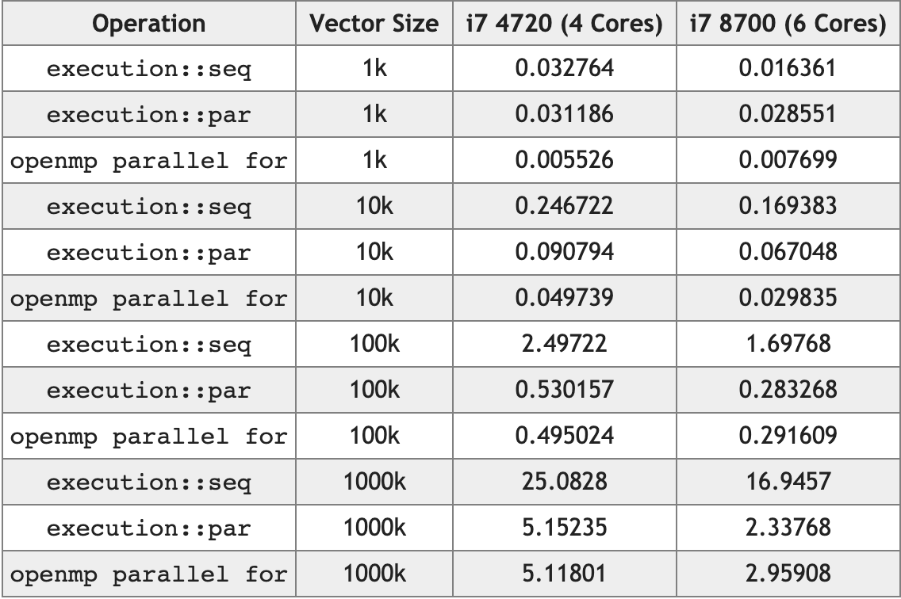
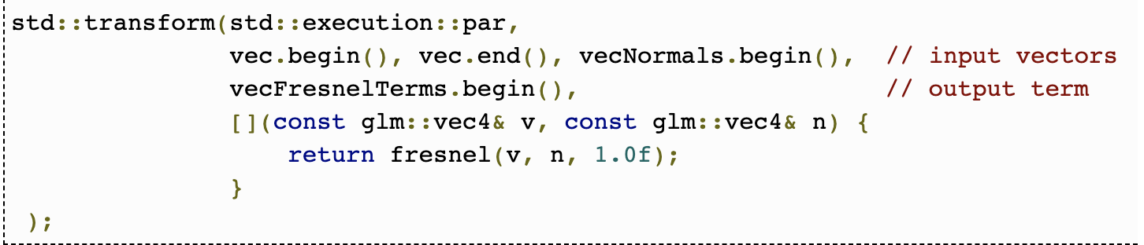
How does C++17 perform in comparison to OpenMP?
https://www.bfilipek.com/2018/11/parallel-alg-perf.html
Notes:
Let’s compute Fresnel equations that describe reflection and refraction of light at uniform planar interfaces. It’s a popular technique for generating realistic lightning in 3D games.

Slide 19
Thank you

