Slide 1
Introduction of this course
李宏毅
Hung-yi Lee

Slide 2
Welcome our TAs
TA 信箱：ntu.mldsta@gmail.com

Slide 3
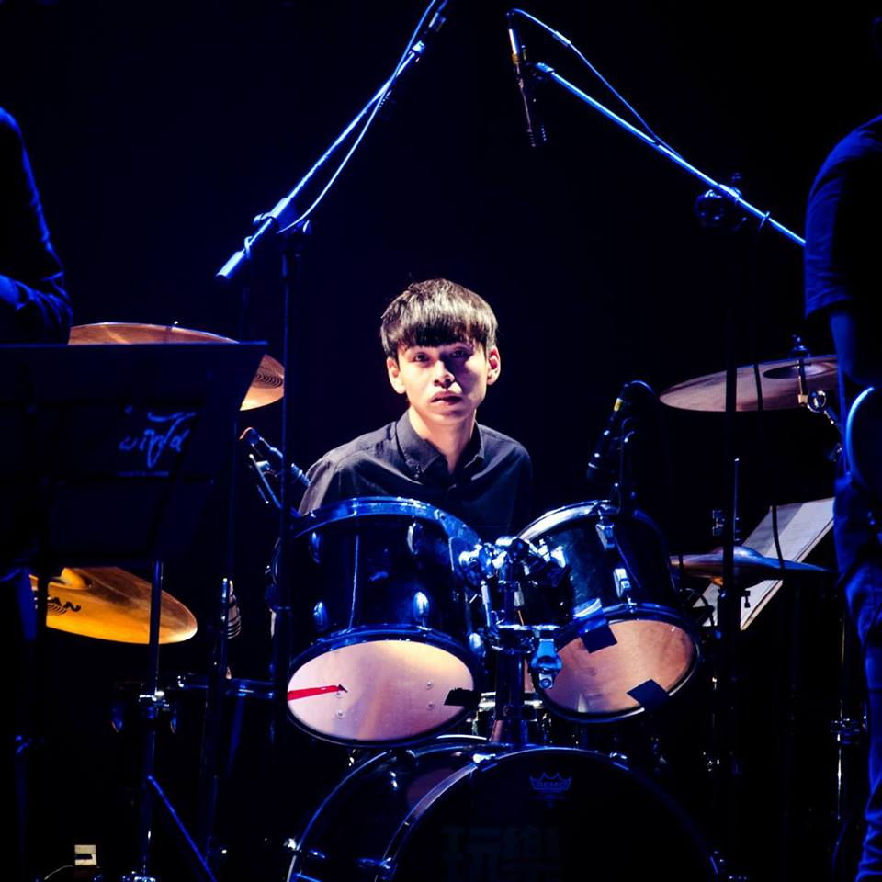
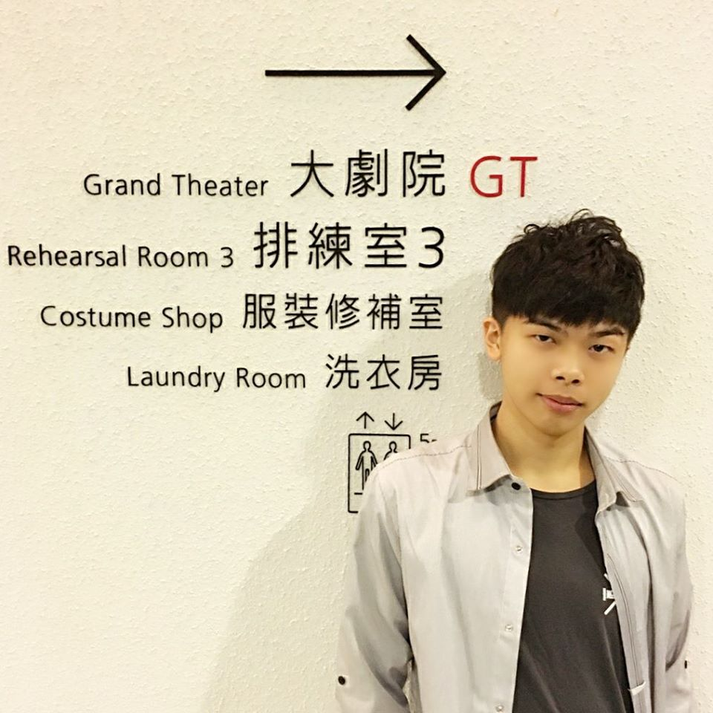
TAs
劉浩然
劉記良

Slide 4
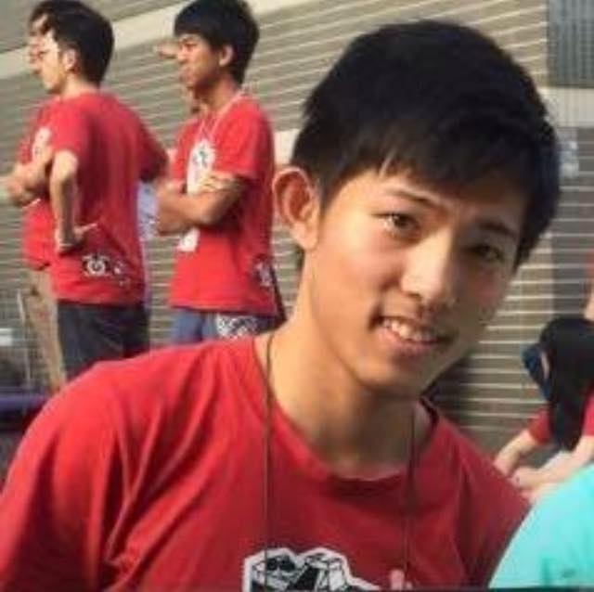
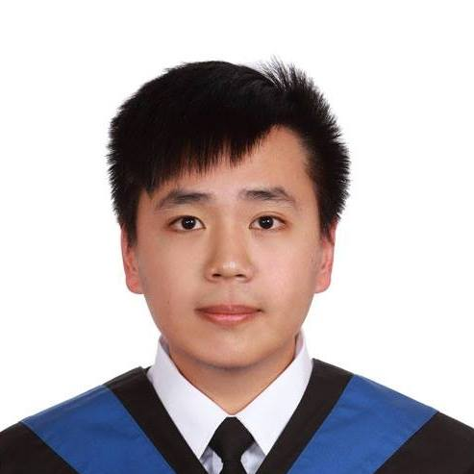
TAs
孫凡耕
吳思霖

Slide 5


TAs
宋易霖
賴至得

Slide 6


TAs
陳力維
陳佳佑

Slide 7

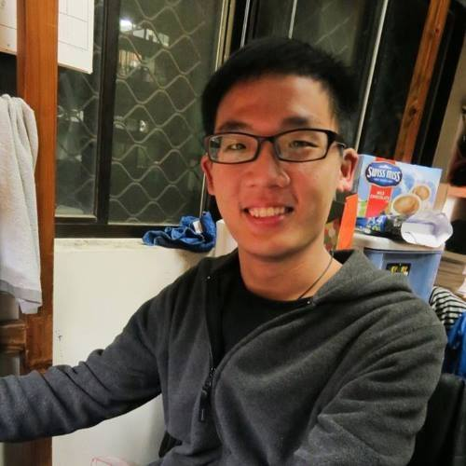
TAs
陳冠宇
劉達融 (大助教)

Slide 8
What are we going to learn?
本課程內容和《機器學習》沒有重疊

Slide 9
課程名稱解釋
機器學習
及其深層與結構化
Machine Learning
and having it Deep and Structured
Method

Slide 10
Deep Learning 可以解決一切 …
遇到問題，用 c4 就對了！
用 deep learning “硬train一發”

Slide 11
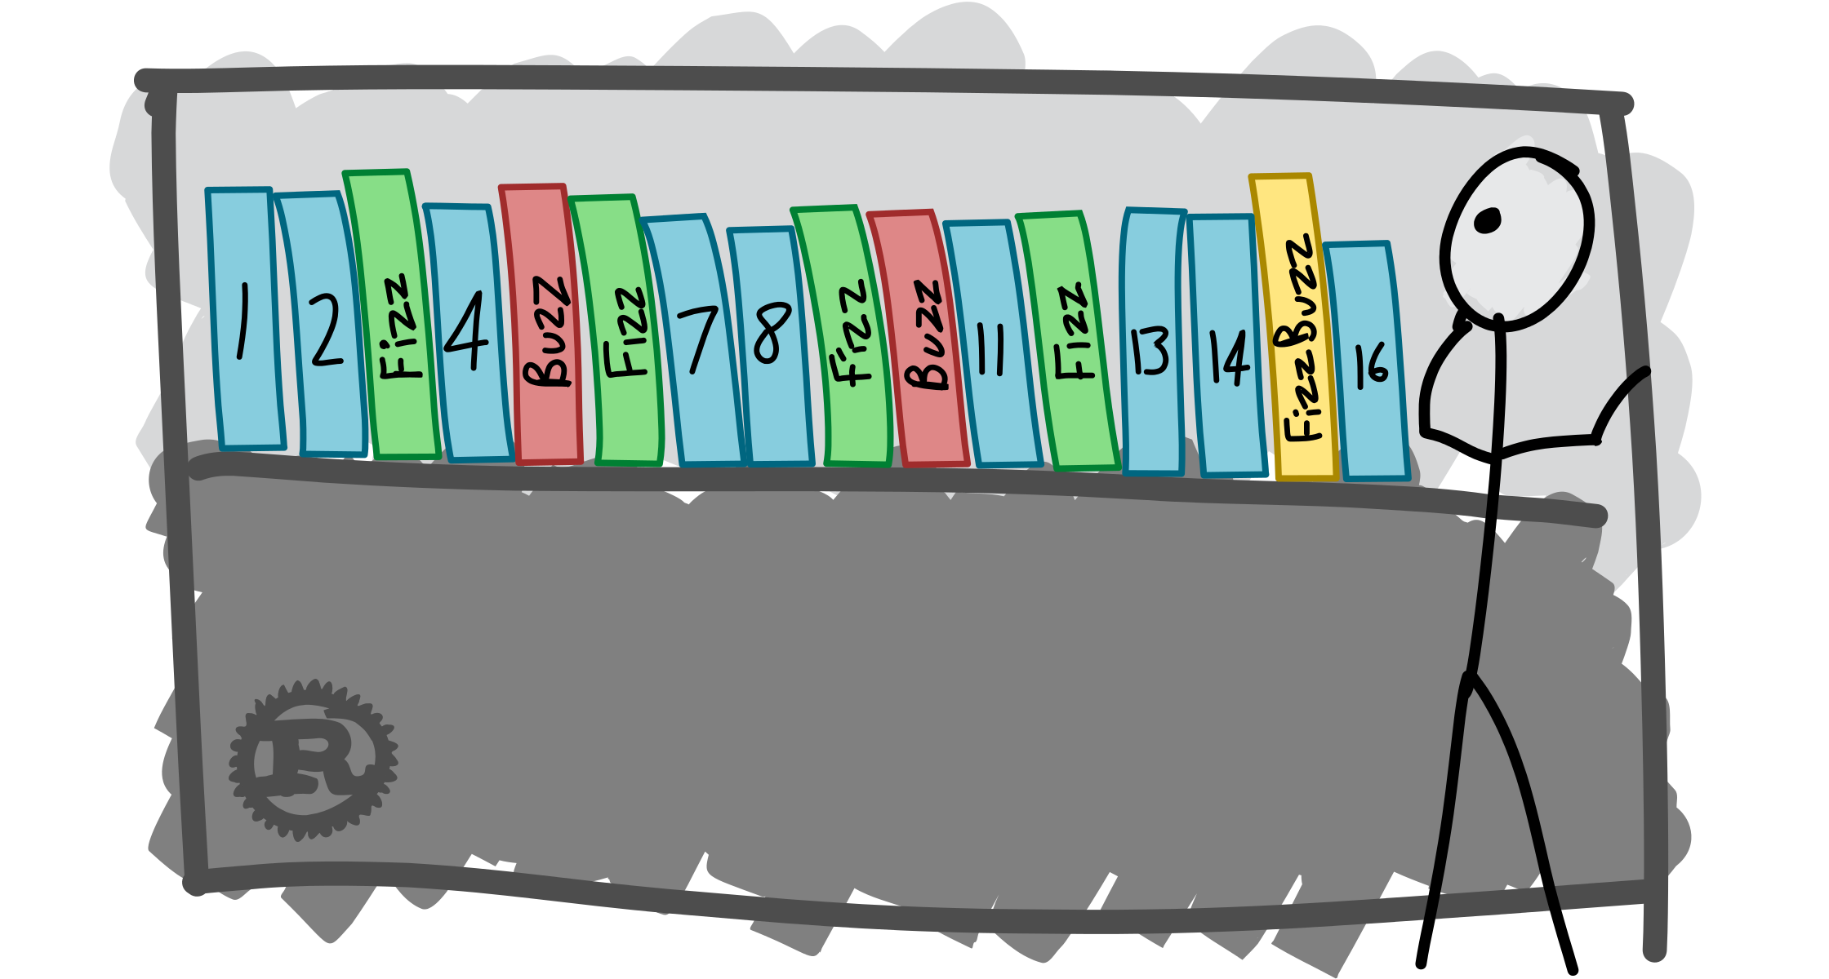
萬事皆可 train ……

Slide 12
Practice of Deep Learning
Previous machine learning developers
Carefully design your algorithm
Theoretically know its performance
Deep learning
Try first
Many results contradict our intuition
Find some reasons to explain what we observed
More like chemistry
Or even worse ……
Notes:
Ali Rahimi, Test of Time Award, NIPS 2017

Slide 13
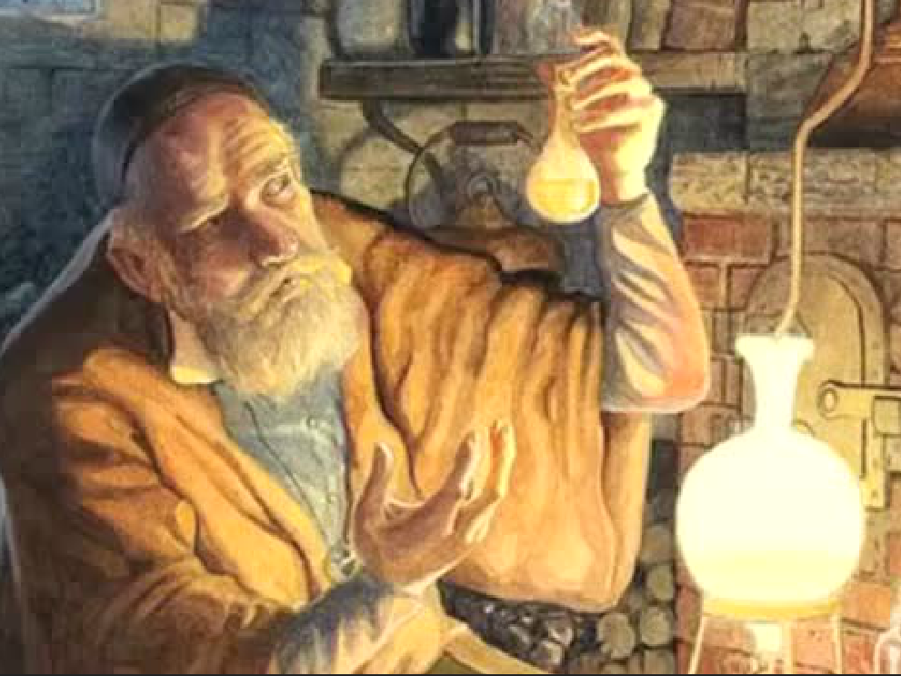

Slide 14
Practice of Deep Learning
Even a simple model can be hard to train ……

Slide 15
Practice of Deep Learning
Interesting facts ……

Slide 16
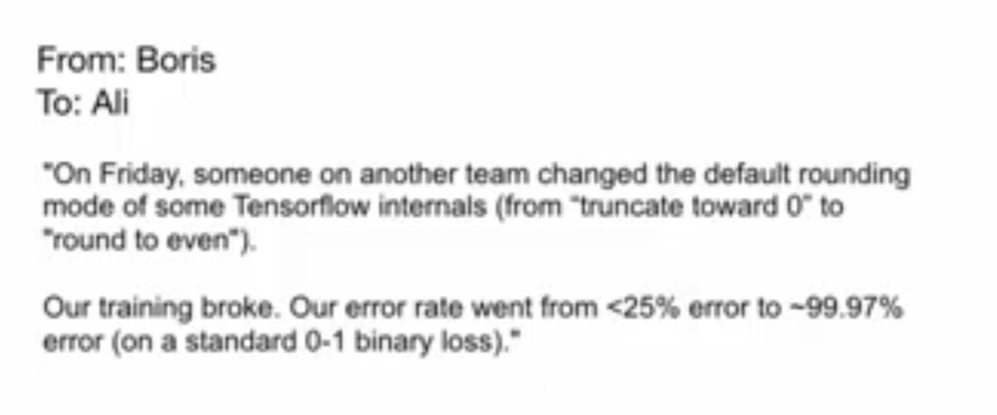
Ali Rahimi, Test of Time Award, NIPS 2017

Slide 17
Theory of Deep Learning
Theory 1: Expressiveness
A network structure defines a function set
Is deep better than shallow?
Theory 2: Optimization
How can we optimize by gradient descent?
Theory 3: Generalization
Why deep network does not overfit?
Although it can ……
There are local minima ……

Slide 18
Theory 1
Computational Graph
CNN
Highway
RNN
Spatial transformer
Recursive Network
Theory 2
Batch Norm
Attention-based Model
Seq-to-seq
Theory 3
SELU
Capsule

Slide 19
課程名稱解釋
機器學習
及其深層與結構化
Machine Learning
and having it Deep and Structured
Task

Slide 20
Structured Learning
Machine learning is to find a function f
Regression: output a scalar
Classification: output a “class”
(one-hot vector)
1 | 0 | 0
0 | 1 | 0
0 | 0 | 1
Class 1
Class 2
Class 3
Structured Learning/Prediction: output a sequence, a matrix, a graph, a tree ……
Output is composed of components with dependency
Notes:
Just name a few
Take human language processing and image processing as examples

Slide 21
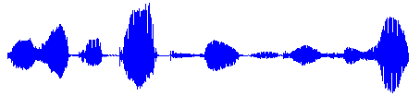
Output Sequence
Machine Translation
“機器學習及其深層與結構化”
“Machine learning and having it deep and structured”
(sentence of language 1)
(sentence of language 2)
Speech Recognition
感謝大家來上課”
(speech)
(transcription)
Chat-bot
“How are you?”
“I’m fine.”
(what a user says)
(response of machine)
Notes:
課程名稱只能有12 個字

Slide 22
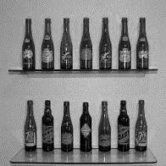
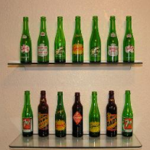
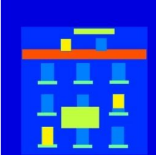
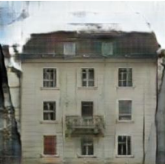
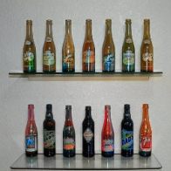
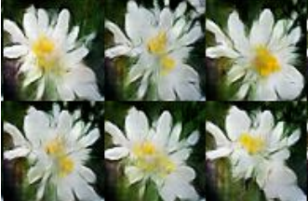
Output Matrix
Image to Image
Colorization:
Ref: https://arxiv.org/pdf/1611.07004v1.pdf
Text to Image
“this white and yellow flower have thin white petals and a round yellow stamen”
ref: https://arxiv.org/pdf/1605.05396.pdf
Notes:
畫圖
上色

Slide 23

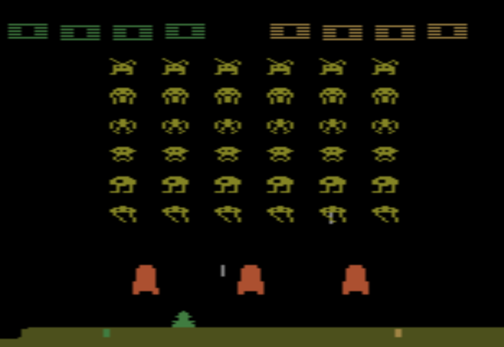


Reinforcement Learning
Action: “right”
Action: “fire”
Action: “left”
A sequence of decisions
Notes:
Decision Making and Control

Slide 24
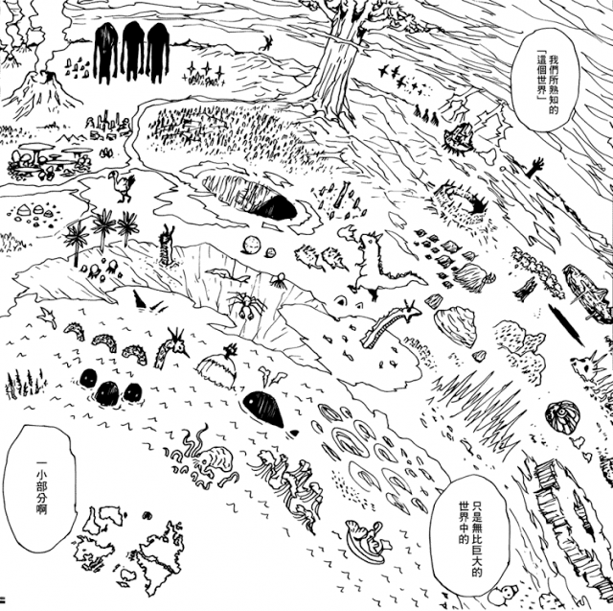
Structured Learning
Regression, Classification

Slide 25
Theory 1
Computational Graph
CNN
Highway
RNN
Spatial transformer
Recursive Network
Theory 2
Batch Norm
Attention-based Model
Seq-to-seq
Theory 3
SELU
Capsule
GAN
Generation Adversarial Network (GAN)
Value-based Approach
Policy-based Approach (PPO)
Actor-Critic
Sequence Generation
Conditional Generation
Imitation Learning
Auto
ML
Unsupervised Conditional Generation
RL

Slide 26
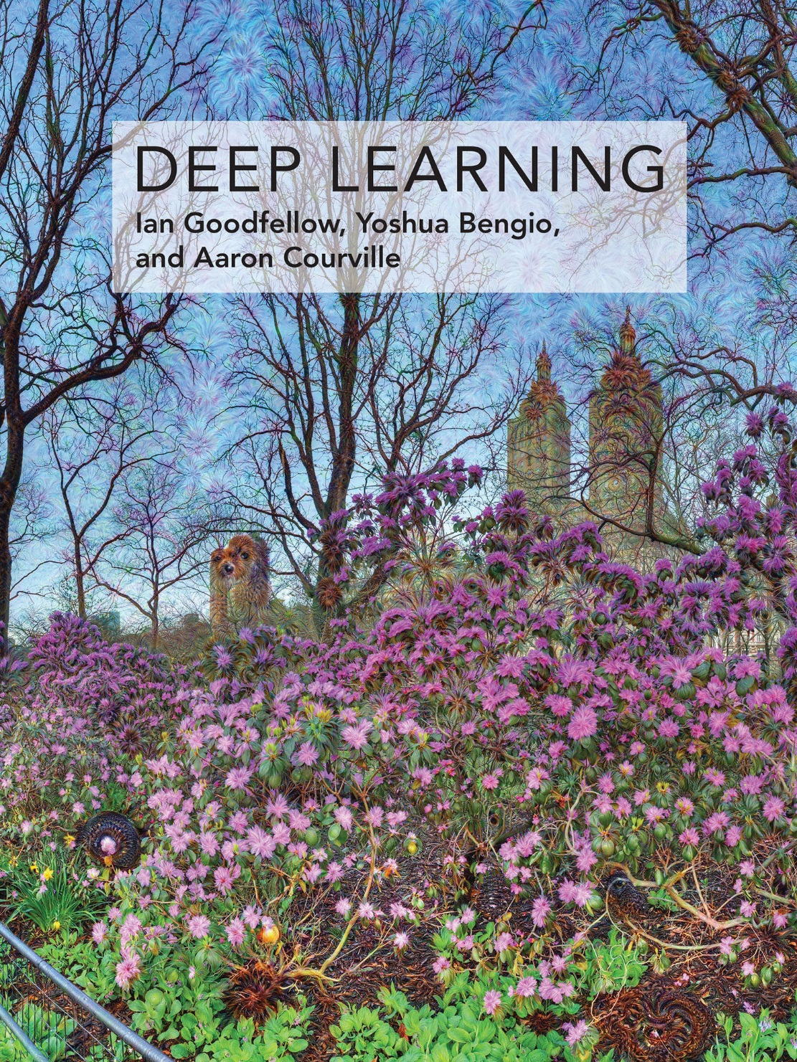
參考書籍
Original image: http://www.danielambrosi.com/Grand-Format-Collection/i-jbhqVhS/A
http://www.deeplearningbook.org/
Notes:
另有助教時間由助教講授作業。

Slide 27
Schedule

Slide 28
四次作業
HW1：深度學習流言終結者
1-1: Deep is better than shallow?
1-2: Is local minima an issue?
1-3: Is deep learning generalizable?
HW2：Seq-to-seq model
2-1: Video caption generation
2-2: Chat-bot (option)

Slide 29
四次作業
HW3: Generative Adversarial Network (GAN)
3-1: Generation
3-2: Conditional Generation
3-3: Unsupervised Conditional Generation (option)
HW4: Reinforcement learning
4-1: Policy gradient
4-2: Q-learning
4-3: Actor-critic

Slide 30
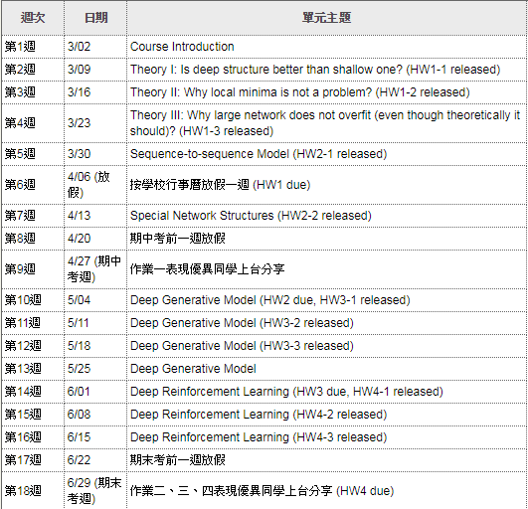
https://ceiba.ntu.edu.tw/modules/index.php?csn=8e8d96&default_fun=syllabus

Slide 31
Policy
Notes:
待處理:
放 cieba
幫忙組隊

Slide 32
評量方式
不點名、不考試
作業一 (25%)、作業二 (25%)、作業三 (25%)、作業四 (25%)
成績是相對的
成績是相對的
成績是相對的

Slide 33
組隊
每組 1 ~ 3 人，其中一人為組長
以組為單位進行所有作業
隊伍登記方法之後和作業一一起說明
組內互評：學期結束前會有組內互評，會影響成績

Slide 34
上課方式
上課投影片和錄音會放到李宏毅的個人網頁上
李宏毅的個人網頁：http://speech.ee.ntu.edu.tw/~tlkagk/courses_MLSD18.html
社團: “Machine learning and having it deep and structured (2018 spring)”
https://www.facebook.com/groups/907901649378100/
有問題歡迎直接在 FB社團上發問
如果有同學知道答案歡迎回答
有任何和機器學習相關的想法都可以在 FB社團上發言

Slide 35
提醒
深度學習必要之惡：訓練過程需要時間、調參數需要時間 ……
作業早點開始
死線前爆氣沒有什麼幫助
健全的心靈
試著調適等待過程的焦慮
運算資源
會有 MS Azure 的贊助，但是自備運算資源更好
請勿有作弊行為 (例如：抄襲同學的作業和程式、抄襲前人的作業和程式等等)
請遵守各作業的規定
如有規定未盡之處，則依照一般社會常識

Slide 36
需要的基礎能力和知識
本課程的定位為機器學習進階課程
程式能力：能夠使用某一個深度學習框架 (e.g. Tensorflow, pyTorch)
使用 Keras 無法完成所有的作業
本學期不會教深度學習框架的使用，請自學
Tensorflow
https://fgc.stpi.narl.org.tw/activity/videoDetail/4b1141305d9cd231015d9d07dbe1002a
https://fgc.stpi.narl.org.tw/activity/videoDetail/4b1141305d9cd231015d9d0852c5002b
https://fgc.stpi.narl.org.tw/activity/videoDetail/4b1141305d9cd231015d9d08fb62002d
pyTorch
https://fgc.stpi.narl.org.tw/activity/videoDetail/4b1141305d9cd231015d9d0992ef0030
Notes:
每次上課前會告訴大家需要先看的部分

Slide 37
需要的基礎能力和知識
基礎知識：希望聽課同學具備深度學習的基礎知識
《機器學習》錄影
DNN: https://www.youtube.com/watch?v=Dr-WRlEFefw
Tips for DNN: https://www.youtube.com/watch?v=xki61j7z-30
CNN: https://www.youtube.com/watch?v=FrKWiRv254g
RNN (Part 1): https://www.youtube.com/watch?v=xCGidAeyS4M
RNN (Part 2): https://www.youtube.com/watch?v=xCGidAeyS4M
Why Deep: https://www.youtube.com/watch?v=XsC9byQkUH8
Auto-encoder: https://www.youtube.com/watch?v=Tk5B4seA-AU
Deep generative model (Part 1): https://www.youtube.com/watch?v=YNUek8ioAJk
Deep generative model (Part 2): https://www.youtube.com/watch?v=8zomhgKrsmQ
Reinforcement Learning: https://www.youtube.com/watch?v=W8XF3ME8G2I

Slide 38
加簽
等一下助教會公告作業 0
作業零其實是《機器學習》這門課的作業
變相擋修《機器學習》
可以用任何機器學習方法完成，不限深度學習，只要達到要求的正確率就行
助教不會改作業零的程式
以個人為單位完成
本課程預期修課人數為 40 ~ 80 人 ，上限為 120 人
如果完成作業零人數超過上限，則按照完成作業的時間排序
完成作業 0 後，授權碼取得方式另行公告
Notes:
不會檢查程式碼

