Slide 1
Chapter 2
The basics of mean reversion

Slide 2
Definition of mean reversion
In theory, asset prices and returns eventually return back to the long-run mean or average of the asset historically.
Typically the prices are not mean reverting and instead are represented by a geometric random walk
Returns tend to mean revert around a mean of zero
So to make assets mean reverting we combine two or more individual assets into a portfolio that has mean-reverting net market value (Cointegration)

Slide 3
Mean reversion and stationary
Mathematically a mean reverting price series is described as having a change in the period proportional to the difference between the mean price and current price.
ADF test is used to test if the next return depends on the current price
Mathematically stationary price series have a variance that is a sublinear function of time, as opposed to a linear function like a geometric random walk.
We use the Variance Ratio test to test whether the price series is a geometric random walk or stationary

Slide 4
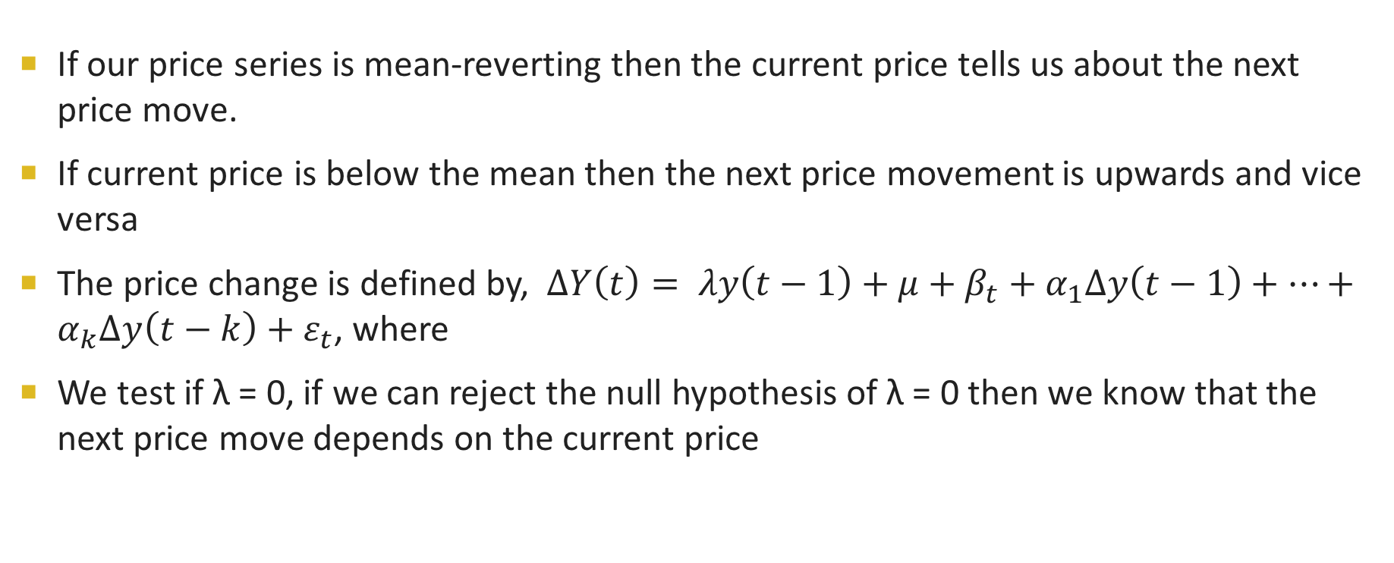
Augmented Dickey-Fuller Test (ADF)
If our price series is mean-reverting then the current price tells us about the next price move.
If current price is below the mean then the next price movement is upwards and vice versa
The price change is defined by, $∆Y\left(t\right)= λy\left(t−1\right)+μ+β_{t}+α_{1}∆y\left(t−1\right)+…+α_{k}∆y\left(t−k\right)+ε_{t}$, where
We test if λ = 0, if we can reject the null hypothesis of λ = 0 then we know that the next price move depends on the current price

Slide 5
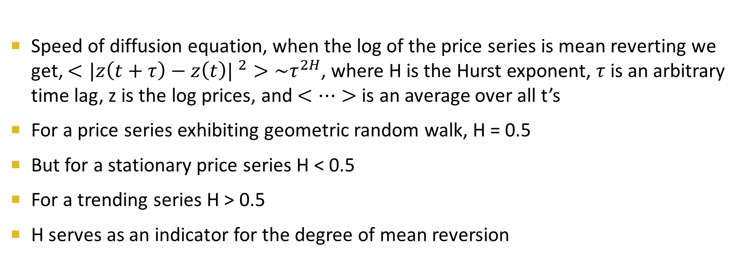
Hurst exponent
Speed of diffusion equation, when the log of the price series is mean reverting we get, $<{|z\left(t+τ\right)−z\left(t\right)| }^{2}>\sim τ^{2H}$, where H is the Hurst exponent, $τ$ is an arbitrary time lag, z is the log prices, and $<…>$ is an average over all t’s
For a price series exhibiting geometric random walk, H = 0.5
But for a stationary price series H < 0.5
For a trending series H > 0.5
H serves as an indicator for the degree of mean reversion

Slide 6
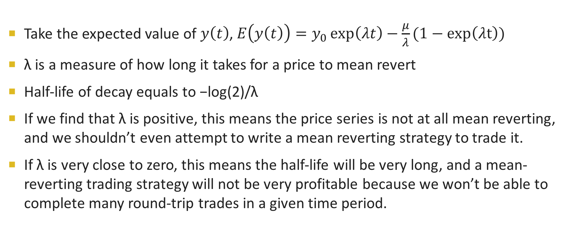
Half-life of mean reversion
Take the expected value of $y\left(t\right)$, $E\left(y\left(t\right)\right)=y_{0}\exp\left(λt\right)−\frac{μ}{λ}(1−\exp\left(λt\right))$
λ is a measure of how long it takes for a price to mean revert
Half-life of decay equals to −log(2)/λ
If we find that λ is positive, this means the price series is not at all mean reverting, and we shouldn’t even attempt to write a mean reverting strategy to trade it.
If λ is very close to zero, this means the half-life will be very long, and a mean-reverting trading strategy will not be very profitable because we won’t be able to complete many round-trip trades in a given time period.

Slide 7
Cointegration
We can proactively create a portfolio of individual price series so that the market value (or price) series of this portfolio is stationary
The most common combination is that of two price series: We long one asset and simultaneously short another asset, with an appropriate allocation of capital to each asset
Tests – CADF and Johansen

Slide 8
Cointegrated Augmented Dickey-Fuller Test
First determine the optimal hedge ratio by running a linear regression fit between two price series
Use the hedge ratio to form a portfolio and then run a stationary test on the portfolio price series
Very similar to the ADF Test

Slide 9
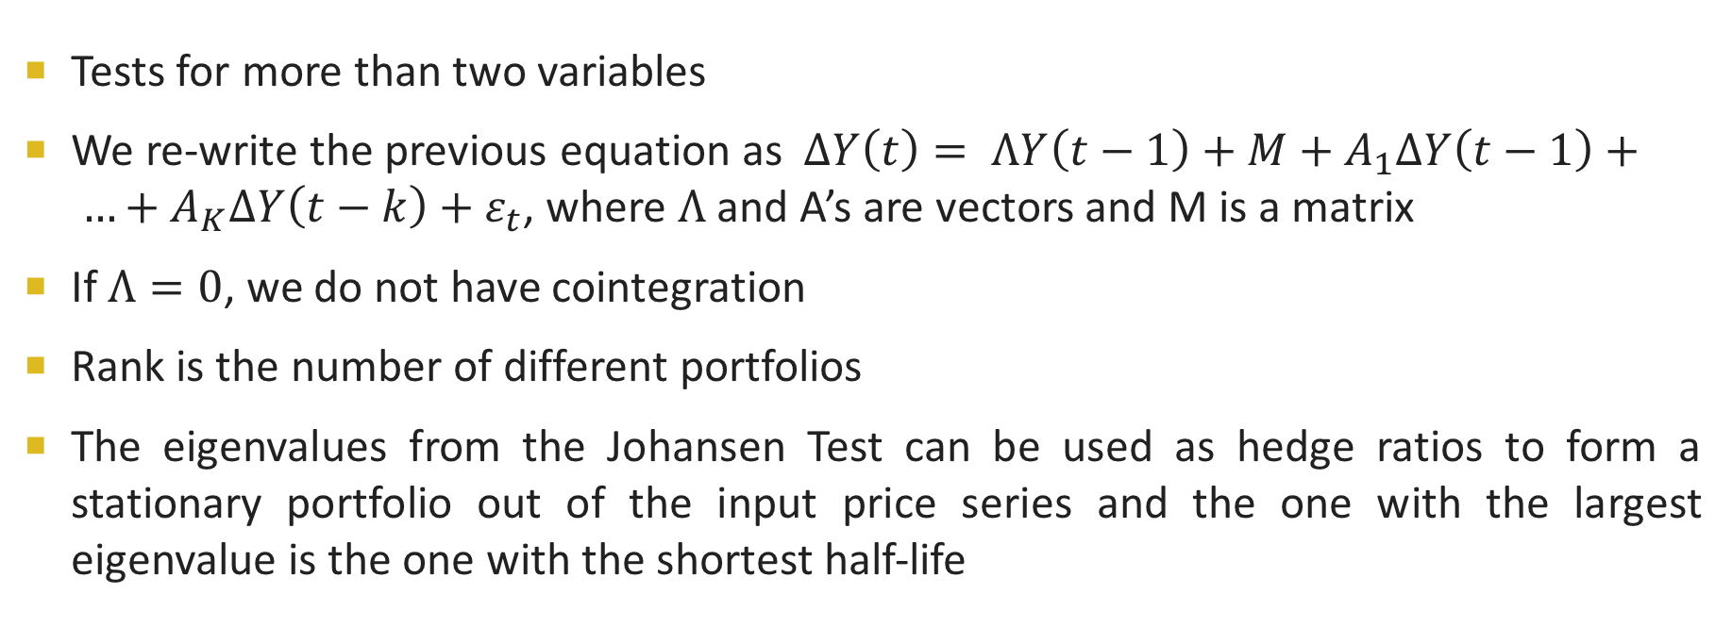
Johansen Test
Tests for more than two variables
We re-write the previous equation as $∆Y\left(t\right)= ΛY\left(t−1\right)+M+A_{1}∆Y\left(t−1\right)+ …+A_{K}∆Y\left(t−k\right)+ε_{t}$, where $Λ$ and A’s are vectors and M is a matrix
If $Λ=0$, we do not have cointegration
Rank is the number of different portfolios
The eigenvalues from the Johansen Test can be used as hedge ratios to form a stationary portfolio out of the input price series and the one with the largest eigenvalue is the one with the shortest half-life

Slide 10
Pros and cons
Pros
Easy to construct; great variety of cointegrating stocks and ETFs to create our own stationary, mean-reverting portfolio
With mean-reverting strategies we often get short time scales which mean a higher number of trades per year, which insures us higher statistical confidence for our backtest and live trading
Cons
The high consistency of mean-reverting strategies often lulls traders into over- confidence and over-leveraging that is the usual cause of the strategy breaking down

