Slide 1
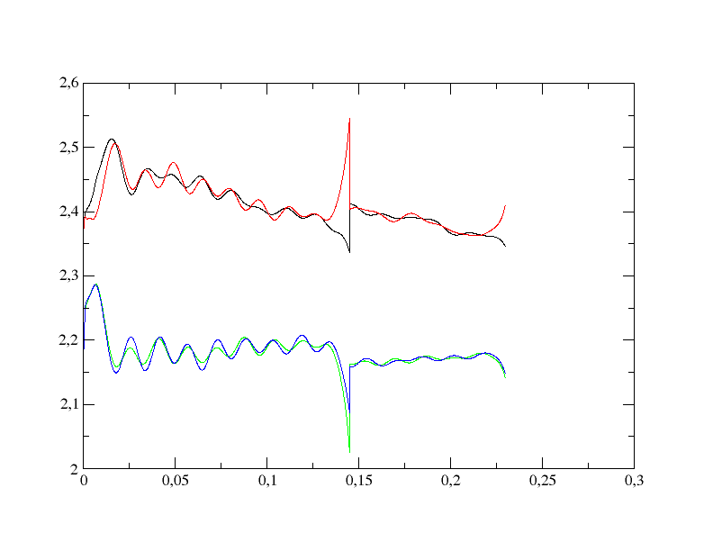
c-c bonds
bond distance [Angström]
o-c bonds
simulation time/ps

