Slide 1
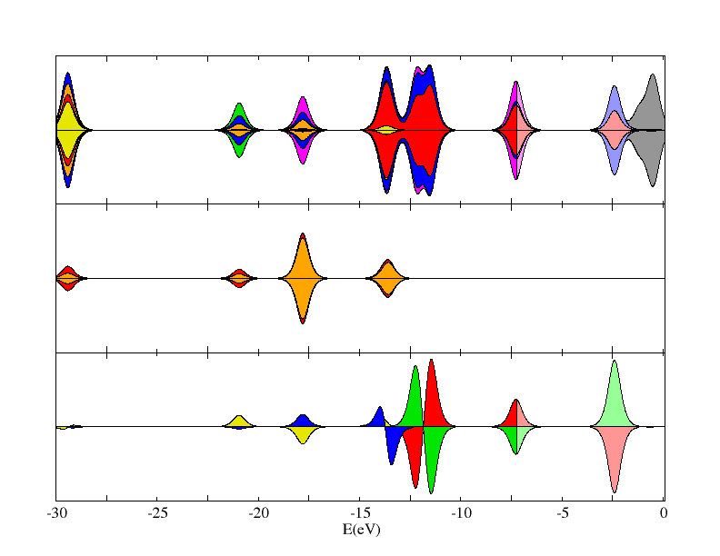
Total
O-p
O-s
C-p outer
C-s outer
C-p inner
C-s inner

