Slide 1

Rush Estimator for Corporate Cafeteria
Aniket Gawade Dylan Dsouza Joy Almeida Sudhanshu Kulkarni
Team : EliteCoders

Slide 2
Problem
•Absence of a tool to accurately predict the rush in restaurants and cafeteria on regular basis results in either food shortage or wastage .
•Moreover, inability to figure out the right numbers lead to overhead expenses on these restaurants owners which has impact on profits in the long term.
•Analyzing the footfall helps in getting customer insights like sales, anticipating future demands, and discovering best performing hours. Which is vital from a business perspective

Slide 3
Our Proposal
•To tackle the aforementioned challenges we bring a fully functional end to end product which can estimate the number of people visiting a restaurant .
•We take the cctv camera feed as the input and count the number of people entering and leaving the cafeteria ,this number is sent to the server every 24 hrs.
•A machine learning model which runs in the backend estimates the footfall on daily/weekly basis.This model is continuously modified with the help of data that is dynamically stored in an excel file.
•Cafeteria owners get an insight of the data via a user-dashboard which updates data in real time along with estimates of revenue generated and amount of ingredients required.

Slide 4
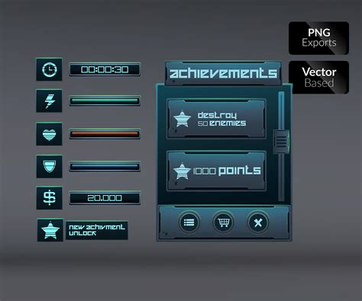


What we offer
Chatbot to assist easy navigation of the web-app and get requisite information at your fingertips!
Web interface to the cafeteria owners for displaying insightful data and estimate the footfall, revenue and ingredients
GUI to get the live count of people entering and leaving the cafeteria

Slide 5
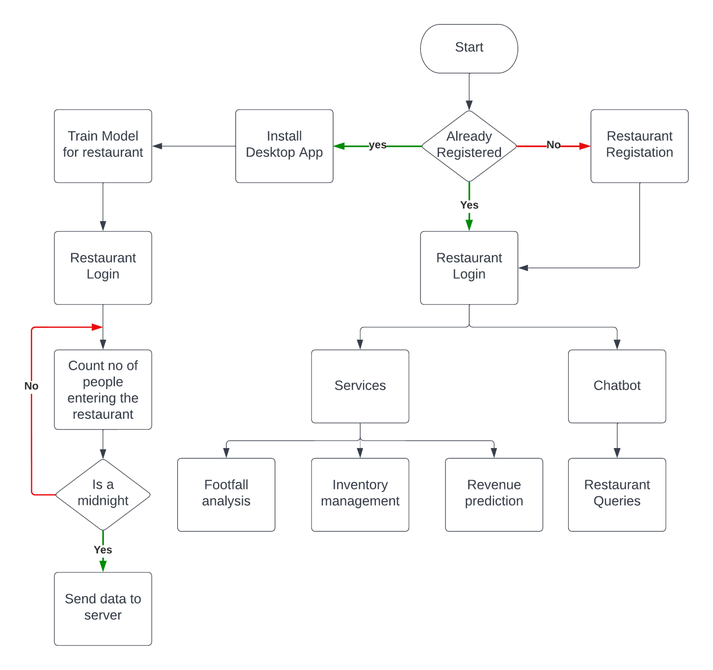
WorkFlow

Slide 6
Thank You!

