Slide 1


Sparkathon 2026
A governance agent for agentic CX
Sparkathon pillar: System Stability & Customer Resolution
Blast Radius Governor
A governance agent for multi-agent handoffs — scoring how much of the next action rests on verified fact before it runs.
Working prototype · scoring engine on Mistral 7B Instruct
Notes:
This is a hackathon prototype. Blast Radius Governor is a governance agent that sits at the handoff point between two AI agents. It is grounded directly in NiCE's own 2026 outlook, which names governance agents as a coming stage but never defines them.

Slide 2
The gap
NiCE names the destination, not this stop
NiCE’s 2026 State of Agentic AI in CX describes the coming shift as a four-stage progression:
→
→
→
01
02
03
04
Conversational AI
Reasoning agents
Orchestration agents
Governance agents
named, never defined
The outlook’s governance section stops at static policy thresholds — “confidence thresholds,” “sensitive scenarios” — with no mechanism behind either. What a governance agent actually does is left open.
Notes:
NiCE's own 2026 State of Agentic AI outlook names a maturity progression that ends in governance agents. But the role is never defined. Its governance section only cites static policy thresholds like confidence thresholds and sensitive scenarios, with no mechanism behind either. That undefined stage is exactly what this project builds.

Slide 3
The real risk
The danger isn’t an agent. It’s the handoff.
A
Upstream agent
B
Downstream agent
INFERS
handoff
ACTS ON IT AS FACT
“This complaint pattern suggests high churn risk.”
inference accepted as premise — never re-checked
Apply a large retention credit and change contract terms.
A probabilistic judgment — not a verified fact
An autonomous, hard-to-reverse action
Each agent behaves correctly in isolation. The blast radius appears only at the boundary — where an unverified premise crosses into an autonomous action with nothing measuring the gap.
Notes:
The risk in multi-agent pipelines is not one agent's action. It is the handoff. Agent A produces an inference. At the boundary, that inference silently becomes Agent B's accepted premise, and B acts on it autonomously. Nothing in between checks how much of that premise was ever verified. The failure point is the boundary, not either agent.

Slide 4
The solution
One gate. Two axes. Three routes.
✓
Auto-Execute
Grounded claim, low blast radius — runs on its own.
For every handoff, the Governor scores two things, then routing is decided in code — never by the model.
◿
Staged / Canary
Mixed signal — roll out narrowly and watch before it widens.
Claim basis
how grounded is the claim
Verified fact
Speculative inference
Action reversibility
how undoable is the action
Easily reversible
Irreversible
Notes:
The Governor sits at the handoff and scores two axes. Claim basis: how grounded the upstream claim is, from verified fact to speculative inference. Action reversibility: how reversible the downstream action is, from easily reversible to irreversible. An LLM returns a structured score and rationale; the route is then decided in code from the score, never by the model. The three outcomes build in as the axes combine: auto-execute, staged or canary, human review.

Slide 5
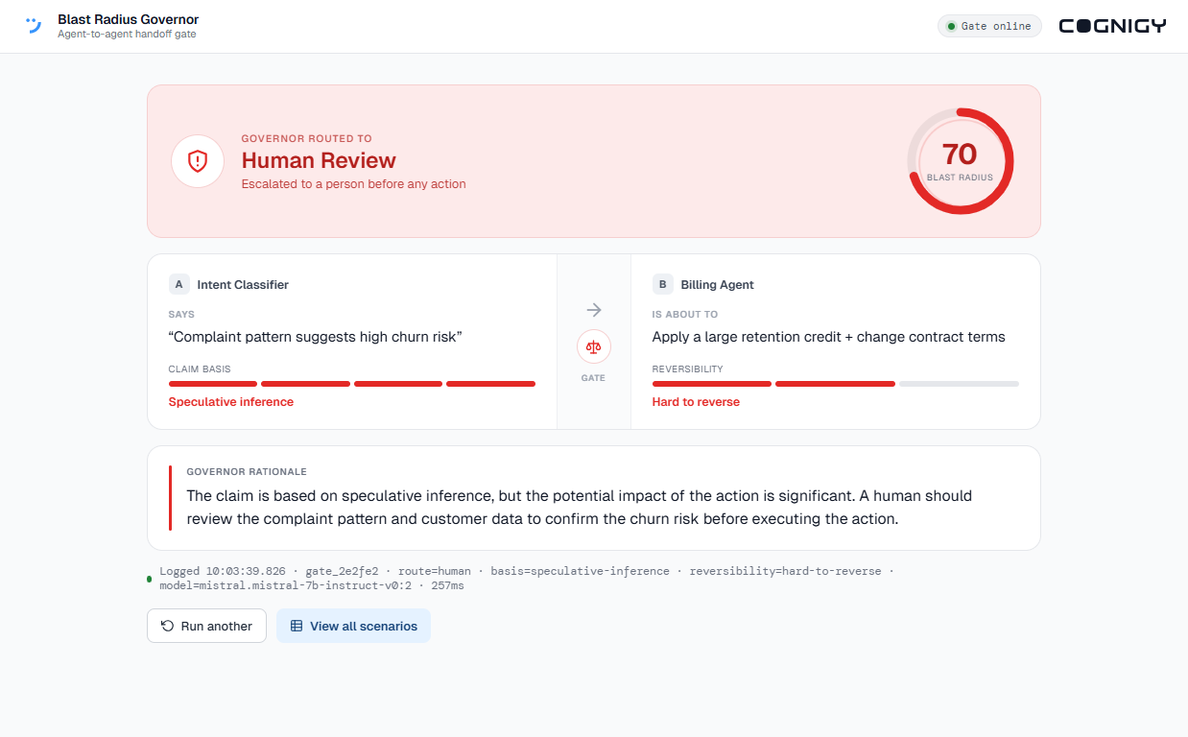
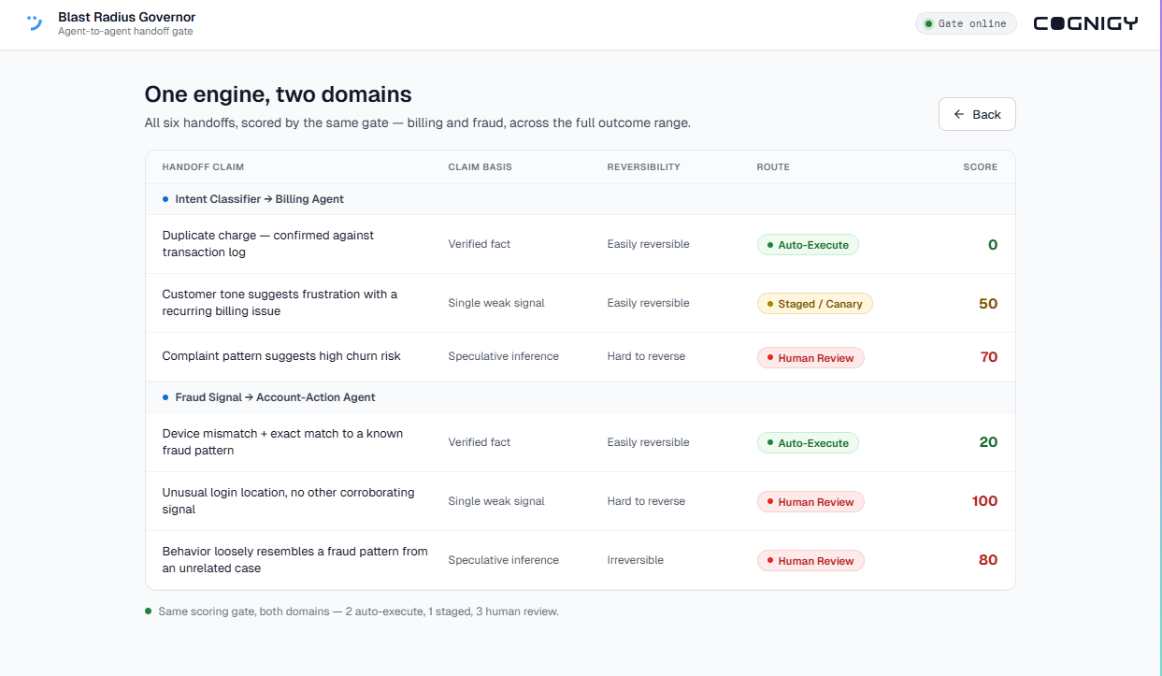
A live decision, and the full picture
Demo
All six, one gate
One handoff, scored live
Both domains, the full outcome range — two auto-execute, one staged, three human review.
Route, blast-radius score, plain-language rationale, and a log line with the model and latency.
One of the six scenarios triggers a live model failure during the demo — the system routes it to Human Review instead of guessing. That’s the fail-safe working as designed, not a bug.
Notes:
This is the working prototype, not a mockup. Left: a single handoff scored live. The Governor routed this speculative-inference, hard-to-reverse handoff to Human Review with a blast-radius score of 70, plus a rationale and a log line showing the model and latency. Right: the view-all summary, all six handoffs scored by the same gate across the full outcome range.

Slide 6
Proof of genericity
One engine. Two unrelated domains.
Same two axes, same three outcomes — the scoring engine is unmodified between pipelines. Nothing in it knows about billing or fraud.
Intent Classifier → Billing Agent
Fraud Signal → Account-Action Agent
billing domain · 3 scenarios
fraud domain · 3 scenarios
Duplicate charge, confirmed against the transaction log
Auto-Execute
Device mismatch plus exact match to a known fraud pattern
Auto-Execute
Tone suggests frustration with a recurring billing issue
Staged / Canary
Unusual login location, no other corroborating signal
Human Review *
Complaint pattern suggests high churn risk
Human Review
Behavior loosely resembles a pattern from an unrelated case
Human Review
* This scenario’s model call failed live during scoring — the system correctly escalated to Human Review under the same fail-closed rule referenced on the Demo slide, rather than guessing or defaulting to Auto-Execute.
Notes:
The same unmodified scoring engine governs two unrelated domains. An intent-classifier handing off to a billing agent, and a fraud-signal agent handing off to an account-action agent. Same two axes, same three outcomes, nothing wired to either pipeline. That is the proof it is a general governance layer, not a one-off integration.

Slide 7
Business value
A concrete mechanism where today there’s only a concept
Catches the mistake before it reaches a customer
Drops in without a rebuild
Proven, not promised
No changes to either agent, no new infrastructure — the gate reads a claim and an action and returns a routing decision. Runs on one of the lowest-cost models available on Bedrock. A team can pilot this on one real handoff in days, not a quarter.
This is a live prototype, not a mockup: real Bedrock calls, defensive response parsing, a bounded retry, and a fail-closed default that has already been observed firing during rehearsal — exactly the discipline a governance layer has to have before anyone trusts it with real actions.
Every hard-to-reverse action a downstream agent takes on unverified inference is a support escalation, a wrongly-frozen account, or a retention promise the business can’t take back. This gate catches those before they execute, not after — turning an invisible risk into a scored, auditable decision.
Notes:
The value is that this is a first, working answer to a role NiCE's own materials name as coming but leave undefined. It gives enterprises moving from single-agent pilots into orchestrated multi-agent operations a concrete way to measure and gate handoff risk, which becomes the real blast radius once agents act on each other's inferences. And because one gate governs any pipeline, governance can be added without rebuilding integrations.

Slide 8

Blast Radius Governor
A governance agent that gates every handoff by how much rests on verified fact.
Proven general across two unrelated domains with one unmodified engine.
Built solo in a 2-day sprint, with an AI coding agent — every scenario in this deck is a real, captured result, not a mockup
Notes:
Recap: a governance agent that gates every handoff by how much of the action rests on verified fact, proven general across two unrelated domains with one unmodified engine. Built solo in a short sprint with an AI coding agent. Adjust the effort line to the real number of days.

