Slide 1
Cleaning up your gooop
How to break Object Oriented Programming muscle memory and become better Gophers
GopherCon 2023

Slide 2
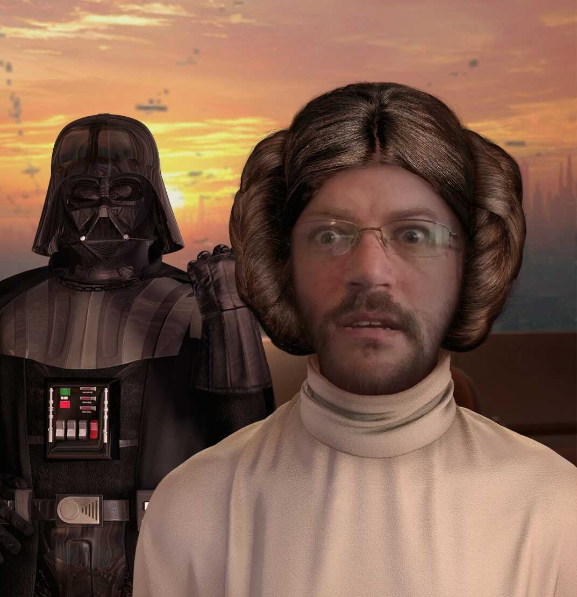
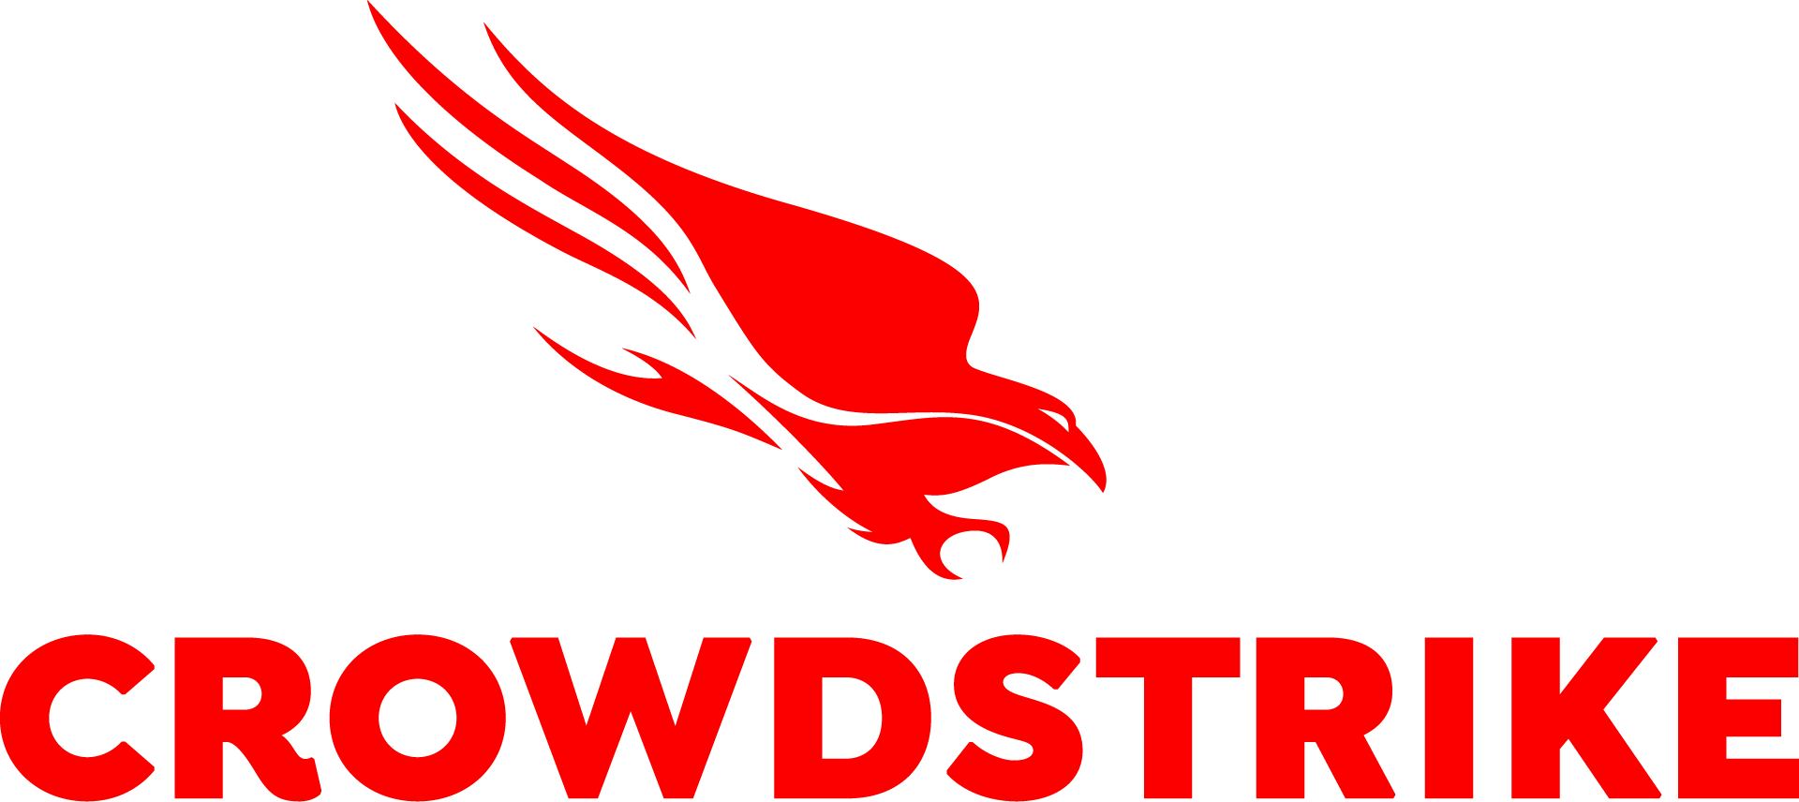
About ME
Senior Engineer II at CrowdStrike
Full-time Go developer since Go 1.6
Software engineer since 1998 across 4 industries and lots of languages
GopherCon 2023
Notes:
Greeting
[Thanks for picking me over Filippo]
I've been around. 25 years, 4 industries including a fintech startup working with stock market data. Past gigs were C++ and C#, with VB, JS, Java and Python sprinkled in. Switched to Go full time in '16
Often in Gophers Slack (#modules, #protobuf, #grpc, #performance)
This is me

Slide 3

🎉 It's My Birthday!! 🎉 🥂 👴🏻 🍻
GopherCon 2023

Slide 4
Go + OOP = GOOOP
Many (Most?) of us Gophers worked in another language first
Often those "other" languages were C++, Java, or C#
Go is a different sort of language
Applying those C++/Java/C# patterns to our Go is …. less than ideal
GopherCon 2023
Notes:
Many of us – maybe most of us – came to Go from some other programming language.
Usually C++, Java or C#. Also Python, Ruby, PHP, Objective-C.
Common thread: class-based object oriented programming model
We all spent years learning and internalizing the patterns and idioms from those languages.
Go is different. Initially designed to make it easy/fast for Google engineers to build and deploy network services.
That focus on efficiency, especially developer efficiency, means that if we apply those OO patterns and practices to writing Go it can lead to lots of GOOOP

Slide 5
Object oriented programming
Grew out of work at MIT in the late '50s and early '60s
Term was first coined by Alan Kay while in grad school in the mid '60s
Focuses on systems based on objects that capture state and methods on those objects to modify that state
System behaviors are defined by the interactions between objects
GopherCon 2023
Notes:
We'll start with some background … what is OOP?
It's a programming model that grew out of work at MIT in the late 50s and early 60s.
[advance]
According to wikipedia (the definitive source of unvarnished truth on The Internet), the term "object oriented programming" was first coined by Alan Kay while he was attending grad school in the mid '60s.
[advance]
The concept focuses on software systems based on objects that capture state and have methods on those objects to manipulate that state.
System behaviors are defined by the interactions between those objects.
The idea is that those software "objects" mirror the real-world objects the software is designed to process

Slide 6
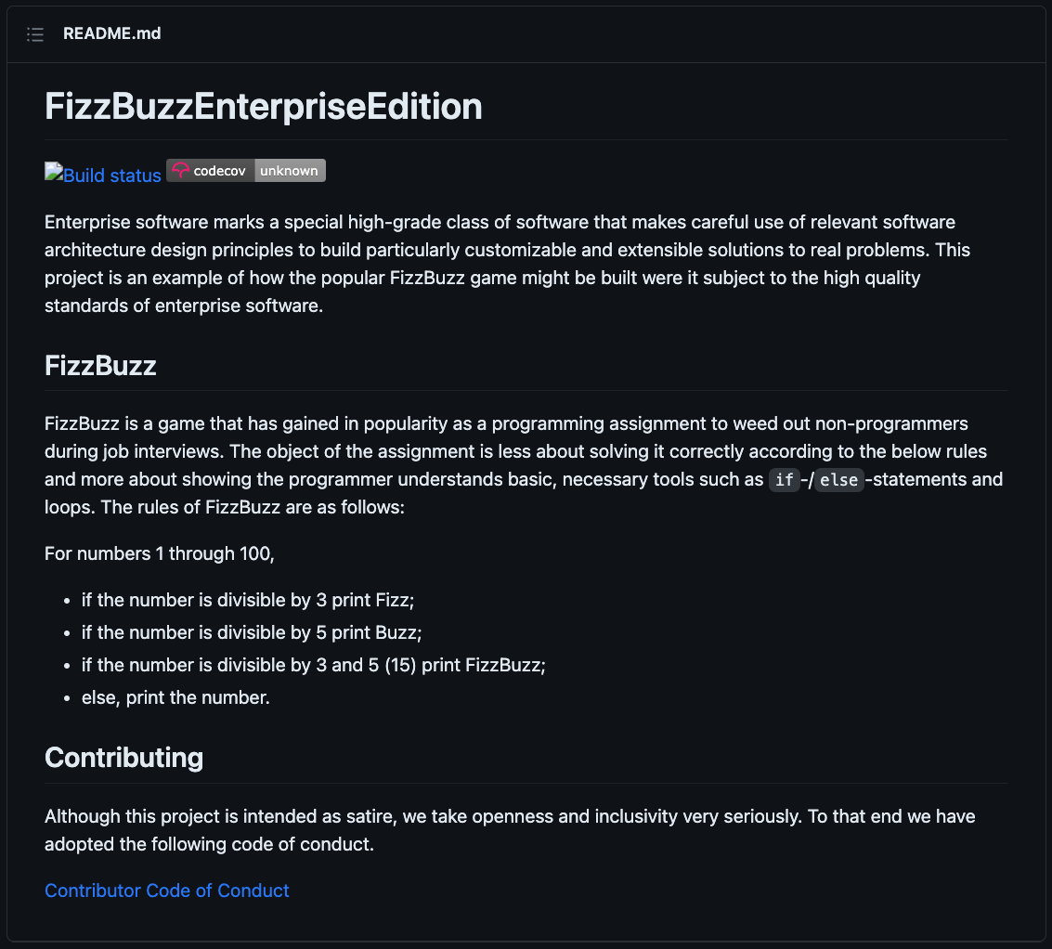
Object oriented programming
It's complicated
I made up the term 'object-oriented' and I can tell you I didn't have C++ in mind – Alan Kay, OOPSLA '97
And the enterprise-ing of software made things worse
GopherCon 2023
Notes:
The thing with OO, though, is that the we can end up fixating on defining abstractions and creating types hierarchies that implement them in a way that mirrors some real-world scenario.
But real life is complicated. As OOP grew, more and more language features, and entirely new languages, were added in an attempt get ever closer to perfection.
Unsurprisingly, all of those features created software that was harder and harder to reason about. This quote from Alan Kay (remember him?) sums it up pretty well.
I made up the term 'object-oriented' and I can tell you I didn't have C++ in mind.
Adding to the fire, in the 1990s and early 2000s (y'all remember those days?) there was a strong push to formalize software development and make it "enterprise class". This led to more abstractions that applied to more and more scenarios, eventually getting to the pinnacle of OOP …
[advance]
It uses all 23 design patterns from the classis GoF book. Everything is insulated from everything else so the code is maximally flexible. I could go on …
I kid. Not all OOP software ends up like this but they can be quite complex

Slide 7
Go is not really object oriented
Go is a practical language that often doesn't reward "fancy"
Go structs are not classes
Embedding is not Inheritance
Packages, not types, are the most basic unit of design
GopherCon 2023
Notes:
Although you can do OO things, Go is not really object-oriented in a traditional sense. It's a practical language … think meat and potatoes rather than Michelin-star
Some specific differences are:
- structs are not classes
- embedding is not inheritance
- packages are the unit of design
We'll go into each of these in more detail

Slide 8
Structs are not classes
Go structs are closer to C structs (a named group of named/typed fields) than to Java or C++ classes
Methods are syntax sugar
Constructors are regular functions and are 100% optional
Make the zero value useful – The Go Proverbs
No Destructors*
* runtime.SetFinalizer() exists but using it is often #darkarts
GopherCon 2023
Notes:
First, let's talk about structs.
There are no classes in Go. Structs are simple things much closer to a C struct than a Java or C++ class. Really just a named collection of fields, each having a name and a type
[advance]
In real-world terms, methods are syntactical sugar over functions that have an extra initial argument for the receiver
[advance]
Constructors in Go are just regular functions, named New[Thing]() by convention, that initialize and return instances of structs. They are 100% optional, though. We even have a proverb!
[advance]
There are also no destructors. Instances are automatically reclaimed by GC once they're out of scope.
[advance]
runtime.SetFinalizer() does exist if there are things that absolutely must be cleaned up when an instance is GC'd, but using it correctly can be quite tricky.

Slide 9
Embedding is not inheritance
Focus on what things a type can do (has-a) not which kind of thing a type represents (is-a)
Fields and methods on the embedded type are promoted to the outer type
Looks like inheritance, but 🐲 🐲 🐲
GopherCon 2023
Notes:
That brings us to our next point ... Go also doesn't have inheritance. Instead we have embedding, a form of composition
[advance]
Embedding focuses on what operations a thing can do (directly or by embedding an instance of another embedded type) rather than on which kind of thing a type represents (an is-a relationship)
[advance]
Optimizing for developer efficiency, fields and methods on the embedded type are promoted to the public surface area of the outer type.
[advance]
Embedding certainly looks like inheritance if you squint just right … but There be Dragons. Let's go through some examples.

Slide 10
Embedding is not inheritance
type BaseThing struct{}
func (b *BaseThing) doStuff() {
fmt.Println("Everything's basic")
}
type NormalThing struct {
BaseThing
}
type FancyThing struct {
BaseThing
}
func (f *FancyThing) doStuff() {
fmt.Println("It's full of stars!!")
}
GopherCon 2023
Notes:
For the first scenario we have a simple system with 3 types. There's a BaseThing that defines a doStuff() method and a NormalThing type that "inherits" from it. There's also a FancyThing type that "inherits" from BaseThing and "overrides" doStuff().
Pretty standard fare for a class-based OO system. It's also valid Go that builds and runs …. mostly

Slide 11
Embedding is not inheritance
func main() {
var (
t1 BaseThing
t2 NormalThing
t3 FancyThing
)
// all 3 things have a doStuff() method
t1.doStuff()
t2.doStuff()
t3.doStuff()
}
// Output
Everything's basic
Everything's basic
It's full of stars!!
GopherCon 2023
Notes:
All's well at first. We can easily create instances of all 3 types. They all 3 have a doStuff() method, including NormalThing inheriting it from BaseThing. [advance] We can also see that doStuff() on FancyThing has overridden the base method.
So far, so good

Slide 12
Embedding is not inheritance
func main() {
var (
t1 BaseThing
t2 NormalThing
t3 FancyThing
)
...
// this works
doTheThing(&t1)
}
func doTheThing(t *BaseThing) {
t.doStuff()
}
// Output
Everything's normal
GopherCon 2023
Notes:
Extending things a bit, we add a function that accepts a BaseThing following traditional OOP idioms and, again, [advance] we get the expected result.
Yes this isn't idiomatic Go, but that's kind of the point. Thinking in terms of base classes and inheritance kinda/sorta does work in Go

Slide 13
Embedding is not inheritance
func main() {
var (
t1 BaseThing
t2 NormalThing
t3 FancyThing
)
...
// This does not compile because there is no "is-a" relationship
// between NormalThing and BaseThing
doTheThing(&t2)
}
...
// Output
./main.go:42:15: cannot use &t2 (value of *NormalThing) as *BaseThing value in argument to doTheThing()
func main() {
var (
t1 BaseThing
t2 NormalThing
t3 FancyThing
)
...
// This does work, though
doTheThing(&t2.BaseThing)
}
...
// Output
Everything's normal
... or does it?
GopherCon 2023
Notes:
But then the wheels come off. We're still in OO mode and try to pass a NormalThing, which inherits from BaseThing, to doTheThing and boom.
The compiler is angry with us. It insists that there is no is-a relationship between a NormalThing and a BaseThing (so they cannot be used interchangeably) and that we should rethink our life decisions
We're dedicated Gophers, though, and won't be discouraged.
[advance]
We look at our code and figure out that we do in fact have a BaseThing right there as part of t2 so we pass *that* to doTheThing()
and voila!
[advance]
We see the expected results and all is right with the world again.
[advance]
Or is it?

Slide 14
Embedding is not inheritance
func main() {
var (
t1 BaseThing
t2 NormalThing
t3 FancyThing
)
...
// This compiles and runs but does the "wrong" thing
// - FancyThing.doStuff() is not called because there is no virtual dispatch
doTheThing(&t3.BaseThing)
}
...
// Output
Everything's normal
GopherCon 2023
Notes:
We apply our newfound adjustment for doing OO inheritance in Go and try to pass a FancyThing to doTheThing() the same way.
It compiles and runs but generates the wrong output. [advance]
The Go compiler is happy to accept t3.BaseThing as an argument to doTheThing() but it will call BaseThing.doStuff(), not the "overridden" method on FancyThing

Slide 15
Embedding is not inheritance
Embedding lets you "inherit" fields and behavior by composing types
but things do not behave as they do in OOP languages
Thinking in terms of base classes, derived classes, and inheritance can lead to GOOOP
GopherCon 2023
Notes:
As we've seen in this example, Go struct embedding can look like inheritance, and it is in some ways, [advance] but the resulting behavior is not the same
[advance]
You can easily end up with a pile of GOOOP with an OO mindset and thinking in terms of base classes, derived classes, and inheritance

Slide 16
Packages are the smallest unit of code
All code must live in a package
Visibility is enforced within and outside of the package
Importing a package brings in the entire package
All consumer references to symbols include the package name
GopherCon 2023
Notes:
For our last difference, let's talk about packages.
In Go, the package is really the smallest unit of code
All code must be defined inside of a package
Every Go source file contains a package declaration as it's first line
[advance]
Encapsulation and visibility are also defined at the pack age level
Private/Unexported symbols are visible to all code within the package (declarations, functions, or methods). There is no type-scoped encapsulation within a package
[advance]
A package can be as small as a single variable declaration and as large as you want to make it
Importing a package brings in the entire package, which means consumers will need to build everything in the package
Anecdote about generating 1000s of types in 1 package and downstream builds taking 7 minutes and emitting 50+M binaries
Research showed that most consumers only used a handful of those types
Grouping types into categories and generating a package per category cut build times to sub-second and binary size down to ~7 MB for a consumer that only needed 1 type
[advance]
Finally, references to any symbol in your package will include the package name (or alias) in consumer code. Your struct type or function is never named in isolation. The package qualifies everything.

Slide 17
Examples of gooop
1. Creating separate, shared components to resolve co-dependency
GopherCon 2023
Notes:
Now we'll dive into a few examples of GOOOP and see what happens when you directly apply OO patterns to Go projects.
First will be creating a separate, shared component in order to resolve a co-dependency

Slide 18
Separate shared components to resolve co-dependency
When A depends on B and B depends on A …
Create a third component C with the commonality
Update A and B to depend on C and not each other
GopherCon 2023
Notes:
One of the classic examples of refactoring is taking 2 components that depend on each other and breaking them apart
[advance]
The canonical "fix" is to define a 3rd component with the common pieces [advance] then update the first two to depend on the new thing instead of each other
In abstract comp sci terms that's the "right" path but doing it the OO way can make things worse, not better

Slide 19
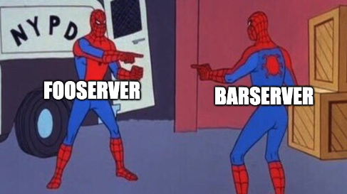
Separate components to resolve co-dependency
package fooserver
import bar "example.com/gooop/barserver/client"
type Server struct {
...
c *bar.Client
}
package barserver
import foo "example.com/gooop/fooserver/client"
type Server struct {
...
c *foo.Client
}
GopherCon 2023
Notes:
To set the stage, we have a Foo service that depends on another service, Bar. Foo communicates with Bar via Bar's exported client
[advance]
The Bar team works in the next building over, and it turns out that Bar *also* depends on the Foo service so they have dutifully pulled in Foo's client
This is perfectly valid Go. Everything will even build and run since there's no package import cycle.
There's a hidden problem, though, because there *IS* a circular dependency between the Foo and Bar modules
The current version of Foo depends on some version of Bar, which depends on an earlier version of Foo, which depends on ….
[advance]

Slide 20
Separate components to resolve co-dependency
package clients
type FooClient interface {
...
}
type BarClient interface {
...
}
GopherCon 2023
Notes:
Let's put on our OO refactoring hat and dive in. We create a new clients module with interfaces for FooClient and BarClient.
Everything is nice and clean and we release this new module

Slide 21
Separate components to resolve co-dependency
package fooserver
import "example.com/gooop/clients"
type Server struct {
...
c clients.BarClient
}
package barserver
import "example.com/gooop/clients"
type Server struct {
...
c clients.FooClient
}
GopherCon 2023
Notes:
We circle back to our Foo and Bar services and update them to reference the new clients package and we're done.
Neither service depends on the other. Problem solved. Pour the drinks!! Right?

Slide 22
Separate Components to resolve co-dependency
Reduces cohesion and can create unnecessary coupling
Often leads to "bad" module/package names
Modifying multiple modules at once can be difficult
GopherCon 2023
Notes:
While this is technically a successful refactor (Foo and Bar no longer depend on each other) it's not actually that great if we dig a little bit
[advance]
The new components that refactors like this create very often reduce cohesion in the system. Now the owners of each service have to *also* maintain their client interfaces
They also create unnecessary coupling. Other consumers of Foo now also indirectly depend on Bar. Same for Bar's consumers.
When either interface changes, every client of either service will see an available update for the clients module
[advance]
Because they lack cohesion, these components are also difficult to name. As we all know, along with off-by-one errors, naming is one of the 3 hardest things in comp sci
In this case, we called the new component clients but doesn't that really convey the functionality the package provides. It says what kind of things it contains.
[advance]
Lastly on this topic, this refactor has introduced a third Go module that will need to be versioned and released over time.
Since each service is now effectively spread across 2 modules, developers will have to manage Go workspaces and coordinate releasing 2 modules in sequence with each change.
Have we really made things "better"?

Slide 23
Separate Components to resolve co-dependency
Signs of GOOOP
Packages/modules with names like "base", "clients", "interfaces", etc.
Packages that only contain interfaces and structs with no behavior
The new system has more moving parts
GopherCon 2023
Notes:
So how do we tell whether we're being good Gophers and making things better or we're creating GOOOP?
Here are a few signs:
[advance]
The refactored component has a package name like "client", "base", or "interfaces"
[advance]
Or we've defined a Go package that doesn't actually provide any functionality. It's just a place to hold definitions for things that are actually used in other packages
[advance]
And finally, the resulting system has more moving parts and requires more effort to maintain

Slide 24
Examples of gooop
2. Declaring interfaces as exported provider abstractions
GopherCon 2023
Notes:
In our 2nd example of GOOOP, we'll talk about something many of you are probably thinking about right now … interfaces
Declaring an interface to insulate consumers from the concrete implementation of some component is probably even more common than refactoring into shared components
It's an excellent pattern, even in Go.
But *how* that interface is defined is important

Slide 25
Interfaces as exported abstractions
Interfaces in OOP
Abstract base classes in Java and C++, Interfaces in C#, ...
Enumerate the available operations on some type
Commonly used as an insulation layer between the class and consumers
Types often declare which interfaces they implement explicitly
Can lead to more complicated code
GopherCon 2023
Notes:
Interfaces (or abstract base classes in class-based OO) are a core tenet of OOP
[advance]
List available operations
No implementation, only declarations
[advance]
As mentioned, typically used to insulate consumers from providers
Consumers code to the interface so they don't depend on the provider directly
[advance]
Class-based OO often includes types declaring which interfaces they implement explicitly
[advance]
Can lead to GOOOP-y code though, with tightly coupled, harder to maintain modules

Slide 26
Interfaces as exported abstractions
An extreme example
package s3iface
import "github.com/aws/aws-sdk-go-v2/service/s3"
type ClientAPI interface {
AbortMultipartUploadRequest(
*s3.AbortMultipartUploadInput) s3.AbortMultipartUploadRequest
// +90 additional methods covering every S3 operation
// :mother_of_god_meme:
}
GopherCon 2023
Notes:
As an extreme example of how things can go off the rails …
The AWS SDK for Go contains a ClientAPI interface that contains every possible S3 operation
That's 91 methods!
And let's be honest, most of us really only use ListObjects, GetObject and PutObject.

Slide 27
Interfaces as exported abstractions
package server
import "example.com/gooop/foo"
...
// Service defines the operations provided by the service
type Service interface {
// CRUD for Foo entities
CreateFoo(name string, age int) (*foo.Foo, error)
GetFoo(id int64) (*foo.Foo, error)
UpdateFoo(f *foo.Foo) error
DeleteFoo(id int64) error
// repeat for a dozen or more entity types
}
GopherCon 2023
Notes:
For a more likely scenario, let's say we're working on a new service that provides CRUD operations plus some higher-level queries
Remember we're still wearing our OO hat so we start with the "abstraction"
We create a Service interface with create, get, update, and delete methods for our Foo entity
Then Bar, then Baz, and so on. Add in a dozen or so higher level queries and, by the time we're done, the Service interface has almost 60 methods

Slide 28
Interfaces as exported abstractions
package server
import "example.com/gooop/foo"
func NewService() *ServiceImpl {
...
}
type ServiceImpl struct {}
func (s *ServiceImpl) CreateFoo(name string, age int) (*foo.Foo, error) {
...
}
...
GopherCon 2023
Notes:
Once we have our interface defined, we start writing code
First comes the ServiceImpl struct (because we called the interface Service) and a NewService constructor
We implement CreateFoo(), then the rest of our methods, along with a full suite of tests.
After checking everything in we tag the first release of our new server module

Slide 29
Interfaces as exported abstractions
package consumer
import (
"example.com/gooop/foo"
"example.com/gooop/service/server"
)
func PrintFoo(id int64, s server.Service) {
foo, err := s.GetFoo(id)
if err != nil {
fmt.Printf("unable to get Foo with ID=%d: %v", id, err)
return
}
fmt.Printf("%#v\n", *foo)
}
GopherCon 2023
Notes:
Moving to the consumer, we import our new server module and start calling our server.
We pretty quickly need some diagnostics so we write ourselves a PrintFoo() function that dumps a Foo to the terminal given its ID
As conscientious gophers, we also accept a server.Service interface that we use to retrieve the data
Some of you are out there thinking "So what's the problem?" and you're right.
This is a fully functional software system and we even have an interface that we can mock for tests.
But this isn't really the Go way

Slide 30
Interfaces as exported abstractions
Interfaces in Go
Define one or more methods that represent some set of behavior
Satisfied implicitly by any type having the right methods
Should be defined by the consumer, not the provider
GopherCon 2023
Notes:
Go interfaces are a conceptually different.
They still define some set of behavior by declaring one or more methods
[advance]
But they are automatically satisfied by any type that has the right method(s). There's no need, or mechanism for that matter, for a type to explicitly declare that it satisfies any interface
[advance]
The real nugget … in Go the *consumer* should be defining an interface, not the provider

Slide 31
Interfaces as exported abstractions
Interfaces in Go
Insulation is "free" - consumer is not bound to ANY implementation
Simplifies testing - tests only need to deal with the method(s) explicitly being called
Eases future development
Implementations can satisfy many interfaces, even those that don't exist yet
Providers can add new functionality without breaking existing interfaces
GopherCon 2023
Notes:
On the surface, this is a subtle distinction but it's a very powerful one.
By defining interfaces in the consumer …
[advance]
Not only is the consumer decoupled from that specific provider implementation, it's insulated from *ANY* implementation
[advance]
Also simplifies testing b/c tests only need to mock the specific methods being called
- i.e. most of us don't care about ~87 of the methods in ClientAPI
[advance]
Maybe most importantly, consumers defining interfaces eases future development
[advance]
Provider code you write today can satisfy many interfaces, including ones that don't even exist yet
[advance]
You can also extend provider code without impacting existing consumers. No need to update your exported interface, which Go Modules has taught us is a breaking change

Slide 32
Interfaces as exported abstractions
package consumer
import "example.com/gooop/foo"
// FooGetter defines a "get a Foo by ID" behavior that is satisfied by
// server.Service *without* tightly coupling this package to the server
// implementation
type FooGetter interface {
// GetFoo accepts a 64-bit integer ID and returns the matching Foo
// entity or an error
GetFoo(id int64) (*foo.Foo, error)
}
GopherCon 2023
Notes:
With these differences in mind, let's revisit our code
In the consumer repo we define a new FooGetter interface
We've eliminated 50+ methods since we only care about the 1

Slide 33
Interfaces as exported abstractions
package consumer
import (
"example.com/gooop/foo"
"example.com/gooop/service/server"
)
func PrintFoo(id int64, g FooGetter) {
foo, err := g.GetFoo(id)
if err != nil {
fmt.Printf("unable to get Foo with ID=%d: %v", id, err)
return
}
fmt.Printf("%#v\n", *foo)
}
"example.com/gooop/service/server"
GopherCon 2023
Notes:
And we update our PrintFoo function to take our new FooGetter interface rather than the server's exported interface
The actual service implementation can still be passed in but, importantly, [advance] this code is independent of it

Slide 34
Interfaces as exported abstractions
Signs of GOOOP
Used the "good" name for the interface
The implementation has an Impl (or similar) suffix
The interface re-declares every method on the implementation struct
There are no references to the interface in the package that declares it
GopherCon 2023
Notes:
Signs of GOOOP?
[advance]
Used the "good" name for the interface, not the actual thing.
[advance]
Which means you had to "decorate" the actual struct, like by adding an "Impl" suffix
Remember that we're Gophers now
[advance]
Interface re-declares every method on the implementation, and so needs to be updated when new functionality is added
[advance]
No references to the interface in the package

Slide 35
Examples of gooop
3. Applying architectural patterns literally
GopherCon 2023
Notes:
In our third example we'll visit everyone's favorite bikeshed, project structure

Slide 36
Architectural patterns
Many new gophers ask "How should I structure my project?"
Lots of opinions and examples
Prior art in OOP … but Go is not really OO
GopherCon 2023
Notes:
"How should I structure my project?" is a very common question in the Go community
[advance]
There are lots of opinions floating around about what's "good" or "right"
Everything from looking at the standard library to excellent advice from Ben Johnson and others.
The Go team actually just posted a blog with their own high-level guidance
On the other end of the spectrum there's a certain GH repo with a name that includes both "golang" and "standards" with some … questionable … opinions
[advance]
Since we're talking about OOP here, we'll approach the subject from that angle
Tons of research and prior art but … have I mentioned that Go isn't _really_ OO
We'll explore some of those existing patterns with an eye for how to avoid the GOOOP

Slide 37
Clean Architecture
Defined by "Uncle Bob" Martin in 2012
Pattern for software with clean boundaries that make it easier to maintain
Combines several other patterns with a focus on practical guidance
GopherCon 2023
Notes:
One of the most common, certainly the one I've come across the most in my own work
Clean Architecture was defined by Robert Martin around 2012
[advance]
It's a way of organizing a software system with clean boundaries to minimize coupling and help make it easier to maintain
[advance]
Combination of several older patterns (onion, hex, ports and adapters) and references like Clean Code with a focus on practical guidance

Slide 38
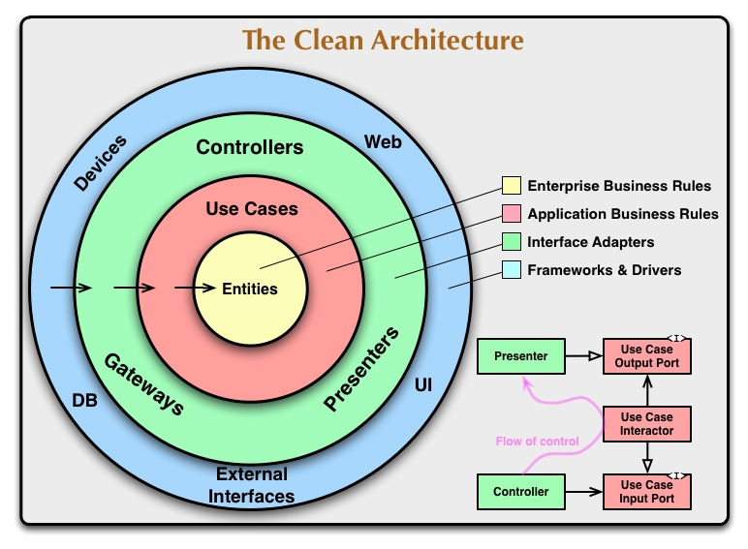
Clean Architecture
4 layers (but allows for more)
Entities
Use Cases
Interfaces and Adapters
Frameworks and Drivers
Dependencies can only point inward
GopherCon 2023
Notes:
CA defines 4 standard layers:
- Entities - core domain, no dependencies
- Use Cases – business logic in terms of the domain
- Interfaces and Adapters – transform data between the internal domain and external systems
- Frameworks and Drivers – integrations with external systems
Can be others but these 4 cover most systems
[advance]
Dependencies can only point inward
Each layer fully insulates the next-inner layer from the rest of the world
Obviously all good concepts. Following these concepts will more than likely lead to better code.

Slide 39
Model, View, *
Focus on building user interfaces
Model
View
Controller/Presenter
Common in web applications
GopherCon 2023
Notes:
Maybe less common in Go but prevalent in the wider software industry
Similar ideas, but focused on building UI
- Model – data types
– View – visual representation of some part of the model
- Controller/Presenter – processes input to update the model then trigger views to re-render
[advance]
Very common in web applications
Again, these are good ideas
The trick is to avoid the GOOOP

Slide 40
Architectural Patterns
clean_gooop/
adapters/
web.go
...
drivers/
database.go
...
entities/
foo.go
bar.go
...
interfaces/
...
usecases/
foo_logic.go
bar_logic.go
...
mvstar_gooop/
controllers/
foo_controller.go
bar_controller.go
...
model/
foo.go
bar.go
...
views/
home.go
foo_edit.go
...
Signs of GOOOP
Packages named for kinds of things that mirror the pattern layers
Types are repeated in each package
Any entity/model change means updating multiple packages
Manageable in isolation, rough for cross-project integration
GopherCon 2023
Notes:
Here we have a couple of examples of projects that applied CA and MVC following the typical OOP examples online
Those of us that came from other languages have seen these structures many times
I even *created* one of these when I first switched to Go. I came from a C# shop where we were doing ASP.NET, which at the time was very much MVC turtles all the way down.
[advance]
Like the other 2 examples, though, they don't feel like idiomatic Go
- packages are named for the kinds of things and mirror the layer names from the pattern
- types are repeated in each package
- entity/model changes require updating multiple packages (sometimes every package)
Manageable enough for 1 project if you came from another language where this is familiar
Rough for cross-project integration
- generic package names mean that consumers will have to alias imports
- the code for a given type is spread across multiple packages

Slide 41
Architectural Patterns
These patterns have stuck around all these years for a reason
Go can be object-oriented to an extent
Accept and apply the wisdom of the past, but do it in Go
GopherCon 2023
Notes:
These architectural patterns are well-known and widely used for a reason, though
The people who defined them are some of our industry "rock stars" and the ideas are all good
[advance]
I known I keep saying that Go isn't really OO, but that means that it can be a little bit OO
[advance]
We only need to accept that existing wisdom without just stamping out the patterns. Apply them *in Go*

Slide 42
Architectural patterns
no_more_gooop/
bar.go
foo.go
cmd/
gooopy/
main.go
internal/
gooopservice/
datastore.go
grpc.go
service.go
web.go
database/
bar.go
db.go
foo.go
...
...
1
Model/Domain in the root package
Other packages are bounded contexts
DataStore interface in goopservice, satisfied by database
main.go bootstraps DB and passes it into the service
4
2
3
2
3
Notes:
This no_more_gooop project still follows the Clean Architecture pattern, just not literally
[advance]
The project's domain is in the root package of the module, so the types are nomoregooop.Foo rather than domain.Foo
[advance]
The other packages represent bounded contexts, which is just a fancy way of drawing a box around some chunk of functionality and adding a label to it
- groups code by functionality, not kind, so packages have better cohesion
- database.User (part of the Frameworks and Drivers layer) and a nomoregooop.User (Domain layer) can exist in the same project without having to munge the names
[advance]
We have collapsed the Interfaces layer into the internal/gooopservice package. Remember, consumers should define interfaces, we don't need to create a dedicated package for them.
We define a local DataStore interface that defines the data layer operations used by the service and is satisfied by the DB implementation in internal/database.
[advance]
Finally, our gooopy application bootstraps things by creating an instance of a database.DB and passing it into gooopservice.NewService() as a dependency
We have built a full project that includes and builds on the wisdom of the past while still being idiomatic Go
We have clean boundaries and well-factored code without a domain or usecases package to be found

Slide 43
S.O.L.I.D.
Five principles that should be applied to produce good, solid code
Typically phrased in OOP terms but can be adjusted to apply to Go
GopherCon 2023
Notes:
Our last bit of GOOOP is maybe the most famous acronym in OOP … SOLID
SOLID calls out five principles that should be applied to produce good code
[advance]
The examples out there are often couched in class-based OO terms
But, like the architectural patterns in the last section, they're still good advice for Gophers, we just need to adjust our thinking a bit

Slide 44
Single responsibility
There should never be more than one reason for a class to change
s/class/package
Avoid package names like base, util, or common – Dave Cheney, Jan 2019
GopherCon 2023
Notes:
First there's the Single Responsibility Principle, which says
There should never be more than one reason for a class to change
[advance]
Go doesn't have classes, so first we replace class with package
[advance]
Then we follow the advice of one of our own Gopher wise ones, Dave Cheney:
Avoid package names like base, util or common
Those packages will inevitably contain more than one thing, violating the SRP

Slide 45
Open/closed
Software entities should be open for extension, but closed for modification
We should be able to add new behavior without rewriting existing code to do so
Consumer-defined interfaces and implicit interface satisfaction
GopherCon 2023
Notes:
The Open/Closed Principle states: Software entities should be open for extension, but closed for modification
[advance]
This one is admittedly a bit vague, but the gist is that we should be able to provide new behavior without needing to modify existing code
[advance]
In Go, consumer-defined interfaces and implicit interface satisfaction make this straightforward
By not pre-declaring and exporting "contract" interfaces, provider code is able to be extended to provide new functionality
Consumers only depend on their own interfaces and so are not disrupted when new methods are added to the provider

Slide 46
Interface segregation
Clients should not be forced to depend on interfaces that they do not use
Consumer-defined interfaces
As narrow as possible, ideally single-method
The bigger the interface, the weaker the abstraction. – the Go Proverbs
Compose narrower interfaces to combine behaviors
GopherCon 2023
Notes:
Next is the Interface Segregation Principle
Clients should not be forced to depend on interfaces that they do not use
[advance]
This one is second nature to most Gophers because this is precisely how much of the standard library is defined.
Interfaces like io.Reader, io.Writer, json.Marshaler are defined by the packages that use them and only have a single method
Always remember the proverbs.
[advance]
When we need larger chunks of behavior, we combine these narrow interfaces. io.ReadWriter is both io.Reader and io.Writer
By defining interfaces this way, any given consumer only depends on the exact behavior it requires.

Slide 47
Liskov substitution
Objects of a superclass should be replaceable by objects of a subclass without affecting the correctness of the program
Consumer-defined interfaces to the rescue once again
Duck typing means consumers don’t need to be coupled to any implementation, not even the "base" one
GopherCon 2023
Notes:
The Liskov Substitution Principle, named for Barbara Liskov for the trivia collectors, says:
Objects of a superclass should be replaceable by objects of a subclass without affecting the correctness of the program
[advance]
Since we don't have classes in Go, we again swap in interfaces
Consumers define interfaces and structs satisfy them implicitly by implementing the appropriate method(s)
[advance]
Because interfaces are satisfied implicitly, the consumer doesn't depend on *any* implementation, not even the "base" one

Slide 48
Dependency inversion
Depend upon abstractions, not concretions
A great rule of thumb for Go is accept interfaces, return structs. – lots of Gophers in various blogs
Define interfaces for input parameters
Return concrete types that can satisfy consumer-defined interfaces
GopherCon 2023
Notes:
And finally, the Dependency Inversion Principle, which is simply this … depend on abstractions, not concretions
Everyone can probably guess what comes next. That's right! Interfaces again
[advance]
Most of us have seen some variation of "accept interfaces, return structs." in Go and it's very good advice
[advance]
By declaring interfaces for our input parameters, we're setting our dependency on the required behavior not any concrete implementation
[advance]
Similarly, by returning instances of structs we allow our consumers to decide which behaviors they require
Structuring things this way minimizes coupling in our code and gives us maximum flexibility.

Slide 49
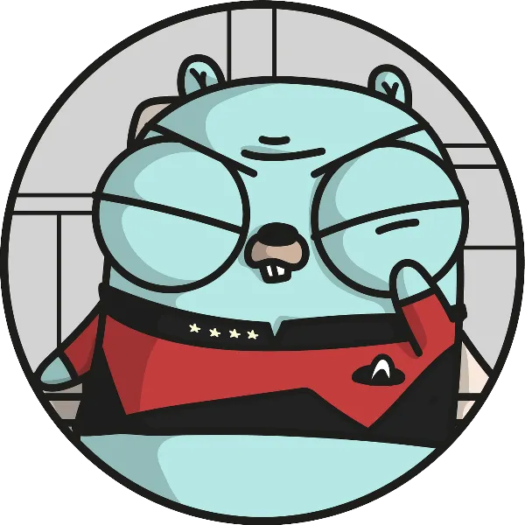
Wrap-UP
Single Responsibility
Open/Closed
Interface Segregation
Liskov Substitution
Dependency Inversion
GopherCon 2023
Notes:
Before I wrap up … who noticed that the last five slides were out of order? I ended up talking about SOILD, which is like SOLID only with more GOOOP

Slide 50
Wrap-up
Go is not really an object-oriented language
OOP concepts can still be used, just not verbatim
Understand the ideas behind those OOP patterns and practices then write idiomatic Go
Clear is better than clever – the Go Proverbs
GopherCon 2023
Notes:
[advance]
Many of us came from other object-oriented languages like C++, Java, C# and Python. Go is a different sort of language though.
As I hope I've shown today, blindly applying those past experiences and using OOP patterns and idioms to our Go can lead to a complex, hard-to-maintain mess
[advance]
We can do better, though. Take the time to learn about *why* those OOP patterns exist and what problems they were meant to solve
The implementations of those patterns in Go can be significantly simpler than in a traditional OO system, they just look a bit different.
One of the hardest parts of learning Go for me was actually un-learning what I'd been doing for almost 18 years. I did it, though, and you can too.
[advance]
Like I mentioned at the start, Go is a practical language where heady abstractions often don't fit well.
Keep things simple, avoid creating GOOOP, and become better Gophers.

