Slide 1
Project Presentation
MATH 4/5530
Jackson Tucker & Dylan Denner
4/6/2021

Slide 2
Introduction
The official poverty rate in 2019 was 10.5 percent
In 2019, 14.4 percent of kids in this country, 10.46 million children, were living in poverty as measured by the official U.S poverty rate.
In 2019, approximately 56.6 million students attended elementary and secondary school in the United States.
Affects of poverty
Affects of educational attainment

Slide 3
Research Questions
What is the relationship between poverty (and its various factors) and educational attainment?
Can this relationship be modeled using publicly available data?

Slide 4
Preliminary Analysis
Gathering data
Cleaning data
Data visualization

Slide 5

American Community Survey
American Community Survey (ACS) data are available from the 1-year ACS since 2005 for geographies of population 65,000 and greater, and from the 5-year ACS for all geographies down to the block group level starting with the 2005-2009 dataset.
ACS data differ from decennial Census data as they are based on an annual sample of approximately 3 million households, rather than a more complete enumeration of the US population. In turn, ACS data points are estimates characterized by a margin of error. tidycensus will always return the estimate and margin of error

Slide 6
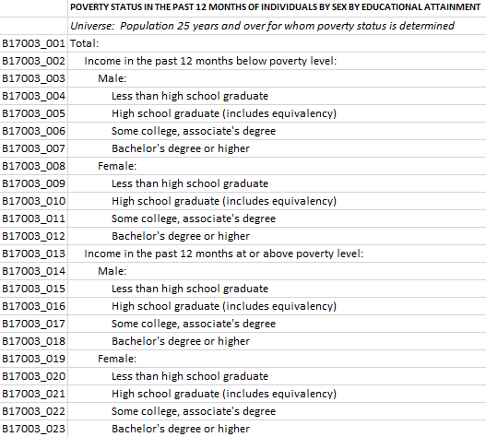
Gathering Data
library(tidycensus) poverty_by_sex_edu_attainment <- get_acs( geography = "school district (unified)", variables = c(total_population = "B17003_001", below_poverty_num = "B17003_002", below_poverty_num_men = "B17003_003", M_below_poverty_less_than_HS = "B17003_004", M_below_poverty_HS = "B17003_005", M_below_poverty_some_college = "B17003_006", M_below_poverty_bachelor_plus = "B17003_007", below_poverty_num_women = "B17003_008", W_below_poverty_less_than_HS = "B17003_009", W_below_poverty_HS = "B17003_010", W_below_poverty_some_college = "B17003_011", W_below_poverty_bachelor_plus = "B17003_012", above_poverty_num = "B17003_013", above_poverty_num_men = "B17003_014", M_above_poverty_less_than_HS = "B17003_015", M_above_poverty_HS = "B17003_016", M_above_poverty_some_college = "B17003_017", M_above_poverty_bachelor_plus = "B17003_018", above_poverty_num_women = "B17003_019", W_above_poverty_less_than_HS = "B17003_020", W_above_poverty_HS = "B17003_021", W_above_poverty_some_college = "B17003_022", W_above_poverty_bachelor_plus = "B17003_023"), state = "OH", year = 2019)

Slide 7
14,099 rows, 5 columns
613 unique school districts
GEOID | NAME | variable | estimate | moe
3900094 | Monroe Local School District, Ohio | total_population | 9268 | 352
3900094 | Monroe Local School District, Ohio | below_poverty_num | 230 | 133
3900094 | Monroe Local School District, Ohio | below_poverty_num_men | 60 | 69
3900094 | Monroe Local School District, Ohio | M_below_poverty_less_than_HS | 10 | 15
3900094 | Monroe Local School District, Ohio | M_below_poverty_HS | 50 | 67
3900094 | Monroe Local School District, Ohio | M_below_poverty_some_college | 0 | 18

Slide 8
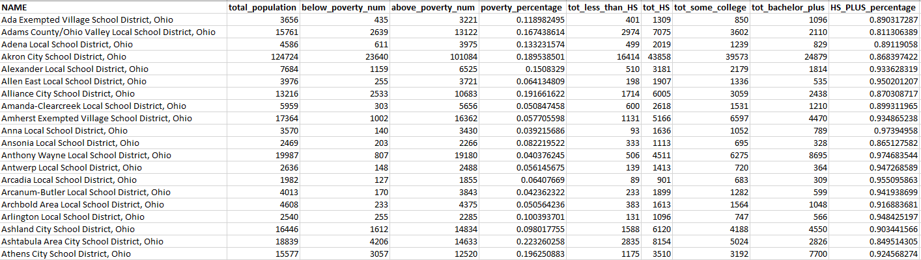
More processing…
613 Rows, 10 columns

Slide 9
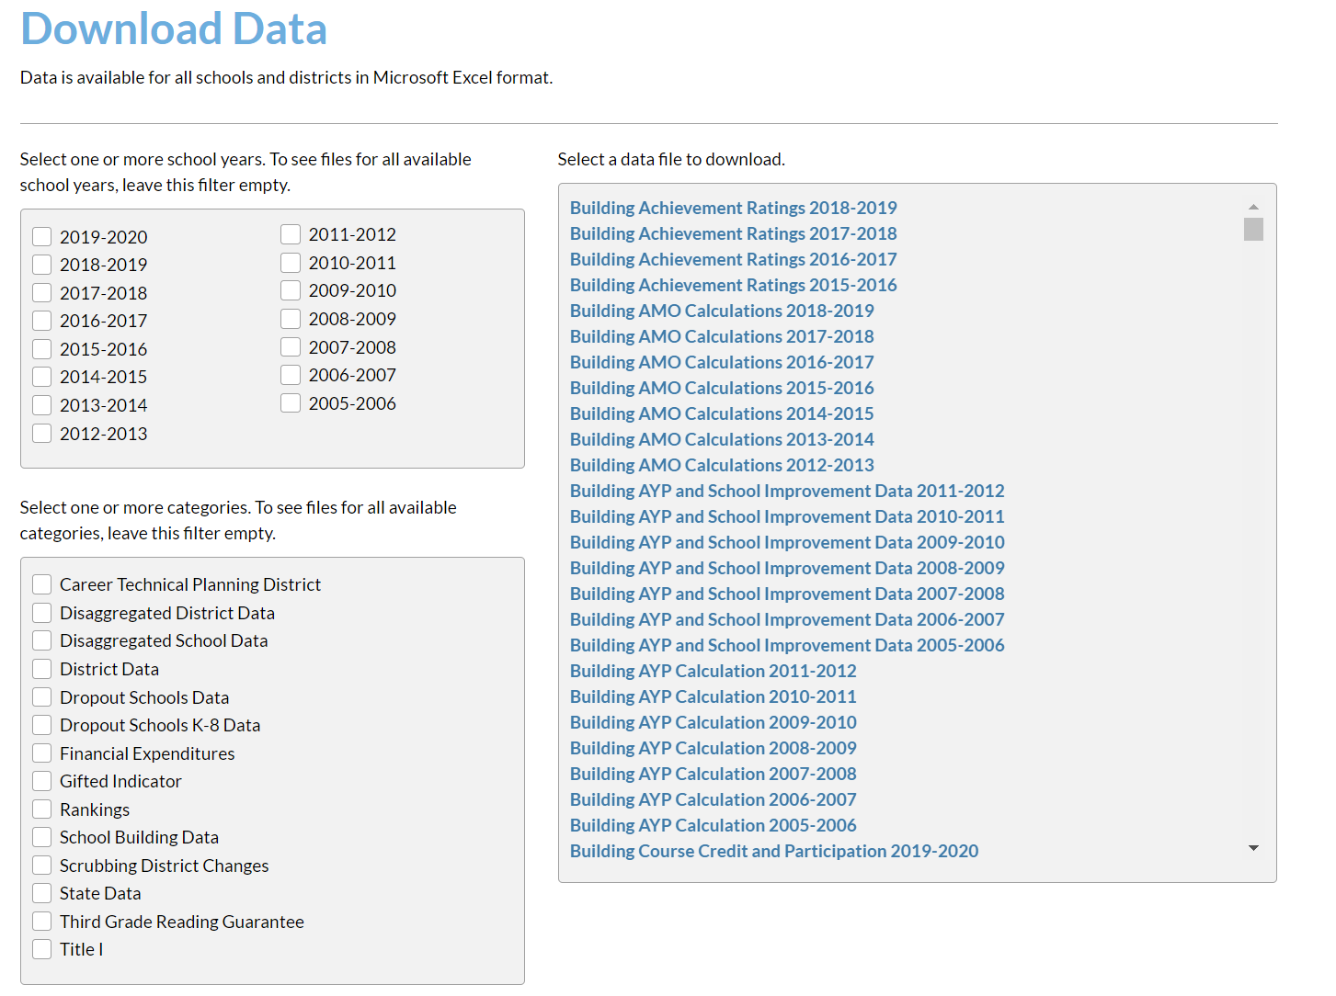

Slide 10
Ohio School Data
overview_data <- select( overview_data, "Building IRN", "Building Name", "District Name", "County", "Region", "Enrollment 2018-2019", "Attendance Rate 2018-2019", "Chronic Absenteeism Percent 2018-2019" )
discipline_data <- select( discipline_data, "Building IRN", "Students Disciplined - Expulsions", "Students Disciplined - Out-of-School Suspensions", "Students Disciplined - In-School Suspensions" )
3,389 Rows (unique school buildings in Ohio)

Slide 11
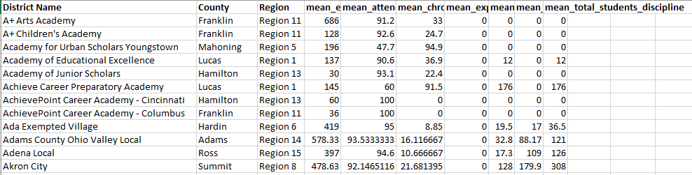
joined_df <- left_join(overview_data, discipline_data, by = "Building IRN")
grouped_df <- joined_df %>% group_by(`District Name`, County, Region) %>% summarise(mean_enrollment = mean(`Enrollment 2018-2019`, na.rm = TRUE), mean_attendence = mean(`Attendance Rate 2018-2019`, na.rm = TRUE), mean_chronic_absenteesim = mean(`Chronic Absenteeism Percent 2018-2019`, na.rm = TRUE), mean_expulsions = mean(`Students Disciplined - Expulsions`, na.rm = TRUE), mean_out_of_school_suspensions = mean(`Students Disciplined - Out-of-School Suspensions`, na.rm = TRUE), mean_in_school_suspensions = mean(`Students Disciplined - In-School Suspensions`, na.rm = TRUE), mean_total_students_discipline = mean(`total_students_discipline`, na.rm = TRUE))
934 Rows

Slide 12
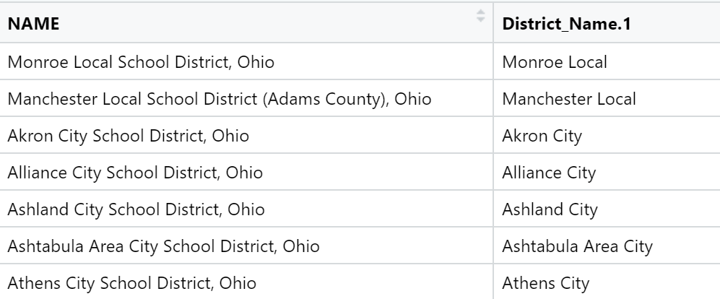
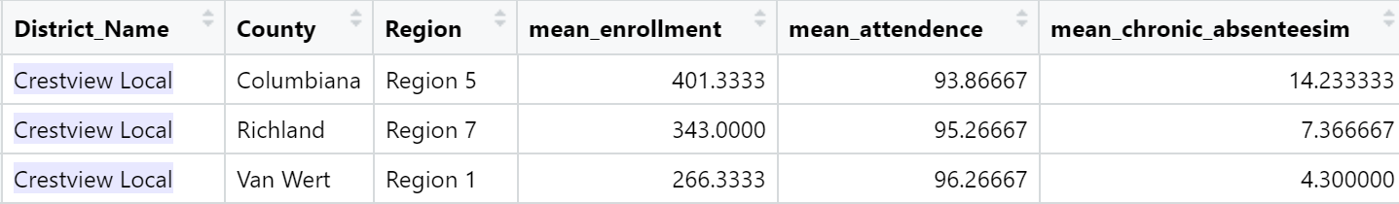
Two Problems

Slide 13
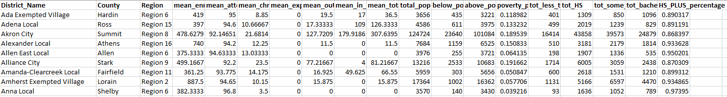
Model Data
595 unique school districts

Slide 14
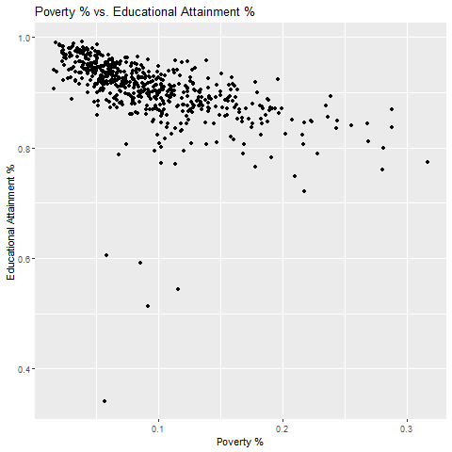
Preliminary Analysis

Slide 15
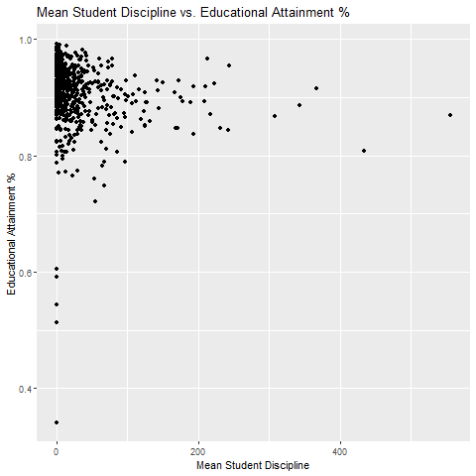
Preliminary Analysis

Slide 16
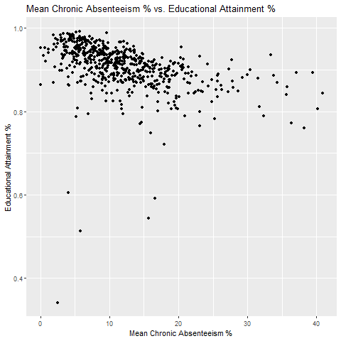
Preliminary Analysis

Slide 17
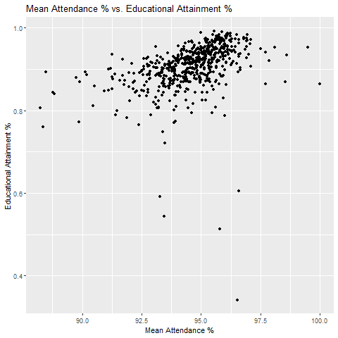
Preliminary Analysis

Slide 18
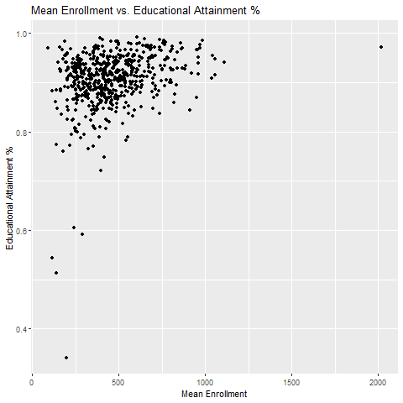
Preliminary Analysis

Slide 19
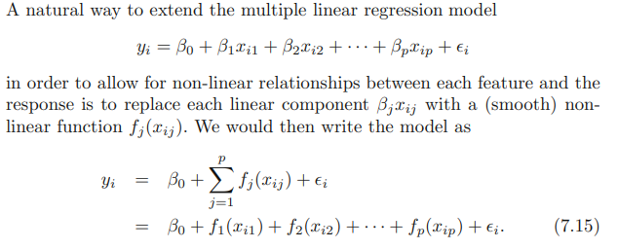
Generalized Additive Models
gam_model_1 <- gam(HS_PLUS_percentage ~ s(poverty_percentage) + s(mean_chronic_absenteeism) + s(mean_attendance) + s(mean_enrollment) + s(mean_total_students_discipline), data = mod_model_data)

Slide 20
Generalized Additive Models
summary(gam_model_1)
## ## Family: gaussian ## Link function: identity ## ## Formula: ## HS_PLUS_percentage ~ s(poverty_percentage) + s(mean_chronic_absenteeism) + ## s(mean_attendance) + s(mean_enrollment) + s(mean_total_students_discipline) ## ## Parametric coefficients: ## Estimate Std. Error t value Pr(>|t|) ## (Intercept) -0.0688202 0.0006799 -101.2 <2e-16 *** ## --- ## Signif. codes: 0 '***' 0.001 '**' 0.01 '*' 0.05 '.' 0.1 ' ' 1 ## ## Approximate significance of smooth terms: ## edf Ref.df F p-value ## s(poverty_percentage) 5.721 6.889 34.294 <2e-16 *** ## s(mean_chronic_absenteeism) 2.773 3.463 2.880 0.0309 * ## s(mean_attendance) 2.605 3.329 1.779 0.2807 ## s(mean_enrollment) 4.177 5.096 10.318 <2e-16 *** ## s(mean_total_students_discipline) 1.636 2.042 0.482 0.6517 ## --- ## Signif. codes: 0 '***' 0.001 '**' 0.01 '*' 0.05 '.' 0.1 ' ' 1 ## ## R-sq.(adj) = 0.614 Deviance explained = 62.5% ## GCV = 0.00028129 Scale est. = 0.00027275 n = 590

Slide 21
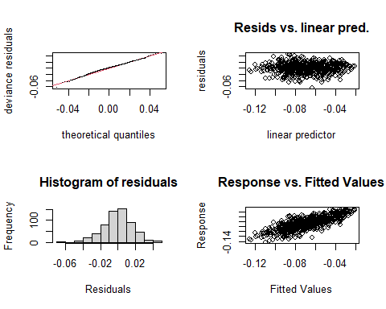
Generalized Additive Models
gam.check(gam_model_1)
## Method: GCV Optimizer: magic ## Smoothing parameter selection converged after 4 iterations. ## The RMS GCV score gradient at convergence was 1.215713e-07 . ## The Hessian was not positive definite. ## Model rank = 46 / 46 ## ## Basis dimension (k) checking results. Low p-value (k-index<1) may ## indicate that k is too low, especially if edf is close to k'. ## ## k' edf k-index p-value ## s(poverty_percentage) 9.00 5.72 1.01 0.57 ## s(mean_chronic_absenteeism) 9.00 2.77 0.98 0.34 ## s(mean_attendance) 9.00 2.61 1.01 0.58 ## s(mean_enrollment) 9.00 4.18 1.02 0.72 ## s(mean_total_students_discipline) 9.00 1.64 1.01 0.60

Slide 22
Generalized Additive Models
gam_model_2 <- gam(HS_PLUS_percentage ~ s(poverty_percentage) + s(mean_chronic_absenteeism) + s(mean_attendance) + s(mean_enrollment), data = mod_model_data)
summary(gam_model_2)
## Parametric coefficients: ## Estimate Std. Error t value Pr(>|t|) ## (Intercept) -0.06882 0.00068 -101.2 <2e-16 *** ## --- ## Signif. codes: 0 '***' 0.001 '**' 0.01 '*' 0.05 '.' 0.1 ' ' 1 ## ## Approximate significance of smooth terms: ## edf Ref.df F p-value ## s(poverty_percentage) 5.201 6.343 38.020 <2e-16 *** ## s(mean_chronic_absenteeism) 2.734 3.415 2.966 0.0277 * ## s(mean_attendance) 2.732 3.490 1.965 0.2467 ## s(mean_enrollment) 4.242 5.169 11.210 <2e-16 *** ## --- ## Signif. codes: 0 '***' 0.001 '**' 0.01 '*' 0.05 '.' 0.1 ' ' 1 ## ## R-sq.(adj) = 0.613 Deviance explained = 62.3% ## GCV = 0.00028041 Scale est. = 0.00027284 n = 590

Slide 23
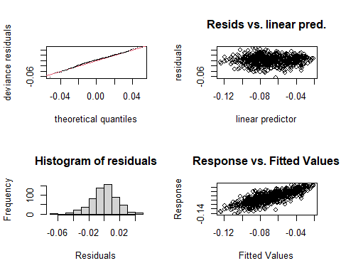
Generalized Additive Models
gam.check(gam_model_1)
## Method: GCV Optimizer: magic ## Smoothing parameter selection converged after 4 iterations. ## The RMS GCV score gradient at convergence was 3.410101e-09 . ## The Hessian was positive definite. ## Model rank = 37 / 37 ## ## Basis dimension (k) checking results. Low p-value (k-index<1) may ## indicate that k is too low, especially if edf is close to k'. ## ## k' edf k-index p-value ## s(poverty_percentage) 9.00 5.20 1.00 0.50 ## s(mean_chronic_absenteeism) 9.00 2.73 0.98 0.25 ## s(mean_attendance) 9.00 2.73 1.01 0.57 ## s(mean_enrollment) 9.00 4.24 1.02 0.70

Slide 24
Generalized Additive Models
gam_model_3 <- gam(HS_PLUS_percentage ~ s(poverty_percentage) + s(mean_chronic_absenteeism) + s(mean_enrollment) + s(mean_total_students_discipline), data = mod_model_data)
summary(gam_model_3)
## ## Family: gaussian ## Link function: identity ## ## Formula: ## HS_PLUS_percentage ~ s(poverty_percentage) + s(mean_chronic_absenteeism) + ## s(mean_enrollment) + s(mean_total_students_discipline) ## ## Parametric coefficients: ## Estimate Std. Error t value Pr(>|t|) ## (Intercept) -0.0688202 0.0006834 -100.7 <2e-16 *** ## --- ## Signif. codes: 0 '***' 0.001 '**' 0.01 '*' 0.05 '.' 0.1 ' ' 1 ## ## Approximate significance of smooth terms: ## edf Ref.df F p-value ## s(poverty_percentage) 5.067 6.195 38.738 <2e-16 *** ## s(mean_chronic_absenteeism) 2.381 3.026 7.144 0.0001 *** ## s(mean_enrollment) 4.143 5.058 10.786 <2e-16 *** ## s(mean_total_students_discipline) 2.153 2.710 0.977 0.4911 ## --- ## Signif. codes: 0 '***' 0.001 '**' 0.01 '*' 0.05 '.' 0.1 ' ' 1 ## ## R-sq.(adj) = 0.61 Deviance explained = 61.9% ## GCV = 0.00028262 Scale est. = 0.00027556 n = 590

Slide 25
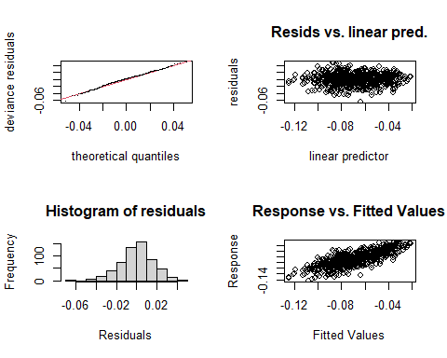
Generalized Additive Models
## Method: GCV Optimizer: magic ## Smoothing parameter selection converged after 4 iterations. ## The RMS GCV score gradient at convergence was 9.066325e-08 . ## The Hessian was positive definite. ## Model rank = 37 / 37 ## ## Basis dimension (k) checking results. Low p-value (k-index<1) may ## indicate that k is too low, especially if edf is close to k'. ## ## k' edf k-index p-value ## s(poverty_percentage) 9.00 5.07 1.00 0.48 ## s(mean_chronic_absenteeism) 9.00 2.38 0.98 0.34 ## s(mean_enrollment) 9.00 4.14 1.03 0.70 ## s(mean_total_students_discipline) 9.00 2.15 1.01 0.57

Slide 26
anova(gam_model_1, gam_model_2, gam_model_3, test = "F")
## Analysis of Deviance Table ## ## Model 1: HS_PLUS_percentage ~ s(poverty_percentage) + s(mean_chronic_absenteeism) + ## s(mean_attendance) + s(mean_enrollment) + s(mean_total_students_discipline) ## Model 2: HS_PLUS_percentage ~ s(poverty_percentage) + s(mean_chronic_absenteeism) + ## s(mean_attendance) + s(mean_enrollment) ## Model 3: HS_PLUS_percentage ~ s(poverty_percentage) + s(mean_chronic_absenteeism) + ## s(mean_enrollment) + s(mean_total_students_discipline) ## Resid. Df Resid. Dev Df Deviance F Pr(>F) ## 1 568.18 0.15604 ## 2 570.58 0.15664 -2.4015 -0.00060156 0.9184 0.41447 ## 3 572.01 0.15852 -1.4273 -0.00187929 4.8273 0.01682 * ## --- ## Signif. codes: 0 '***' 0.001 '**' 0.01 '*' 0.05 '.' 0.1 ' ' 1

Slide 27
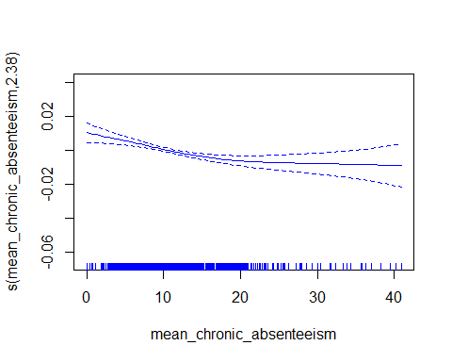
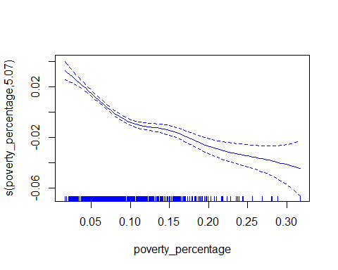
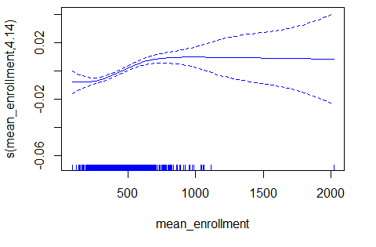
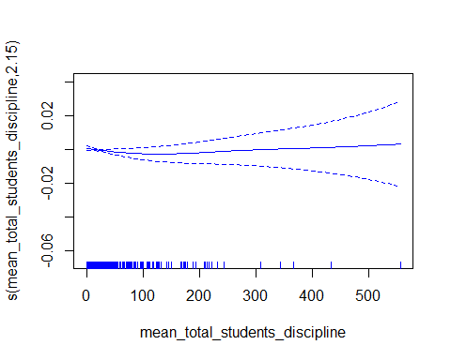
plot(gam_model_3, se=TRUE, col="blue")

