Slide 1
MATH 5530 Presentation
Jackson Tucker & Dylan Denner

Slide 2
Introduction
…

Slide 3
Research Questions
..
…
…

Slide 4
Preliminary Analysis
Pulling data
Census Data
Ohio Data
## ## Attaching package: 'dplyr'
## The following objects are masked from 'package:stats': ## ## filter, lag
## The following objects are masked from 'package:base': ## ## intersect, setdiff, setequal, union
## -- Attaching packages --------------------------------------- tidyverse 1.3.0 --
## v ggplot2 3.3.3 v purrr 0.3.4 ## v tibble 3.0.5 v stringr 1.4.0 ## v tidyr 1.1.3 v forcats 0.5.1 ## v readr 1.4.0
## -- Conflicts ------------------------------------------ tidyverse_conflicts() -- ## x dplyr::filter() masks stats::filter() ## x dplyr::lag() masks stats::lag()
## Getting data from the 2015-2019 5-year ACS

Slide 5
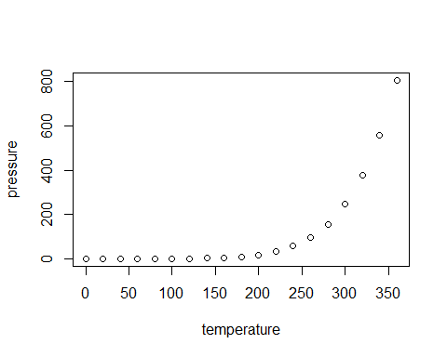
In-depth Analysis

Slide 6
Conclusions and Future Work

Slide 7
Data and Code

