Slide 1
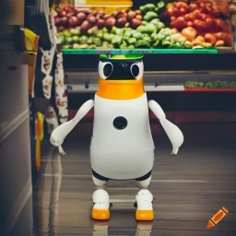
ECE4078 Intelligent robotics
AI art generated by https://www.craiyon.com/
(prompt: “a penguin robot shopping for fruits and vegetables in a supermarket”)
Lab 2-1: Wheel and Camera Calibration

Slide 2
ECE4078 Intelligent robotics
Week | Objectives | Milestones
2: M1-1 | Introduction and setup
3: M2-1 | Calibration, ARUCO markers | M1 due
4: M2-2 | SLAM
5: M2-3 | SLAM
6: M3-1 | Object recognition & localisation | M2 due
7: M3-2 | Object recognition & localisation
8: M4-1 | Navigation & Planning | M3 due
9: M4-2 | Navigation & Planning
10: M5-1 | Integration | M4 due
11: Final | Improvement | M5 due
12: Final | Final demo & competition | Final demo
*
From this week you will be working as teams.
Each team will adopt a PenguinPi for the rest of the semester. Please treat it well.

Slide 3
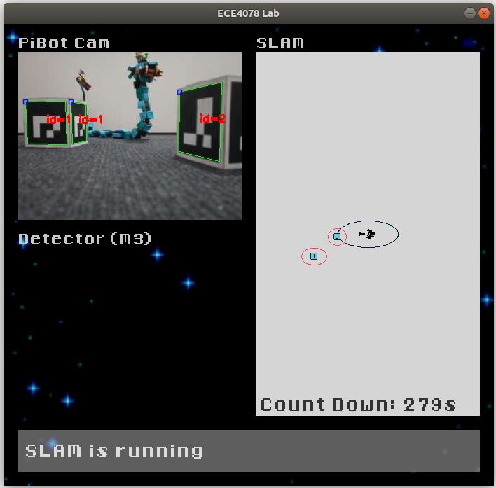
Milestone 2: SLAM
PenguinPi is at the supermarket.
It can read the aisle labels if it sees them, it also remembers how its wheels has moved.
How would it know where itself is and where those aisles are while wondering around?
M2 is all about SLAM, in which the robot uses information from its motion model and camera inputs to estimate the position of all 10 aisle labels (ARUCO markers) in a supermarket (3m x 3m arena), in which it started at (x,y,theta) = (0,0,0)
You will need to install a few additional Python packages. Please read the README.md carefully
Live demo marking wk6 (will talk more in wk5): see M2_marking_instructions.md

Slide 4

M2 – Wheel Calibration
Task 1: Wheel calibration (Week 3)
- Objective is to calculate the wheel radius r and the distance between both wheels L
- You will need to modify “wheel_calibration.py”
- Using the motion equations from the lectures
$\dot{x}=rω \dot{θ}=\frac{r}{L}\left(ω_{r}−ω_{l}\right)$
- Figure out how to estimate $r$ and $L$ by driving forwards and spinning on the spot
- The wheel radius is saved in “scale.txt”, wheel distance in “baseline.txt”, under “calibration/param/”

Slide 5
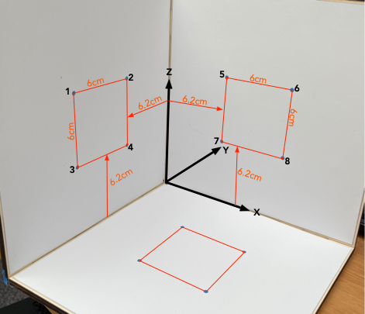

M2 – Camera Calibration
Task 2: Camera calibration (Week 3)
- Objective is to calculate the intrinsic parameters of the camera
(you’ll learn more about this in M3 / Week 5 workshop)
$$\left[\begin{matrix}F_{x} & 0 & u_{0} \\ 0 & F_{y} & v_{0} \\ 0 & 0 & 1\end{matrix}\right]$$
- Modify “calib_pic.py” based on your M1 to move the robot
Then run “calib_pic.py” to take a picture of the calibration rig
- Using the “camera_calibration.py” script, calibrate the camera
(Make sure you click the dots in the correct order)
no need to modify “camera_calibration.py”
- Your results are saved in “intrinsic.txt”

Slide 6
M2 – SLAM (Week 4&5)
Task 3: SLAM (Week 4 & 5)
- Estimate the position of the robot and ARUCO markers in the environment using a Kalman filter
- You’ll need to modify “robot.py” and “ekf.py” under the “slam” folder
- When running “operate.py”, press ENTER to start slam and press S to save the map (predicted marker positions) as “slam.txt“ under a “lab_output” folder
- Will talk about this more next week
- Also check out the additional contents in Lab2_additional_contents.pptx

Slide 7
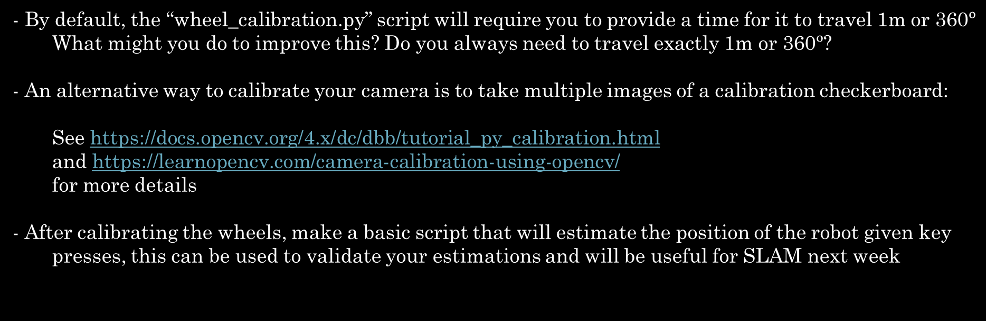
Additional recommendations (optional)
- By default, the “wheel_calibration.py” script will require you to provide a time for it to travel 1m or $\text{360}ᵒ$ What might you do to improve this? Do you always need to travel exactly 1m or $\text{360}ᵒ$?
- An alternative way to calibrate your camera is to take multiple images of a calibration checkerboard:
See https://docs.opencv.org/4.x/dc/dbb/tutorial_py_calibration.html
and https://learnopencv.com/camera-calibration-using-opencv/
for more details
- After calibrating the wheels, make a basic script that will estimate the position of the robot given key presses, this can be used to validate your estimations and will be useful for SLAM next week

Slide 8
M1 marking
You don’t need to be marked again if you have been marked last week already
Check out the bottom of README.md under the Week01-02 folder for the marking procedure
Step 1: (BEFORE coming to the lab)
Submit a zipped folder containing:
Necessary files to run your solution (operate.py, util/, pics/, don’t include your Python venv)
A text file of commands / self notes for easy copying and pasting (optional)
Step 2: (BEFORE the demonstrator comes to mark you)
- Close all folders / applications / windows
- Log into Moodle navigate to the M1 submission box
- Make an empty folder called “LiveDemo” in your home directory ( ~/LiveDemo/ )
Step 3: (DURING the marking period)
- Download your submission from Moodle into the LiveDemo folder and extract the contents
- Connect to the robot via WiFi
- Activate your python venv by typing “PenguinPi/Scripts/activate” in your terminal
- Navigate into the unzipped submission “cd LiveDemo/Week01-02/” in your terminal
- When the demonstrator says it’s fine to start you may run your solution by typing “python operate.py --ip 192.168.50.1 --port 8080” in your terminal

