Slide 1
CS 544
Final Project
Foundation of Analytics
_{Adults Census Income}
_{Tzupin Kuo}
_{U36-17-2777}

Slide 2
Introduction
Introduction – Adults Census Income
Topic:
An individual’s annual income results from various factors. Intuitively, it is influenced by the individual’s education level, age, gender, occupation, and etc.
Source From:
https://www.kaggle.com/uciml/adult-census-income
Acknowledgement:
This data was extracted from the 1994 Census bureau database by Ronny Kohavi and Barry Becker (UCI machine learning repository)

Slide 3
Adults Income
Introduction
15 Attributes
Continuous -
age, fnlwgt(final weight), educational_num, capital.gain, capital.loss, hours.per.week
Categorical -
occupation, relationship, race, gender, native.country,
workclass, education, marital.status
Class -
Income (1. >50K 2. <=50K)

Slide 4
Imputing the missing values
The missing values contribute much to this attribute workclass
Imputing the missing values makes the attribute occupation biased towards the upper end

Slide 5
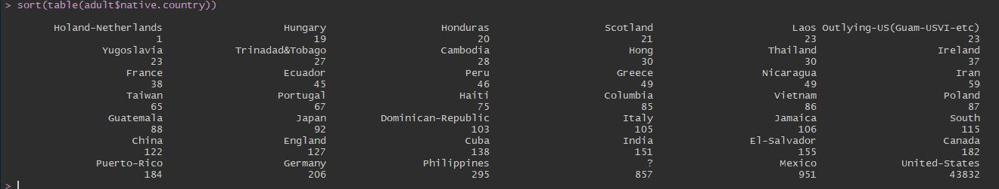
Imputing the missing values
native.country has the third maximum and lower end is much low compared to missing values

Slide 6
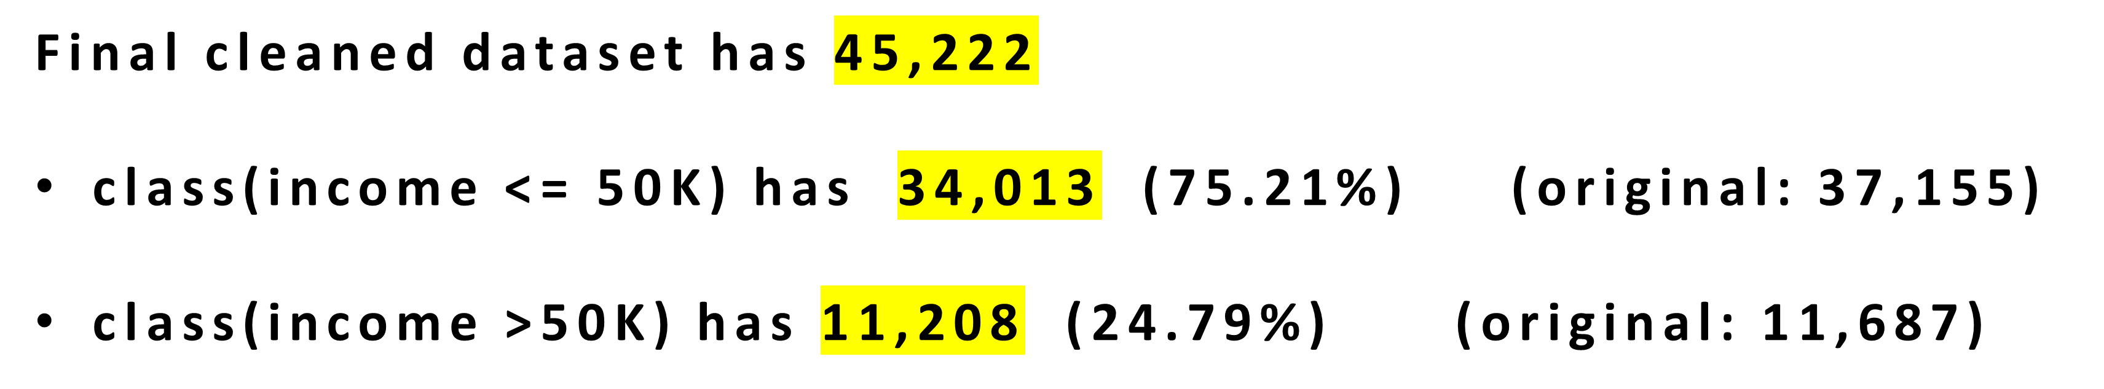
Removing the missing values
Because we found out that imputing missing values is not the best option, we need to remove the rows of data of those missing values.

Slide 7
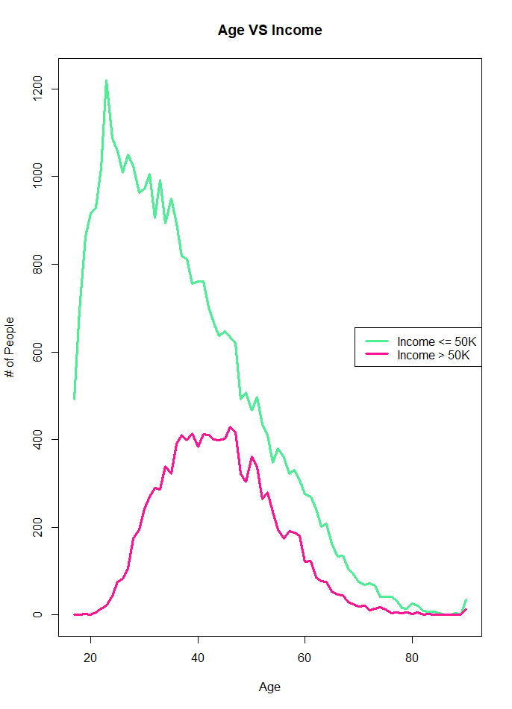
Analysis – Age vs Income
Age ranges from 17 - 90

Slide 8
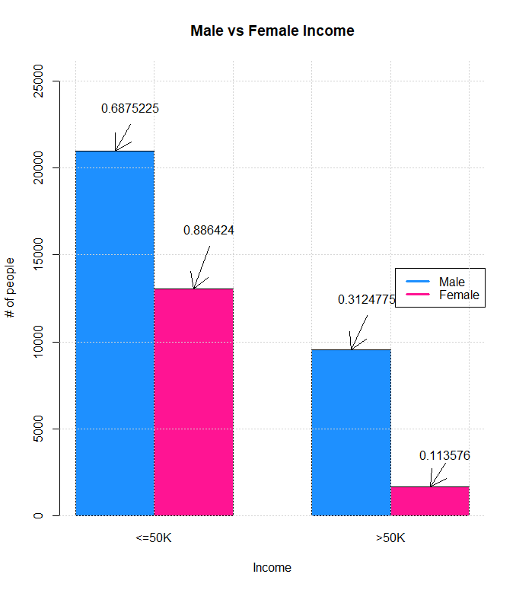
Analysis – Gender vs Income
Male
<= 50 K : 20,988
> 50 K : 9,539
Female
<= 50 K : 13,026
> 50 K : 1,669

Slide 9
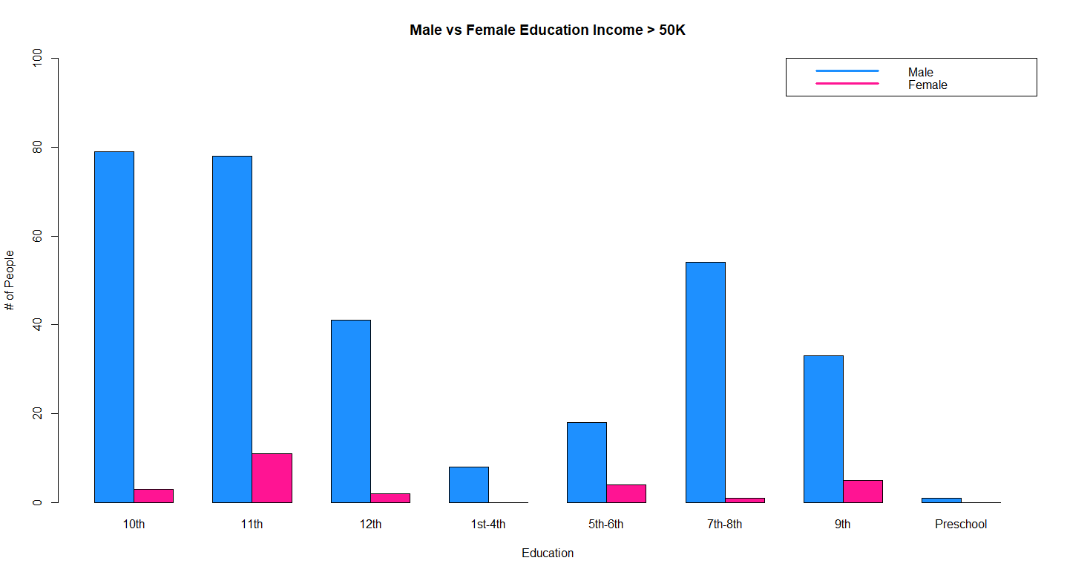
Analysis – Education vs Income

Slide 10
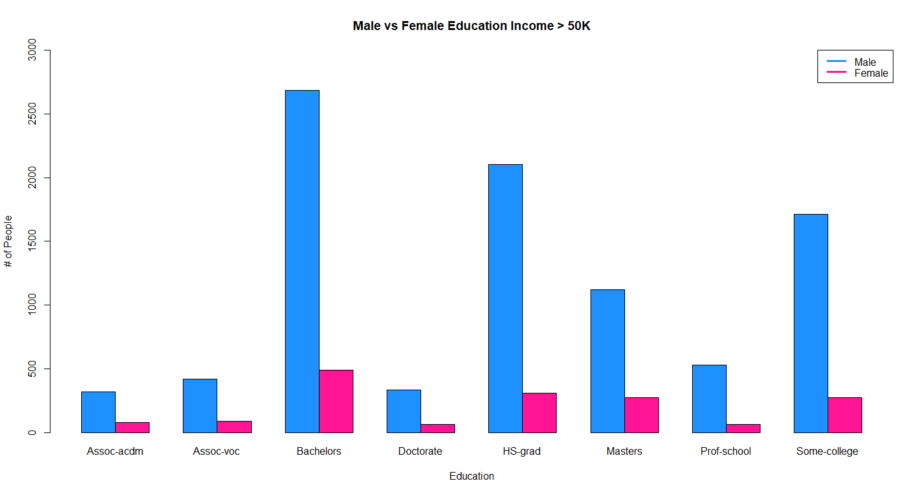
Analysis – Education vs Income

Slide 11
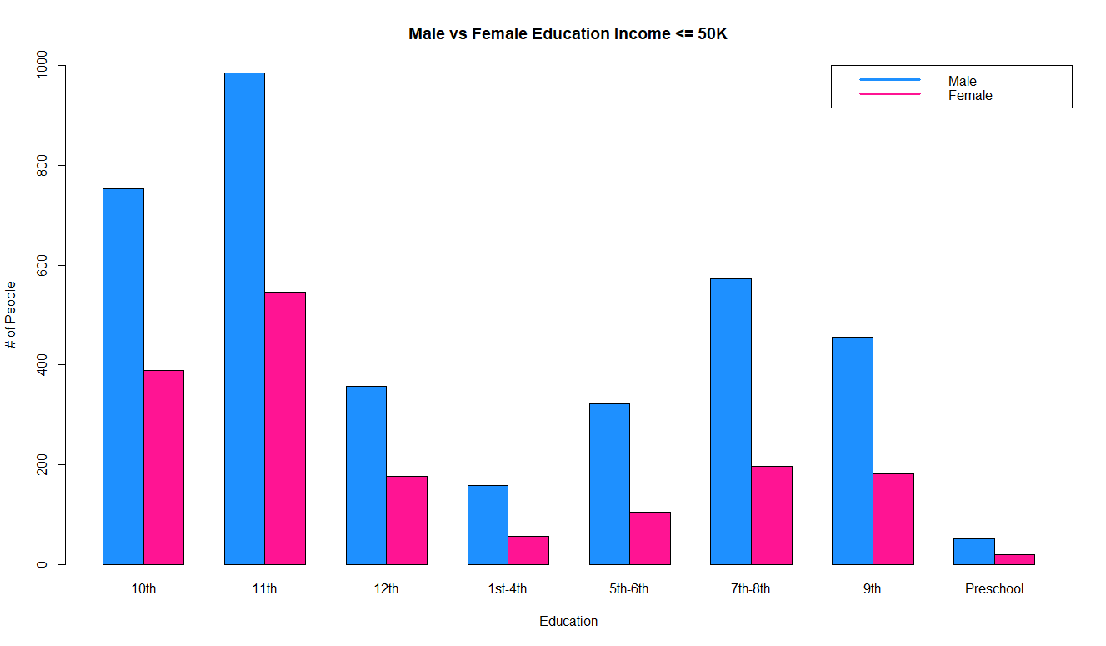
Analysis – Education vs Income

Slide 12
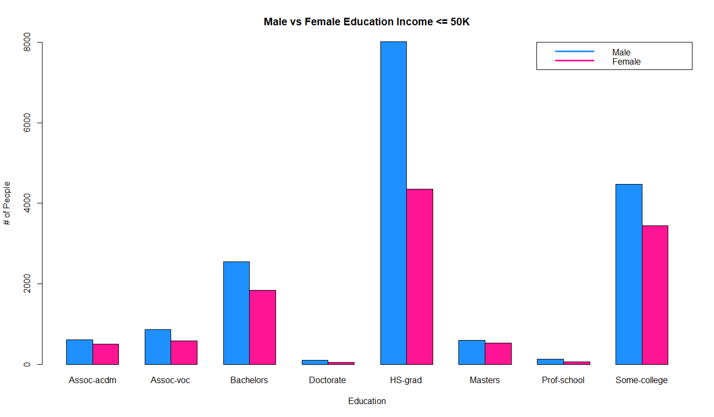
Analysis – Education vs Income

Slide 13
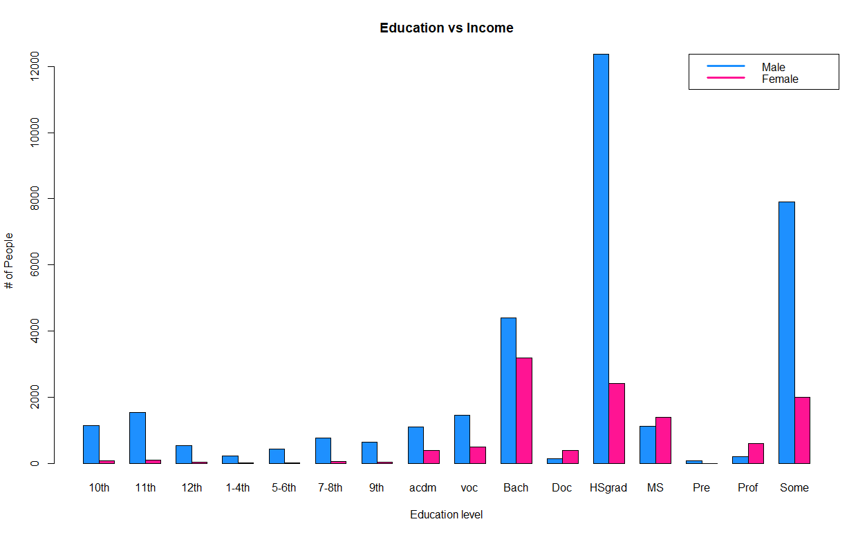
Analysis – Education vs Income

Slide 14
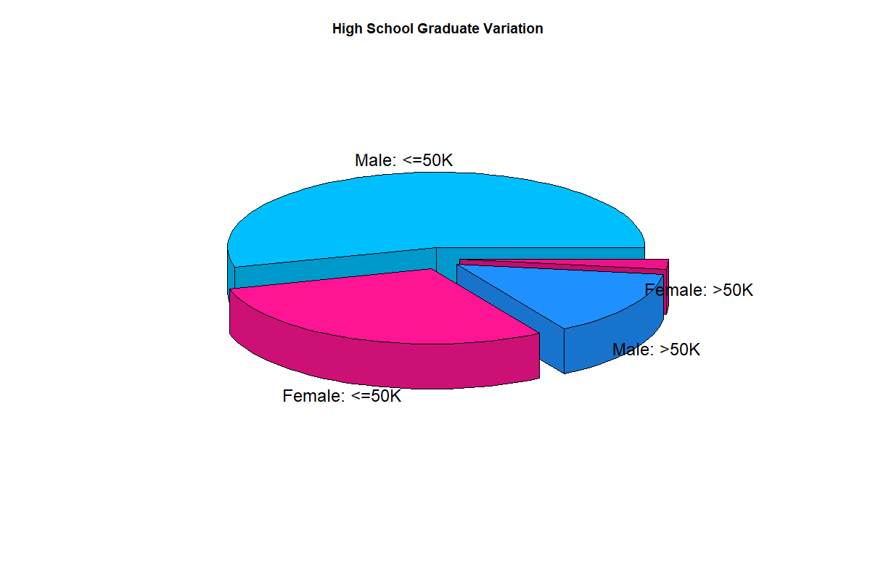
Analysis – Education vs Income
High School Graduate Variation Analysis

Slide 15
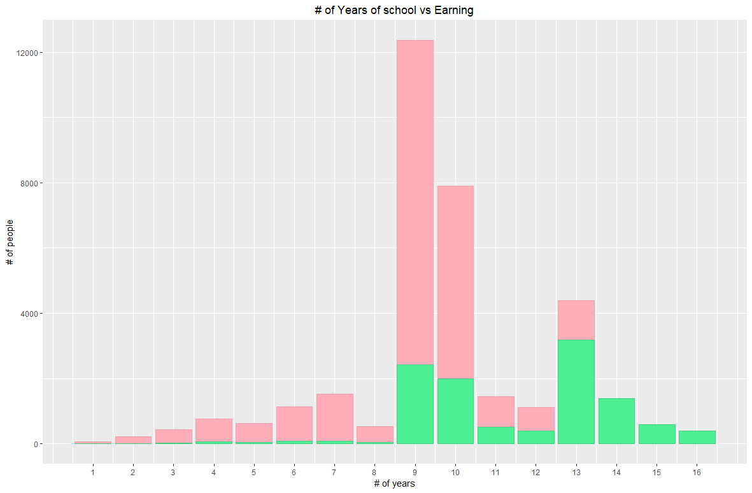
Analysis – Years of Education vs Income
Green : Income >50K
Red: Income <=50K

Slide 16
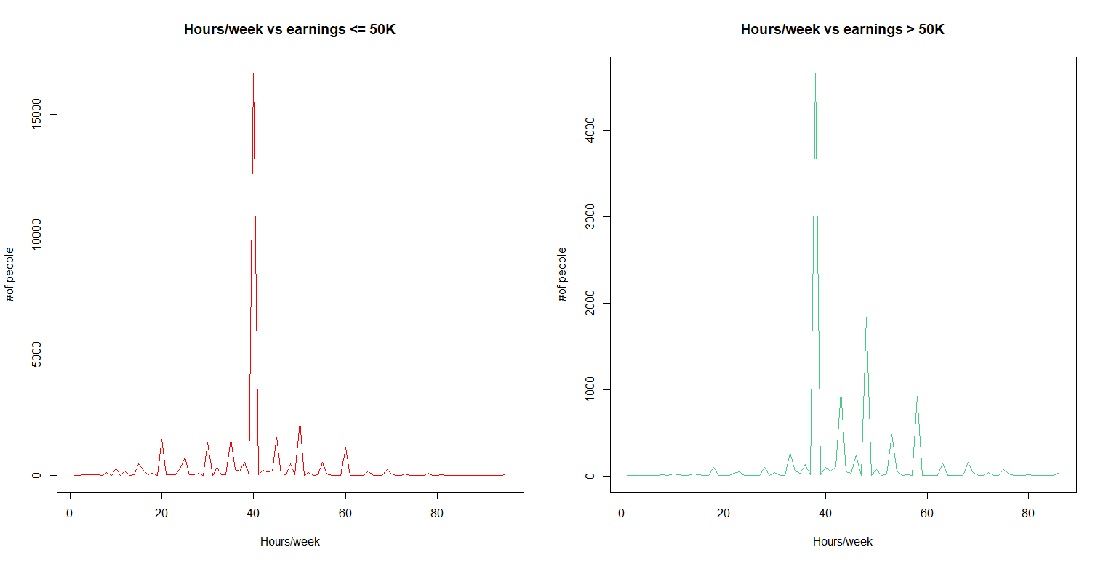
Analysis – Hours/Week vs Income

Slide 17
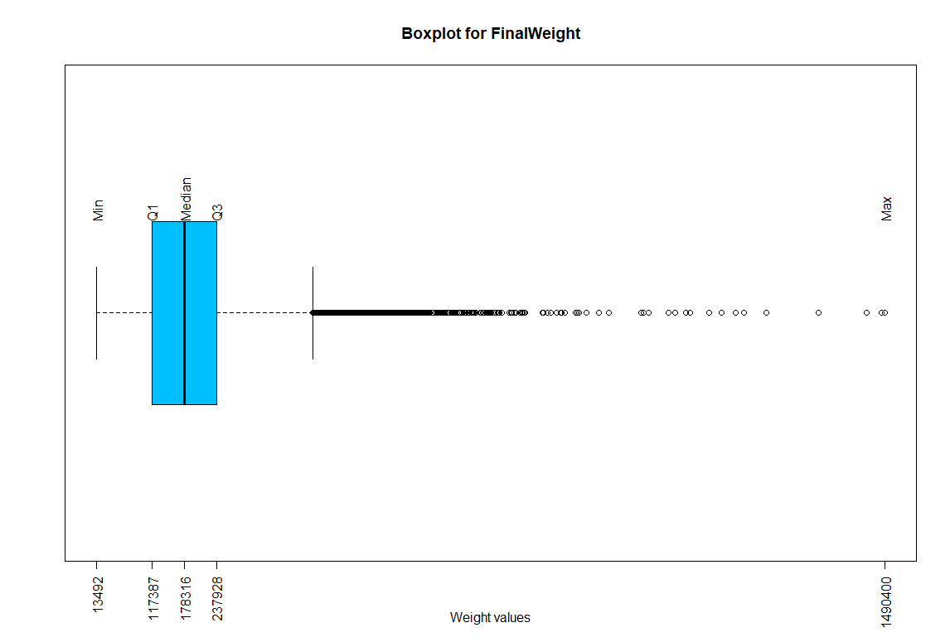
Analysis – Final Weights
Main predictor of the class
Most values are in the lower end
Need to split the set into upper/lower

Slide 18
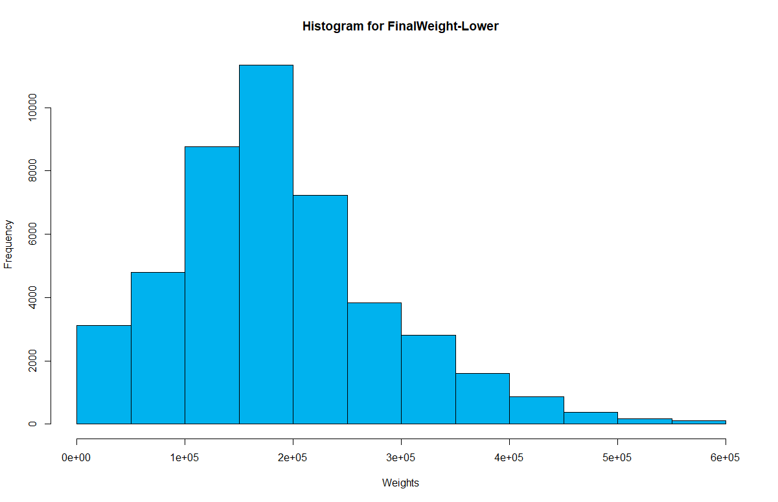
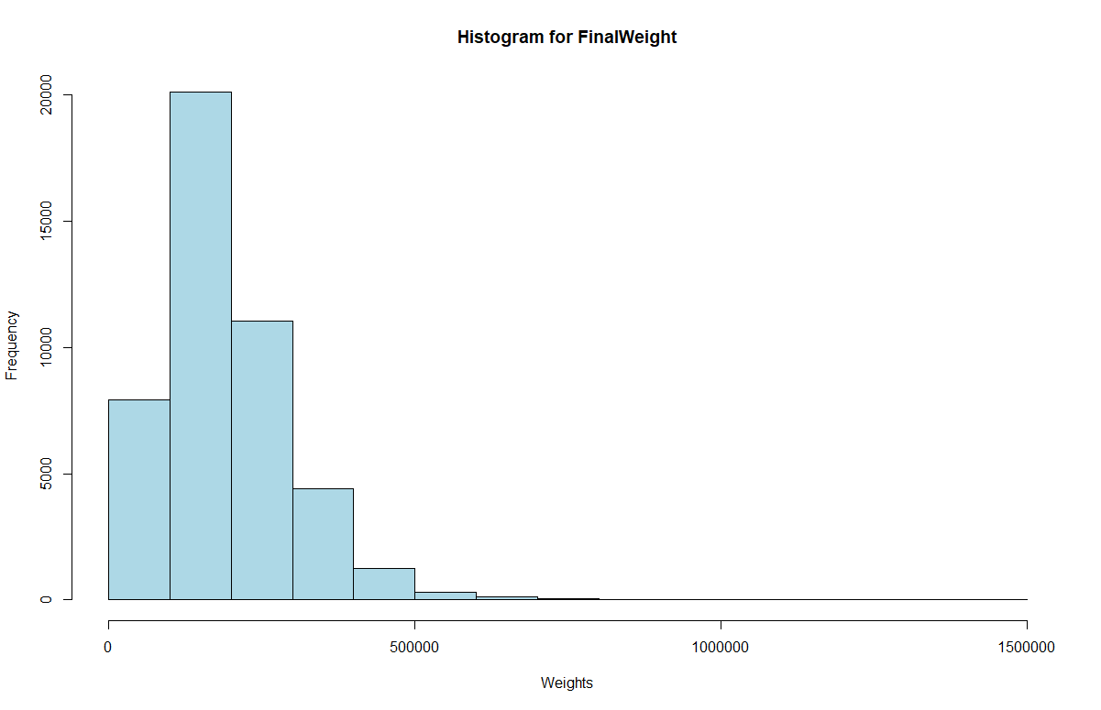
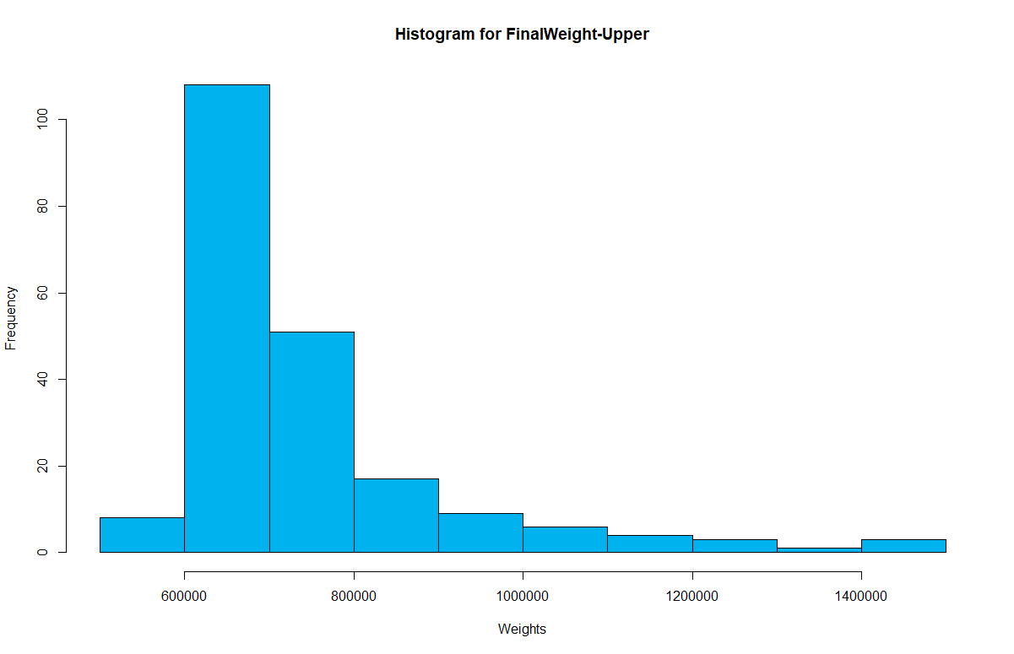
Analysis – Final Weights
<= 0.4*(max(adult$fnlwgt))
Distribution of the values in this attribute is wide-spread
> 0.4*(max(adult$fnlwgt))

Slide 19
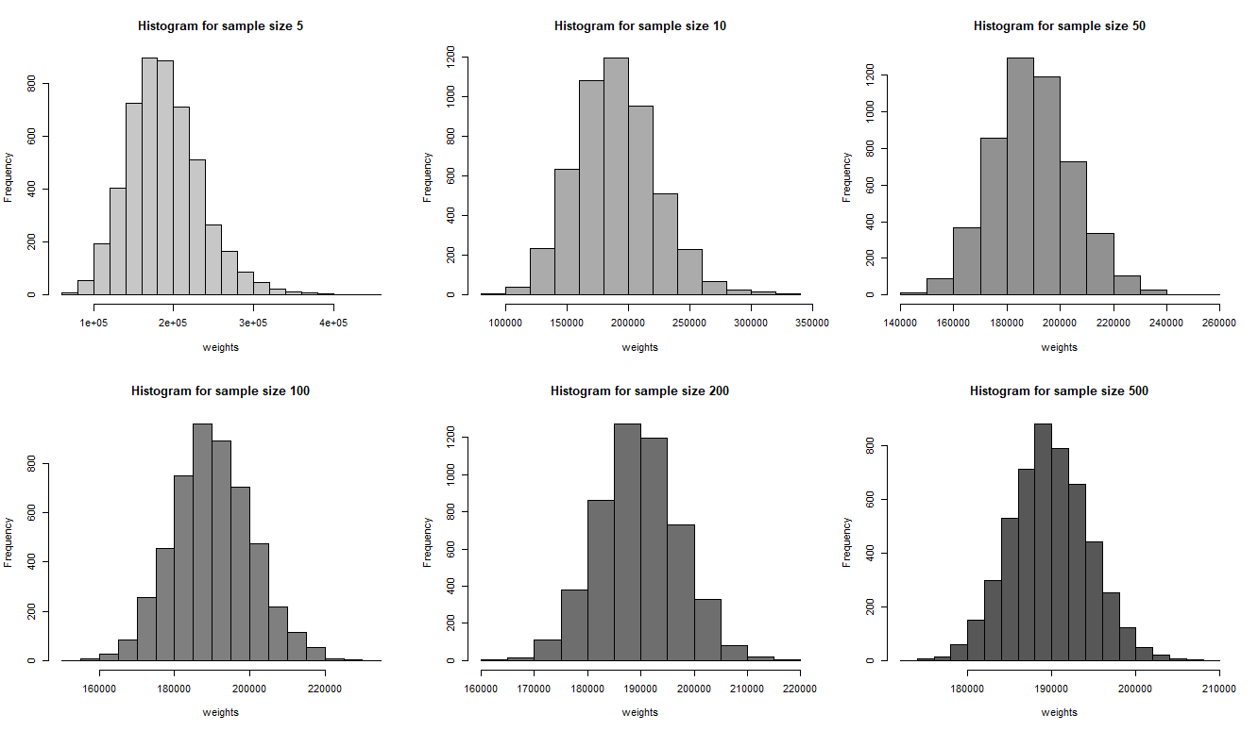
Central Limit Theorem
Distribution of Means for various sample size

Slide 20
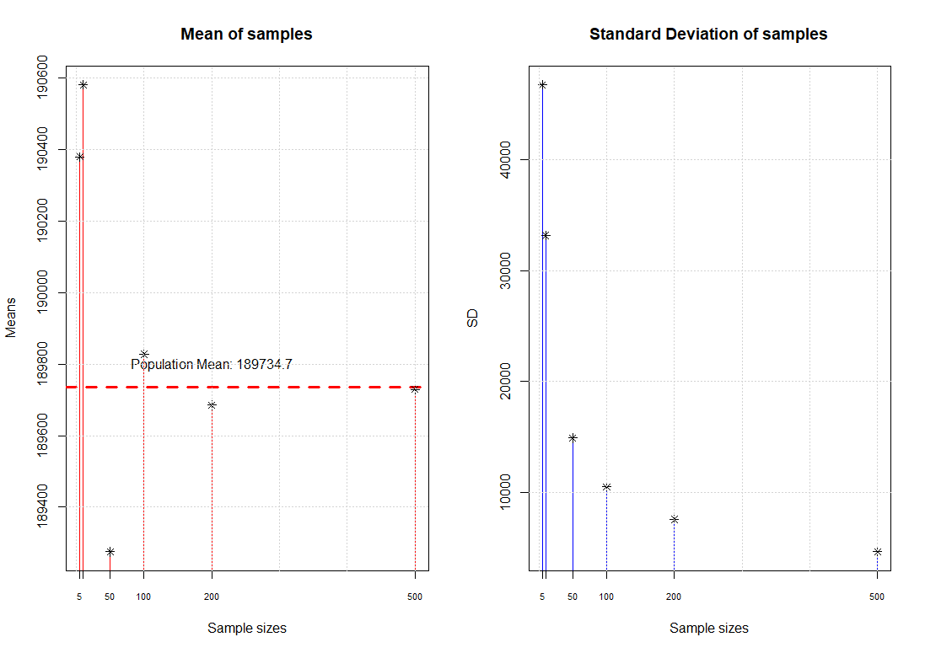
Central Limit Theorem
Mean and Standard Deviation of the samples
Population standard deviation: 105,639.2
Sample size increases
The mean of samples are around the population mean
The standard deviation of samples decreases

Slide 21
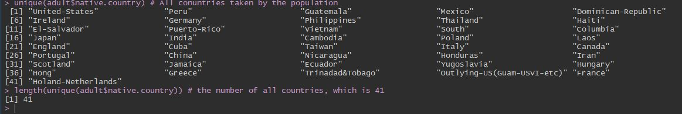
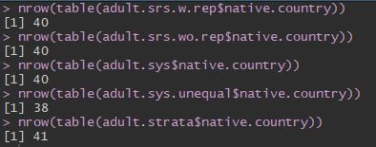
Sampling
Sampling results
Stratified sampling effectively picked up the samples with all 41 countries included

Slide 22
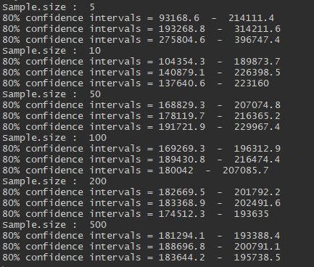
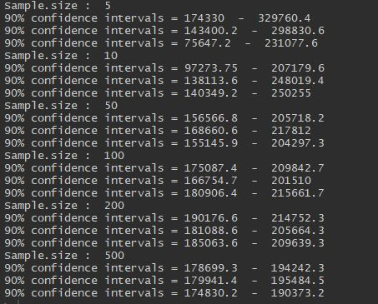
Confidence Intervals
Confidence Intervals – 80% & 90%
Population Mean falls inside the Confidence Intervals
Population Mean: 189734.7

Slide 23
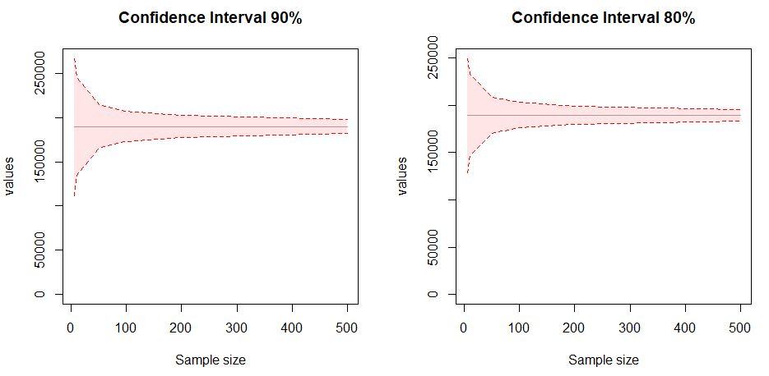
Confidence Intervals
Graph for CI Limits

Slide 24

Adult Income
CS 544
Boston University
Thank You
Foundations of Analytics
Final Project
Dataset: Adult Census Income
Student: Tzupin Kuo
StudentID: U36-17-2777

