Slide 1
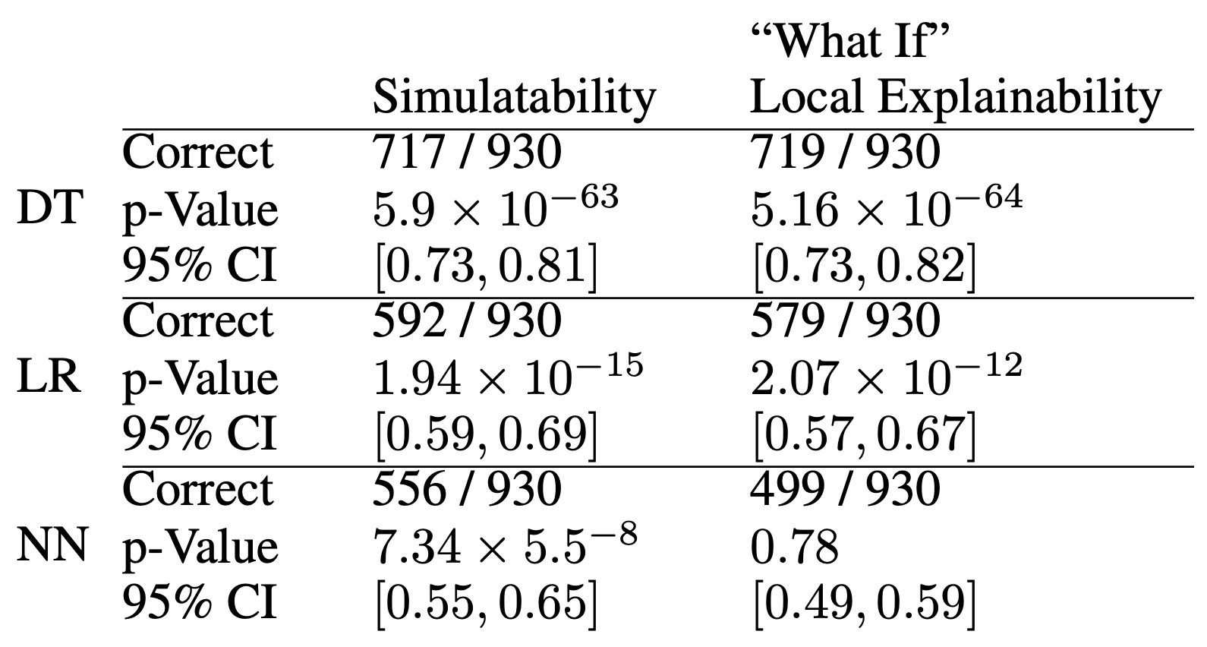
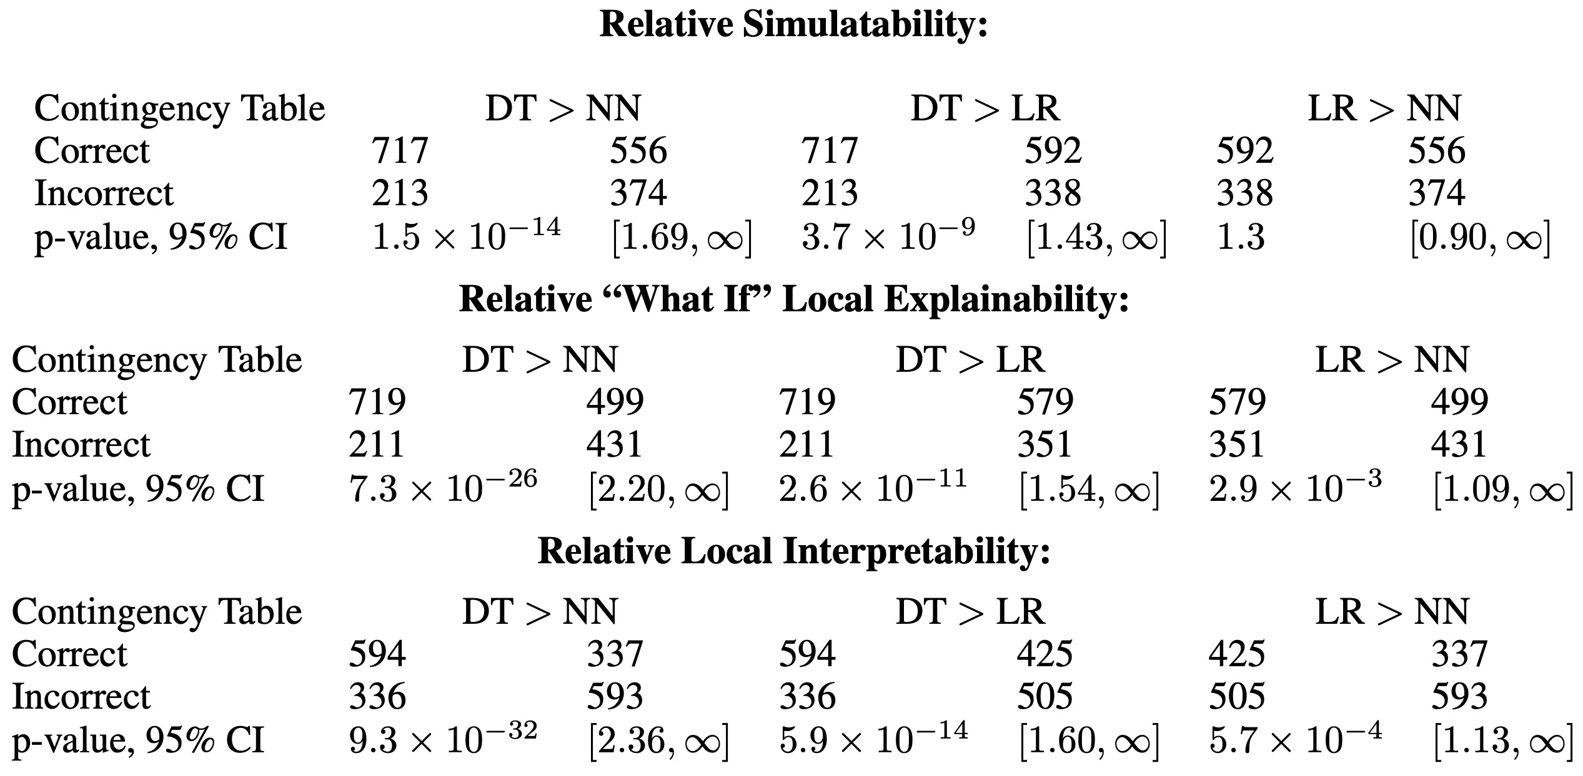
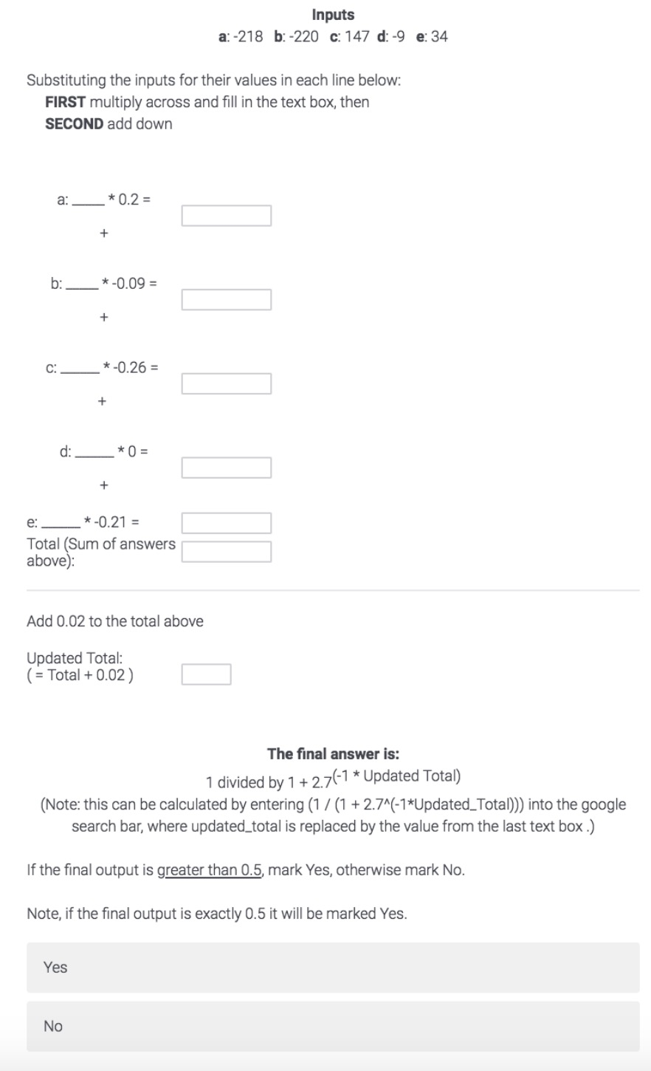
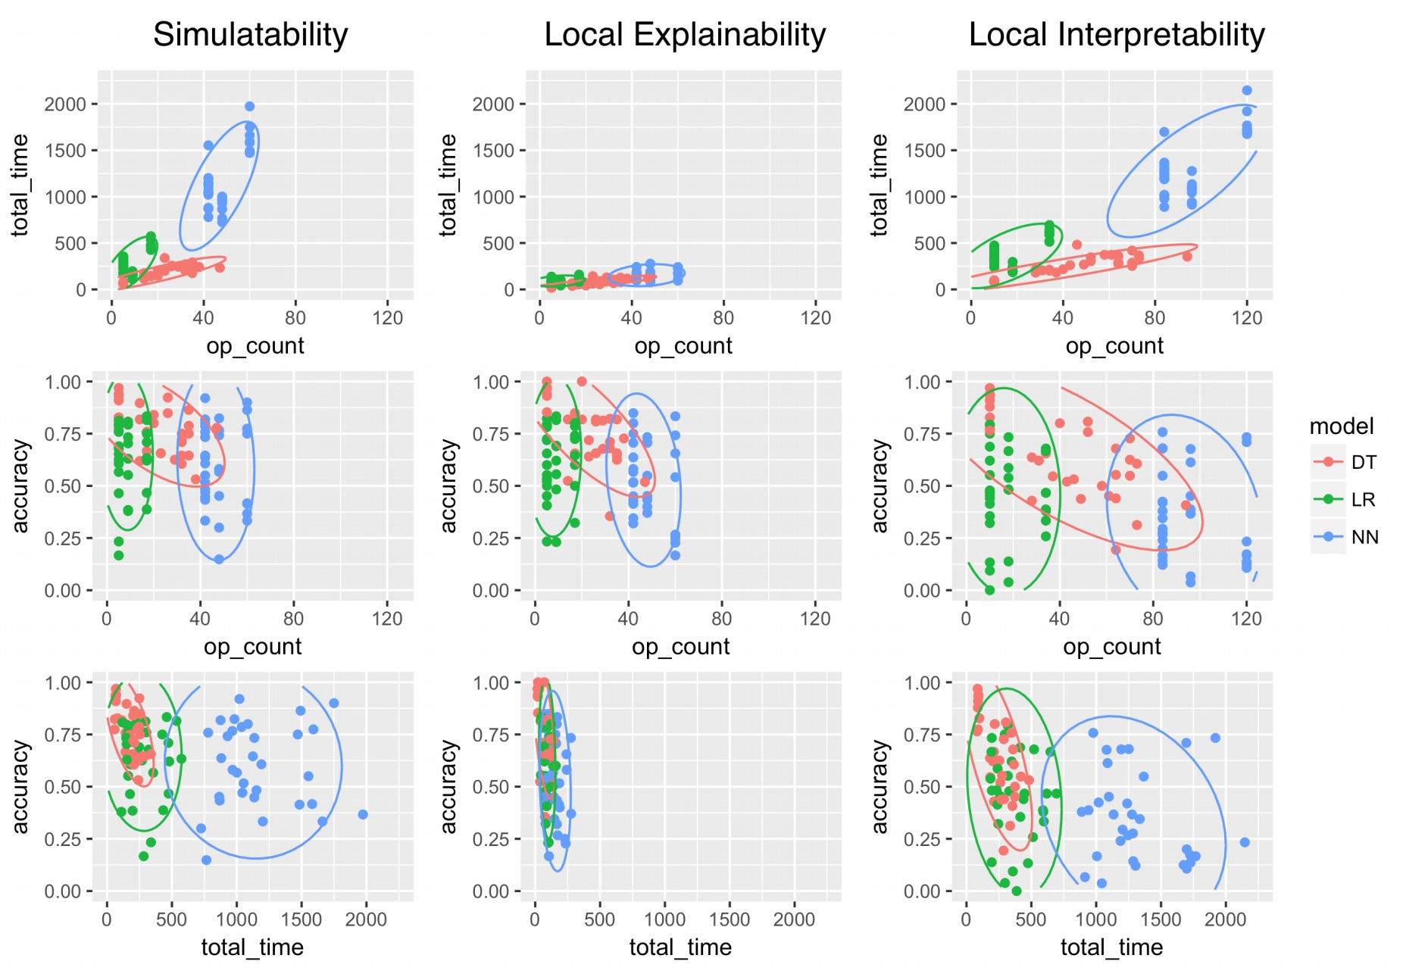





Runtime operation count can serve as a proxy metric for local interpretability.
Title: Subtitle
Assessing the Local Interpretability of Machine Learning Models
EXACT BINOMIAL TEST
WRT RANDOM GUESSING
MODEL COMPARISON USING FISHER EXACT TEST
RELATIONSHIP BETWEEN OPERATION COUNT, TIME, AND ACCURACY
Dylan Slack, Sorelle Friedler,
Carlos Scheidegger, Chitradeep Dutta Roy
INTRODUCTION
How do we provide user grounded metrics for motions of model interpretability?
We focus on simulatibility (ability to trace computation of input) and “what if” local explainability (determine local changes on input).
METHODS
We assess runtime operation count as a proxy metric for our proposed notions of interpretability in decision trees, logistic regression, and (small) feedforward neural networks using a 1,000 person user study.
EXAMPLE LOGISTIC
REGRESSION SURVEY QUESTION
Scan code for arXiv.

