Slide 1
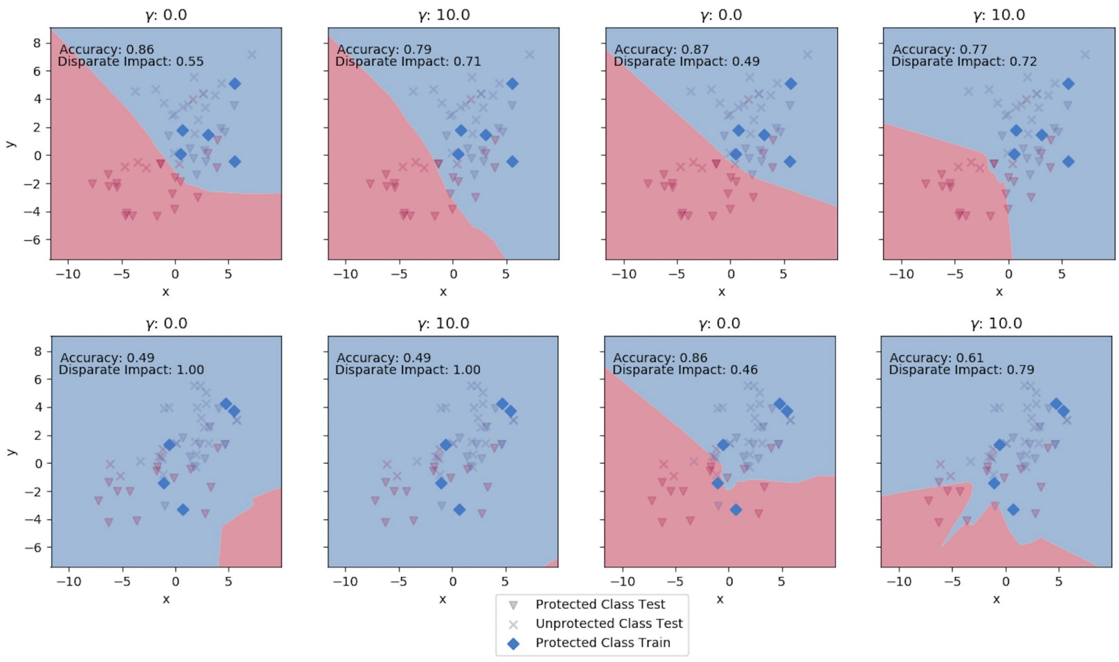
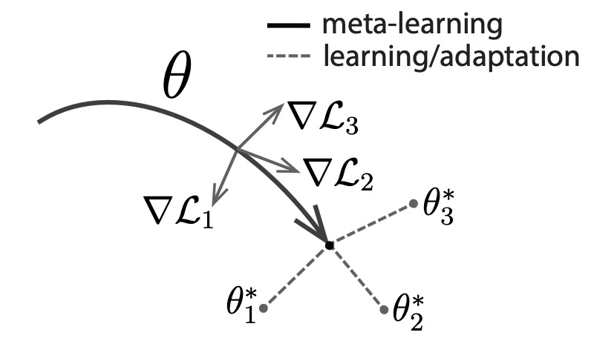
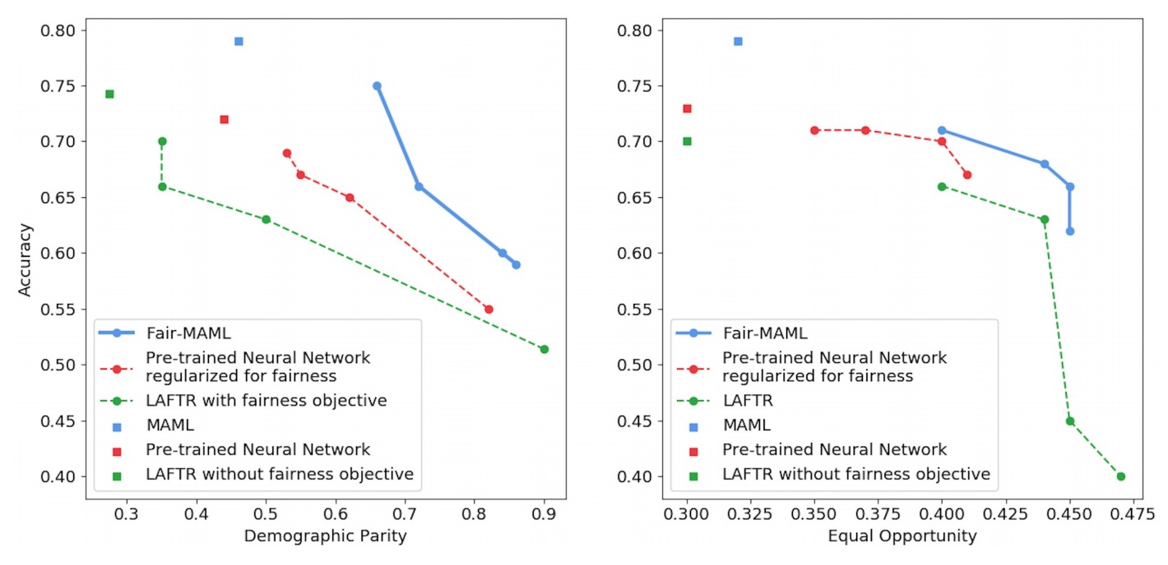
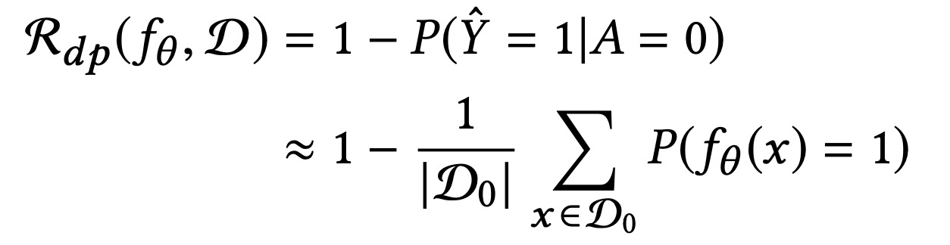

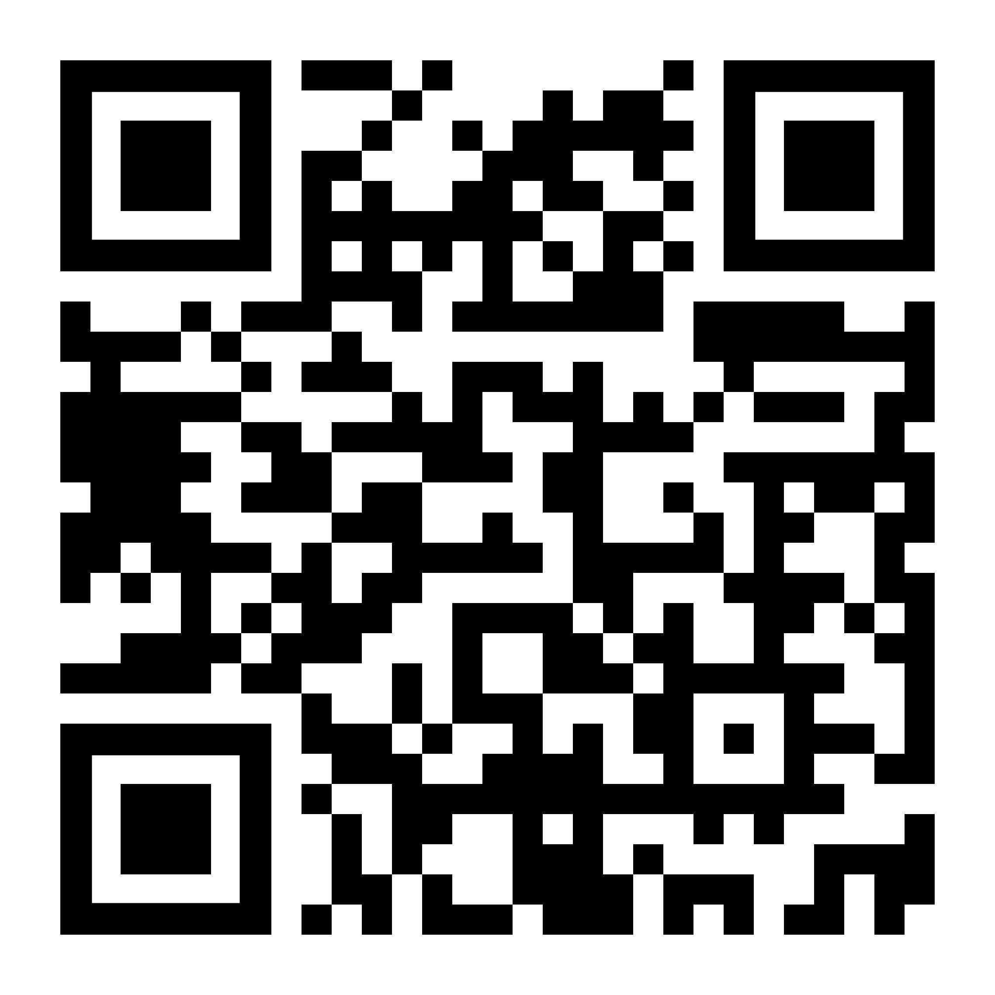

Fair-MAML trains fair meta- models that can be fine-tuned for specific tasks with minimal data.
Fair Meta-Learning: Learning How to Learn Fairly
Dylan Slack, Sorelle Friedler, and Emile Givental
MOTIVATION
Minor changes in test distribution can have significant effects on fairness (see Fairness Warnings). How can we train a model that copes?
METHODS
We can train fair meta-model that contains general features relating to both fairness and accuracy using model agnostic meta-learning with added fairness objective (Fair-MAML).
Fair-MAML can be fine-tuned to new fairness tests to achieve high degrees of accuracy with minimal data.
DEMOGRAPHIC PARITY REGULARIZER IN TASK LOSS:
(D_0 indicates protected instances)
SYNTHETIC EXAMPLE ON NEW TASK
COMMUNITIES AND CRIME EXAMPLE
[Finn et. al., 2017]
Check us out at FAT* 2020:
Fairness Warnings & Fair-MAML: Learning Fairly from Minimal Data
Scan code for arXiv.

