Slide 1
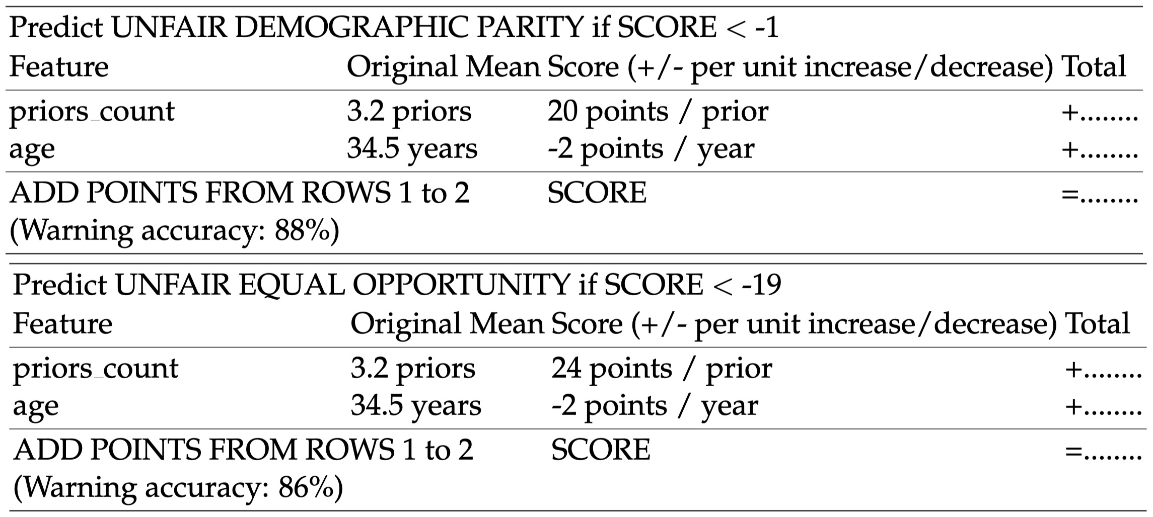

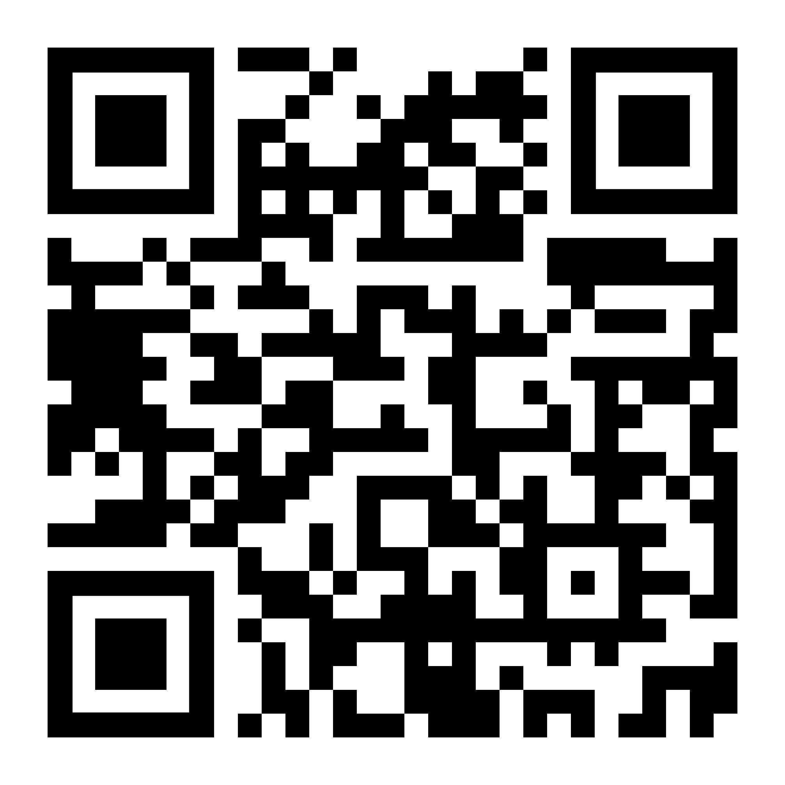

Fairness Warnings provide interpretable boundary conditions for when a fairly trained model may behave unfairly.
Title: Subtitle
Leeroy Jenkins, author2, author3, author4
Fairness Warnings
Dylan Slack, Sorelle Friedler, and Emile Givental
MOTIVATION
When shouldn’t you use your fair machine learning tool?
Example: Suppose there’s a fair recidivism tool trained in Chicago, will it behave fairly in Philadelphia?
METHODS
Idea: Practitioners often have access to covariate information
Perturb data set.
Label perturbation covariates by binary notion of model fairness (e.g. < 80% demographic parity).
Predict covariate shift fairness behavior with interpretable model.
COMPAS SLIM EXAMPLE
LIMITATIONS
Warnings only suggest that there may be unfairness in particular application; fairness warnings are based on summary statistics and may not capture true covariate shift behavior.
Check us out at FAT* 2020:
Fairness Warnings & Fair-MAML: Learning Fairly from Minimal Data
Scan code for arXiv.

