Slide 1
Predicting Moscow Apartment Prices
A Machine Learning Comparison Study
Mason Reitmeier • Dylan Hicks • Justin Zens
ISyE 521: Machine Learning in Action | Spring 2026

Slide 2
Executive Summary
Random Forest predicts Moscow apartment prices within ~15% on average, explaining 95% of log-price variance.
DATASET
18,374 cleaned Moscow listings
12 features · target: log(Price)
80 / 20 train–test split
APPROACH
Eight models, one pipeline
OLS · Lasso · Ridge · Tree · RF
AdaBoost · MLP · Stacking
WINNER — RANDOM FOREST
Test R² 0.946 · MAPE 15.1%
MAE ≈ ₽11.6M · RMSE(log) 0.249
Ties stacking; simpler to deploy
WHAT DRIVES PRICE
Area dominates (perm. imp. 0.36)
Designer renovation: +0.65 log-₽
Moscow city vs oblast: +0.43
Abstract | Headline results

Slide 3
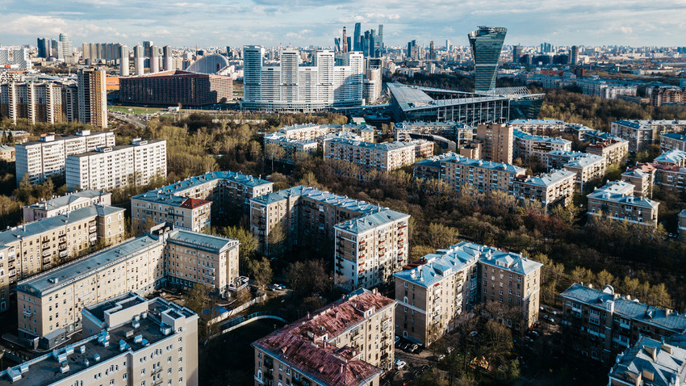
Why Moscow housing?
One of Europe's most expensive housing markets
Prices swing by tens of millions of rubles for similar listings
Research questions
How accurately can we predict prices?
Which features do buyers prioritize?
Which features matter most for prediction?
Slide 1 of 15 | Motivation

Slide 4
Moscow apartment listings dataset
Source
Kaggle, Moscow apartments
Size
22,676 listings × 12 columns
Target
Price in Russian rubles
7 numeric features
Area, Living area, Kitchen area
Rooms, Floor, Number of floors
Minutes to metro
4 categorical features
Apartment type (2 values)
Region (Moscow / oblast)
Renovation (4 levels)
Metro station (317, dropped)
Slide 2 of 15 | Data source

Slide 5
Two-pass cleaning, 18% of rows dropped
− 1,851
− 2,451
22,676 raw listings
20,825 after deduplication
18,374 clean
duplicates
invalid
Sanity checks removed: Floor > Building floors (1,502) · Kitchen > Total (1) · Living + Kitchen > Total (956)
No missing values in the raw data.
Slide 3 of 15 | Data cleaning

Slide 6
Log transform tames a severe right skew
Raw Price (skew 7.63)
Log Price (skew 1.13)
[ Histogram: raw Price ]
[ Histogram: Log_Price ]
log
Every model predicts Log_Price; the log transform makes the target workable for linear and neural models.
Slide 4 of 15 | Target variable

Slide 7
Area drives price, and correlates with itself
Top correlations with Log(Price)
Area: 0.80
Living area: 0.74
Number of rooms: 0.67
Kitchen area: 0.63
Weak predictors
Floor 0.11, Floors 0.08, Metro mins −0.08
⚠ Area × Living area = 0.91
multicollinearity risk for linear models
[ Correlation heatmap vs Log(Price) ]
Slide 5 of 15 | Correlations

Slide 8
Renovation and region also move price
Renovation → Designer premium
Region → Moscow city premium
[ Box plot: Log_Price by Renovation (Without · Cosmetic · European · Designer) ]
[ Box plot: Log_Price by Region (Moscow · Moscow oblast) ]
Also: New buildings slightly above Secondary; smaller effect than Renovation or Region.
Slide 6 of 15 | Categorical drivers

Slide 9
One pipeline, eight models, same split
ColumnTransformer
11 inputs after dropping Metro station
12 features into every model
StandardScaler 7 numeric
OneHot drop_first 5 dummies
80 / 20 split · random_state = 42
Metrics reported for every model
14,699 train | 3,675 test
Train & Test R² · RMSE (log) · MAE (₽) · MAPE
Same pipeline, same 12 features for every model; results are directly comparable.
Slide 7 of 15 | Methodology

Slide 10
Linear baselines: R² ≈ 0.87, MAPE ≈ 28%
All three agree
Test R²: 0.869
RMSE log: 0.389
MAPE: 28.4%
Lasso zeroed: Floor only
Coefs agree within 0.02
Baseline set: regularization didn't help because multicollinearity didn't hurt much.
Slide 8 of 15 | OLS · Lasso · Ridge

Slide 11
Decision trees: from overfit to 0.92 test R²
Initial (untuned)
Train 1.00 → Test 0.887
Memorized training data
Tuned
GridSearchCV 5-fold · 45 combos
max_depth = 10
min_samples_leaf = 10
Test R² = 0.9243
RMSE log = 0.296
MAPE = 19.0%
MAE ≈ ₽13.1M
Tuning closed the gap, the first meaningful jump over linear baselines.
Slide 9 of 15 | Decision trees

Slide 12
Random Forest: our best single model
Best single model
0.9464
Test R²
15.07%
MAPE
MAE ≈ ₽11.6M
RMSE log = 0.2491
300 trees · depth 20
RandomizedSearchCV, 20/324
Permutation importance: Area dominates (0.36); Apartment type and Region follow.
Slide 10 of 15 | Random Forest

Slide 13
AdaBoost: respectable R², worst MAPE
Test R²
MAPE
0.886
30.3%
middle of the pack
worst of any model
RMSE log 0.363 · MAE ₽15.1M
exponential loss chases outliers
Tuned AdaBoost · DecisionTreeRegressor(max_depth=3) base · n_estimators=300 (grid ceiling) · learning_rate=0.05
R² looks fine, but exponential loss over-fits the tail; percent errors suffer.
Slide 11 of 15 | AdaBoost

Slide 14
PyTorch MLP: R² = 0.91, short of the tree
Architecture
Metrics & loss curve
Input · 12 features
Test R²: 0.9065
RMSE log: 0.329 · MAPE: 18.47%
Linear 128 · ReLU · Dropout
[ Training / validation loss curve ]
Linear 64 · ReLU · Dropout
Linear 32 · ReLU
Output · Log_Price
Adam · weight_decay 1e-3 · 300 epochs · GPU
Two-phase train: val split to confirm architecture, then fresh retrain on full 14,699 rows. Still behind the tuned tree.
Slide 12 of 15 | Neural network

Slide 15
Stacking Ensemble
Base learners
Random Forest
+0.955
Stacking result Test R² = 0.9450 MAPE = 14.93% (best MAPE)
Neural Network
+0.209
RidgeCV meta-learner (5-fold CV)
Decision Tree
−0.013
Ridge
−0.017
AdaBoost
−0.134
Meta-learner placed 95% weight on Random Forest; RF had already captured most of the signal.
Slide 13 of 15 | Stacking ensemble & meta-learner weights

Slide 16
Model Comparison
Random Forest & Stacking tie at the top (~0.946 R²); linear models cluster ~8 pts lower. One 80/20 split, not nested CV.
Slide 14 of 15 | Full model leaderboard by Test R²

Slide 17
Conclusions
1
How accurately?
2
What do buyers value?
3
What matters for prediction?
R² = 0.946
Renovation + Location
Area dominates
~95% of log-price variance explained. MAPE 15% ≈ ₹4M off a typical listing.
Linear coefficients: Designer (+0.65), Moscow city (+0.43 vs region), Area (+0.40).
RF permutation importance: Area 0.36, Apt type 0.09, Region 0.07.
Limitations
Future Work
Single 80/20 split • listing (not sale) prices • 2021 snapshot • Metro dropped (317 stations)
Gradient boosting (XGBoost, LightGBM) • finer geography • time-series features
Slide 15 of 15 | Answers to our three research questions

