Slide 1

The extremely talented and versatile team of
Chi, Dylan, Hasan and Hollie present to you
Notes:
**HASAN**
Hi Guys, we are the Wizards and we’re delighted to present to you, StockWizard.

Slide 2

Why StockWizard???
Notes:
**HASAN**
By combining the power of the News API and the Polygon API, our platform, StockWizard, provides you with a comprehensive solution.
StockWizard seamlessly integrates real-time stock data from Polygon API with the last news articles from the News API, tailored specifically to the stocks you’re interested in.
With StockWizard, you can easily search for a specific stock, set data range, and instantly access a curated list of news articles focused solely on that stock.
Stay ahead of the market by getting timely updates on relevant news, market trends and company developments.
Our platform not only saves you valuable time by aggregating the most relevant news,but it also empowers you to make informed investment decisions based on real-time stock data.
Whether you’re a seasoned investor or just starting, StockWizard is your go-to resource for staying up to date with stock market news and making well-informed trading choices.
Experience the power of combining the News API and the Polygon API with StockWizard today and take your stock market research and decision-making to the next level

Slide 3
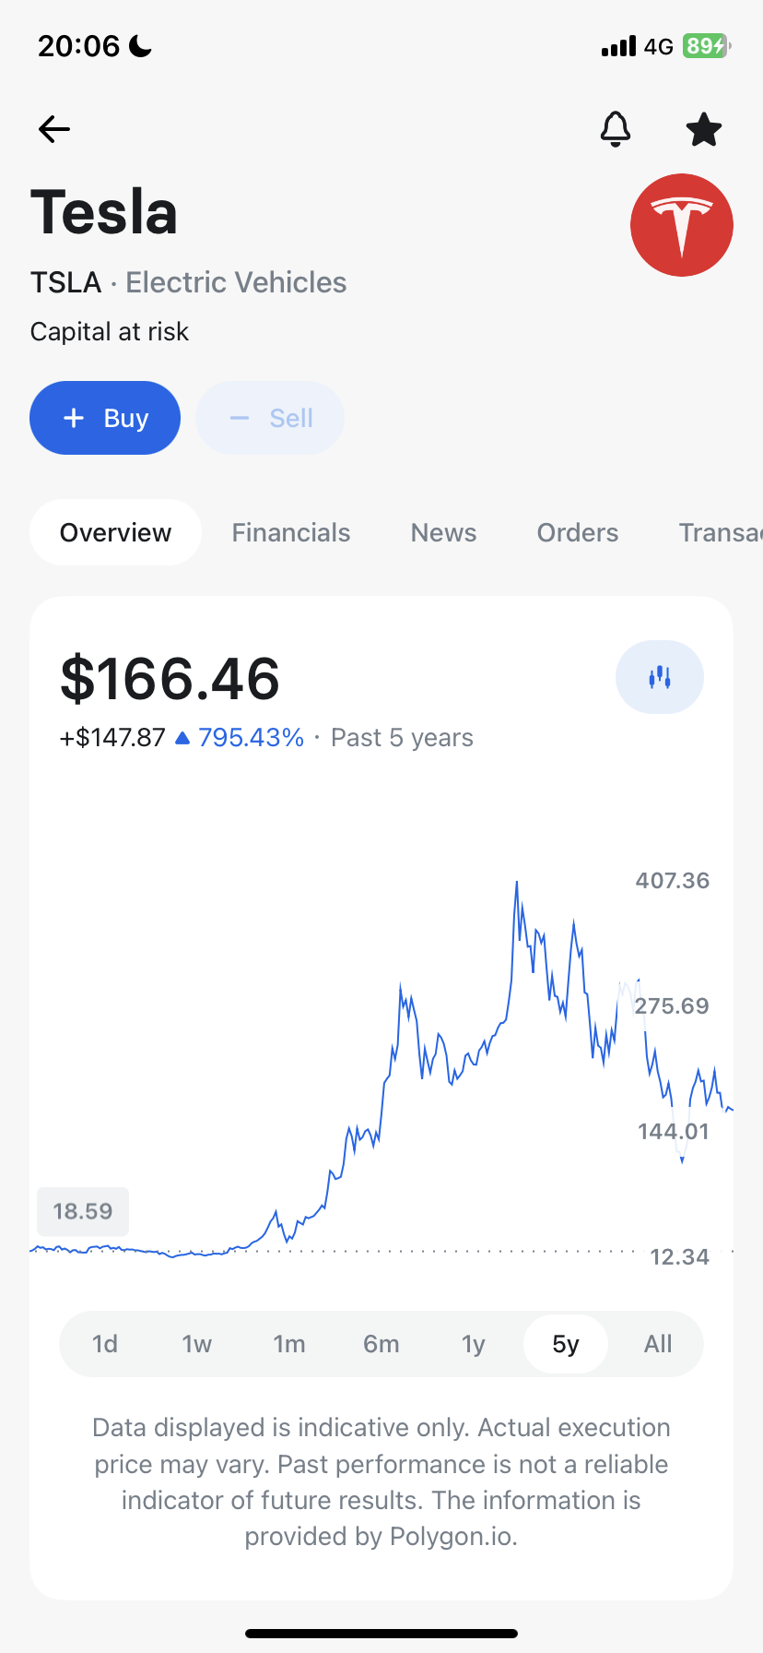
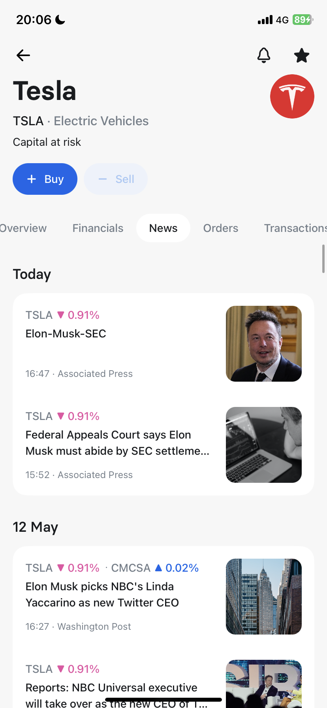
Inspiration:
Notes:
Our Motivation: Because we want to get rich, but don’t want to work and study. So we think of buying stock and have the money falling from the sky.
Inspiration: We like using Google to help us buying stock, because we can visualize the trend of the stock, and have news related to the stock in the same platform, for us to analyze the relationship between the news and the price of stock easily.
However, I hate to give too much of our data to Google and I want the application to be tailor-made for us.

Slide 4
Concept
As a user I want to be able to query stock data and news data by putting in the code of stock in a specified period.
As a user, I want to display the chart and the news in the same platform for the specified period.
As a user I want to be able to save the search history.
As a user I want to be able to click on each search history and display the chart and news for the stored stock and dates.
As a user I want the application to be able to handle error.
Notes:
**CHI**
Description: We want to implement an application which can show stock chart and news, and store our search history so that we can keep track on the performance of our preferred stocks easily.
User story

Slide 5
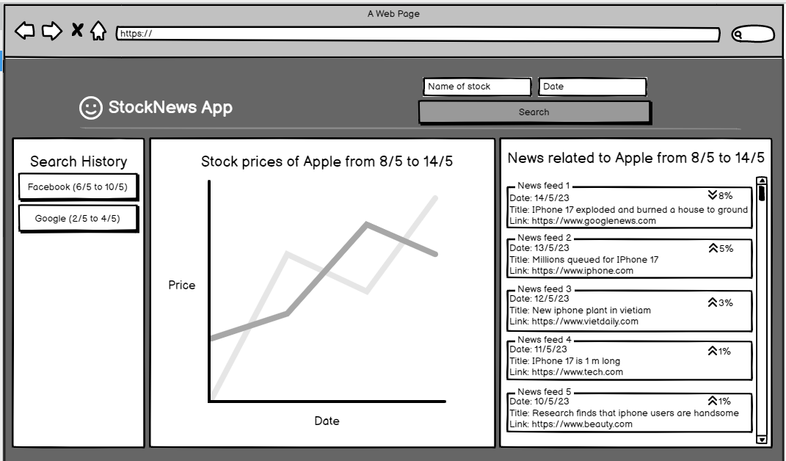
The plan:
Notes:
**CHI**
After coming up with the ideas, we come up with a design for the web page. It has a header for making query, and three columns at the bottom to display history, chart and news.
The design is plain to make it more professional and the investors can focus on the information.

Slide 6
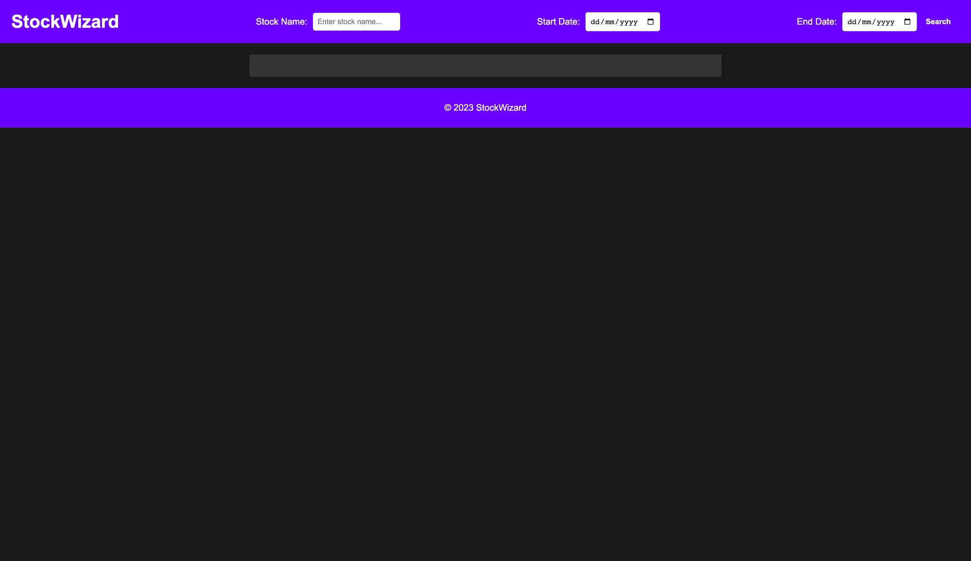
The First Design:
Notes:
**HASAN**
The initial design was created using some simple HTML and CSS
We wanted to include the colours of our brand within the design - originally we went with purple and black
.
However this theme was a little bit too dark and not what you’d expect to see when searching for a stock news website

Slide 7
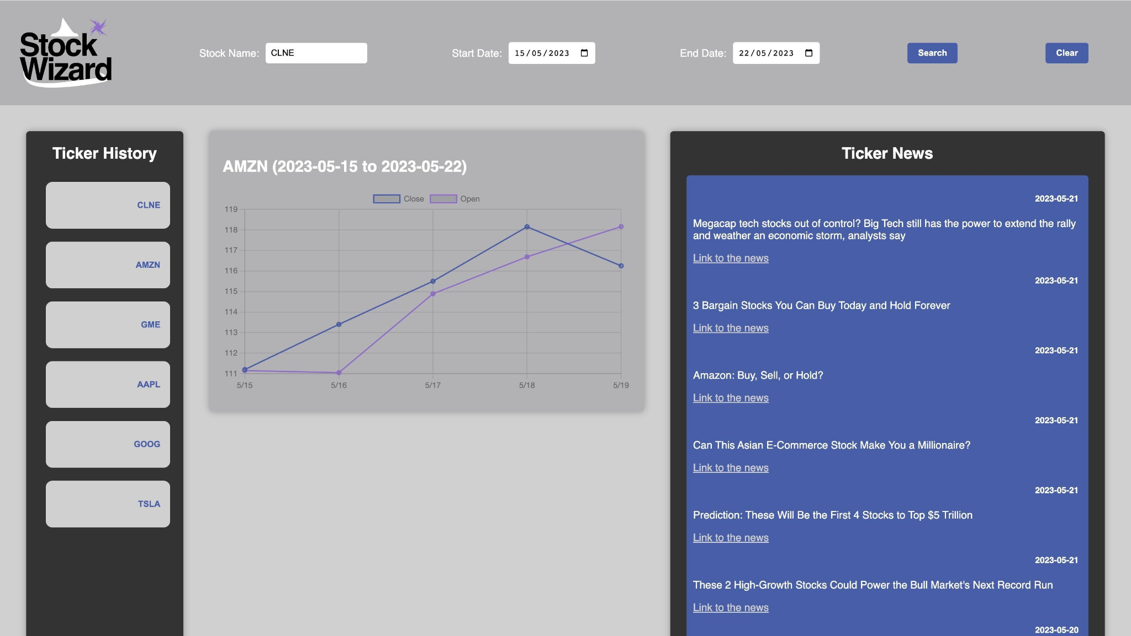
Design once the 2 APIs were integrated
Notes:
**HASAN**
Once we integrated the 2 APIs, Dylan did some further work on the CSS, using a more neutral colour palette.
We went with lavender and navy blue
We wanted to avoid bright hues

Slide 8
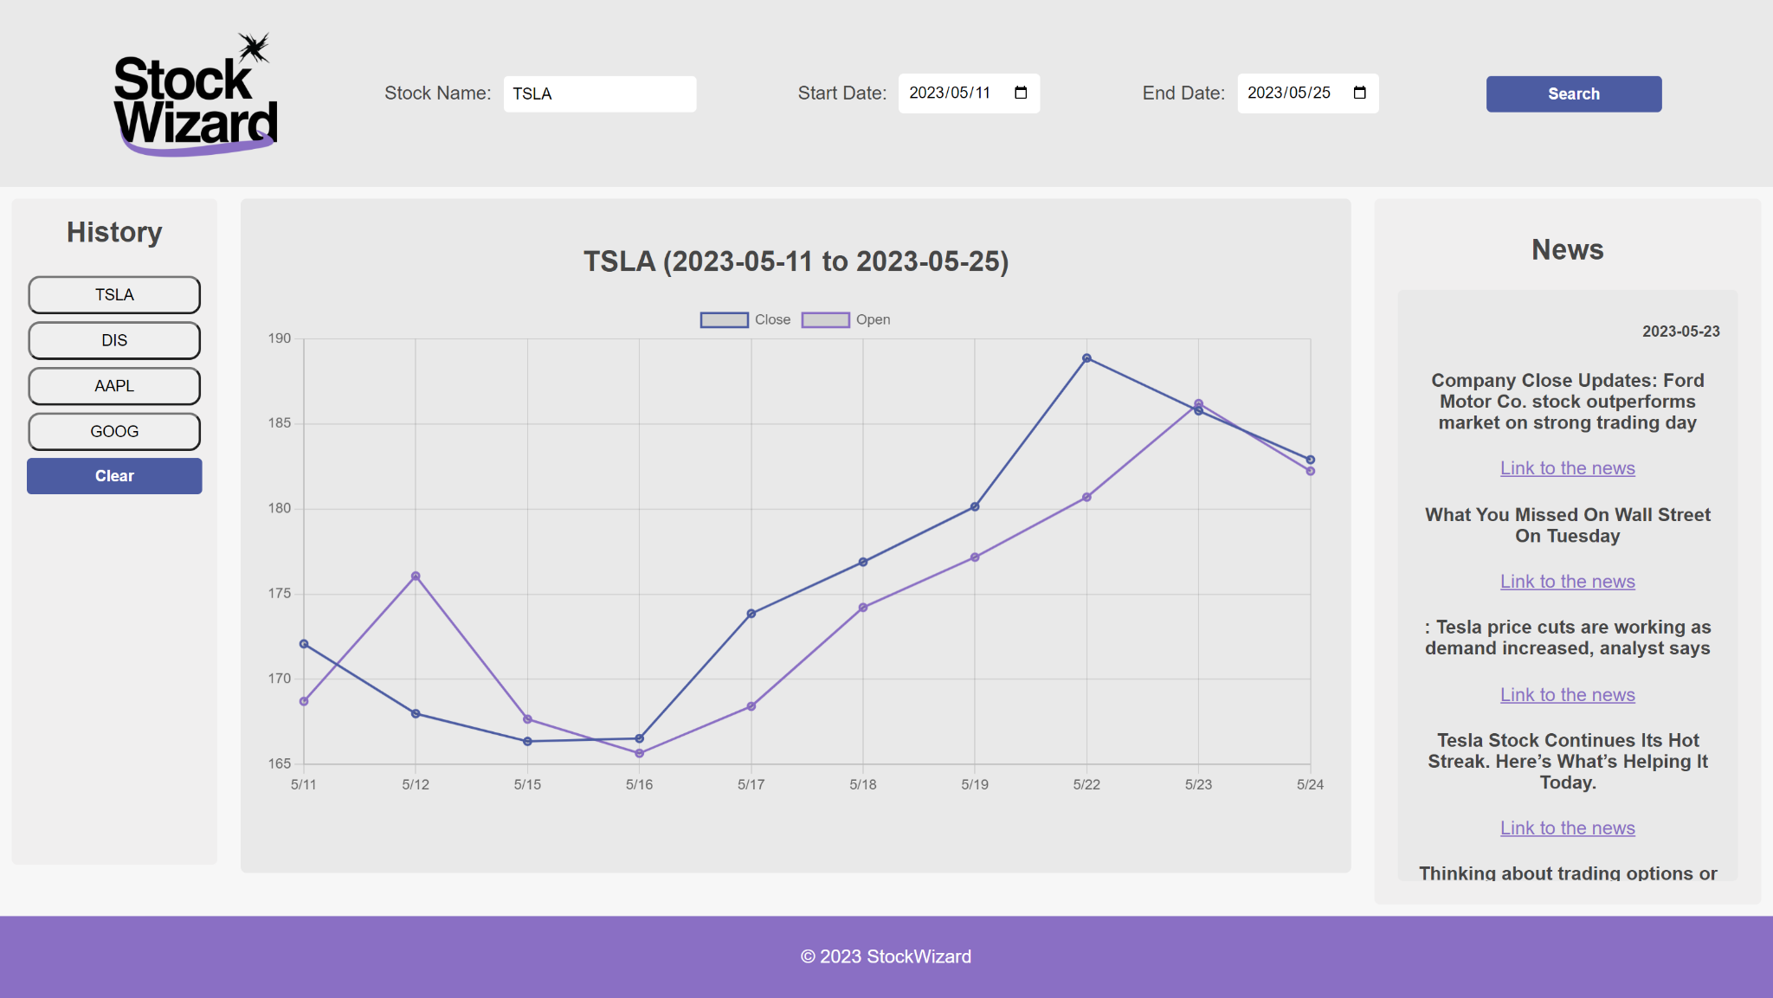
The final product:
Notes:
**HASAN**
This is the final design.
We stuck to our lavender and navy blue colour scheme, however we partnered those colours with a lighter colour palette. We felt like this gave our StockWizard website a sleek and professional look.

Slide 9
The Process…
Technologies
We used two API’s in this application, PolygonAPI and NewsAPI. PolygonAPI fetches the stock data in a period and the information regarding the news of that particular ticker.
Notes:
**DYLAN**

Slide 10
The Process continued…
Breakdown of tasks and jobs
Notes:
*DYLAN*
We all had a few ideas that we came up with, in regards to the two API’s. We all agreed on two API’s that were simple to work with and that compliment each other
Chi: Design of the Website, JS, Debugging
Dylan: HTML, CSS, News API
Hasan: CSS, Local storage and Presentation
Hollie: Chart JS, ReadME, Presentation

Slide 11


The challenges and success’
Notes:
**HOLLY**
Challenges:
Writing the code itself:
Finding two API’s that work - we had loads of ideas but were unable to execute them as we weren’t able to find a decent
Working in a project:
Understanding each others code to enable us to merge them
Working as a group and being able to distribute the work when we have all been used to working on our own
Successes’
Writing the code itself:
Once we found one API (The polygon API) - we were able to then find other API’s and have other options for the second API eg: Reddit, News
Working in a project
Versatile skill set
Being able to work as a group and communicate

Slide 12
Directions for future development
User registration
Comparison
Monetise
Mobile application
Notes:
Allowing the user to register for a certain stock so they are able to keep an eye on certain stocks and get news updates about that particular stock. Sending the user an email or a notification about a particular ticker that they have their eye on.
If we had the time we would enable the user to compare different stocks and shares
Monetise - allow the investor to purchase the stock itself
Mobile application - develop an app for StockWizard to provide a seamless experience on mobile devices
**HOLLY**

Slide 13
Links:
Deployed
GitHub repository

Slide 14
Demo of the Website
- function (search, showing of chart and news)
- search history saving
- error handling (if there are errors, the button will not be created)
- responsive
Notes:
**DYLAN**

