Slide 1
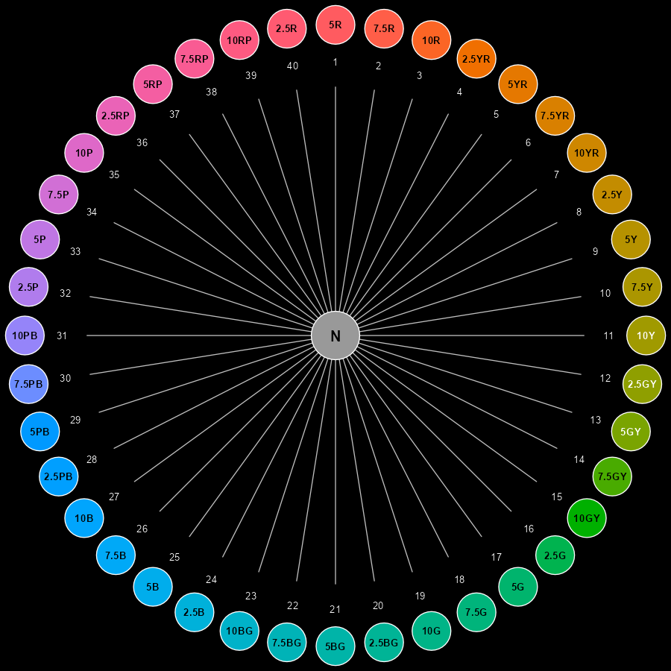
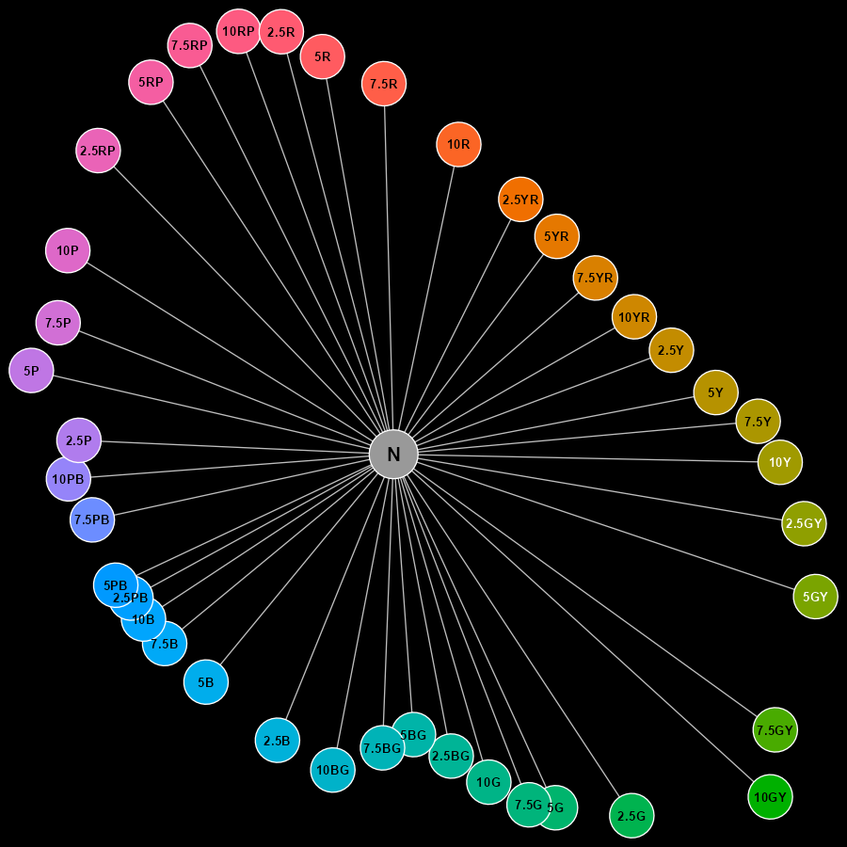
Munsell Hue – Conceptual Arrangement
Munsell Hue – Perceptual Arrangement ${∆E}_{00}$

