Slide 1

Lyrics generator
Dylan Bowman, Junseok Yang

Slide 2
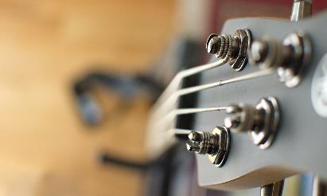
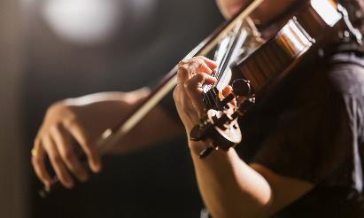
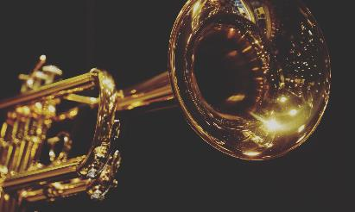
Agenda
Introduction
Related Work
Method
Result
Limitation / Future Work

Slide 3

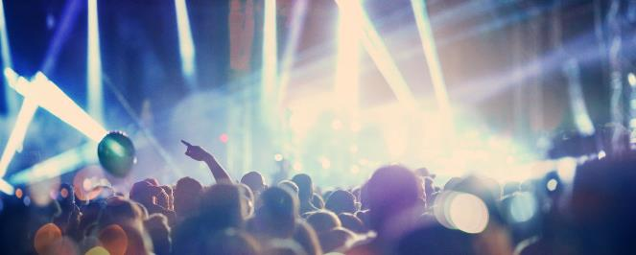


introduction
More AI & Deep Learning
Power & Importance of “TEXT” data
Ex) Natural Language Processing (NLP)
Generative Models
Text Generator
Many fields using text data…
Music industry - ”LYRICS”
Generate lyrics based on different genres

Slide 4
Related work
Generating Sequences with Recurrent Neural Network
Ghostwriter: Using an LSTM for Automatic Rap Lyric Generation
Prior work 3
Graves, Alex (2014)
Add transitions, animations, and motion.
Save to One Drive, to get to your presentations from your computer, tablet, or phone.
Add text, images, art, and videos.
Add transitions, animations, and motion.
Potash, Peter, et al (2015)
Add transitions, animations, and motion.
Save to One Drive, to get to your presentations from your computer, tablet, or phone.
Add text, images, art, and videos.
Add transitions, animations, and motion.
Add text, images, art, and videos.
Add transitions, animations, and motion.
Save to One Drive, to get to your presentations from your computer, tablet, or phone.
Add text, images, art, and videos.
Add transitions, animations, and motion.

Slide 5
Related work
Ghostwriter: Using an LSTM for Automatic Rap Lyric Generation
Potash, Peter, et al (2015)
Ghostwriting issue
Generating rap lyrics & Rhyme component
Larger training & testing data
Expanded to more genres including rap

Slide 6
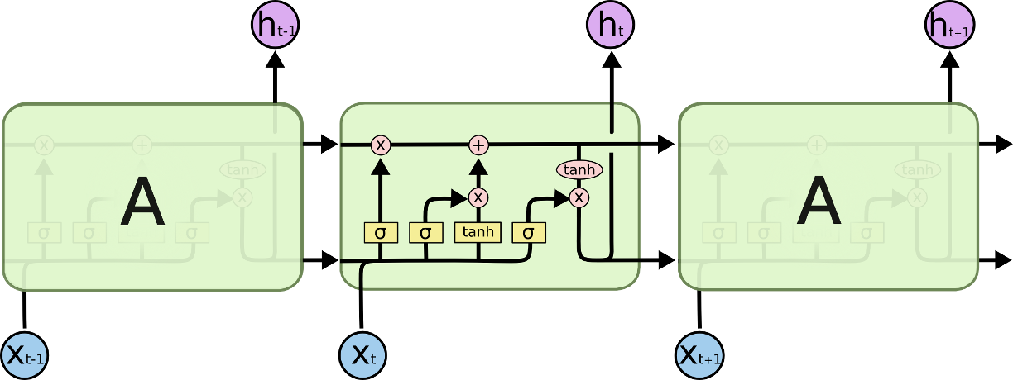
method
Data Pre-processing
Model
5.91 million songs from genius.com
Country / Rap / R&B / Pop
Data cleaning
Regular expression
[Verse 1] , [Chorus]…
Long Short-Term Memory (LSTM)
Type of Recurrent Neural Network (RNN)
Previous output as parameter
Sequential Data
3 Layers
Hyperparameter tuning
Sequence length (2 / 3)
Batch size (128 / 256)

Slide 7
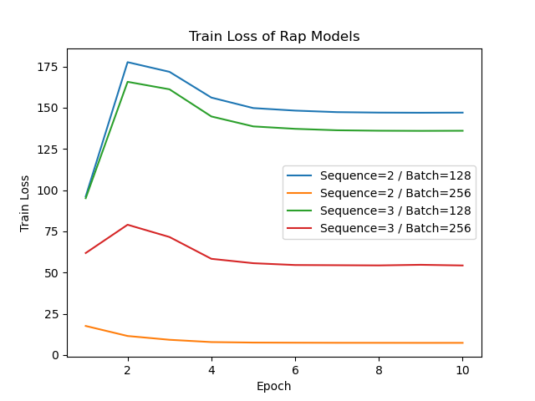
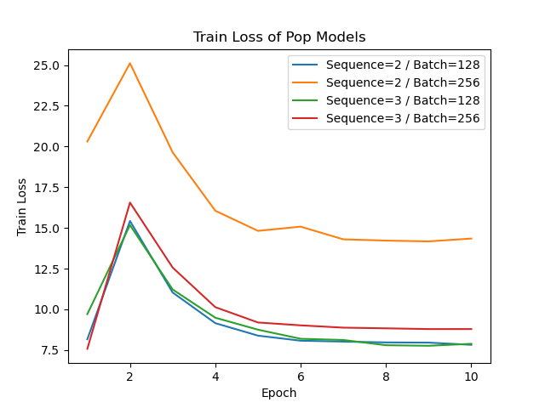
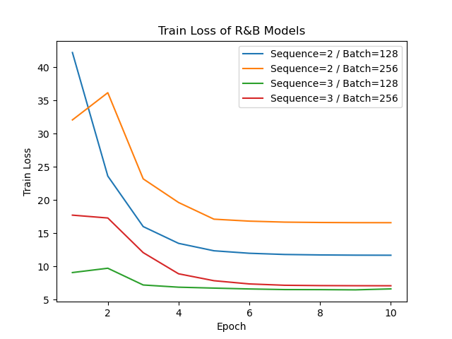
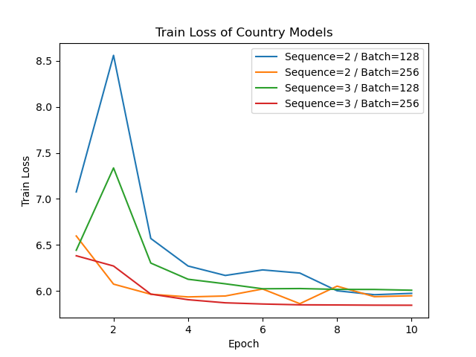
Result - loss
Test goes here…?

Slide 8
Result – generated lyrics
Genre (Sequence length=3 / Batch size = 256) | Generated Lyrics (Input = “I am”)
Country | I am im one truck im wide any on still than…
Rap | I am scene cam / Gangsta river somewhere shoot…
R & B | I am is / Room would day me when / I put up…
Pop | I am wind / Thang change thriller ich tiene…

Slide 9
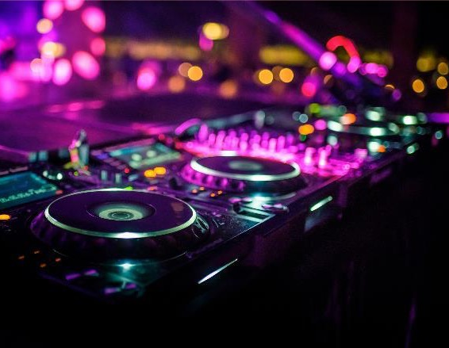

Summary
Limitations
Data cleaning
Model structure & training
Hyperparameter tuning
Future Works
Music components
Linguistics-related studies
More diverse genres / artists

Slide 10

Thank you
Code
https://github.com/dylanbowman314/lstm-lyrics-generation

