Slide 1

Lyrics generator
Dylan Bowman, Junseok Yang

Slide 2



Agenda
Introduction
Related Work
Method
Result
Limitation / Future Work

Slide 3




introduction
More AI & Deep Learning
Power & Importance of “TEXT” data
Ex) Natural Language Processing (NLP)
Generative Models
Text Generator
Many fields using text data…
Music industry - ”LYRICS”
Generate lyrics based on different genres

Slide 4
Related work
Ghostwriter: Using an LSTM for Automatic Rap Lyric Generation
Potash, Peter, et al (2015)
Ghostwriting issue
Generating rap lyrics & Rhyme component
Larger training & testing data
Expanded to more genres including rap

Slide 5
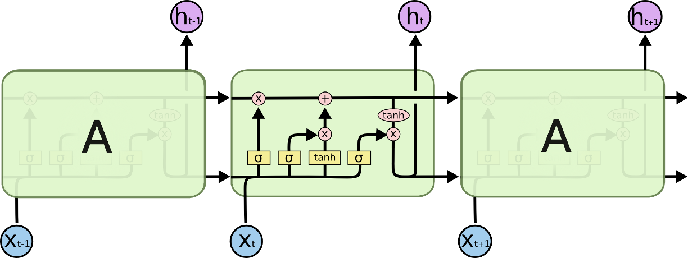
method
Data Pre-processing
Model
5.91 million songs from genius.com
Country / Rap / R&B / Pop
Data cleaning
Regular expression
[Verse 1] , [Chorus]…
Long Short-Term Memory (LSTM)
Type of Recurrent Neural Network (RNN)
Previous output as parameter
Sequential Data
3 Layers
Hyperparameter tuning
Sequence length (2 / 3)
Batch size (128 / 256)

Slide 6
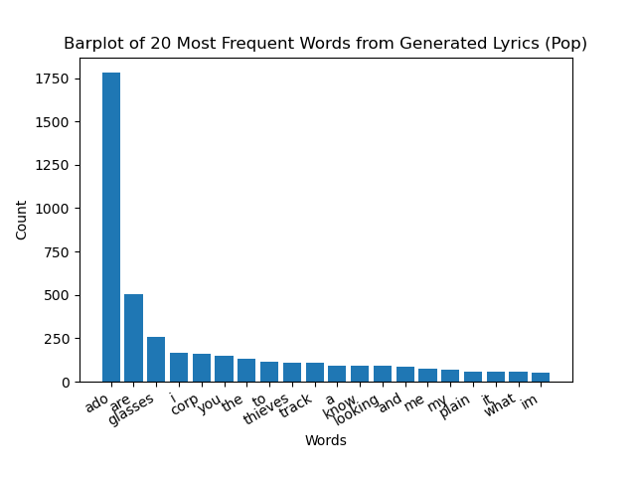
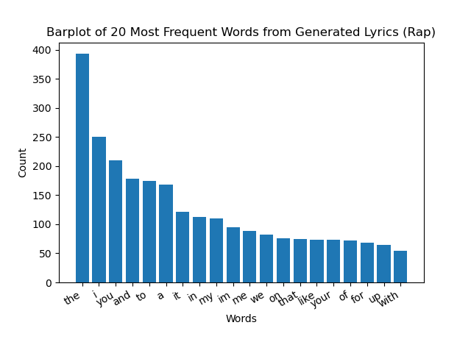
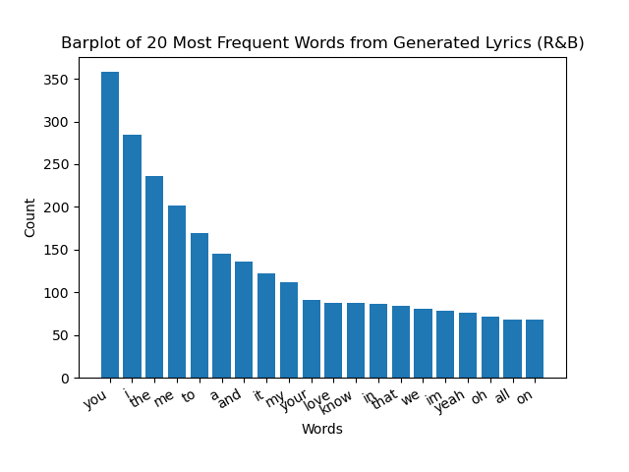
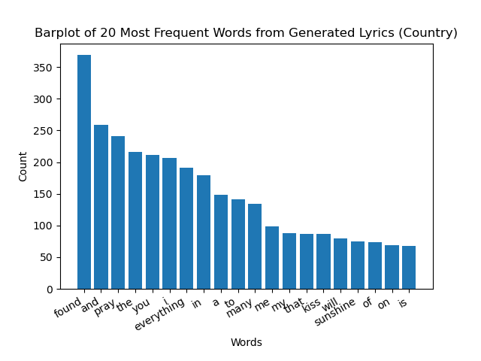
Result – generated lyrics
Top 20 most frequent words from generated lyrics
Rap
Stop / Short / Negative xwords
Country / R&B
Long words
‘Love’ - Positive
Pop
Mixed

Slide 7
Result – generated lyrics
Genre (Sequence length=3 / Batch size = 256) | Generated Lyrics (Input = ”I am”)
Country | I am im one truck im wide any on still than…
Rap | I am scene cam / Gangsta river somewhere shoot…
R&B | I am is / Room would day me when / I put up…
Pop | I am wind / Thang change thriller ich tiene…

Slide 8


Summary
Limitations
Data cleaning
Model structure & training
Hyperparameter tuning
Future Works
Music components
Linguistics-related studies
More diverse genres / artists

Slide 9

Thank you
Code
https://github.com/dylanbowman314/lstm-lyrics-generation

