Slide 1

Intro to Databases for Games

Slide 2


Intro
Me
  Corporate coder for 20’ish years
  Many, many, many small, big or huge data applications. Mostly web based
  Starting my own studio, Imaginary Component
Demo: database-driven item system
Demo Installs Required:
  Unity, LibreOffice Base, SQLite, SQLite Browser
SQLite

Slide 3
Outline
Technical discussion
Why to use a database for items and what kinds are available
Demo Project
Building an item database that loads to Unity Scriptable Objects
Notes:
Technical advantages to using databases
Functional uses of databases in games
Different types of databases
Practical connectivity in Unity
Quick touch on an Ideal solution
Installing SQLite
Connecting to SQLite
Connect to SQLite database via LibreOffice Base
Create ScriptableObject class
Generate ScriptableObjects out of SQLite via Unity Editor command

Slide 4


Why Use a Database?
Effective at taking up space in expensive server farms, Network Operation Centers, and cloud accounts
Give players something to complain about

Slide 5

But Wait, What if We Want Organization?
Editing our items in 200 Scriptable Object files is kinda rough, man.
  I can’t find all the items this medusa drops. It needs a Soft potion 10% of the time for sure.
  For that matter, this medusa fifty levels later doesn’t need one. The whole area doesn’t.
  How many items do we have?
  Do they match the spreadsheet?
  Can I update my spreadsheet and the three hundred items in it all at once?

Slide 6
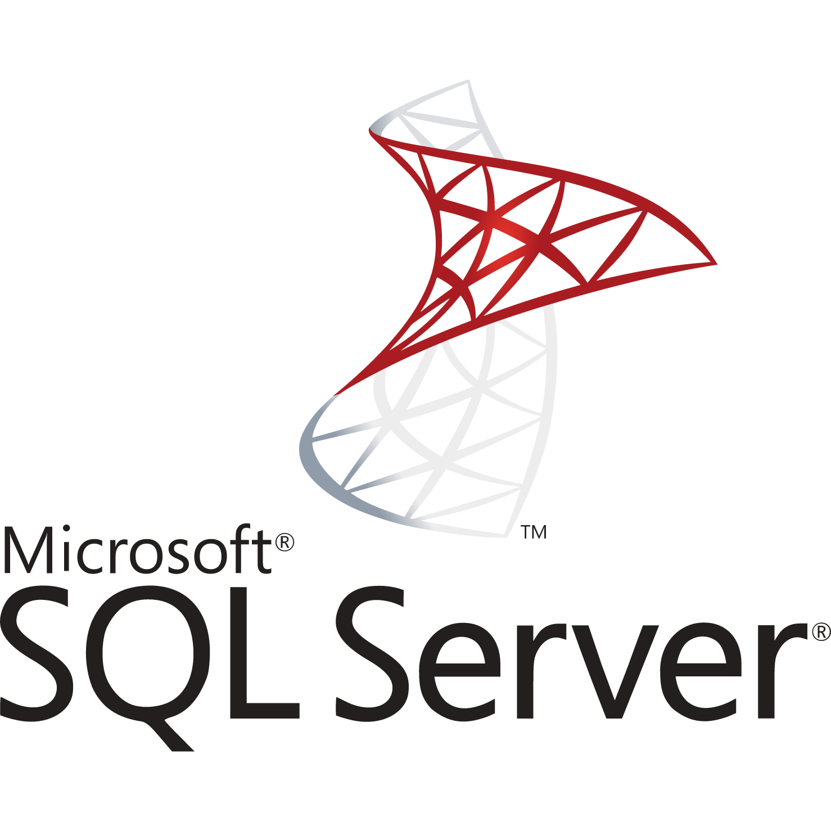

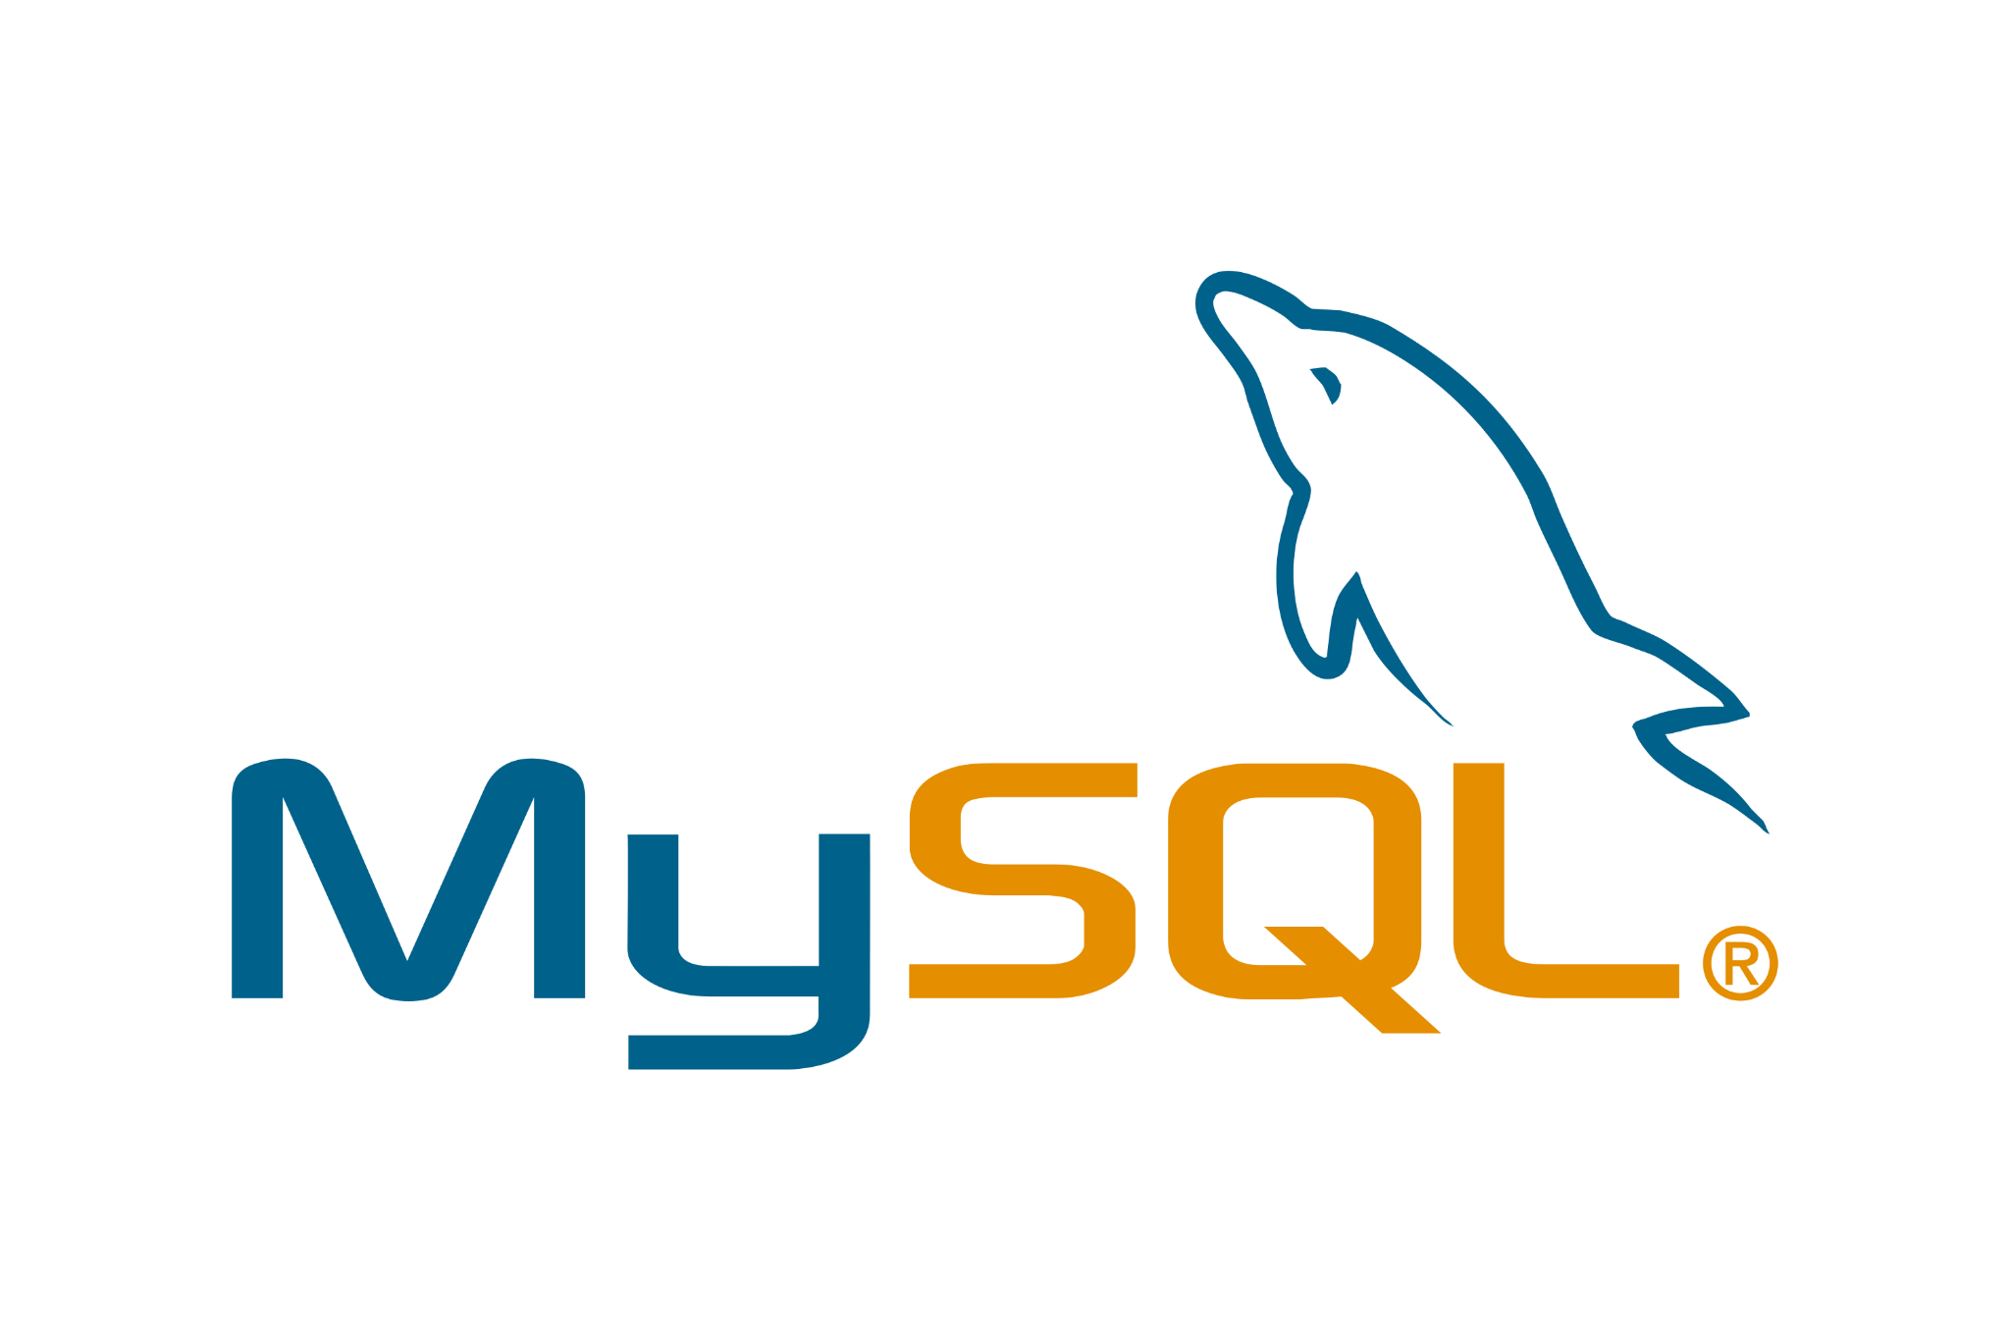
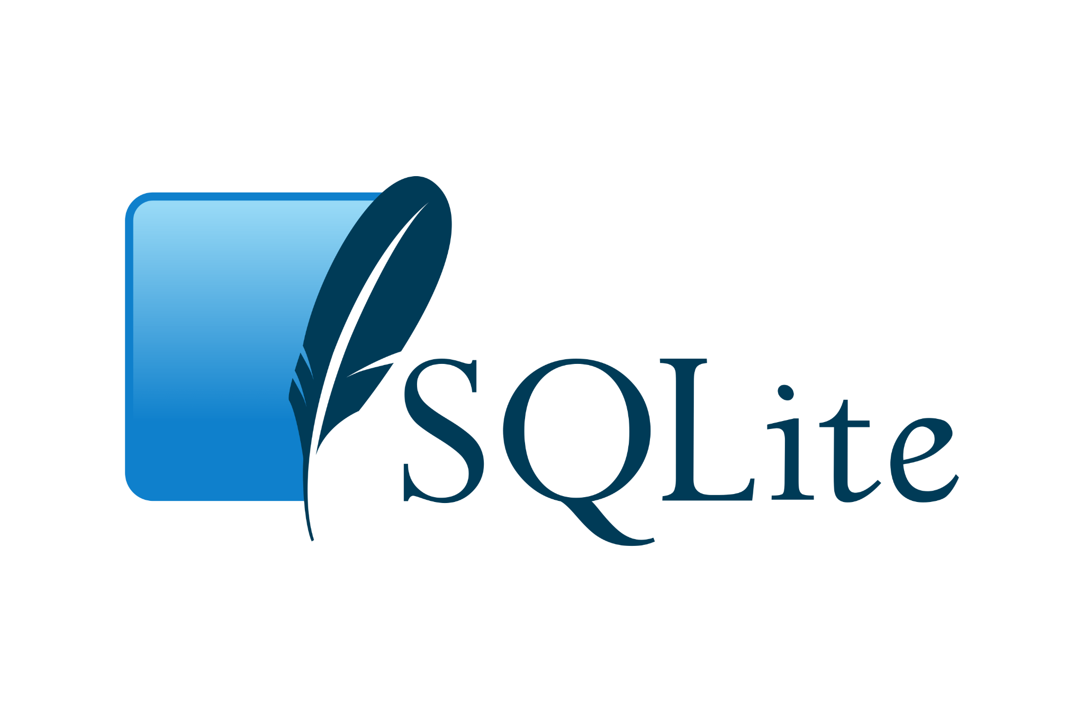

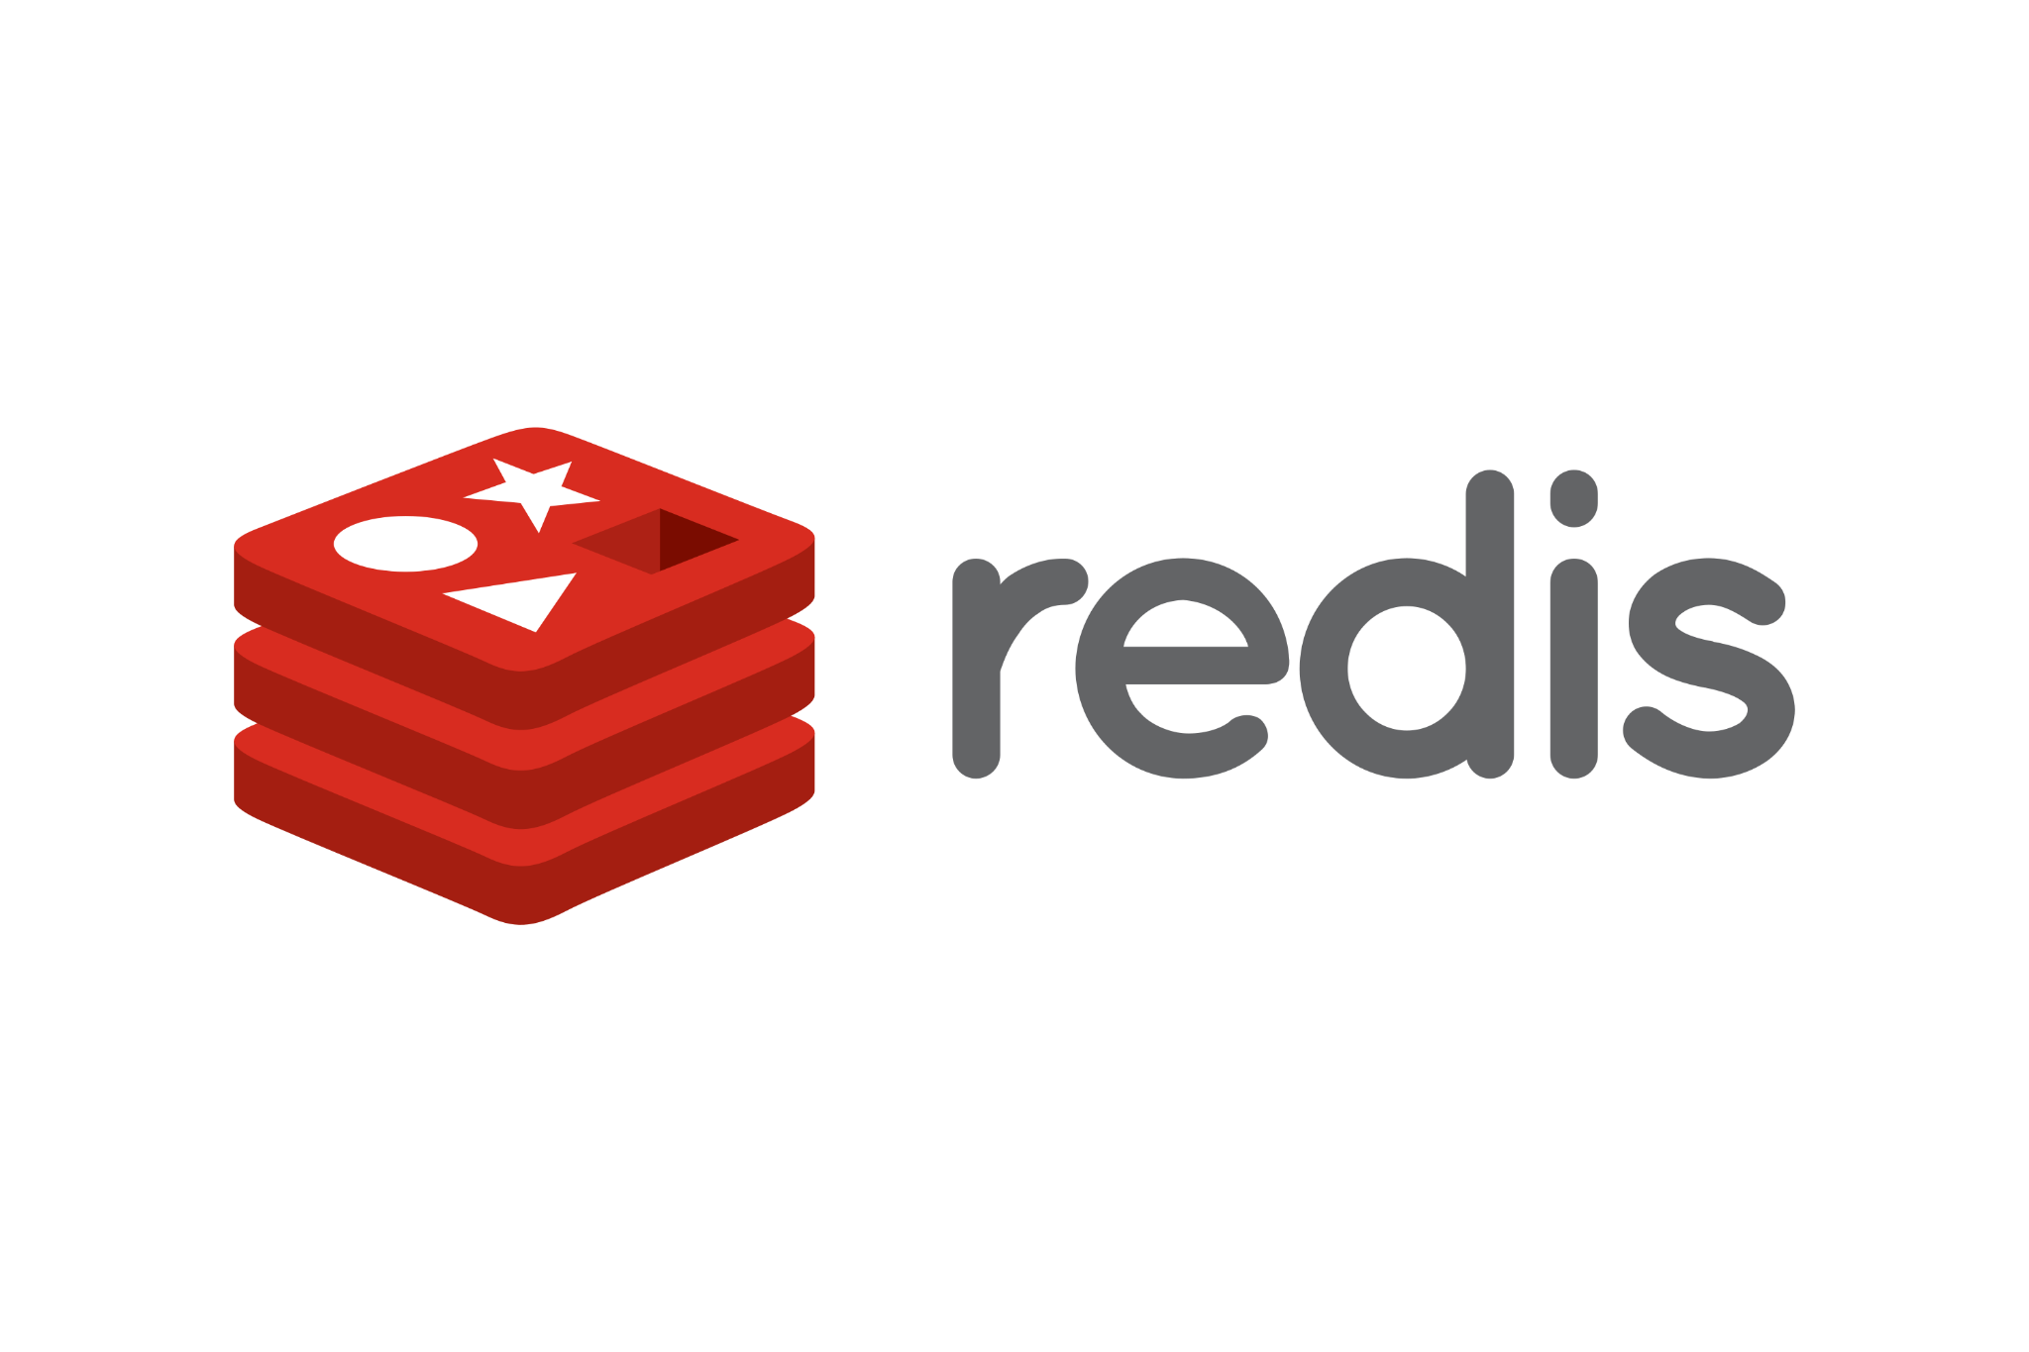

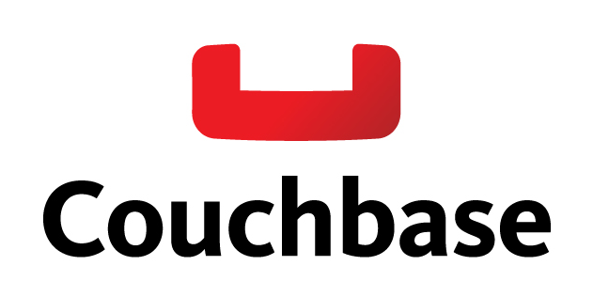
The Right Database is Like the Right Datastructure
Picking the right database will save you time and headaches.
E.G.
Relational
Diablo
Key - Value (Think Huge, scalable dictionary)
Vampire Survivors
Object Store / Database
Divinity: Original Sin

Slide 7
Demo
Create SQLite database in directory (Assets/StreamingAssets/ItemDatabase.db)
Create DSN pointing to SQLite database
Open SQLite database with LibreOffice Base
Create several items using auto-generated Base form
Move SQLite DLL from Unity directory and Open SQLite database from Unity.
(My Directory: C:\Program Files\Unity 2020.3.21f1\Editor\Data\MonoBleedingEdge\lib\mono\unity\Mono.Data.Sqlite.dll)
Move other SQLite DLL from SQLite install directory (D:\SQLite\sqlite3.dll and sqlite3.def in my case)
Create C# script for reading SQLite data (Note: Should be in Entity Framework, is not to make demo more compact)
Load items into Unity
Export items to ScriptableObjects

Slide 8
Conclusion (What We’ve Learned)
Databases are used to store large amounts of data
  Uniform, organized data works well in an RDBMS
  Disorganized data is better suited to a NoSQL database
Databases abstract data workflows from code workflows
It can be easier to build data editing tools and import / export data instead of working with data objects in code.
Dylan Brams
www.imaginarycomponent.com
https://www.youtube.com/channel/UCP7WaiERgv5dJgW-E57R1EQ

Slide 9
Additional Tech Slides for More Completeness
Cut for time and sheer boredom factor
Peruse at your leisure

Slide 10
DevOps-Style Architecture
Smaller components
Each component plays to its own strengths
Unity as a frontend.
Dotnet Core for server middleware (as much code reuse as possible)
The real advantage of using Unity for scaled architecture (over Unreal) is C# is a more common cross-platform tool.
Item / Money Management
Scoreboard
Data
Unity
(big front end)
Interwebs
Back End Routing / Combination
World
Data
Data
Player Designed Content

Slide 11
Practical Connectivity
Direct connection to a database is not an easy problem to solve across platforms.
Rest API’s are a much better solution, so definitely do that instead of direct connections from Unity until Unity supports more of the Dotnet Core platform
Building one is too large for this talk.
Example Production Stack
DB
Unity Application
Network Interaction (REST API)
Processing (using Entity Framework)
Local Dev / Scriptable Object Stack (Demo Example)
SQLite
Scriptable Objects In Uniy
LibreOffice Base

Slide 12
No, Really.
Caching (Redis or other simplistic key-value datastore)
Data Storage (Anything, Mongo or other Key / value)
Management of uniform data (RDBMS)
Isolation of data from code for scaling and division of labor / function
Production Stack
DB
Client Application
Network Interaction (REST API)
Data Processing (with ORM)
Development Stack
Web Based Data Editing
Entity Framework (Developers)
DB
Excel or other Imports

Slide 13
Advantages: Technical
Organization
Performance
Storage – More at higher speed than in-app
ACID (Atomicity, Consistency, Isolation, and Durability) – RDBMS and NewSQL Only
Atomicity: Is each transaction one tiny chunk? Yes.
Consistency: Does the database contain valid data after each transaction? Yes.
Isolation: Can concurrent transactions break each other? No.
Durability: Once a transaction is committed, if the system shuts down unexpectedly will it lose that transaction? No.
DB

Slide 14



Advantages: By Type of Database
RDBMS: (Relational Database Management Systems)
  ACID compliant
  expertise and ORM’s widely available
  Servers are free and easy to set up, capable of massive scaling, or both.
NoSQL: (Not Only SQL)
  NoSQL is generally not ACID compliant
  Faster to implement
  Can be extremely effective under load and in production
  Often special-use, so selection of the proper tool is more difficult and beneficial.
NewSQL:
  Combines NoSQL use cases / scaling with ACID reliability.
  New technology, comparatively, and expertise is rare / expensive.

Slide 15
Insert Talking Head Here

