Slide 1


University of Wisconsin-Stout
Computer Engineering
Class Project Presentation
Dylan Christopherson
Dr. Cheng Liu
May 1, 2019

Slide 2
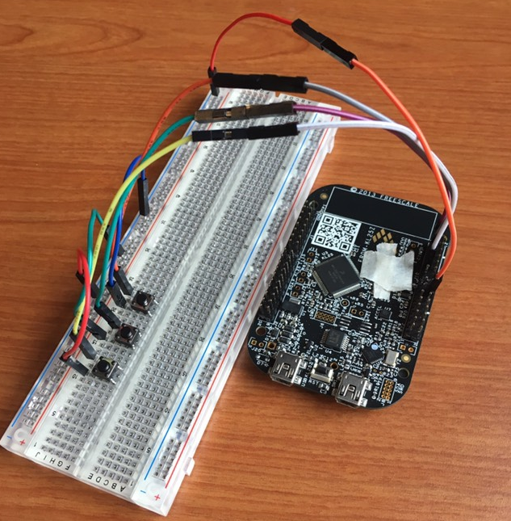
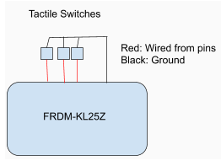
LED control using Capacitive Touch Sensor
Capacitive Touch Sensor

Slide 3
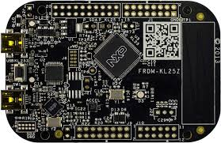
Project Description
Goals
Initial goal: Use the capacitive touch sensor to control the on board LED (Initial)
Additional goal: Use push buttons to change color of LED
Costs (<$20)
Freedom board
Wires/breadboard
Tactile switches
Notes:
Push my self to be a better student and really embody the polytechnic aspect of the university

Slide 4
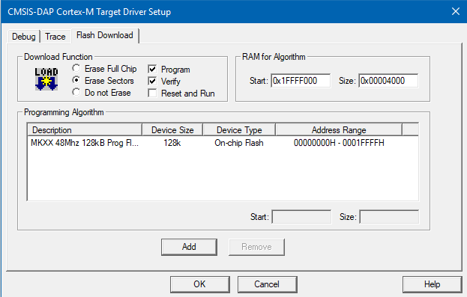
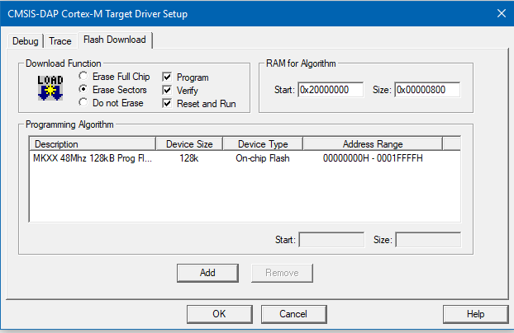
Project Progression
Initially, wanted to code myself
Touch Sensing Software(TSS): NXP Semiconductors
Contains examples, large amount of code
Wouldn’t build immediately (Options for target)

Slide 5
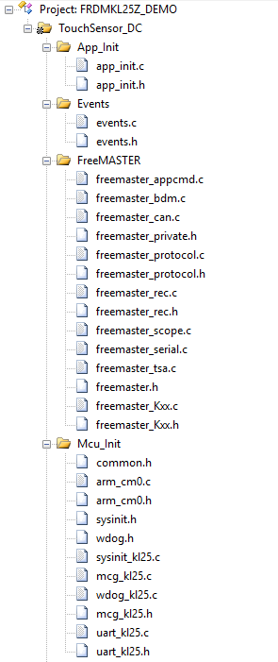
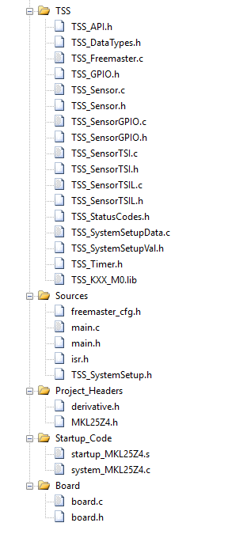
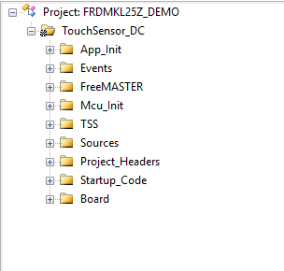
TSS provided project structure

Slide 6
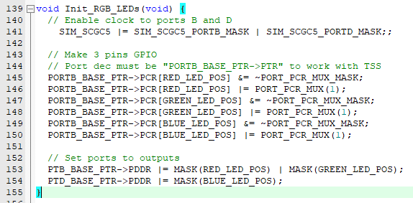
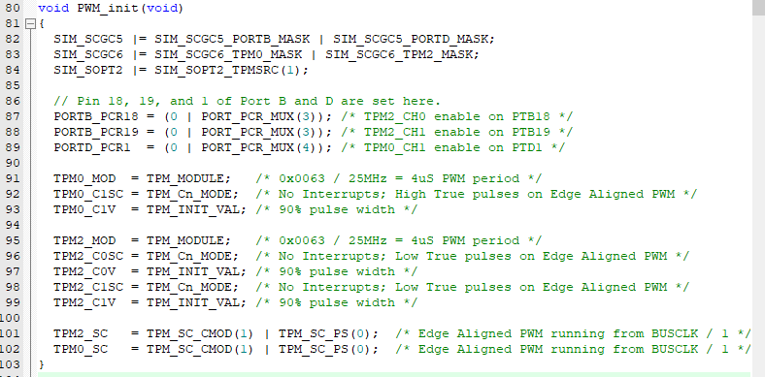
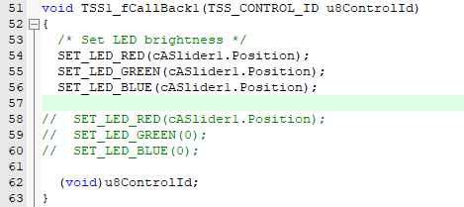
Beginning of multicolor LED
Lab 9 LED code
Init_RGB_LED()
PTB_BASE_PTR->PCOR = MASK()
TSS
PWM_init()
SET_LED_{COLOR}();
More problems
Search SET_LED…
cASlider.Position
Variable in events.c

Slide 7
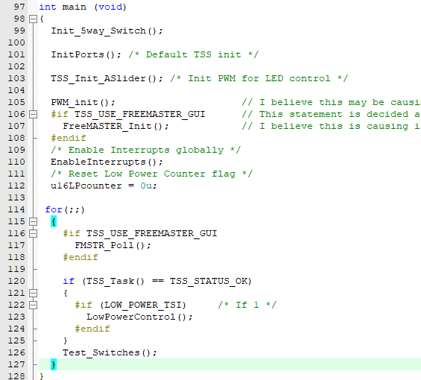
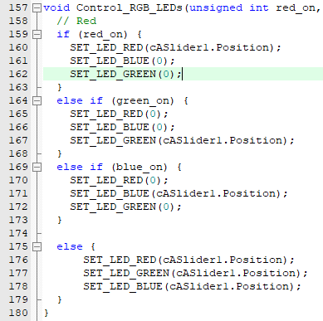
Main function
Main()->Test_Switches()->Control_RGB_LEDs()

Slide 8
Wrap up/Any Questions?
Just had to find the right functions/variables
Project structure had depth
Questions?

