Slide 1
Build GUIs with Python and Glade
Terry Howald

Slide 2
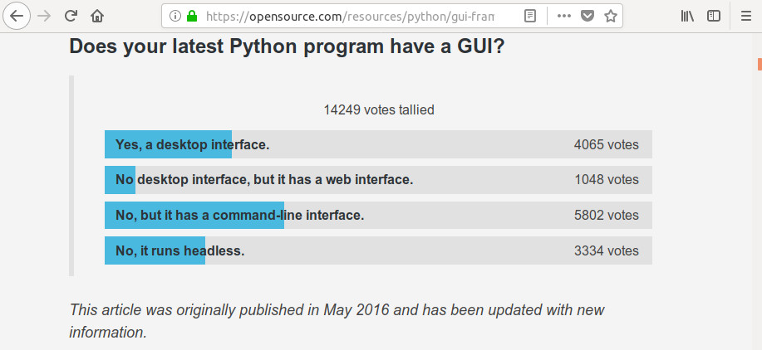
Build GUIs with Python?

Slide 3
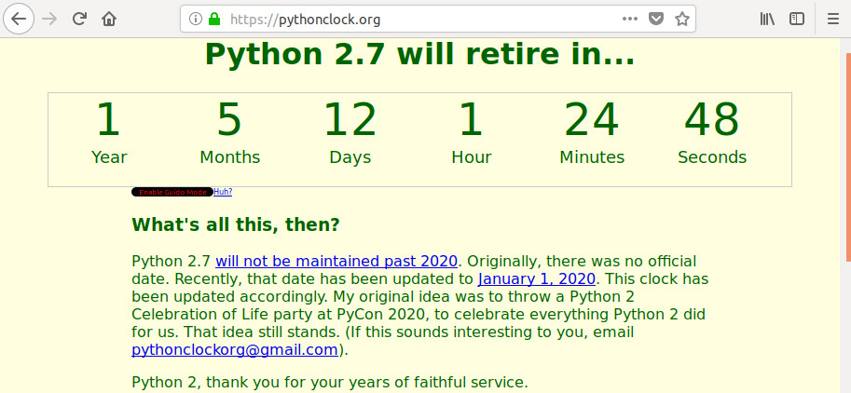
Develop with Python3

Slide 4
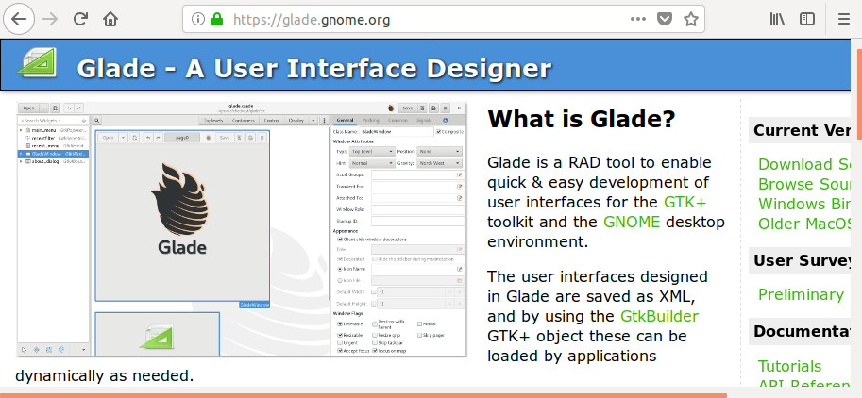
Build GUIs with Glade?

Slide 5
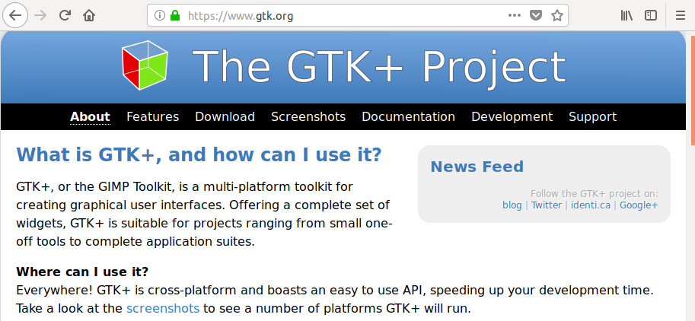
Glade creates GUIs for GTK+

Slide 6
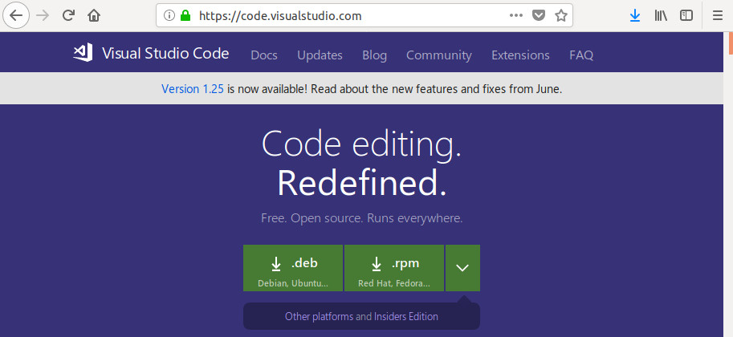
Edit in Visual Studio Code

Slide 7
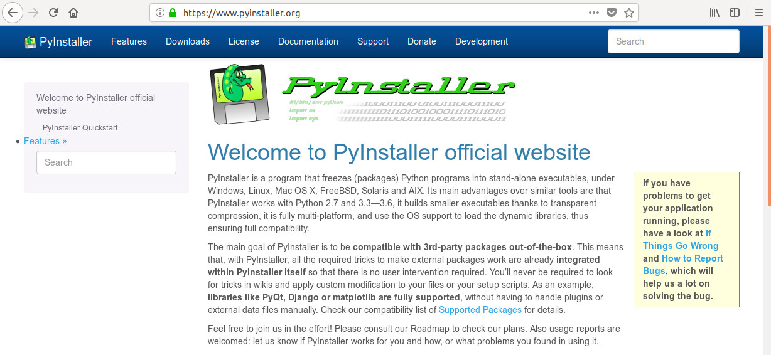
Distribute with PyInstaller

Slide 8
Questions and/or Comments
Build GUIs with Python and Glade
Terry Howald
terry.howald@gmail.com
https://github.com/terryhowald/pyohio_2018

