Slide 1
PCA

Slide 2
Introduction
Machine Learning problems involve thousands or even millions of features for each training instance => training is extremely slow + make it much harder to find a good solution
It is often possible to reduce the number of features considerably
E.g. the pixels on the image borders of MNIST are almost always white => you can drop these pixels from the training set without losing much information
2 neighboring pixels are often highly correlated => you could merge them into 1 single pixel without losing much information
It may lead to slightly worse performance + makes the pipeline a little more complex.
Or it may filter out some noise and unnecessary details

Slide 3
Introduction
Useful for data visualization → reducing the number of dimensions to 2 or 3 =>
plot a condensed view of a high-dimensional training set on a graph and gain some important insights by visually detecting patters, such as clusters.
communicate you conclusions to people who are not data scientists

Slide 4
Curse of dimensionality
Things behave very differently in high-dimensional space.
Example 1
If you pcik a random point in a unit square (a 1 x 1 square) => 0,4% chance of being located less than 0,001 from a border
In a 10 000 dimensional unit hypercube => probability > 99,999999% => most points in a high-dimensional hypercube are very close to the border
Example 2
distance between 2 points in a unit square ~ 0,52
distance between 2 points in a unit 3D cube ~ 0,66
distance between 2 points in a 1 000 000 hypercube ~ 408,25

Slide 5
Curse of dimensionality
high – dimensional datasets are at risk of being very sparse: most training instances are likely to be far away from each other
A new instance will likely to be far away from any training instance => making predictions much less reliable than in lower dimensions => great risk of overfitting
One solution to the curse of dimensionality could be to increase the size of the training set => reach a sufficient density of training instances. The number of training instances required to reach a given density grows exponentially with the number of dimensions

Slide 6
Main approaches for Dimensionality Reduction
Projection
Manifold Learning

Slide 7
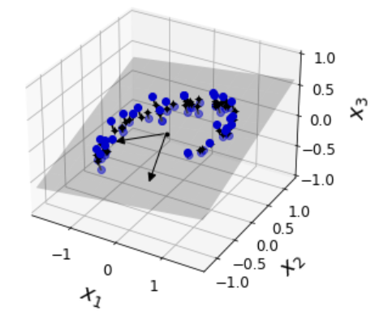
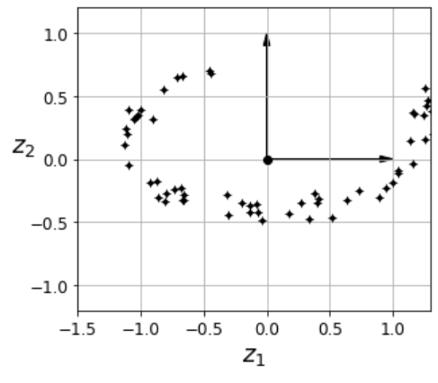
Projection
In most real-world problems, training instances are not spread out uniformily across all dimensions => all training instances actually lie withn a much lower-dimensional subspace of the high-dimensional space.
All training instaces lie close to a plane We can project every training instance perpendicularly onto this subspace 3D → 2D

Slide 8
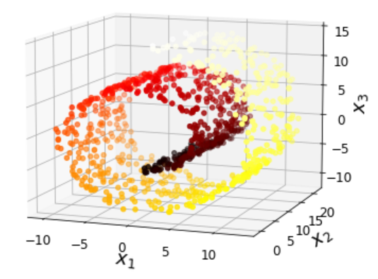
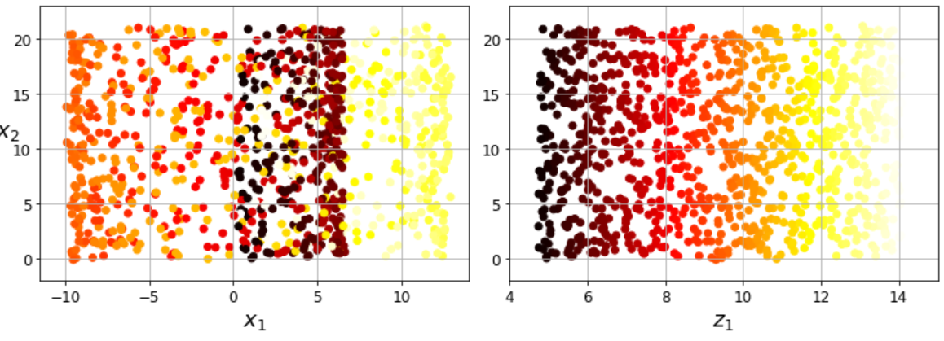
Projection
Projection is not always the best approach to dimensionality reduction, e.g. Swiss rol Simply projecting onto a plane would squash different layers of the Swiss roll together. Instead, you want to unroll the Swiss roll

Slide 9
Manifold learning
The Swiss roll is an example of a 2D manifold. A 2D manifold is a 2D shape that can be bent and twisted in a higher-dimensional space. A d-dimensional manifold is a part of an n-dimensional space (d < n) that locally resembles a d-dimensional hyperplane. In the case of the Swiss roll (d = 2 and n = 3): it locally resembles a 2D plane, but it is rolled in the third dimension
Manifold Learning relies on the manifold assumption (also called manifold hypothesis) which holds that most real-world high-dimensional datasets lie close to a much lower-dimensional manifold. This assumption is very often empirically observed.

Slide 10
Manifold learning
E.g. the MNIST dataset: connected lines, borders are white, digits are more or less centered <-> randomly generated images The degrees of freedom available if you try to create a digit image are dramatically lower than the degrees of freedom you would have if you were allowed to generate any image you wanted
The manifold assumption is accompanied by another implicit assumption: the task at hand will be simpler if expressed in the lower-dimensional space of the manifold This assumption does not always hold.
If you reduce the dimensionality of the training set before training a model, it will usually speed up training, but it may not always lead to a better or simpler solution. It all depends on the dataset.

Slide 11
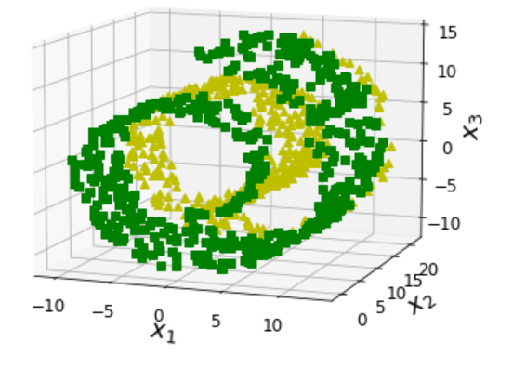
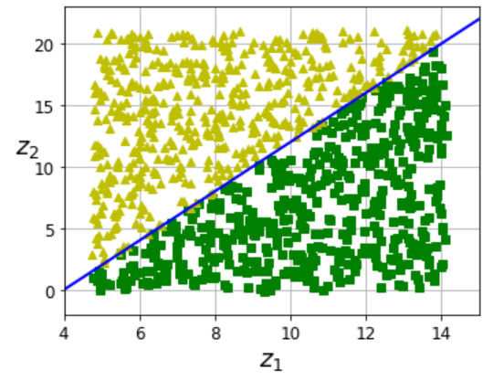
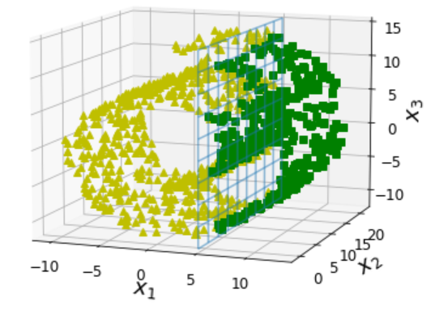
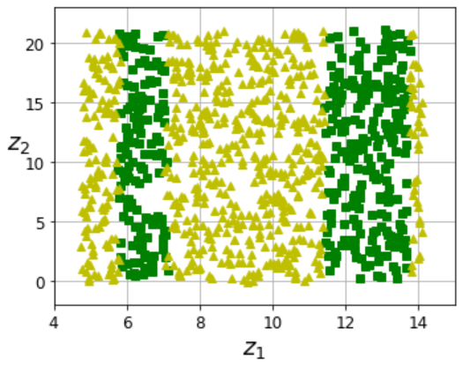
Manifold learning
In 3D space, the decision boundary would be fairly complex. In 2D space the decision boundary is a simple line
In 3D space, the decision bounday is located at x1 = 5. In 2D space it looks more complex

Slide 12
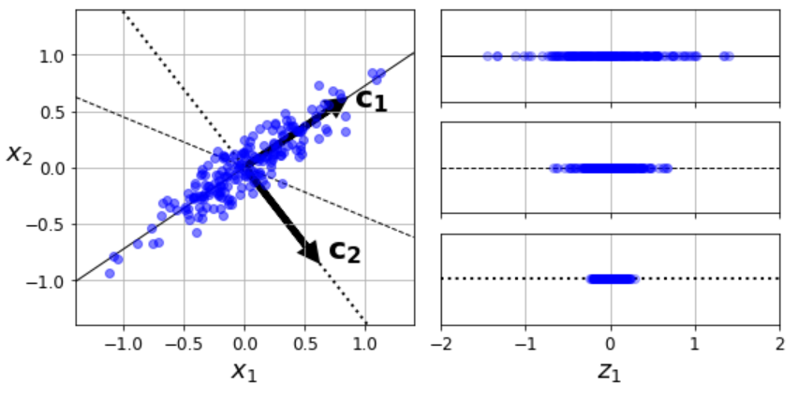
PCA = Principal Component Analysis
Before you project the training set onto a lower-dimensional hyperplane, you first need to choose the right hyperplane. a simple 2D dataset at the left + the projection on a 1D hyperplane
Projection onto the solid line preserves the maximum variance, while projection onto the dotted line preserves very little variance It is the axis that minimizes the mean squared distance between the original dataset and its projection onto that axis.

Slide 13
Principal Components
PCA identifies the axis that accounts for the largest amount of variance in the training set.
The second axis (= orthogonal to the first one) accounts for the largest amount of remaining variance (in the example → dotted line)
In a higher-dimensional dataset, PCA also finds a third axis, orthogonal to both previous axes, and a fourth, fifth, …
i^{th} principal component = unit vector that defines the i^{th} axis
1st PC is c₁
2nd PC is c₂
3rd PC is orthogonal to the plane

Slide 14
Principal Components
How can you find the principal components of a training set?
Using SVD = Singular Value Decomposition
X = U Σ V^{T} where V contains all the principal components that we are looking for
Once you have identified all the principal components, you can reduce the dimensionality of the dataset down to d dimensions by projecting it onto the hyperplane defined by the first d principal components. Selecting this hyperplane ensures that the projection will preserve as much variance as possible
X_{d-proj} = X * W_{d} (W_{d} is the matrix containing the first d principal components = the first d columns of V)

Slide 15
Using Scikit-Learn
from sklearn.decomposition import PCA
pca = PCA(n_components = 2)
X2D = pca.fit_transform(X)
pca.explained_variance_ratio_ → indicates the proportion of the array([0.84248607, 0.14631839]) dataset's variance that lies along the axis of each principal component
84.2% of dataset's variance lies along the first axis 14,6% lies along the second axis => 1,2% lies along the third axis => it probably carries little information

Slide 16
Choosing the right number of dimensions
If you want to reduce dimensionality for data visualization => you want to reduce the dimensionality down to 2 or 3
Otherwis, choose the number of dimensions that add up to a sufficiently large portion of variance (e.g. 95%)
pca = PCA()
pca.fit(X_train)
cumsum = np.cumsum(pca.explained_variance_ratio_)
d = np.argmax(cumsum >= 0.95) + 1
→
pca = PCA(n_components=0.95)
X_reduced = pca.fit_transform(X_train)

Slide 17
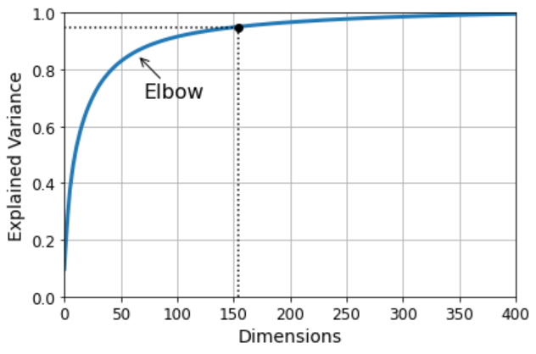
Choosing the right number of dimensions
Plot the explained variance as a function of the number of dimensions (simply plot cumsum)

Slide 18
PCA for Compression
After dimensionality reduction, the training set takes up less space.
E.g. applying PCA to the MNIST dataset while preserving 95% of its variance => 150 features (instead of 784) => dataset is less than 20% of it's original size
It is also possible tho decompress the reduced dataset back to 784 dimensions by applying the inverse transformation on the PCA projection.
Rhe projection lost a bit of information
Reconstruction error = means squared distance between the original data and the reconstructed data

Slide 19
PCA for compression
pca = PCA(n_components = 154)
X_reduced = pca.fit_transform(X_train)
X_recovered = pca.inverse_transform(X_reduced)
X_{recovered} = X_{d-proj} * W_{d} ^{T}

Slide 20
Randomized PCA
rnd_pca = PCA(n_components=154, svd_solver="randomized")
X_reduced = rnd_pca.fit_transform(X_train)
svd_solver = "randomized" => Scikit-Learn uses a stochastic algorithm (Randomized PCA) that quickly finds an approximation of the first d principal components
svd_solver = "auto" => Scikit-Learn uses the randomized PCA algorithm if m or n is greater than 500 and d is less than 80% of m or n, or else it uses the full SVD sapproach.
svd_solver = "full" => full SVD

Slide 21
Incremental PCA
If the whole training set doesn't fit in memory => you cans split the training set into mini-batches and feed an ICPA algorithm one mini-batch at a time.
Useful for large training sets + to apply PCA online
from sklearn.decomposition import IncrementalPCA
n_batches = 100
inc_pca = IncrementalPCA(n_components=154)
for X_batch in np.array_split(X_train, n_batches):
inc_pca.partial_fit(X_batch)
X_reduced = inc_pca.transform(X_train)

Slide 22
Kernel PCA
Kernel trick = a mathematical technique that implicitly maps instances into a very high-dimensional space (called the feature space), enabling nonlinear classification and regression with SVM
A linear decision boundary in the high-dimensional feature space corresponds to a complex nonlinear decision boundary in the original space
Kernel PCA makes it possible to perform complex nonlinear projections for dimensionality reduction. It is often good at preserving clusters of instances after projection

Slide 23
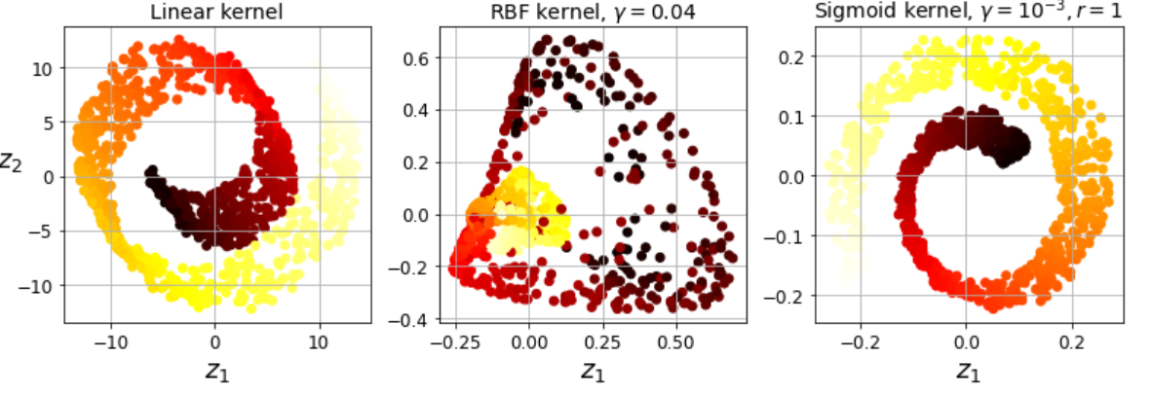
Kernel PCA
from sklearn.decomposition import KernelPCA
rbf_pca = KernelPCA(n_components = 2, kernel="rbf", gamma=0.04)
X_reduced = rbf_pca.fit_transform(X)

Slide 24
Selecting a Kernel and Tuning Hyperparameters
kPCA is an unsupervised learning algorithm => there is no obvious performance measure to help you select the best kernel and hyperparameter values.
Dimensionality reduction is often a preparation step for a supervised learning task (e.g. classification) => you can simply use grid search to select the kernel and hyperparameters that lead to the best performance on that task.

Slide 25
Selecting a Kernel and Tuning Hyperparameters
from sklearn.model_selection import GridSearchCV
from sklearn.linear_model import LogisticRegression
from sklearn.pipeline import Pipeline
clf = Pipeline([
("kpca", KernelPCA(n_components=2)),("log_reg", LogisticRegression())])
param_grid = [{ "kpca__gamma": np.linspace(0.03, 0.05, 10),
"kpca__kernel": ["rbf", "sigmoid"] }]
grid_search = GridSearchCV(clf, param_grid, cv=3)
grid_search.fit(X, y) print(grid_search.best_params_)
{'kpca__gamma': 0.043333333333333335, 'kpca__kernel': 'rbf'}

Slide 26
Selecting a Kernel and Tuning Hyperparameters
Another approach = select the kernel and hyperparameters that yield the lowest reconstruction error.
Reconstruction is not as easy as with linear PCA
Applying kPCA us mathematically equivalent to mapping the training set to an infinite- dimensional feature space using the feature map φ, then projecting the transformed training set down to 2D using linear PCA.

Slide 27
Selecting a Kernel and Tuning Hyperparameters
If we could invert the linear PCA step for a given instance in the reduced space => the reconstructed point would lie in feature space, not in the original space.
But the feature space is infinite-dimensional => we cannot compute the reconstructed point => we cannot comput the true recon- struction error
It is possible to find a point in the original space that would map close to the reconstructed point (reconstruction pre-image). Once you have this pre-image, you can measure its squared distance to the original distance. => You can select the kernel and hyperparameters that minimize this reconstruction pre-image error.

Slide 28
Selecting a Kernel and Tuning Hyperparameters
rbf_pca = KernelPCA(n_components = 2, kernel="rbf", gamma=0.0433,
fit_inverse_transform=True)
X_reduced = rbf_pca.fit_transform(X)
X_preimage = rbf_pca.inverse_transform(X_reduced)
from sklearn.metrics import mean_squared_error
mean_squared_error(X, X_preimage)
32.786308795766132

Slide 29
LLE
Locally Linear Embedding is another powerful nonlinear dimensionality reduction technique. It is a Manifold Learning technique that does not rely on projections.
It first measures how each training instance linearly relates to its closest neighbours and then it looks for a low-dimensional representation of the training set where these local relationships are best preserved
It makes it particularly good at unrolling twisted manifolds
from sklearn.manifold import LocallyLinearEmbedding
lle = LocallyLinearEmbedding(n_components=2, n_neighbors=10)
X_reduced = lle.fit_transform(X)

Slide 30
Other dimensionality reduction techniques
Multidimensional Scaling (MDS) reduces dimensionality while trying to preserve the distances between the instances
Isomap creates a graph by connecting each instance to its nearest neighbours, then reduces dimensionality while trying to preserve the geodesic distances between het instances
t-Distributed Stochastic Neighbor Embedding (t-SNE) reduces dimensionality while trying to keep similar instances close and dissimilar instances apart. It is mostly used for visualization, in particular to visualize clusters of instances in high-dimensional space (e.g., to visualize the MNIST images in 2D).

Slide 31
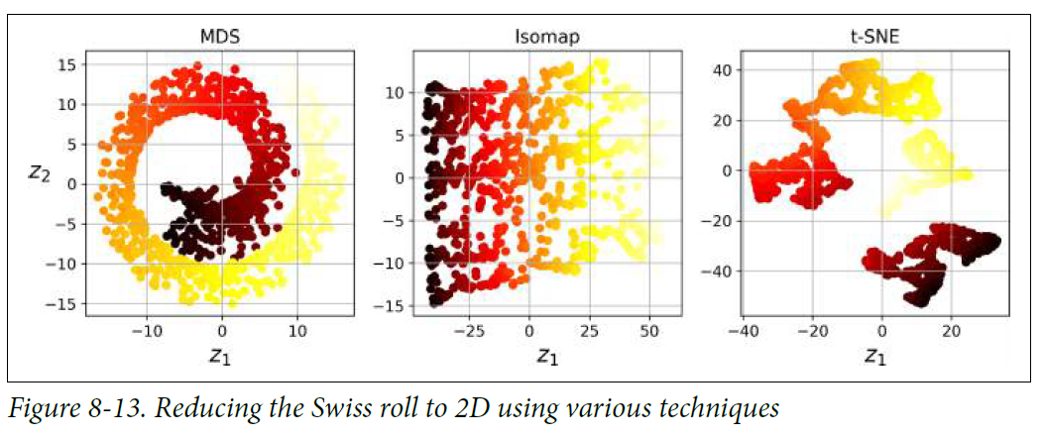
Other dimensionality reduction techniques
Discriminant Analysis (LDA) is actually a classification algorithm, but during training it learns the most discriminative axes between the classes, and these axes can then be used to define a hyperplane onto which to project the data. The benefit is that the projection will keep classes as far apart as possible, so LDA is a good technique to reduce dimensionality before running another classification algorithm such as an SVM classifier.

Slide 32
Questions
1. What are the main motivations for reducing a dataset’s dimensionality? What are the main drawbacks?
2. What is the curse of dimensionality?
3. Once a dataset’s dimensionality has been reduced, is it possible to reverse the operation? If so, how? If not, why?
4. Can PCA be used to reduce the dimensionality of a highly nonlinear dataset?
5. Suppose you perform PCA on a 1,000-dimensional dataset, setting the explained variance ratio to 95%. How many dimensions will the resulting dataset have?

Slide 33
Questions
6, In what cases would you use vanilla PCA, Incremental PCA, Randomized PCA, or Kernel PCA?
7. How can you evaluate the performance of a dimensionality reduction algorithm on your dataset?
8. Does it make any sense to chain two different dimensionality reduction algorithms?

