Slide 1
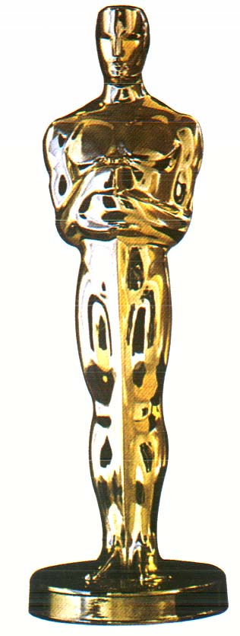
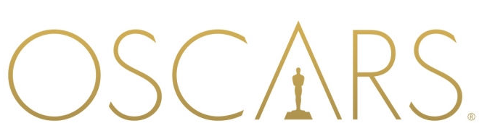

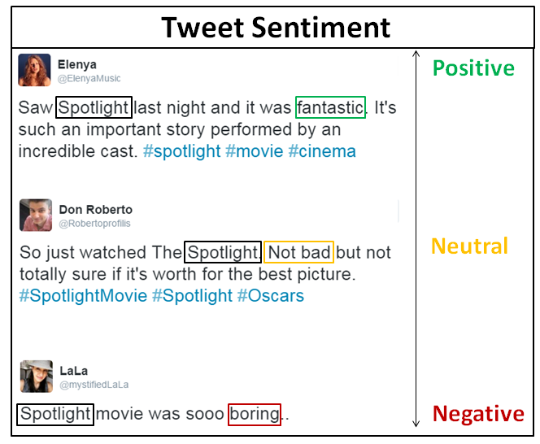
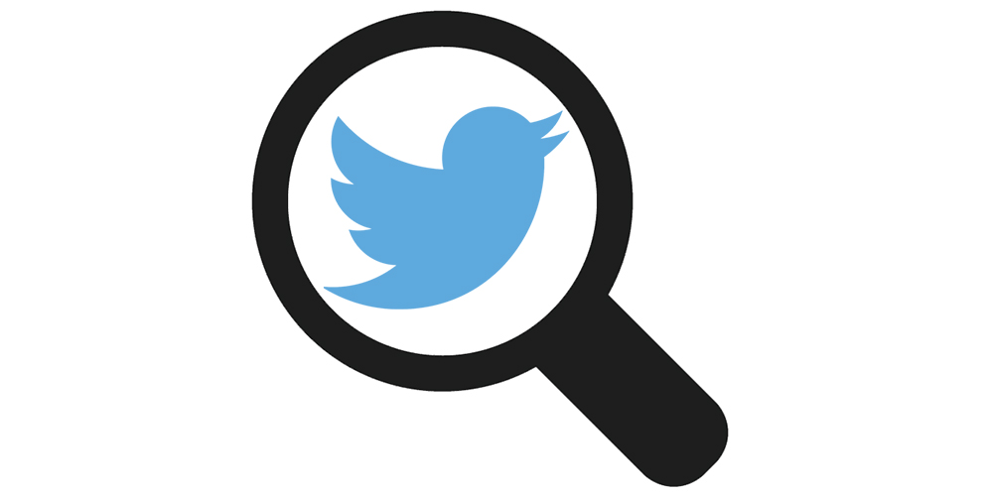
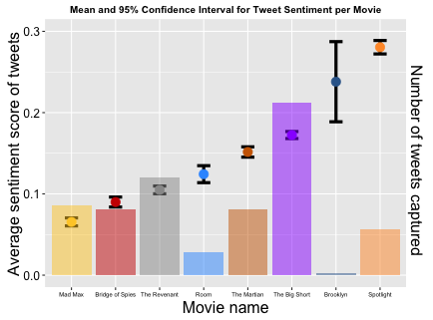
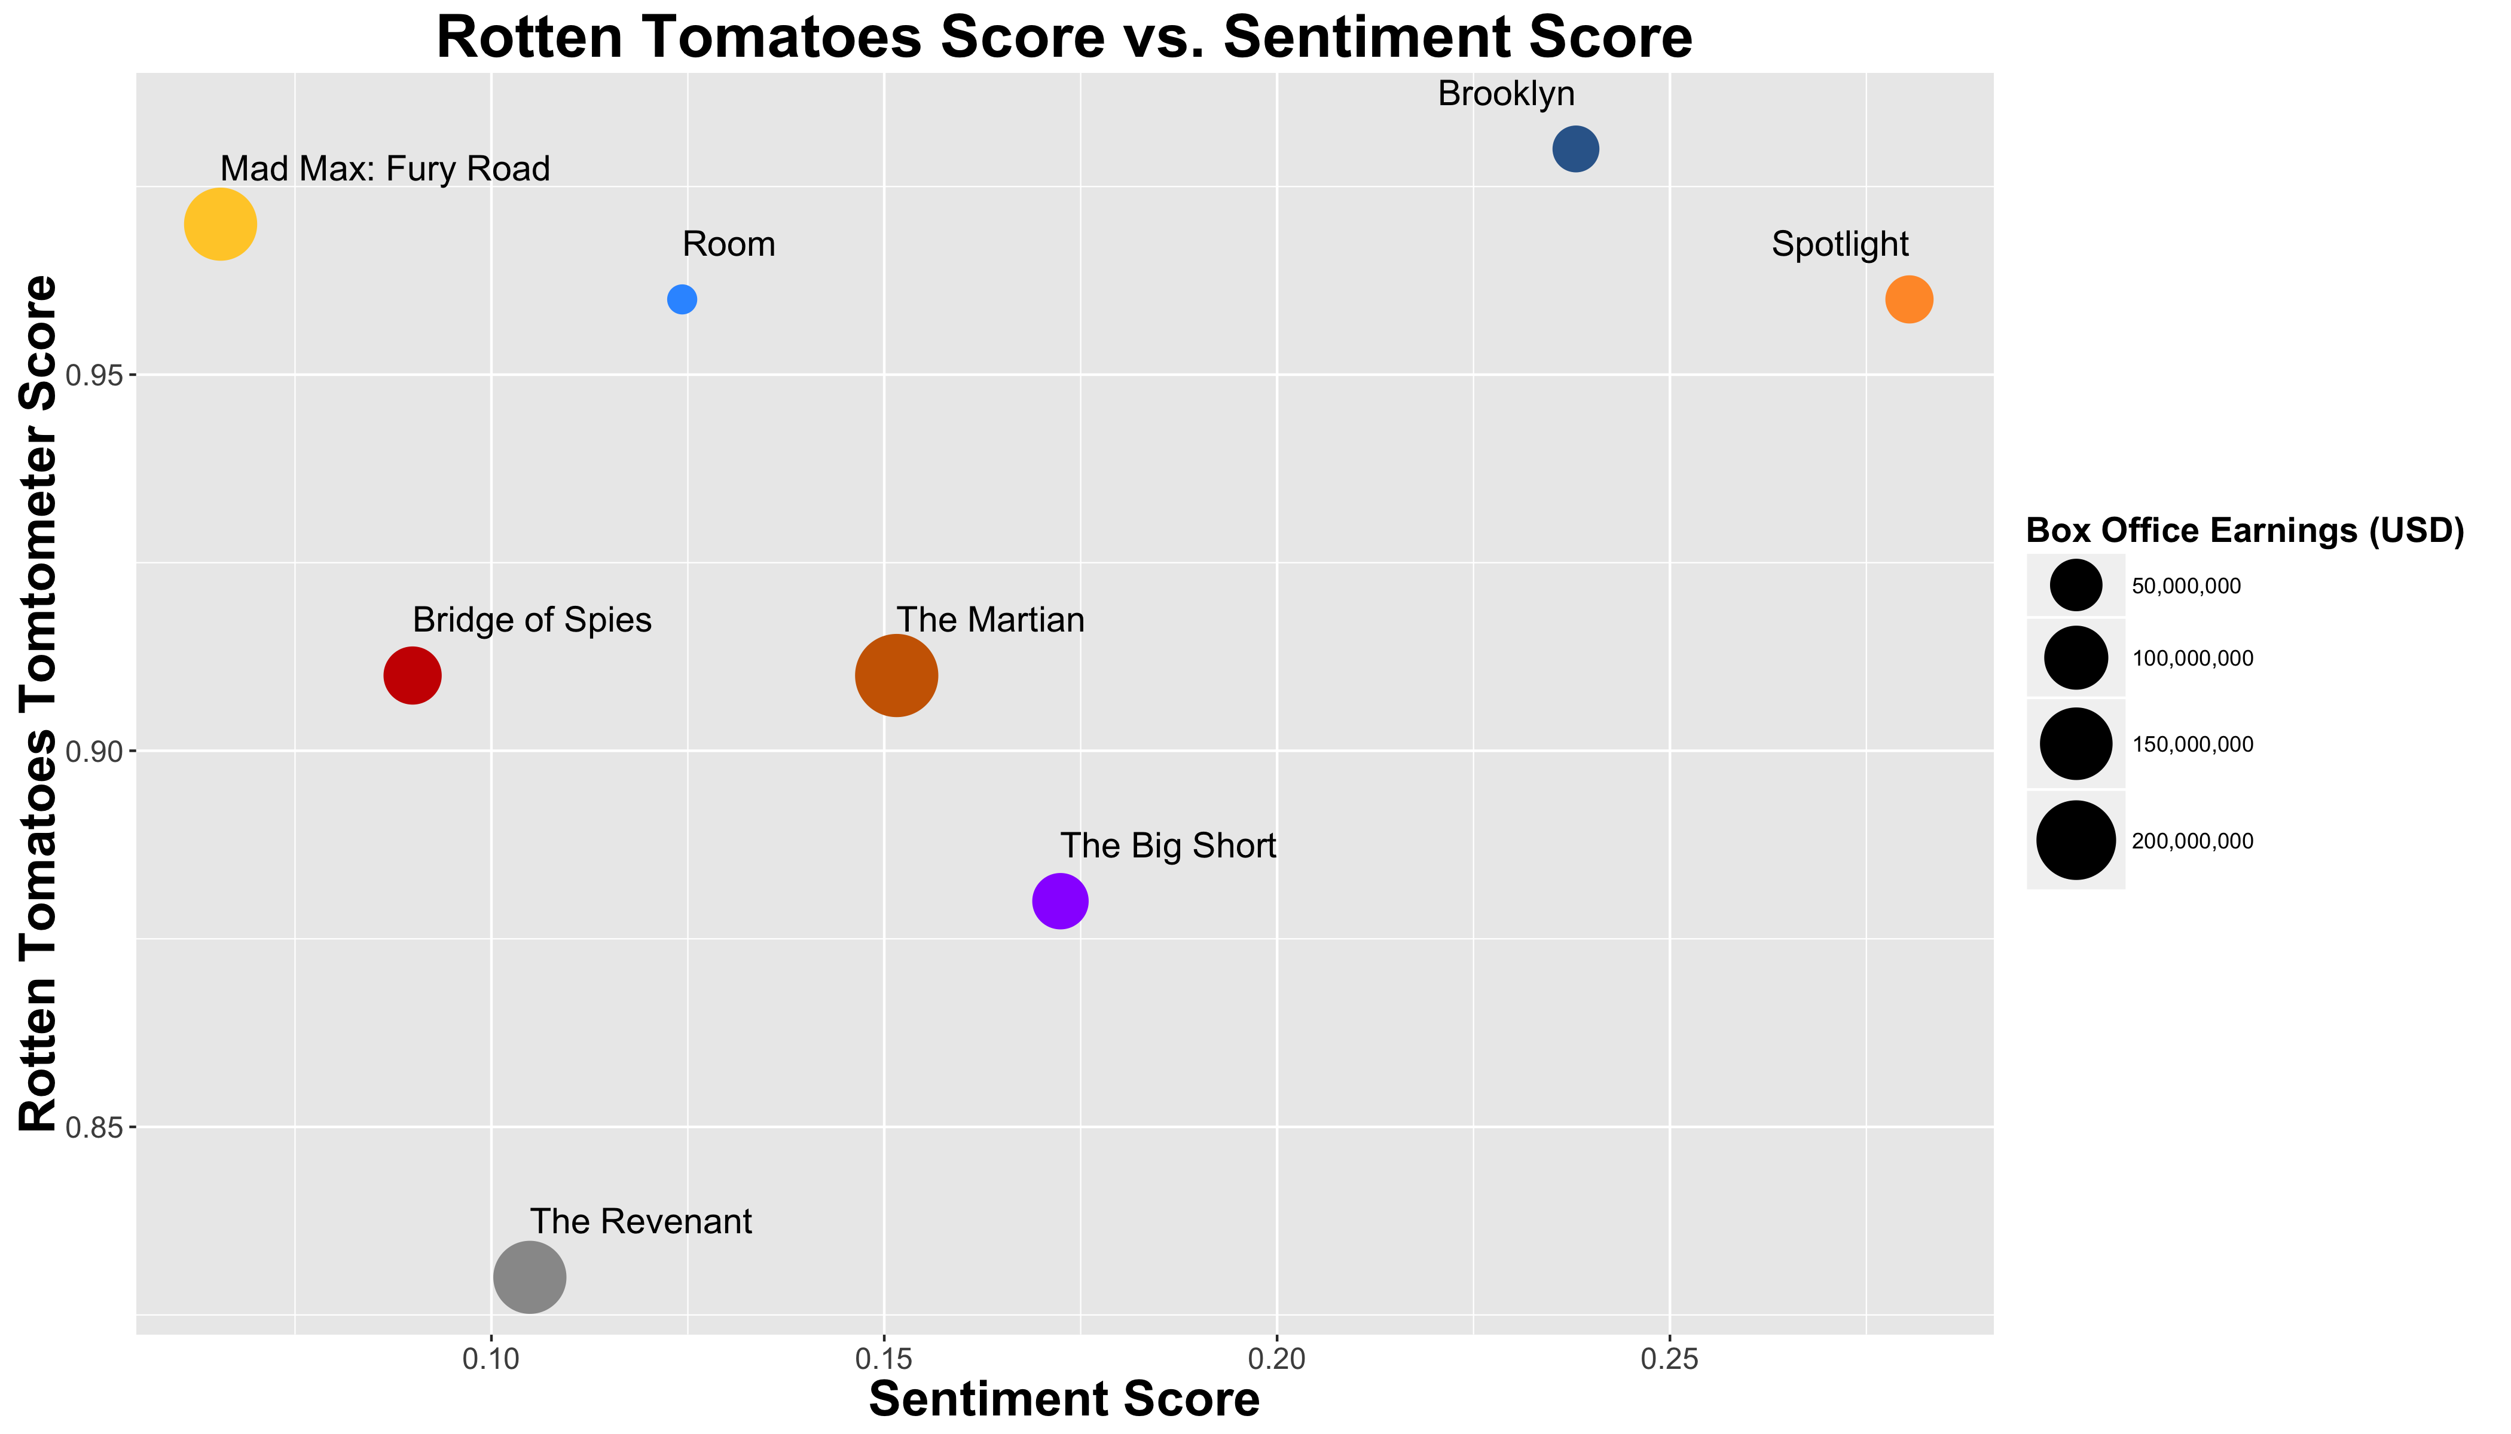
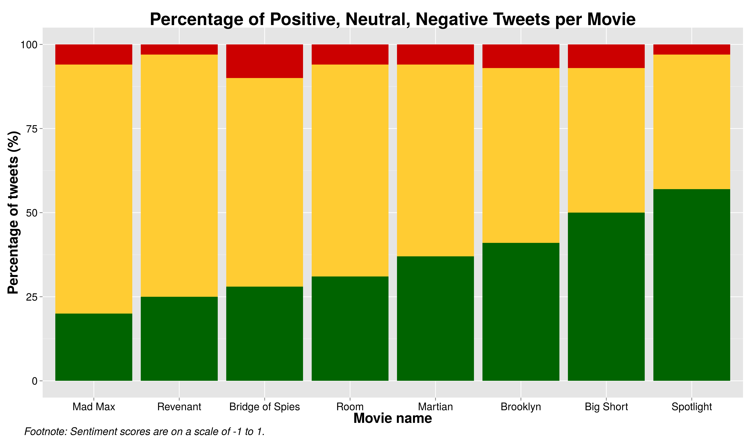
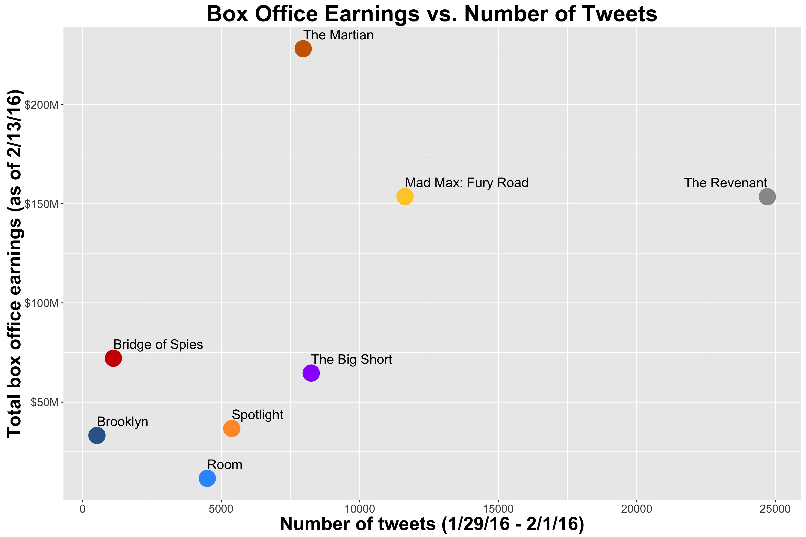
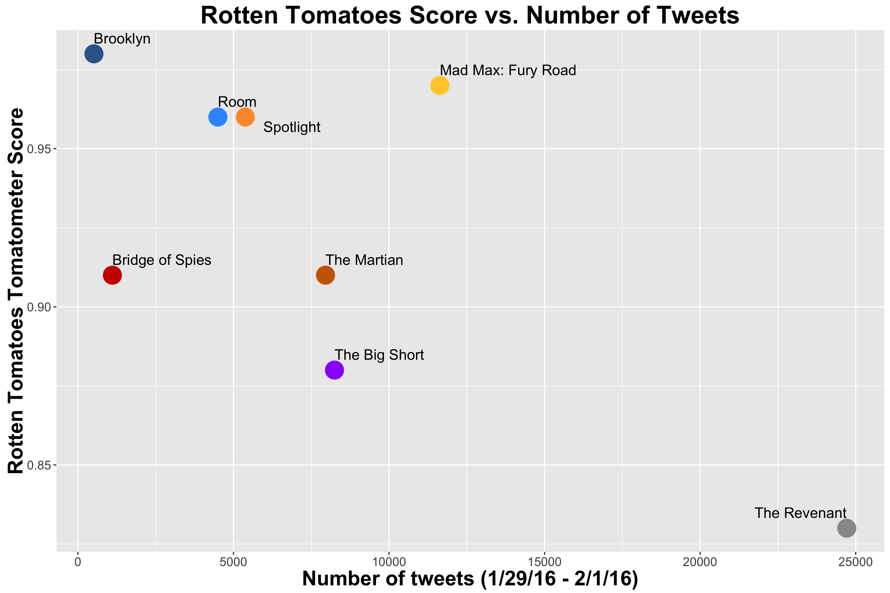
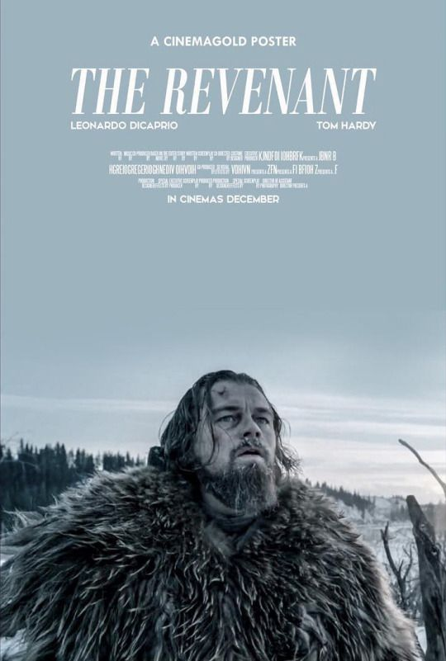
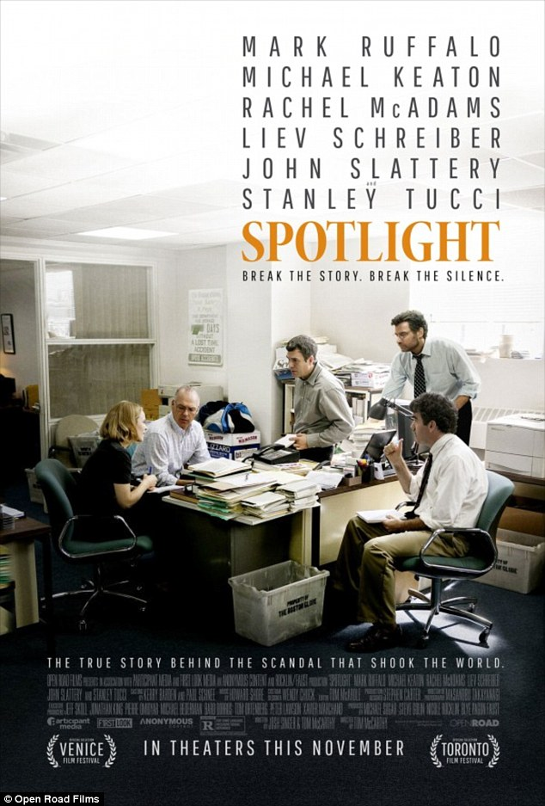
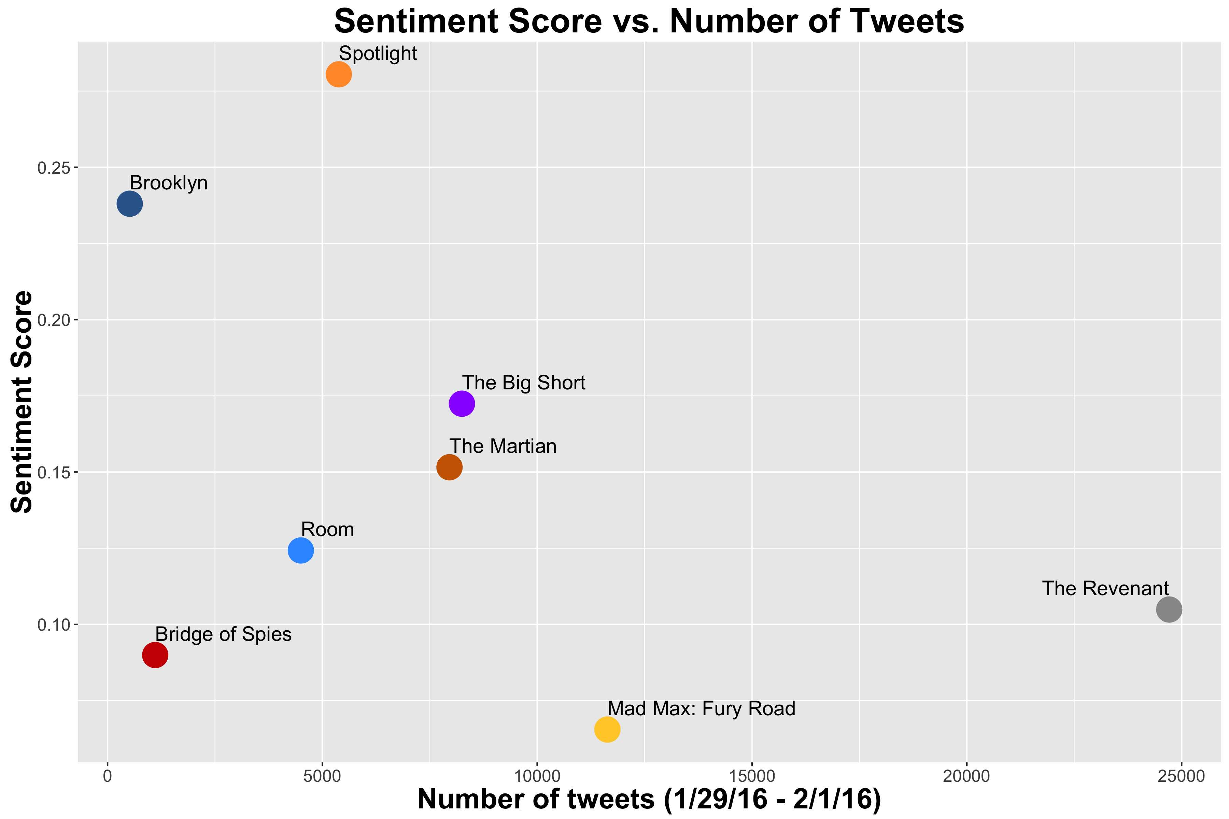


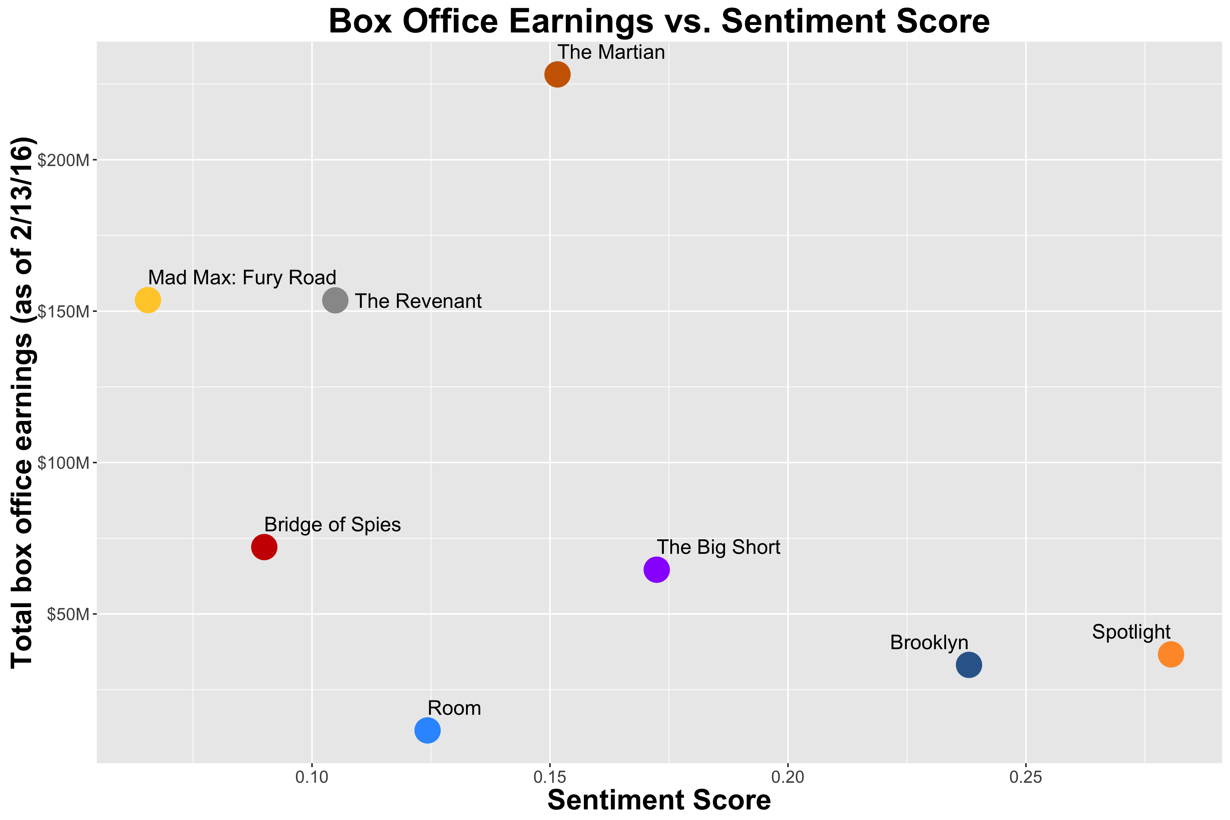
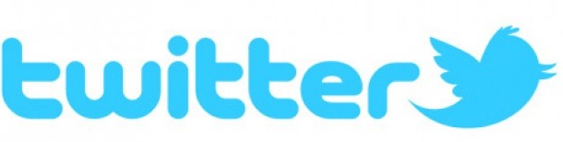
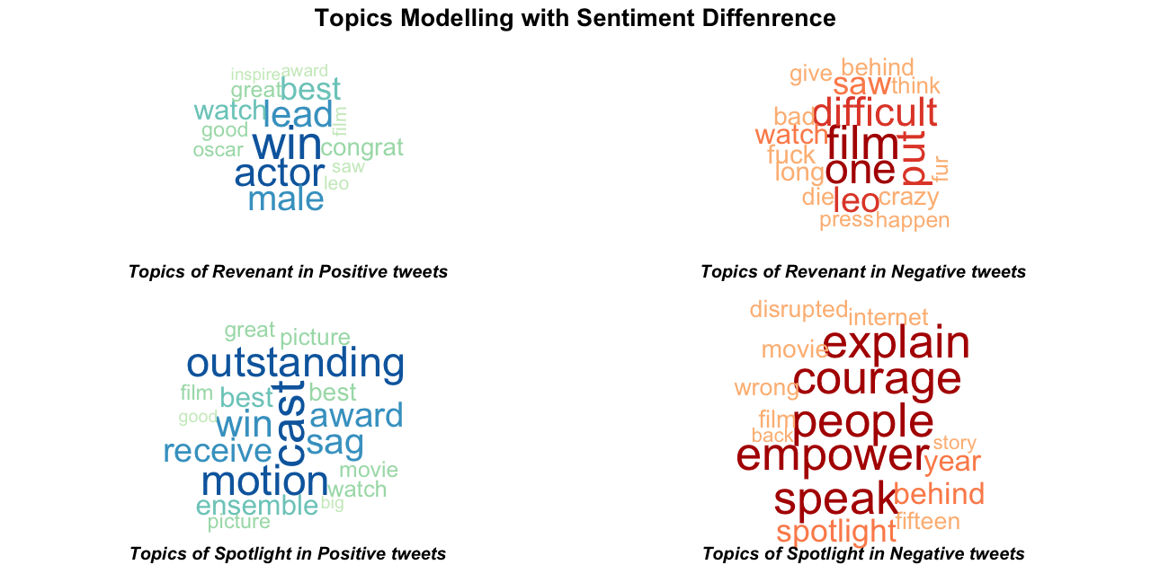
Analyzing the Sentiment and Success of the Best Picture Nominees
Dylan Daniels, Alanna Iverson, Mingyung Kim, Weiyan Shi, Yun Zhou and Jiang Zhu
UC Berkeley STAT 222 Master’s Capstone, Spring 2016
ABSTRACT
EVALUATING SENTIMENT
CONCLUSION
The “twittersphere” provides a vast trove of textual information, which can be mined to determine consumers’ opinions on a wide array of topics. With the Oscars looming, we set out to answer the question: What is the relationship between the sentiment and number of tweets about the 2016 Oscar’s best picture nominees and their commercial or critical success? We found that there exists a negative association between the average positivity of tweets and commercial success, and a positive association between the average positivity of tweets and critical success. In addition, among the tweets we analyzed, we found that more people tweeted about movies which had more success at the box office, but fewer people tweeted about those movies which were favorites amongst critics. Based on our analysis, who do you think the award will go to?
Search and Streaming API: 64,064 tweets January 29 – February 3, 2016
Despite the common perception that critics and moviegoers have differing opinions on popular movies, our analysis suggests the contrary for the eight Best Picture Nominees: moviegoers’ and critics actually tend to agree.
Positive tweets about The Revenant are focused on the main actor, rather than about the movie itself as with positive tweets about Spotlight. The Revenant also has much more negative words within its negative tweets than does Spotlight, showing a split in sentiment intensity.
Although box office success does seem to trend with higher numbers of mentions on Twitter, a higher proportion of positive tweets does not. Although box office success does seem to trend with higher numbers of mention on Twitter, it does not guarantee a higher proportion of positive tweets.
Validating, the wisdom of the crowds hypothesis, “Spotlight” won Best Picture on 2/28/2016. Nate Silver’s FiveThirtyEight.com had predicted “The Revenant.”
SENTIMENT AND SUCCESS
POPULARITY AND SUCCESS
trend
trend
Last Year’s Winner’s (Birdman) Score
trend
Last Year’s Winner’s (Birdman) Earnings
Figure 2: Moviegoers and critics tend to agree.
Figure 5: Positive association between number of tweets and box office success per movie.
Figure 6: More critically acclaimed movies are mentioned less frequently on Twitter.
Figure 1: Mean and 95% confidence interval of average sentiment per movie. The large CI around Brooklyn is explained by the low number of tweets.
Figure 3: Spotlight had the highest percentage of positive tweets, while The Revenant had the second lowest.
The Revenant | Spotlight
Positive | Negative | Positive | Negative
actor | difficult | cast | people
wins | films | outstanding | ordinary
male | put | motion | explains
leading | leo | sag | speaks
best | saw | award | courage
congrats | long | receives | empowering
win | oscar | best | years
great | mad | wins | movie
saw | never | winning | behind
good | crazy | ensemble | film
trend
trend
Figure 7: The most talked about movies are not always the most well-liked.
CONTACT
Dylan Daniels: dylandaniels@berkeley.edu
Alanna Iverson: agi82@berkeley.edu
Mingyung Kim: mingyung_kim@berkeley.edu
Weiyan Shi: wyshi@berkeley.edu
Yun Zhou: yzhou277@berkeley.edu
Jiang Zhu: pigriver@berkeley.edu
https://github.com/dylandaniels/twitter-oscars
Figure 4: Positive sentiment does not guarantee box office success.
Table 1: Top 10 frequent words in both positive and negative tweets.

