Slide 1
Neural Network Architectures for Short Text

Slide 2
Agenda
Introduction
Background
Related Work
Models Compared
Experiments Performed
Experimental Comparison
Conclusion and Future Work

Slide 3
Introduction
Introduction
Background
Related Work
Models Compared
Experiments Performed
Experimental Comparison
Conclusion and Future Work
Motivation
Purpose
Contributions
Experiment Overview

Slide 4
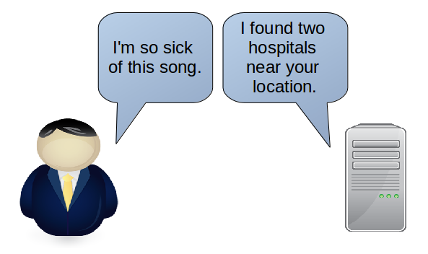
Motivation
Neural networks are end-to-end trainable.
Language is a catalyst for learning and discovery.
Large language barrier
between humans and
machines!
Introduction
Notes:
A large part of the human learning process involves interaction through the use of language---especially in the form of short sequences being exchanged back and forth. Machines need to have this skill too if they are to reach human level intelligence! Machines should be able to interact with a human as easily as a human can interact with a human---through language!
Conversation is short text being exchanged back and forth.
Massive amounts of information can be found in wikipedia but also forums of conversations.

Slide 5
Purpose
Investigate neural network models used for short text data.
Gather insight into relative strengths and shortcomings of different models.
Apply insight to larger integrated systems.
Introduction
Notes:
Important questions:
Why do some neural network models work better than others?
Why does the same neural network model perform differently on different datasets?

Slide 6
Contributions
Comparison of four neural network models:
  Three short-text classification datasets (sample sentence, numerical label)
  Supervised learning task
  Semi-Supervised learning task
Model behavior and analysis:
  Visualization of learned representations
  Clustering learned representations
  Comparison to traditional text representations
Introduction

Slide 7
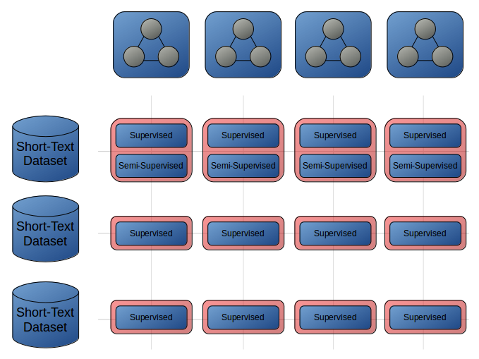
Comparison Overview
Introduction

Slide 8
Background
Introduction
Background
Related Work
Models Compared
Experiments Performed
Experimental Comparison
Conclusion and Future Work
NLU
Clustering
Neural Networks
Bag of Words
TF-IDF
Word Embeddings
Features in Text

Slide 9
Natural Language Understanding (NLU)
Machine comprehension of language as it normally appears to humans.
  Text
  Speech
Challenges:
  Language is dynamic
  Hard to define rule-based system
  Machines accept numerical values
Background
Notes:
Pre-processing: what is the best way to convert data in the form of text or speech to numerical values to be ingested by machines?
Challenges:
Language is always being redefined---humans can adapt to this very quickly
No good way to define a set of rules that captures language interaction
How to convert sequences of letters/sounds to numerical values machines can ingest?

Slide 10
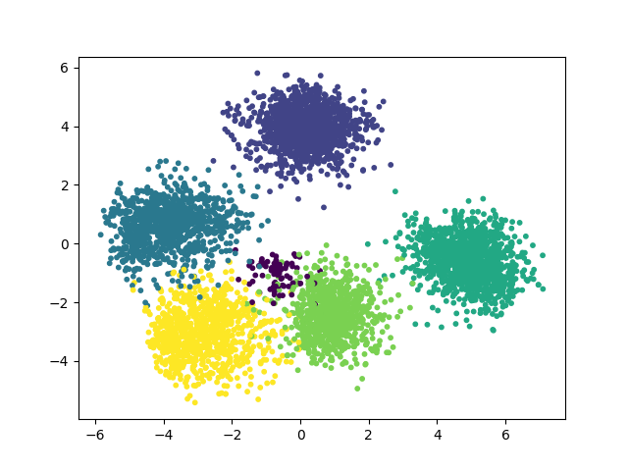
Clustering
Search for K separable groups in categorical data.
Unsupervised
K-Means algorithm:
  Prior choice of K
  Representative
Background
Notes:
Unsupervised: arbitrary labels
K: number of clusters
Representative:
Clusters defined by their centroids
Sample belongs to cluster with closest centroid

Slide 11
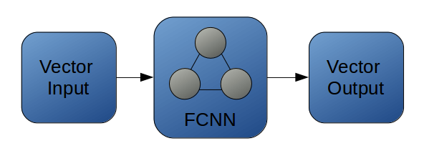
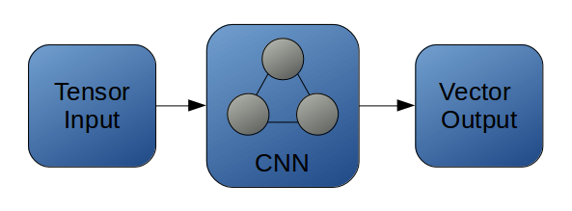
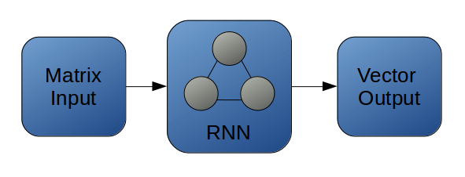
Neural Networks
Network of linear/nonlinear processing units.
End-to-end trainable with gradient descent optimization.
Fully Connected Neural Network
Convolutional Neural Network
Recurrent Neural Network
Background

Slide 12
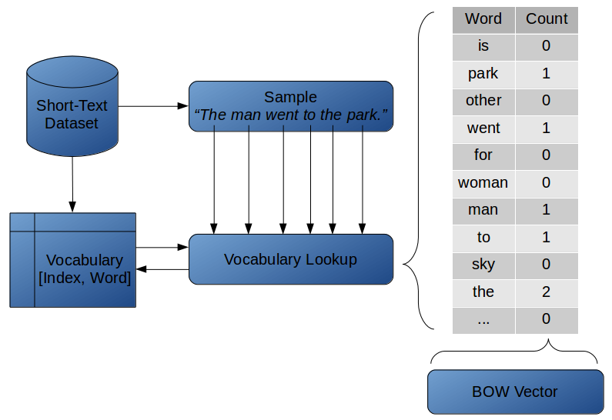
Text Representation: Bag of Words
Background

Slide 13

Text Representation: TF-IDF
Term Frequency: # of occurrences of a word in one text sample.
Document Frequency: # of occurrences of a word throughout all text samples.
Background

Slide 14
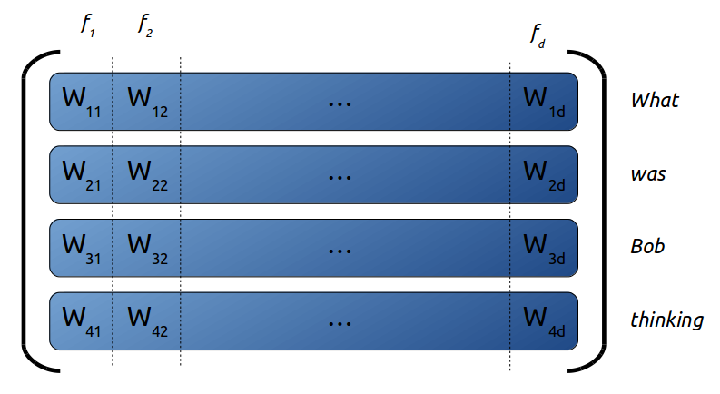
Text Representation: Word Vectors
Words -> word vectors
Text sequence -> word embedding matrix
Background

Slide 15
Features in Text
Syntactic Features:
  Part-of-speech (POS) tags
  Chunks of POS patterns
Semantic Features:
  Topic
  Named Entities
  Sentiment
  Intent
  Question-Type, Answer-Type and Modifiers
Background

Slide 16
Related Work
Introduction
Background
Related Work
Models Compared
Experiments Performed
Experimental Comparison
Conclusion and Future Work
Text Enrichment
Neural Networks for Text Data

Slide 17
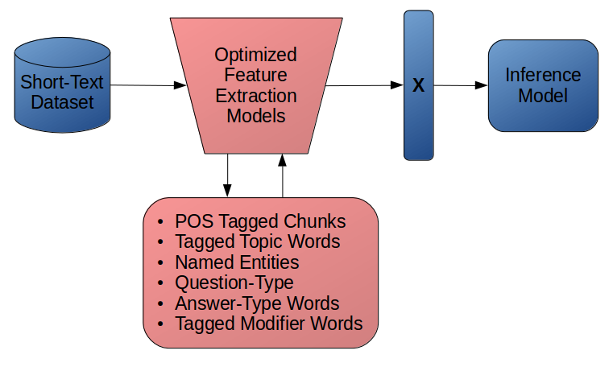
Text Enrichment
Convert text to a feature vector X through text enrichment.
This is a lot of overhead!
Related Work

Slide 18
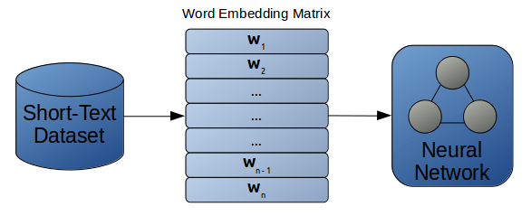
Neural Networks for Text
Automatically learn features relevant to task.
Equal or better performance than text enrichment models.
Related Work

Slide 19
Models Compared
Introduction
Background
Related Work
Models Compared
Experiments Performed
Experimental Comparison
Conclusion and Future Work
NBOW
LSTM
TCNN
DCNN

Slide 20
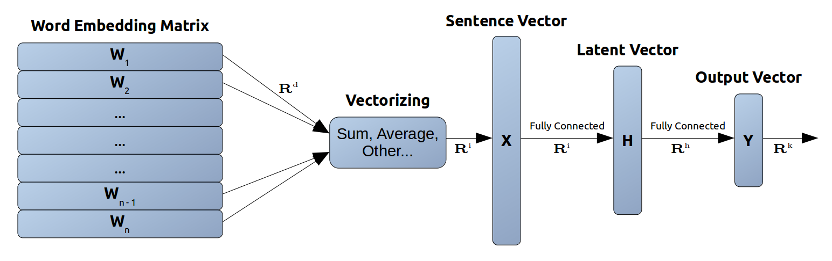
Neural Bag of Words (NBOW) Model
Models Compared

Slide 21
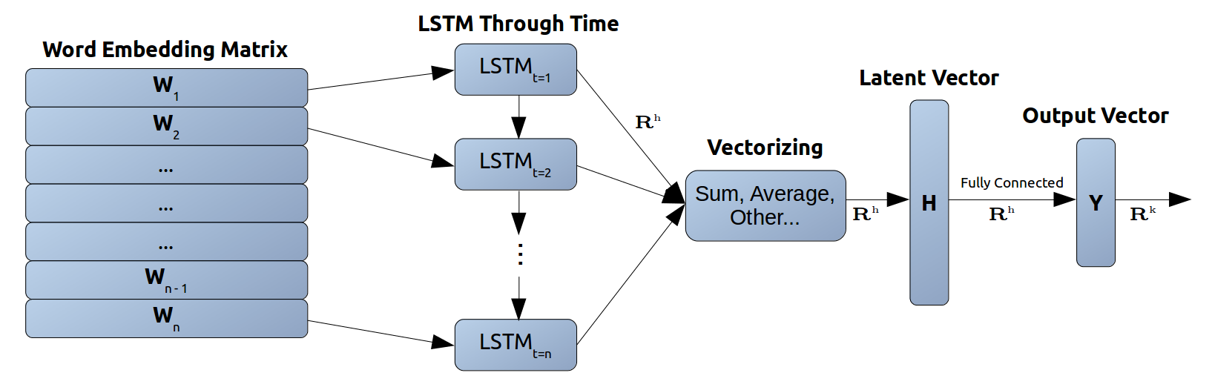
Long Short-Term Memory (LSTM) Model
Models Compared

Slide 22
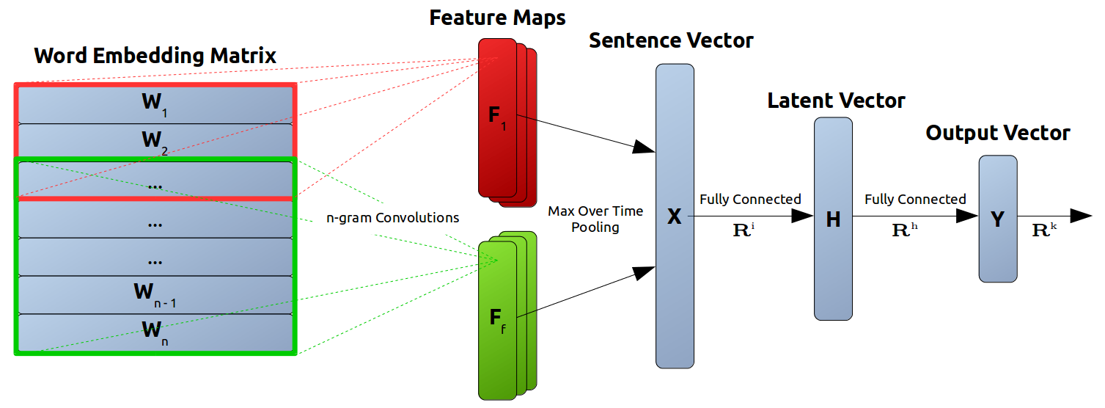
Max-Over-Time Convolutional Neural Network (TCNN) Model
Models Compared

Slide 23
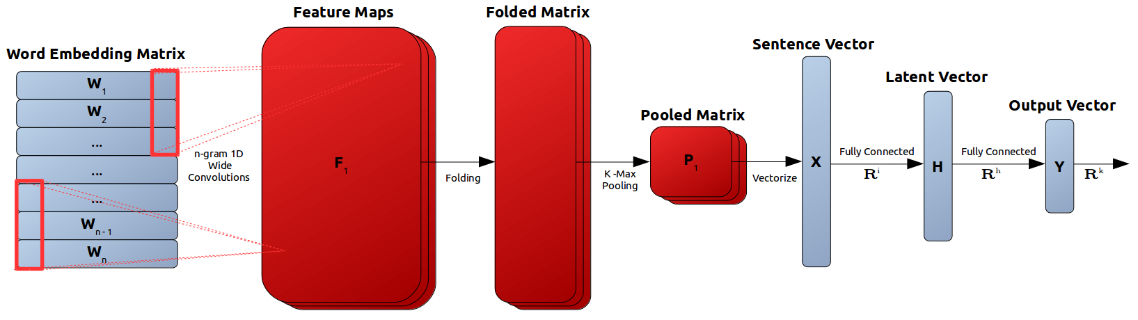
Dynamic Convolutional Neural Network (DCNN) Model
Models Compared

Slide 24
Experiments Performed
Introduction
Background
Related Work
Models Compared
Experiments Performed
Experimental Comparison
Conclusion and Future Work
Supervised Classification Task
Semi-Supervised Learning Task
Clustering Learned Text Representations

Slide 25
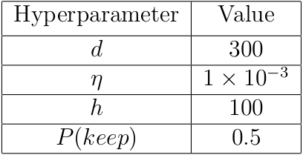
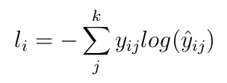
Supervised Classification Task
Train each model on each dataset with some hyperparameters held constant.
Softmax output for K labels with cross entropy loss.
Experiments Performed

Slide 26
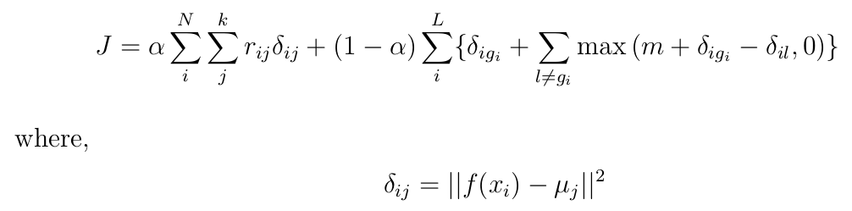
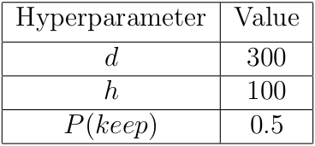
Semi-Supervised Learning Task¹
Learn latent vector representations from a K-means inspired objective.
Pre-train model with 10% labeled samples.
[1] Semi-supervised Clustering for Short Text via Deep Representation Learning (Wang, Mi, Ittycheria - 2017)
Experiments Performed

Slide 27
Semi-Supervised Learning Task
Parameter | Description
alpha | Weighting to control influence of labeled data. Lower alpha = More influence of labeled data.
r_{ij} | Cluster assignments for all samples. 1 if sample i is assigned to cluster j, 0 otherwise. R^{N✕K} matrix stores all r_{ij} values for a dataset with N samples and K unique labels.
μ_{j} | h dimensional centroid for cluster j.
g_{i} | Mapping from truth label i to cluster label g_{i}
Experiments Performed

Slide 28
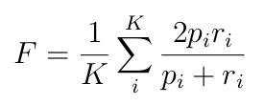
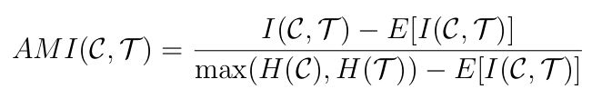
Clustering Learned Text Representations
Perform K-means on learned latent representations with K centroids.
External cluster evaluation using dataset labels (F-Measure and Adjusted Mutual Info).
Experiments Performed

Slide 29
Experimental Comparison
Introduction
Background
Related Work
Models Compared
Experiments Performed
Experimental Comparison
Conclusion and Future Work
Datasets
Supervised Classification Results
Semi-Supervised Learning Results
Clustering Results

Slide 30
Short Text Datasets
Question-Type²
Answer categories for sample questions
K = 6 classes
(Abbreviation, Entity, Description, Human, Location, Number)
StackOverflow³
Programming topic categories for StackOverflow queries
K = 20 classes
(matlab, bash, apache, excel, etc.)
AG-News⁴
General news topic categories for news titles
K = 4 classes
(World, Sports, Business, Sci/Tech)
[2] Learning Question Classifiers (Li, Roth - 2002)
[3] Short Text Clustering via Convolutional Neural Networks (Xu, Wang, Tian, Zhao, Wang, Hao - 2015)
[4] Character-level Convolutional Networks for Text Classification (Zhang, Zhao, LeCun - 2015)
Experimental Comparison

Slide 31
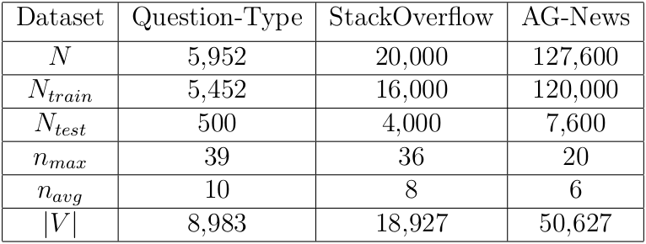
Dataset Statistics
Experimental Comparison

Slide 32
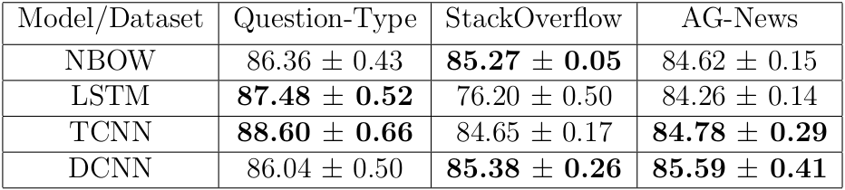
Supervised Classification Results: Testing Set Accuracy
Experimental Comparison

Slide 33
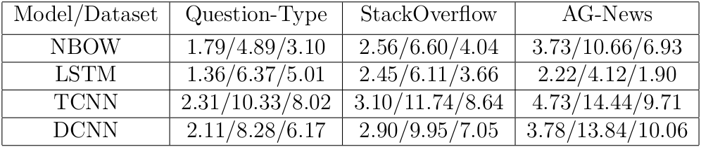
Supervised Classification Results: Intra/Inter Neighbor Separation
(intra-neighbor/inter-neighbor/difference margin)
Experimental Comparison

Slide 34
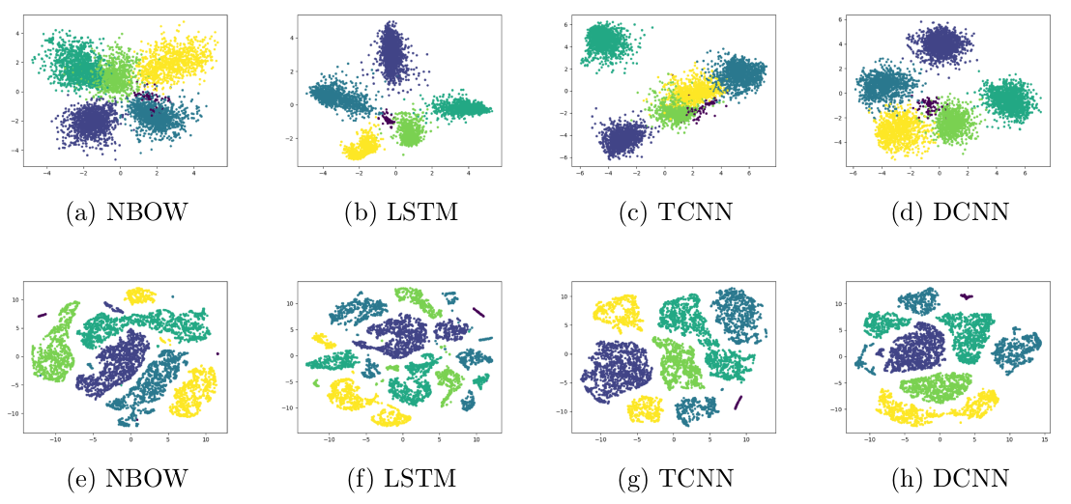
Supervised Classification Results: Question-Type Visualizations
Experimental Comparison

Slide 35
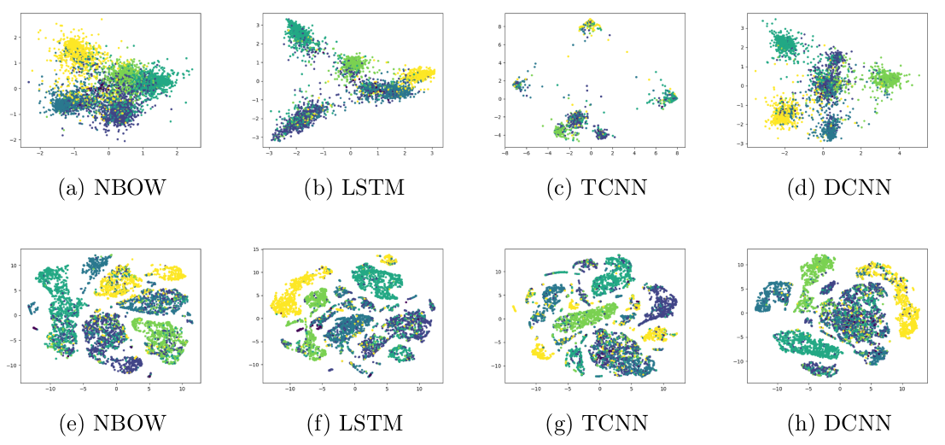
Semi-Supervised Learning Results: Question Type Visualizations
Experimental Comparison

Slide 36
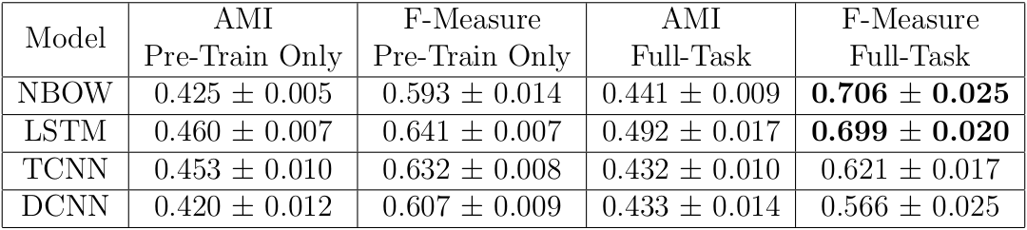
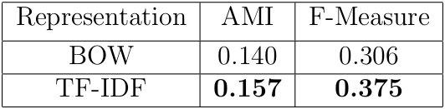
Clustering Results: Semi-Supervised Learned Representations on Question-Type
Experimental Comparison

Slide 37
Conclusion and Future Work
Introduction
Background
Related Work
Models Compared
Experiments Performed
Experimental Comparison
Conclusion and Future Work
Observations
Insights

Slide 38
Observations
Classification: at least one CNN-based model with top performance.
Classification: LSTM seems to struggle with a large amount of labels
Semi-supervised learning: models that achieve less neighbor separation generally result in in better clustering
Conclusion and Future Work
Notes:
LSTM: better performance on Question-Type then other two datasets. Question-Type requires learning slightly higher-level features.
CNN based models: generally better performance on topic based datasets (StackOverflow and AG-News). Overall good performance.

Slide 39
Results Suggest...
Less decisive -> better ability to correct mistakes during further learning.
Performance is dependent on both model architecture and dataset characteristics.
Word vector utilization varies.
LSTM: whole sentence level features.
CNN: single/multiple word level features.
Conclusion and Future Work

Slide 40
Future Work: Pre-Trained Word Vectors
Pre-training word vectors can increase performance.
Quantify the utilization of word vectors depending on model architecture.
Conclusion and Future Work

Slide 41
Future Work: IBM HEALS
Health Empowerment by Analytics, Learning and Semantics.
Chat-bot health informative framework.
Subsystem: organize user queries into intent groups.
Use groupings to help construct chat-bot dialog tree.
Conclusion and Future Work

Slide 42
Future Work: Alternative Models
Autoencoders with adversarial learning⁵:
  Latent representations can be constrained by a classification distribution for semi-supervised learning.
“Siamese” network architectures⁶:
  Pair-wise similarity learning increases training size and simplifies labeling of data.
  Features extracted by comparative learning
[5] Adversarial Autoencoders (Makhzani, Shlens, Jaitly, Goodfellow - 2016)
[6] Signature Verification Using a “Siamese” Time-delay Neural Network (Bromley, Guyon, LeCun, Säckinger, Shah - 1994)
Conclusion and Future Work

Slide 43
Thank You!
Questions?

