Slide 1
Student Management DBMS
CS5200 – Database Theory and Application
Dylan Forck

Slide 2
Objective
Efficiently manage student records and academic data.
Provide secure, role-based access for admins and general users.
Allow quick retrieval and updates of student performance.
Reduces manual errors and data redundancy.
Simplifies administrative tasks and reporting.
Supports concurrent data access by multiple users.

Slide 3
Core Functionality
Secure user registration and login using MD5 password hashing.
Role-based access controls:
Admins: manage student records (add, edit, delete).
Users: view student records and query scores.
Comprehensive CRUD operations for managing student data.
Robust querying capabilities for student scores across various courses.
Implementation of concurrency control for data integrity.
Deployed securely on a cloud platform for web accessibility.

Slide 4
Technologies Used
Programming Language: Python
Web Framework: Flask
Database System: MySQL
Managed with mysql-connector-python
Frontend Technologies: HTML
Deployment Platform: Railway Cloud
Linked with GitHub

Slide 5
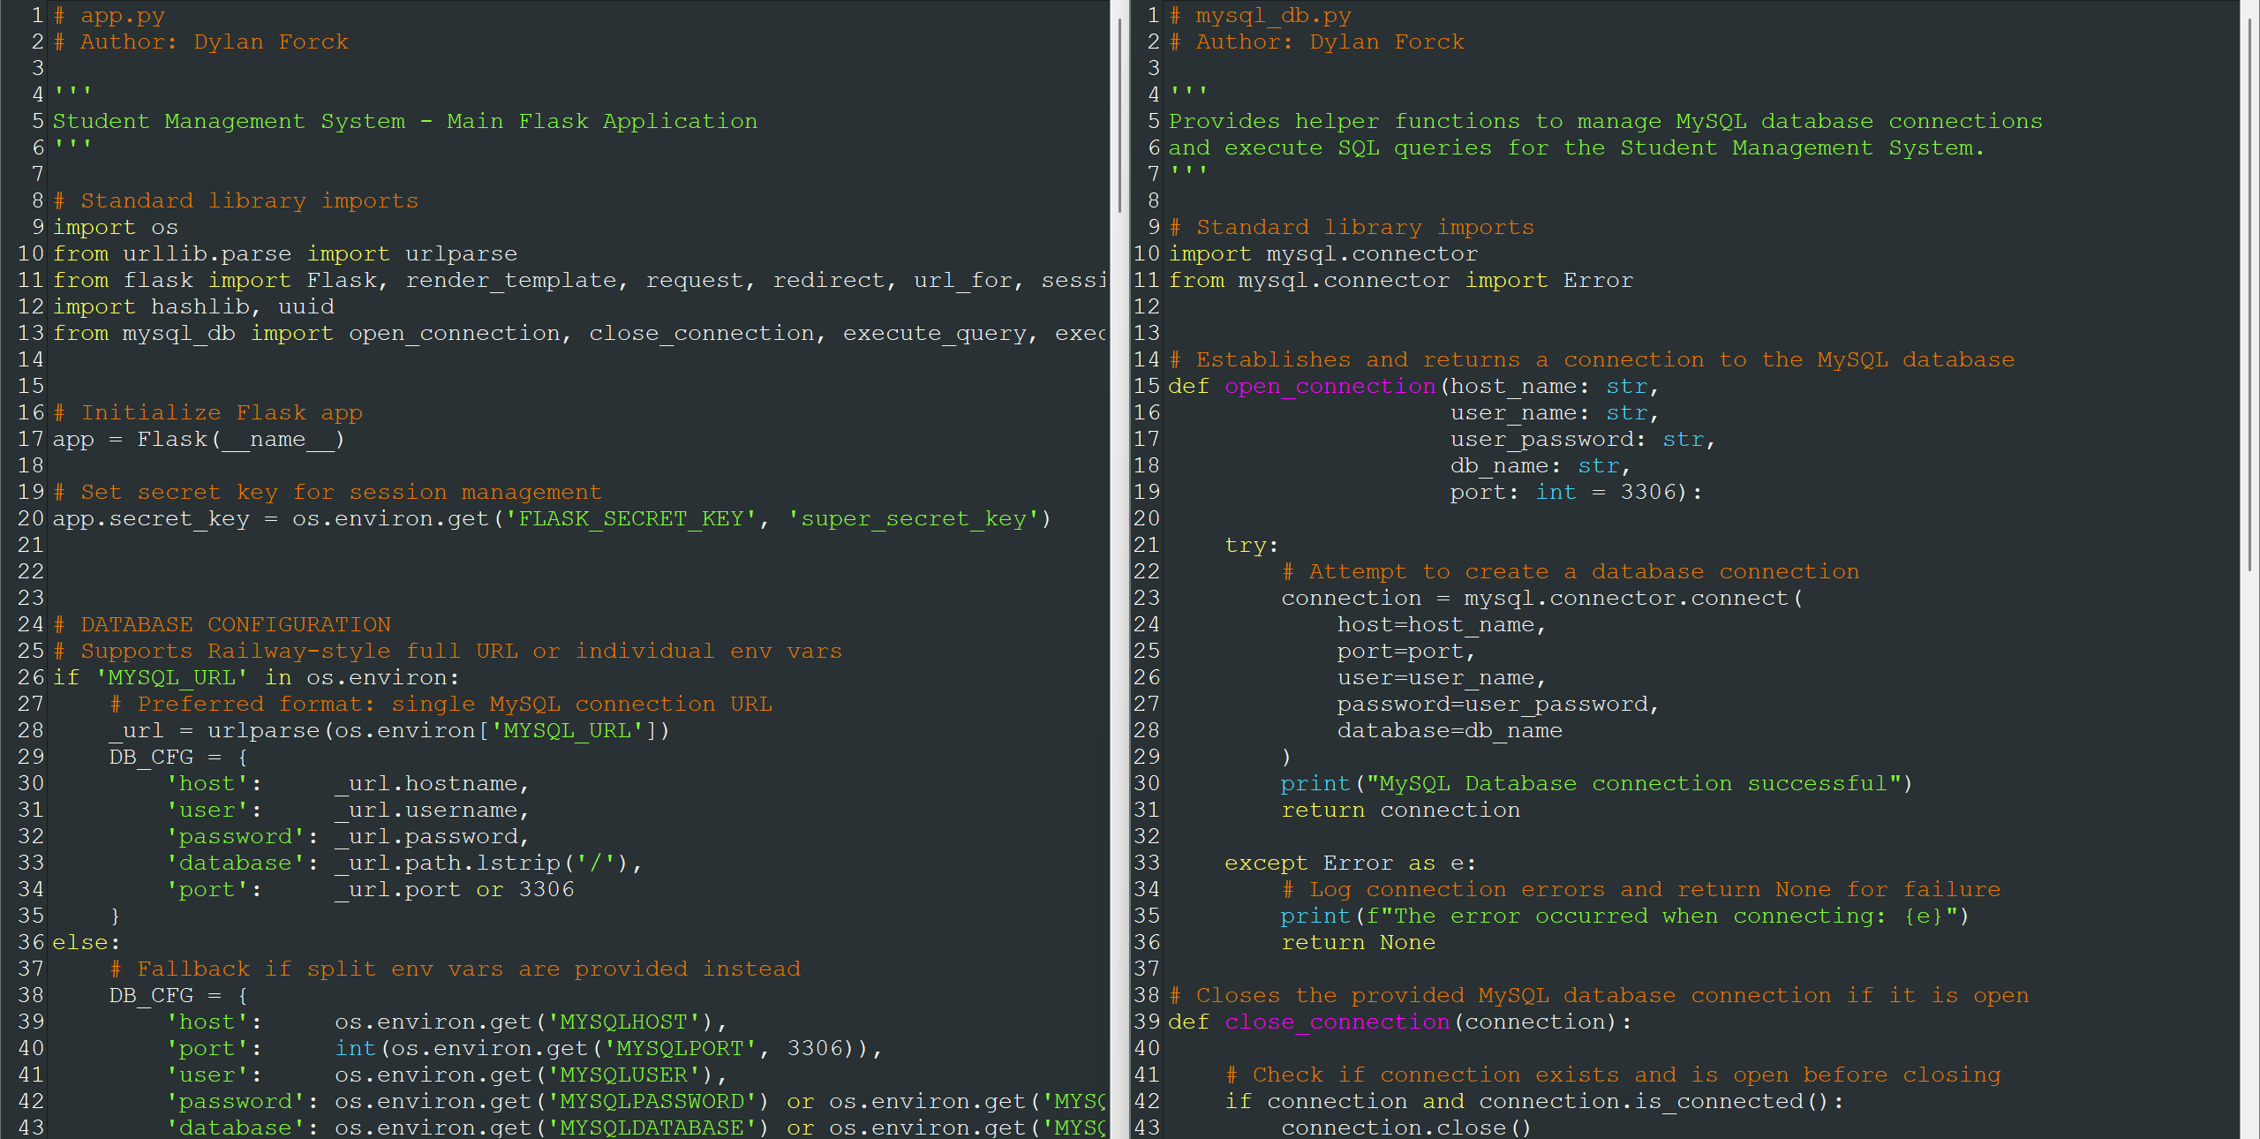
BACK-END CODE SCREENSHOT

Slide 6
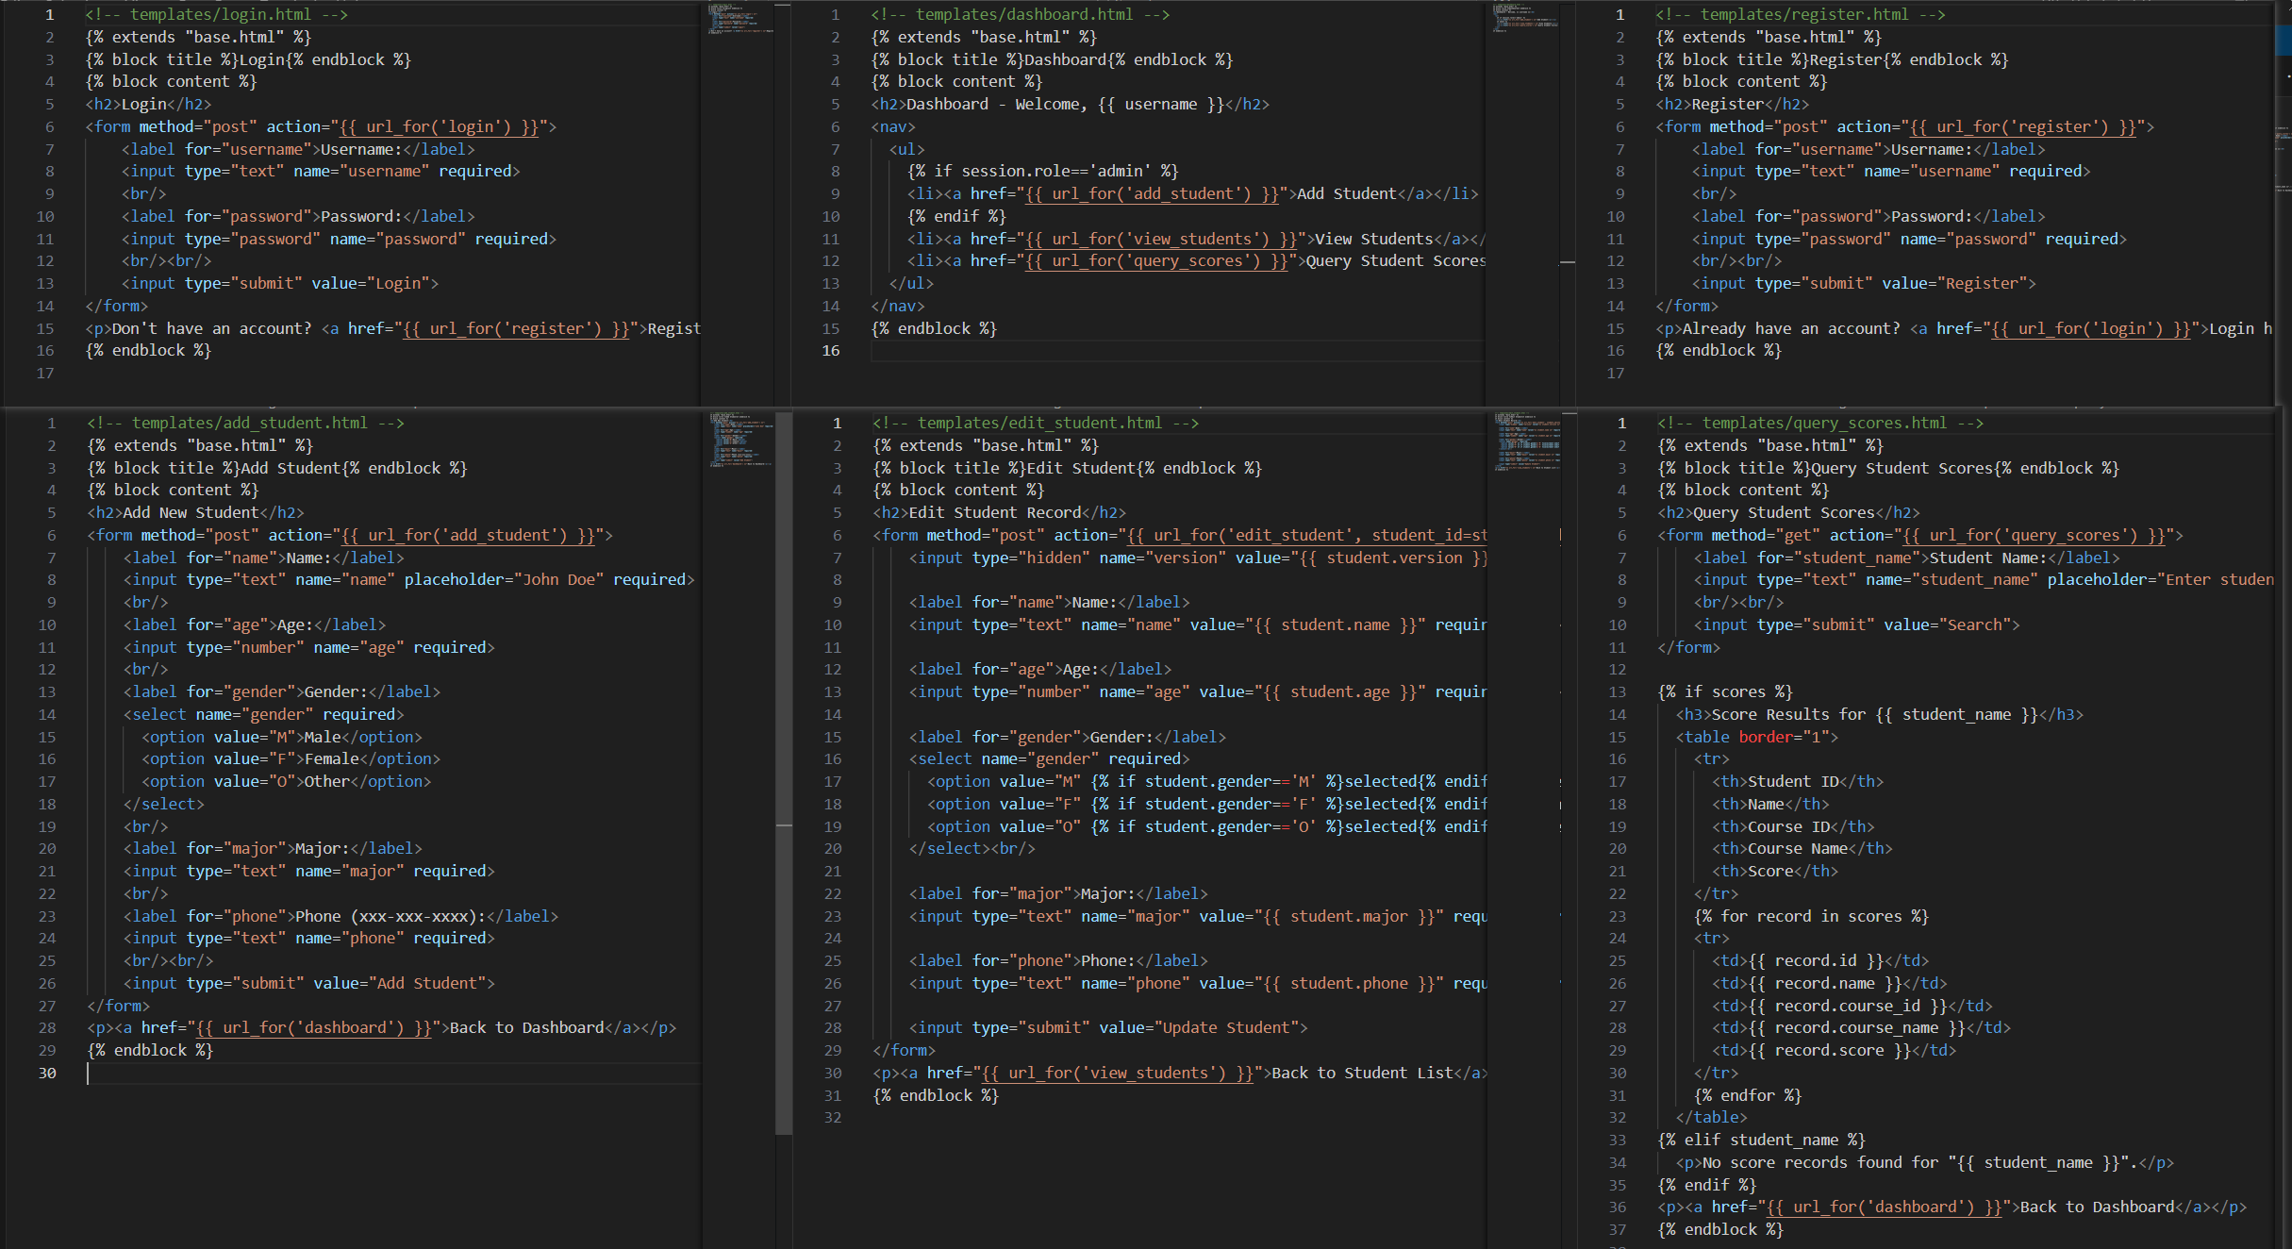
Front-End CODE SCREENSHOT

Slide 7
User Roles & Functions
Admin Role:
Add new students using a detailed form capturing name, age, gender, major, and phone number.
Edit existing student data ensuring concurrency control with version checks.
Delete student records securely from the database.
User Role:
View all student details but restricted from modifications.
Query specific student academic scores through simple search forms.

Slide 8
Input Data
User-entered Data:
Example: Adding a student
("John Doe", 20, Male, Computer Science, "555-123-4567")
Login credentials created at registration.
System-generated Data:
Auto-generated student IDs.
Incremented version numbers each time a student record is updated.

Slide 9
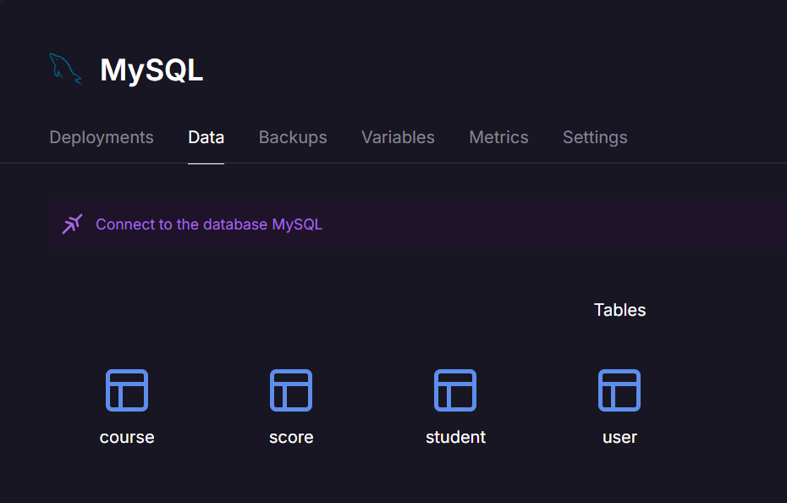
Database SCHEMA - Railway
User Table:
Username, Password (hashed), Role
Student Table:
ID, Name, Age, Gender, Major, Phone, Version
Course Table:
Course ID, Course Name
Score Table:
Student ID, Course ID, Score

Slide 10
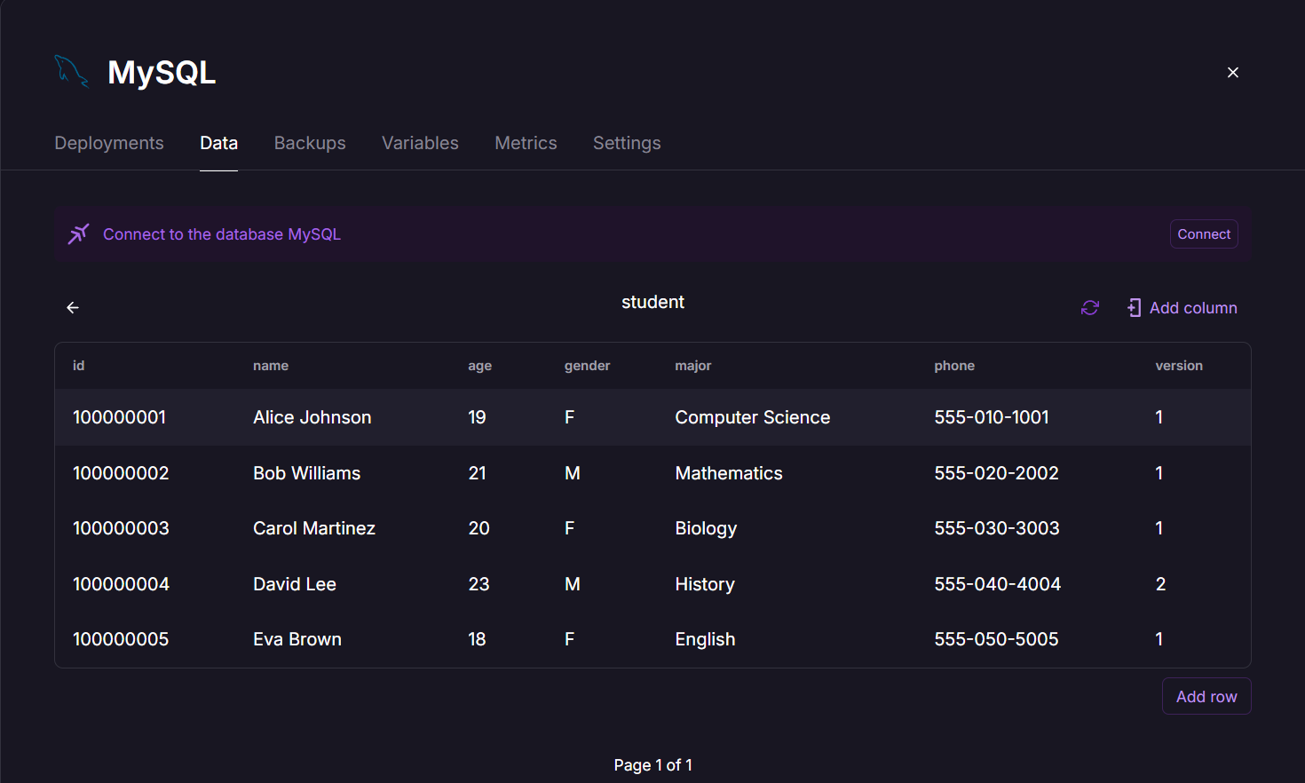
Data Table - Railway

Slide 11
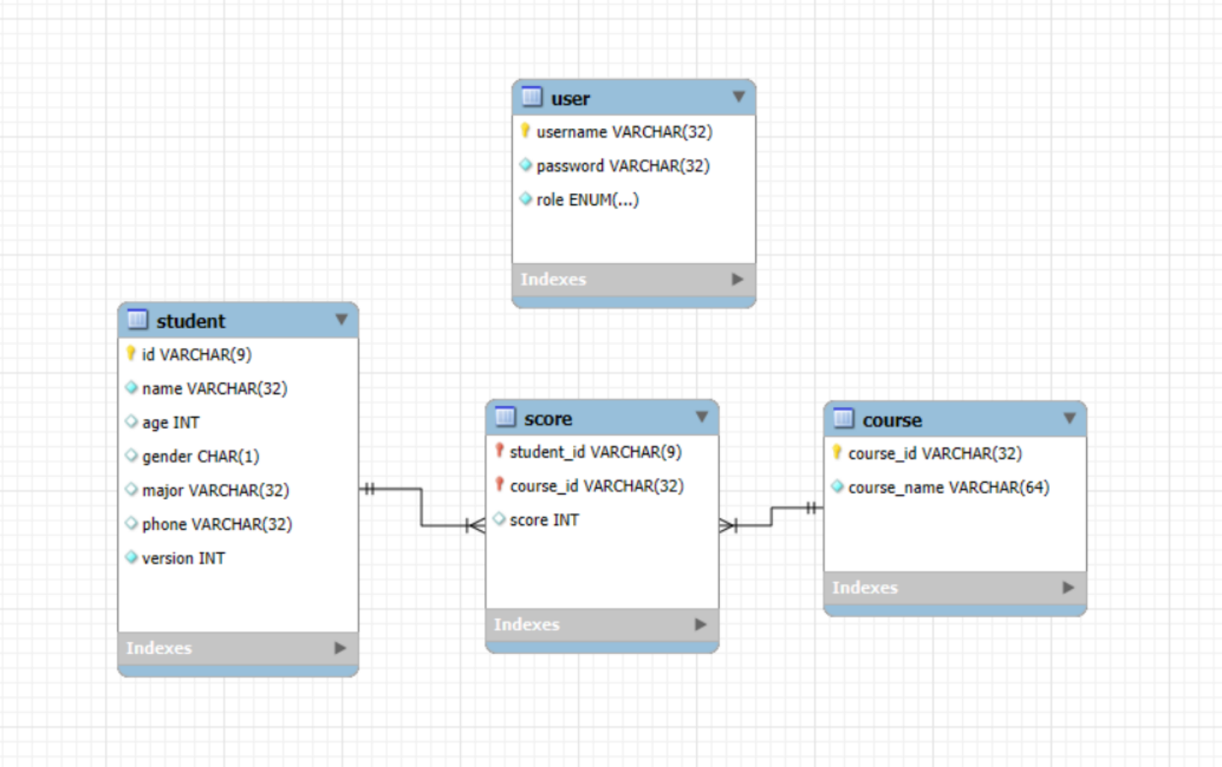
Entity Relationship Diagram
Students linked to multiple Scores (one-to-many).
Courses linked to multiple Scores (one-to-many).
Users managing and querying Students and Scores.

Slide 12
Demonstration
https://student-management-dbms-production.up.railway.app
Admin:
Logging in, adding/editing/deleting student data, show version update.
Username: Admin
Password: Admin123!
User:
Registering, logging in, viewing student data, querying student scores.
Username: Test
Password: Test123!

