Slide 1
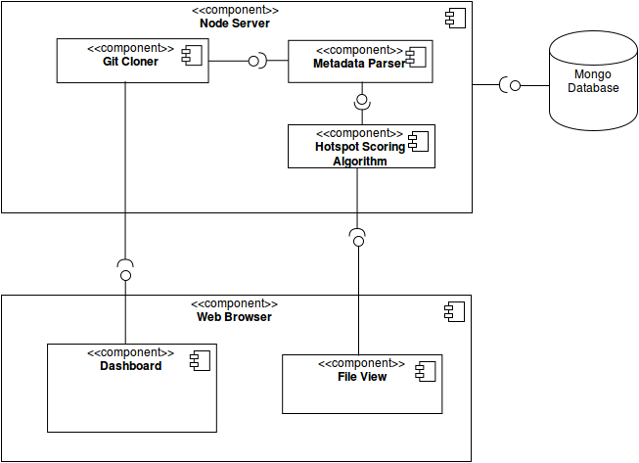




Hotspotter
Temporary Logo
Nate Reinhardt-SM Spencer Smith-OP Dylan Williams-QC
Dr. Igor Crk: Department of Computer Science
Hotspotter is a web application used for early prediction of bugs in software.
This is accomplished by detecting areas of instability called 'hotspots'. Hotspots are determined by analyzing the type and frequency of changes made to the project's repository.
Objectives
Give predictions of problematic areas of code.
Repository quality improvements.
Repository metadata scanner for future analyzing.
Hotspotter is a full web application built with the MEAN stack. Which uses a client/server architecture with MongoDB as its datastore.
Using the Semi-Agile Software Engineering (SAGE) process, a Scrum-like process with ten two-week sprints.
Development Operations: Automated build and deploying mechanisms.
Total Estimated Hours Until Completion: 23
The MEAN Tech Stack
MongoDB- Database
Express -Middleware
AngularJS – Client Side
NodeJS- Server Side

