Slide 1

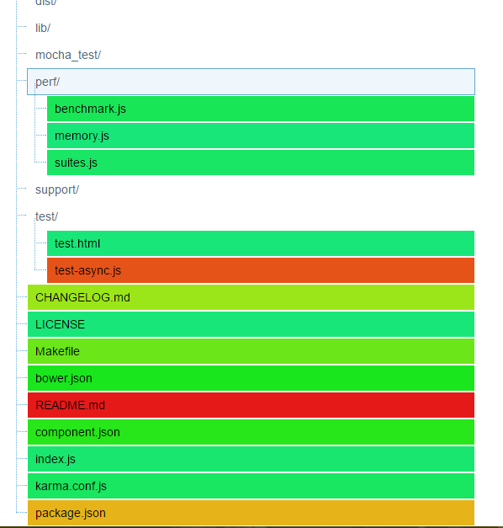
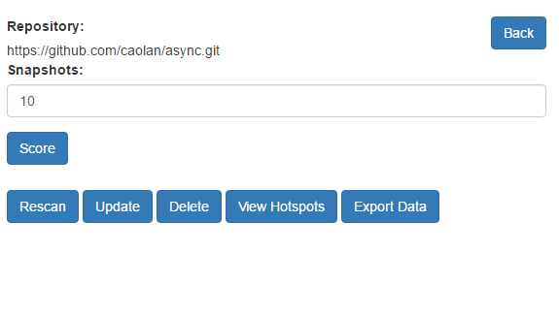
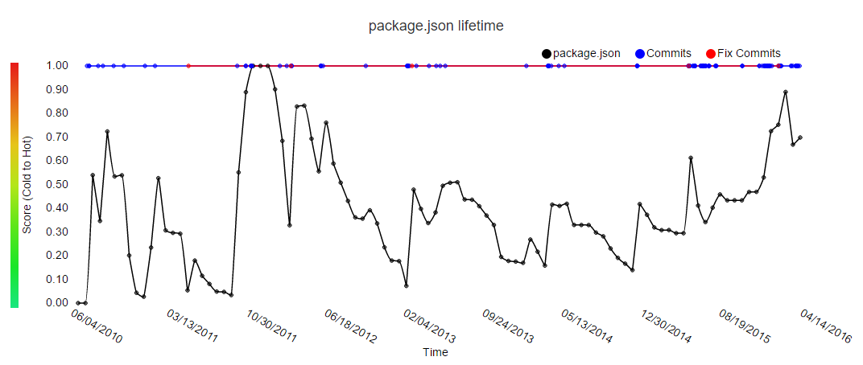
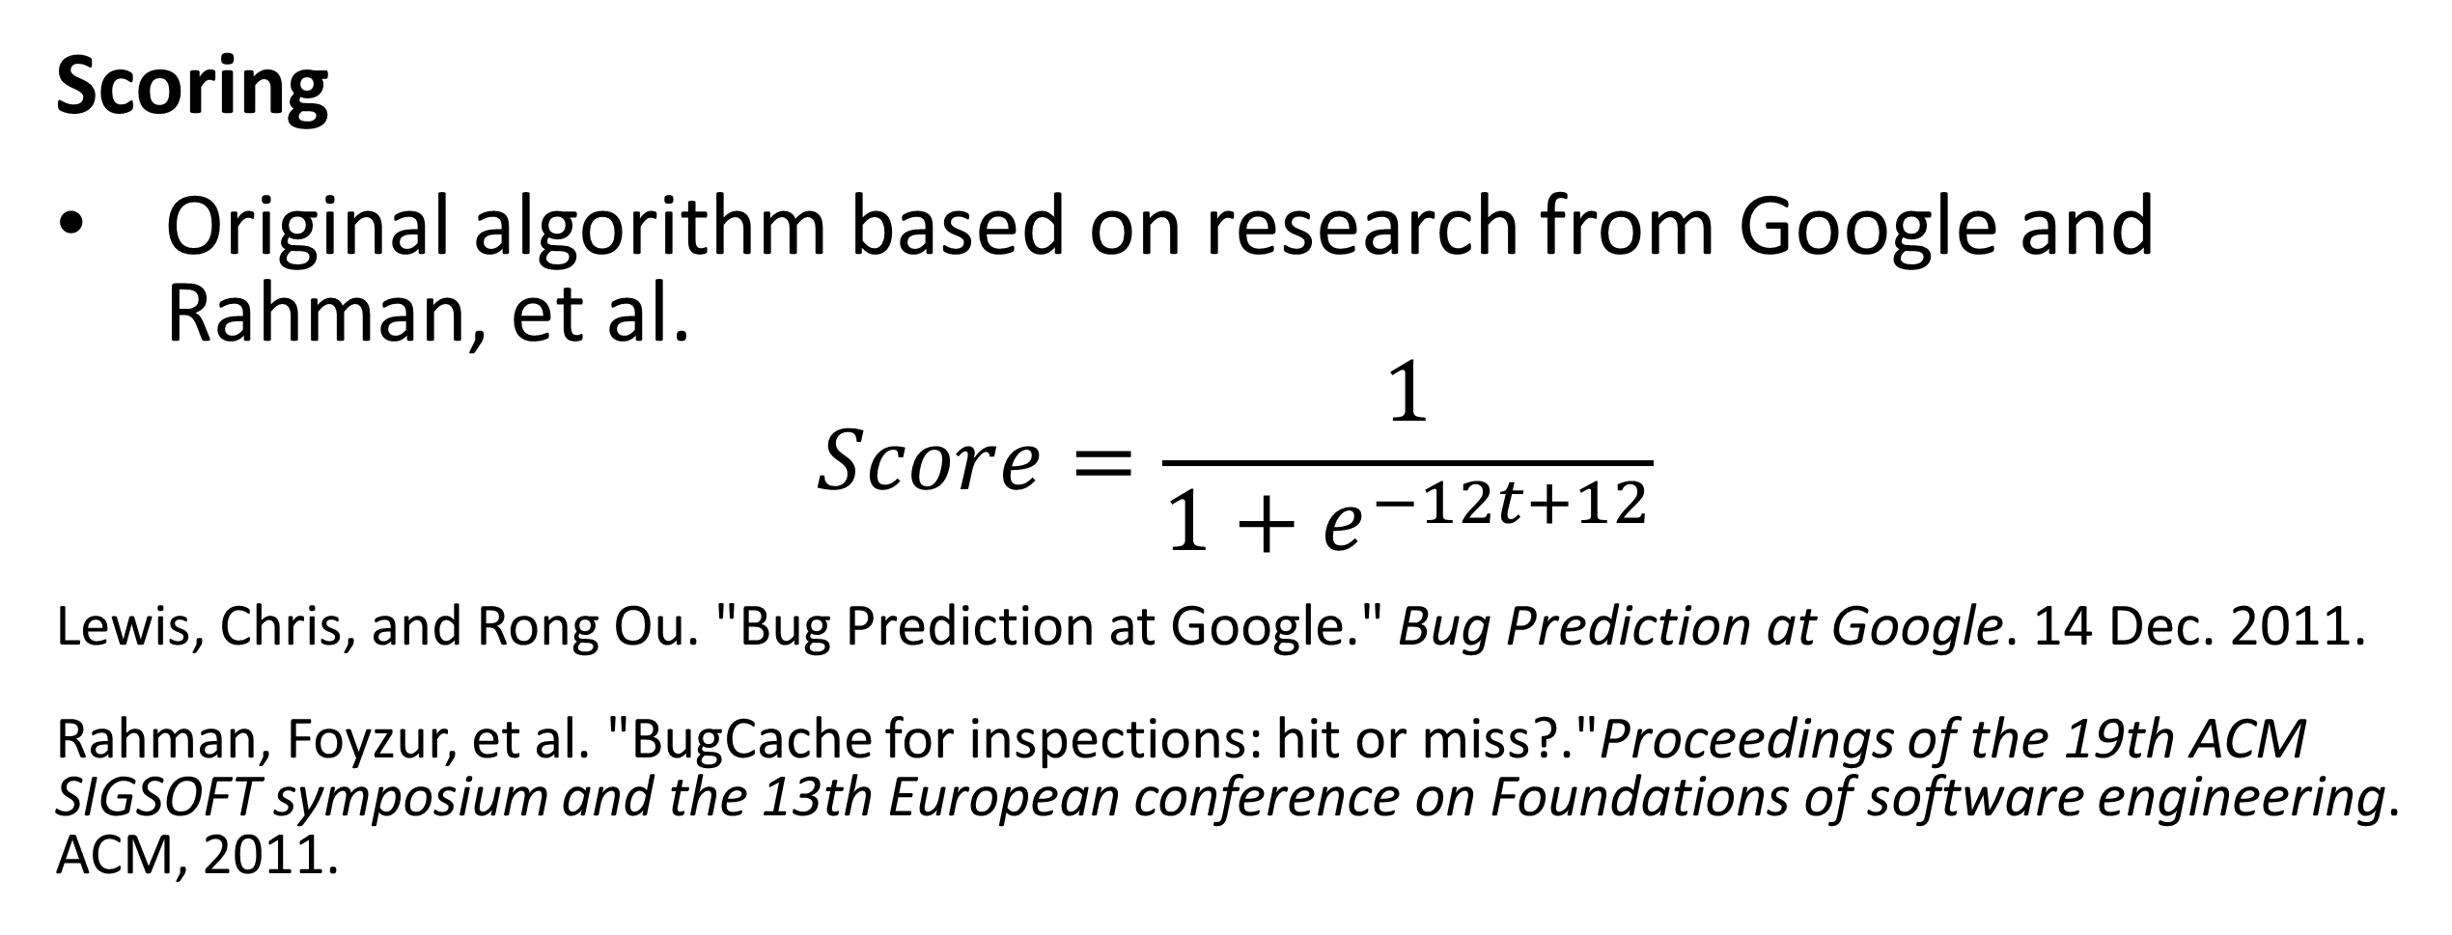
Hotspotter
Nate Reinhardt, Spencer Smith, Dylan Williams
Dr. Igor Crk, Department of Computer Science
Hotspotter is a web application used for early prediction of bugs in software.
This is accomplished by detecting areas of instability called 'hotspots'. Hotspots are determined by analyzing the type and frequency of changes made to a project's codebase.
Objectives
Calculate probability of problematic areas in code
Assist teams with quality control and assurance
Export repository metadata for future research and analysis
Scoring
Original algorithm based on research from Google and Rahman, et al.
$$Score=\frac{1}{1+e^{−12t+12}}$$
Lewis, Chris, and Rong Ou. "Bug Prediction at Google." Bug Prediction at Google. 14 Dec. 2011.
Rahman, Foyzur, et al. "BugCache for inspections: hit or miss?."Proceedings of the 19th ACM SIGSOFT symposium and the 13th European conference on Foundations of software engineering. ACM, 2011.

