Slide 1
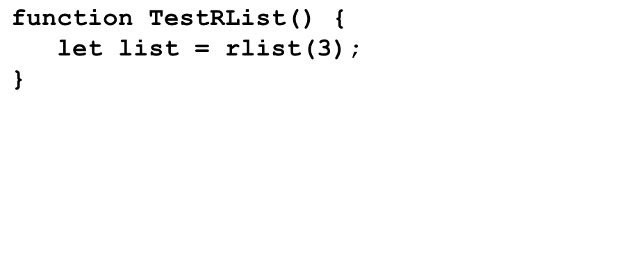
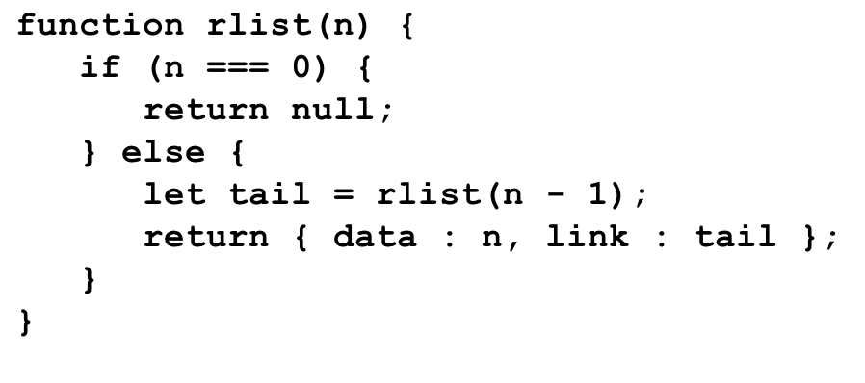
LinkedListTrace
1
data
null
link
2
data
link
3
data
list
link
n
tail
3
n
tail
2
tail
n
tail
1
null
0
n
n
tail
0
null
tail
1
n
tail
2
n
tail
3
n
list

