Slide 1
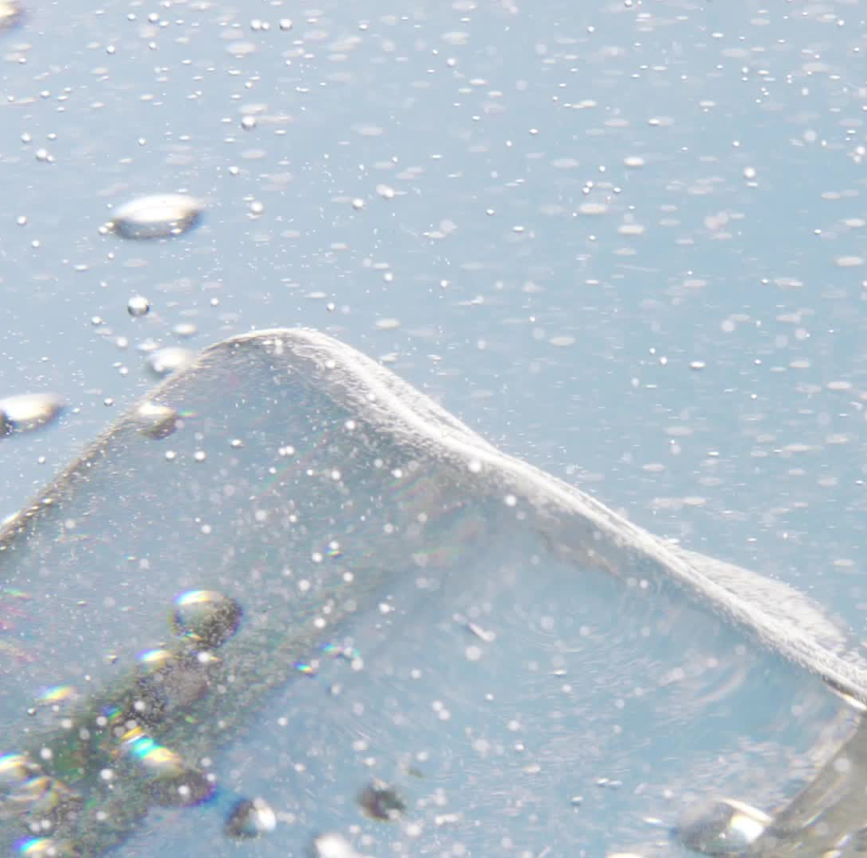
The US Water Crisis: Are We Running out of Water?
Dylan Johnson

Slide 2
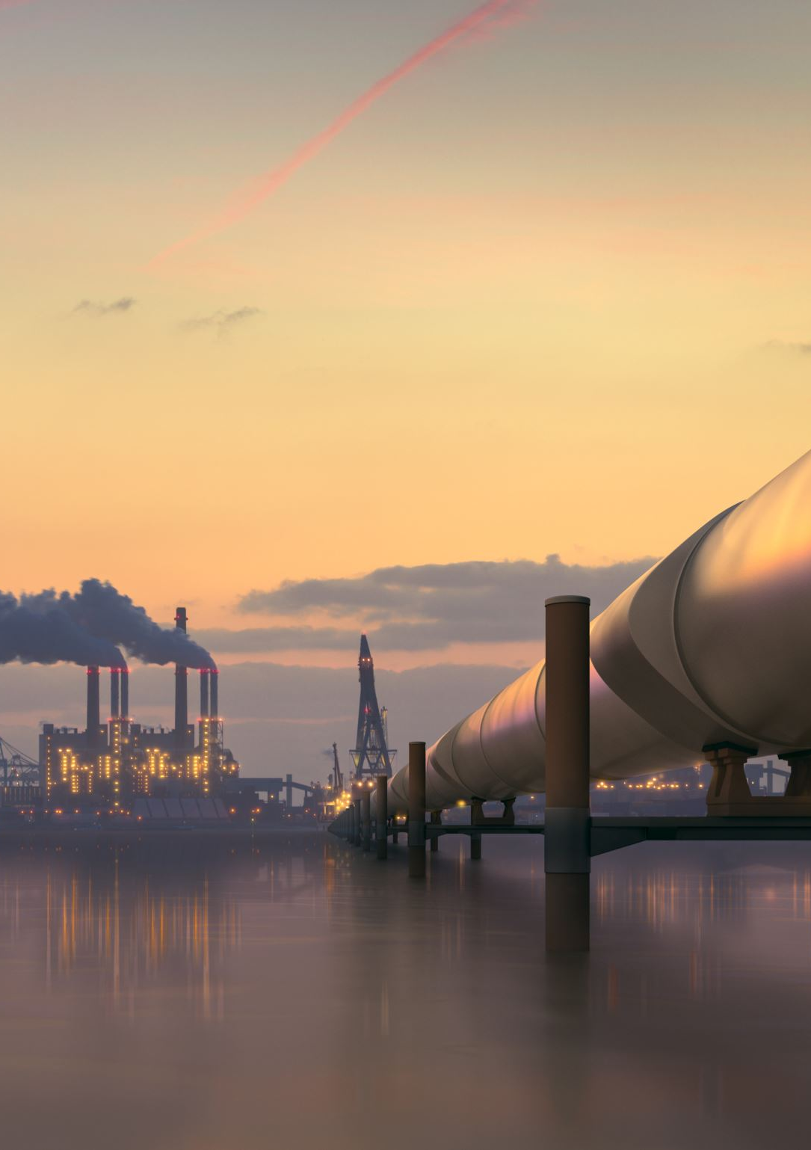
What is the US Water Crisis?
Aging infrastructure is causing frequent leaks, breaks, and inefficiencies in water systems nationwide.
Drought and climate change are reducing freshwater availability, especially in the western U.S.
Groundwater depletion and overuse of major aquifers threaten long-term agricultural and urban supply.
Water pollution from industrial waste, agriculture, and aging pipes is contaminating drinking water.
Legal overallocations of rivers like the Colorado are causing conflict among states and regions.
Unequal access leaves many rural and low-income communities without safe or reliable water.

Slide 3
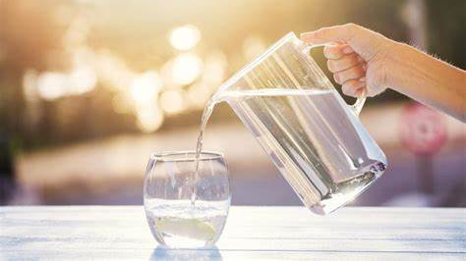
Why This is Important?
Water is used for everything from Drinking, to cooking, to electricity, etc. and with a growing population we are going to run out at some point.

Slide 4
Basic Info
Public Supply: 30,000 MGD (Millions of Gallons per Day)
Thermoelectric: 100,000 MGD (Millions of Gallons per Day)
Irrigation: 80,000 MGD (Millions of Gallons per Day)
The average American uses approximately 80 – 100 gallons of water a day
The US withdrawals roughly 322 billion gallons of water a day across all sectors (https://www.usgs.gov/mission-areas/water-resources/science/total-water-use?qt-science_center_objects=0#qt-science_center_objects)

Slide 5
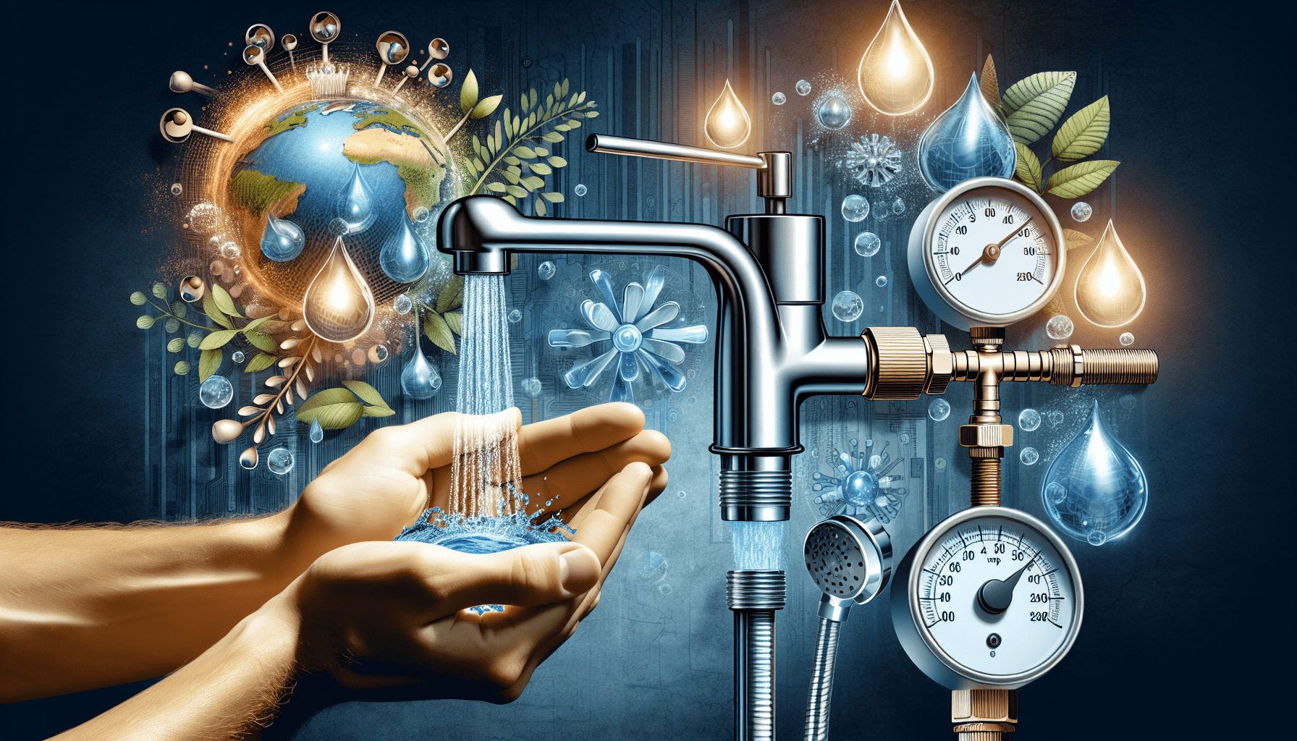
First Findings

Slide 6
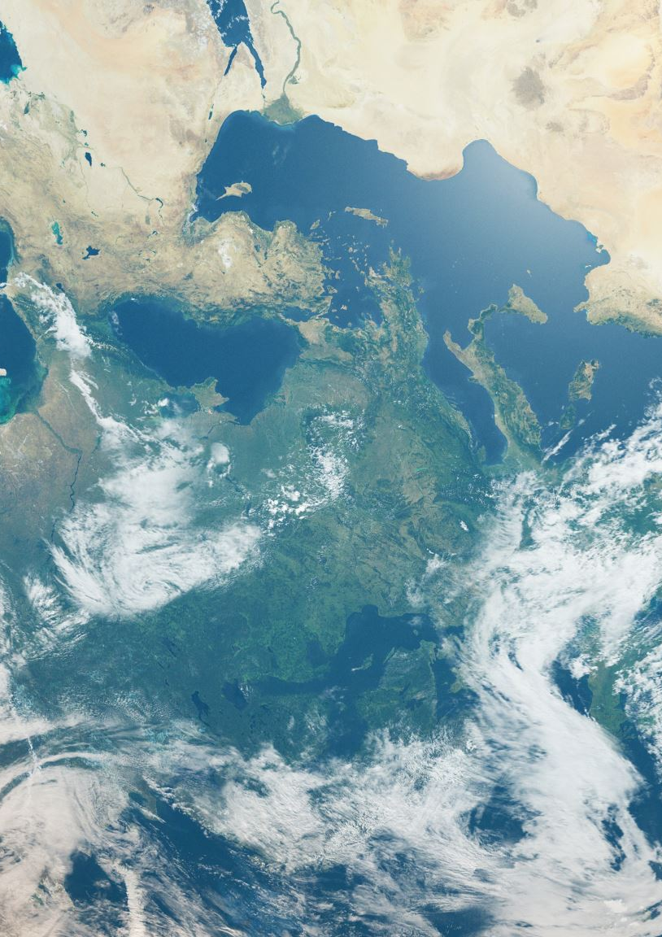
Data Used
30 Data sets (From 10 different counties of 10 different states) compiled into 3 separate datasets:
CA, WA, UT, AZ, ME, MD, FL, IL, TX, SD
Thermoelectric Water Use
Public Supply Water Use
Irrigation Water Use
Census data predicting the population until 2100
Water Quality Data from the Mississippi River Basin provided by (The United States Geological Survey)

Slide 7
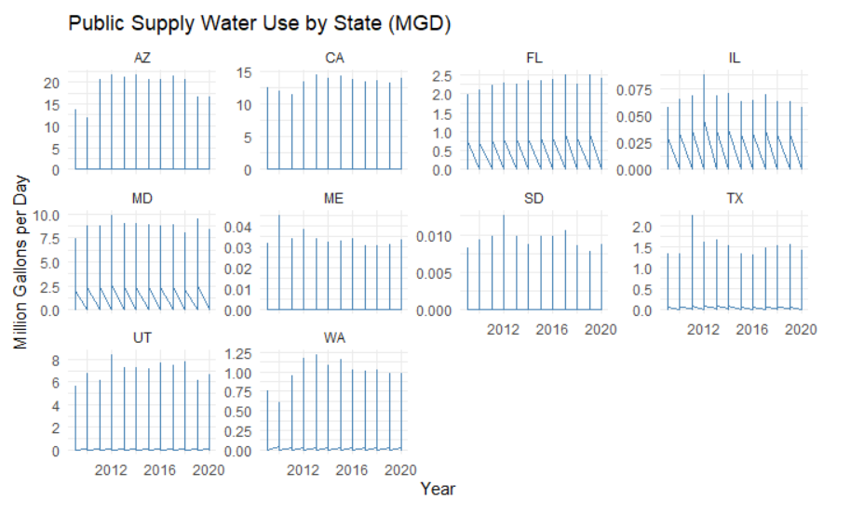
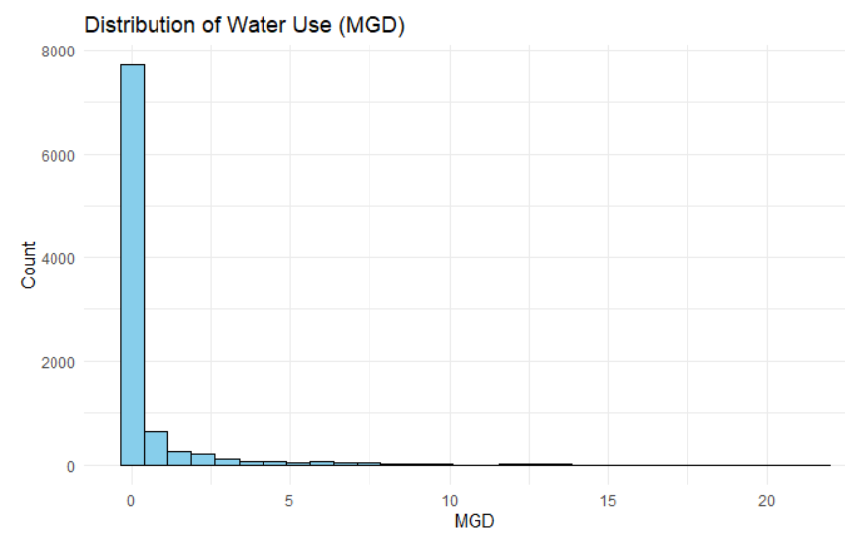
Public Supply
Public Supply Water USE by State (MGD):
Shows the distribution of water use across all recorded observations.
The histogram is heavily right-skewed, with most values concentrated below 1 MGD.
Indicates that low water usage is typical, especially in residential or smaller systems.
However, a visible long tail reveals that some states or sites consume disproportionately large volumes.
Most likely from industrial and public use

Slide 8
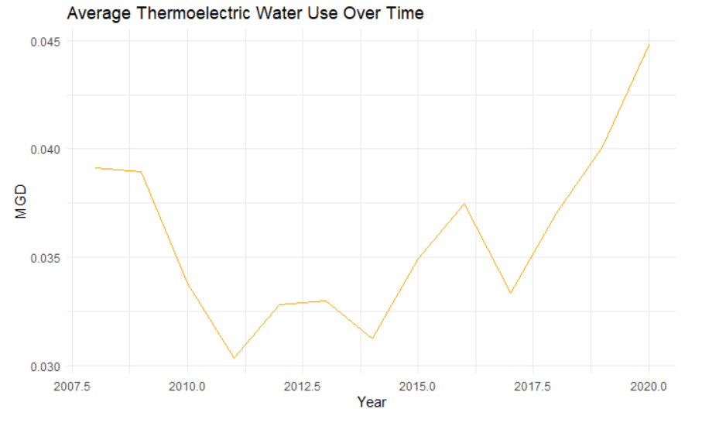
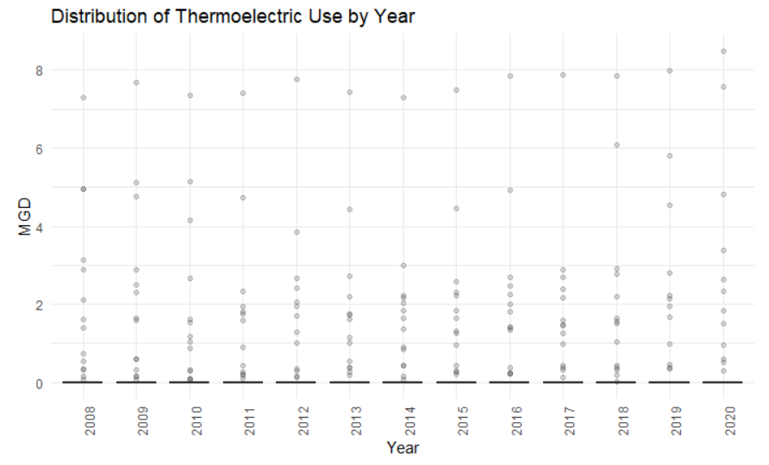
Thermoelectric Water Use
Average thermoelectric water use remained low overall, staying below 0.05 MGD across all years.
There was a decline in average usage from 2008 to 2011, followed by a gradual increase through 2020.
The highest average occurred in 2020, possibly reflecting changes in energy demand, cooling technologies, or policy shifts.
The scatter plot reveals that most thermoelectric sites consume very little water, with the majority of points clustered near 0 MGD.
However, occasional outliers exceed 5–8 MGD, suggesting significant overuse at select facilities or locations.
These outliers warrant further investigation to determine whether specific plants, operational practices, or geographic conditions are responsible for unusually high usage.

Slide 9
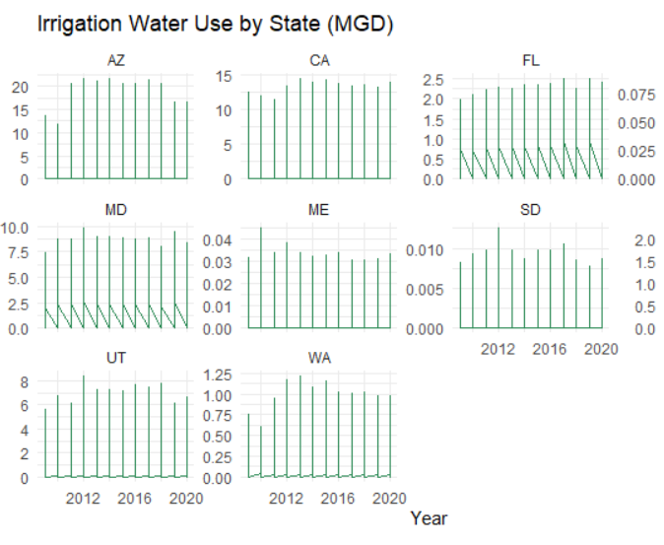
Irrigation Water Use
The graph displays irrigation water use trends across 10 U.S. states using separate line plots for each.
Arizona (AZ) and California (CA) show the highest irrigation use, peaking around 20 and 15 MGD respectively, reflecting their large-scale agricultural demands.
Moderate usage is observed in states like Utah (UT) and Maryland (MD).
Maine (ME) and South Dakota (SD) report very low irrigation use, barely exceeding 0.01 MGD.
Some states exhibit sharp downward spikes, likely due to missing data or seasonal irrigation patterns.
The graph highlights a clear regional disparity, with western and southwestern states using significantly more water for agriculture compared to others.

Slide 10
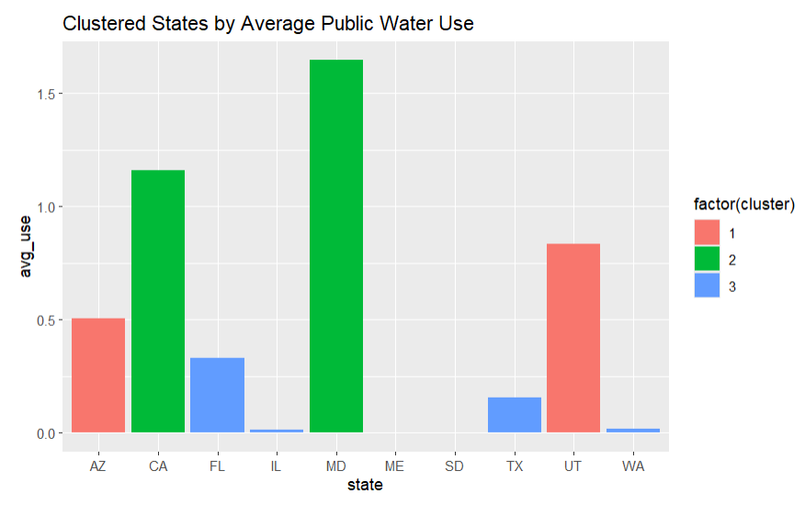
Combined Use per State
States grouped using k-means clustering based on average daily MGD (million gallons per day).
Cluster 1 (Red): Moderate-use states like AZ and UT, showing consistent demand.
Cluster 2 (Green): High-use states such as CA and MD, indicating significant public supply burdens.
Cluster 3 (Blue): Low-use states (e.g., IL, WA, ME) with minimal per-state consumption.
Highlights regional differences in public water dependency.
Can inform targeted conservation strategies or policy adjustments by usage category.

Slide 11
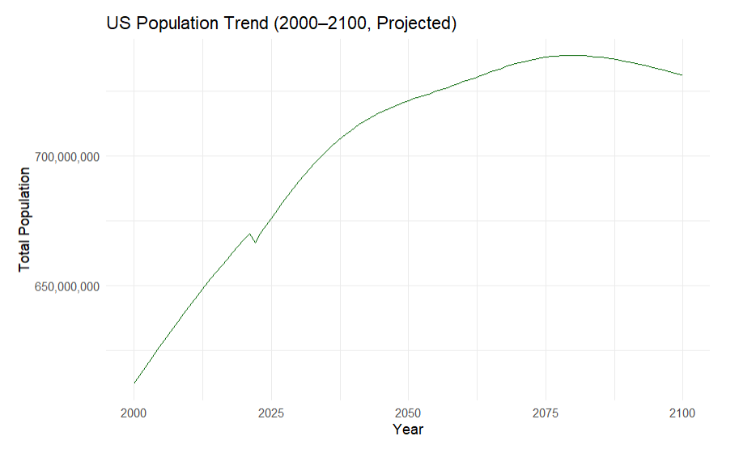
Population Projections
The graph shows a steady increase in U.S. population from 2020 through approximately 2080.
Population is projected to peak just under 740 million around the year 2080.
After peaking, the population begins a gradual decline through the end of the century.
The projections are based on demographic modeling that accounts for birth rates, death rates, and migration.
These trends are critical for forecasting resource demand, including water, energy, housing, and infrastructure.
The long-term decline suggests a future shift in national planning priorities toward sustainability and aging population support.

Slide 12
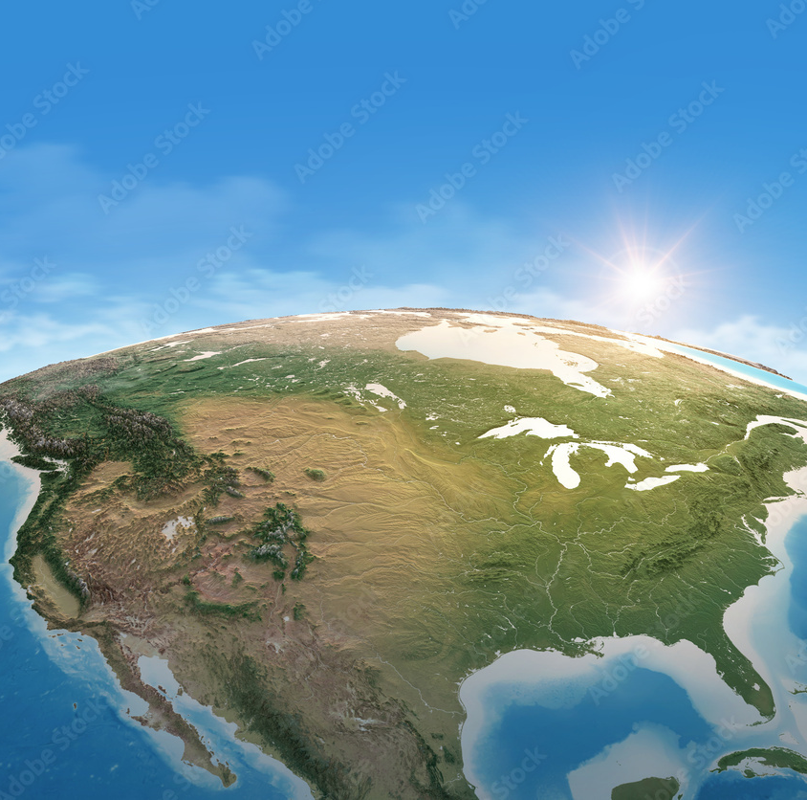
The Big Picture

Slide 13
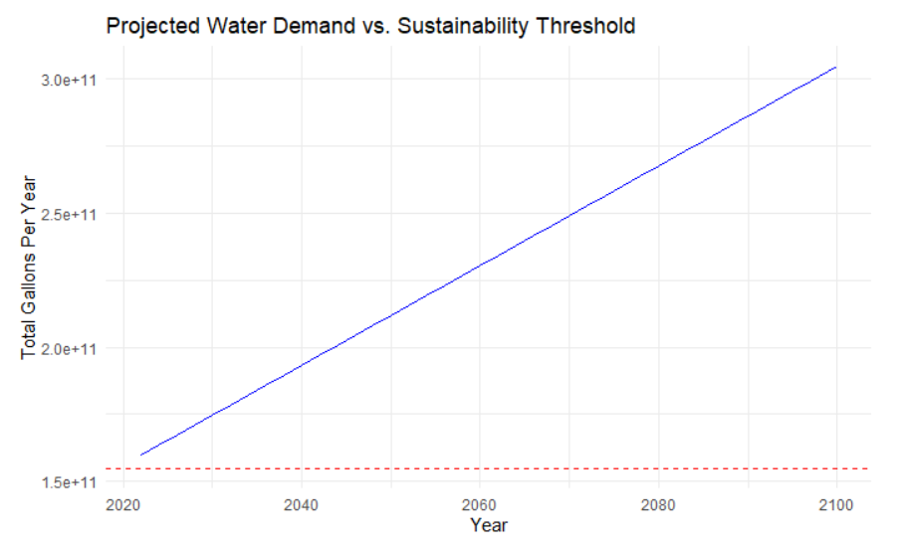
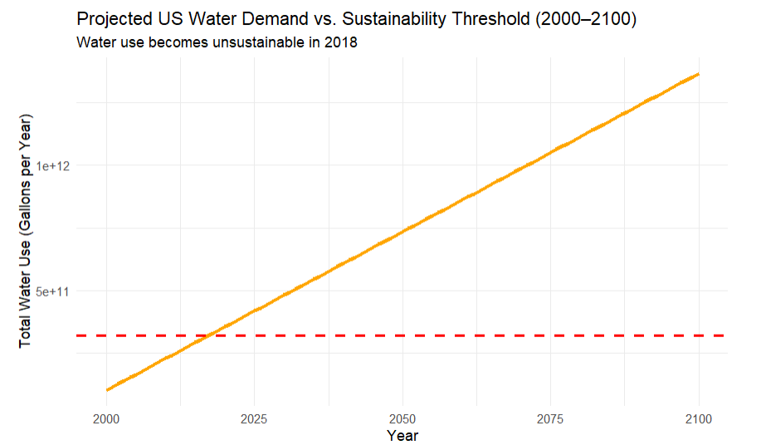
Projected Water Demand V. Sustainability Threshold
Both graphs project significant increases in annual water demand through the year 2100.
The first graph shows combined demand (public supply, thermoelectric, and irrigation), while the second focuses on public water use alone.
In both cases, the projected demand line surpasses the sustainability threshold (red dashed line) well before mid-century.
The combined demand increases at a much faster rate, suggesting agriculture and energy sectors drive a large portion of overuse.
The trend highlights an unsustainable trajectory if current water usage patterns continue alongside population growth.
These projections underscore the urgent need for conservation policies, infrastructure upgrades, and sector-specific water management strategies.

Slide 14
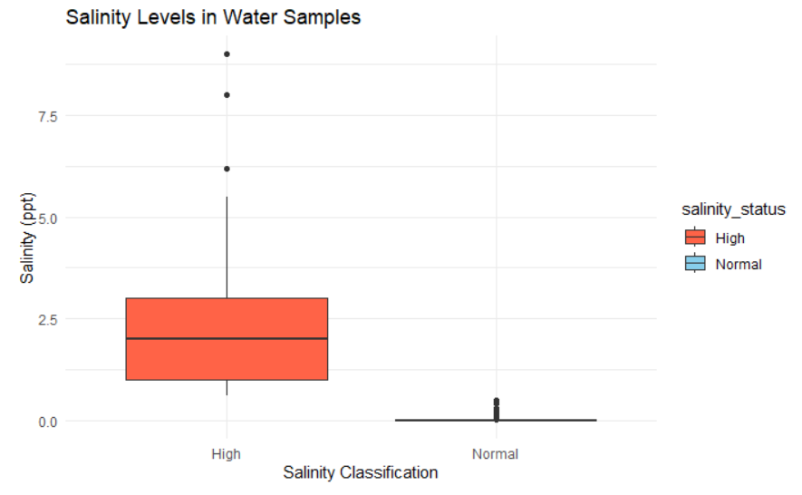
Water Quality
Water samples were categorized as "Normal" or "High" based on a 0.5 ppt salinity threshold.
The "Normal" samples had very low salinity levels, generally close to 0 ppt, and fall within safe drinking water standards.
The "High" salinity group showed a median around 2.5 ppt, with some values exceeding 7 ppt — far above drinkable limits.
Elevated salinity may result from saltwater intrusion, industrial discharge, or inadequate treatment systems.
A significant number of samples were flagged as potentially unsafe for drinking based on their salinity levels.
The results suggest a need for monitoring and intervention in regions where salinity is rising or persistently high.

Slide 15
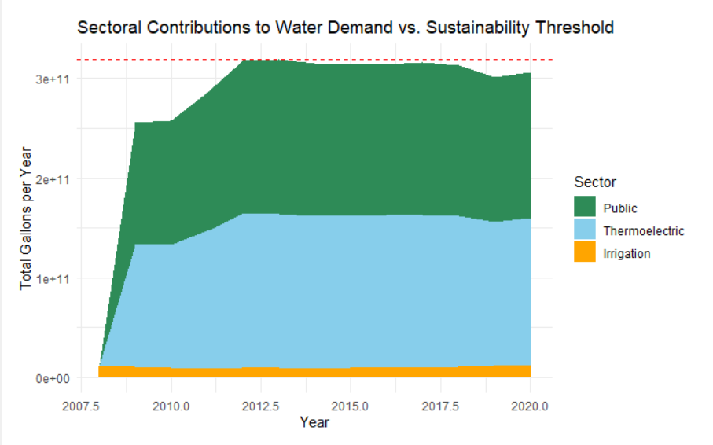
Sectoral Use
The graph displays how public, thermoelectric, and irrigation sectors contribute to total annual water demand from 2008 to 2020.
A red dashed line marks the sustainability threshold, representing the maximum sustainable total water use.
Public supply is the largest contributor, taking up nearly half of total demand in most years.
Thermoelectric water use is the second-largest, showing relatively stable consumption over time.
Irrigation, while the smallest share overall, maintains consistent use and still adds significant pressure in combination with other sectors.
In most years, total demand approaches or exceeds the sustainability threshold, signaling that current sectoral patterns are not sustainable long-term without policy changes or conservation efforts.

Slide 16
How Can We Solve This?
Upgrade water infrastructure by repairing aging pipelines, expanding water recycling systems, and investing in desalination and smart monitoring technologies.
Improve agricultural efficiency through drip irrigation, drought-resistant crops, and regenerative practices that conserve soil moisture and reduce runoff.
Adopt water-efficient practices at the household and industrial levels, including low-flow fixtures, leak detection, and smart landscaping like xeriscaping.
Implement tiered water pricing and consumption caps to discourage overuse while ensuring affordable access for essential needs.
Enhance water policy and governance, including better interstate coordination, sustainable groundwater permitting, and integrating climate risks into planning.
Promote public education and incentives that raise awareness, encourage conservation, and reward sustainable water use behaviors in communities and businesses.

