Slide 1
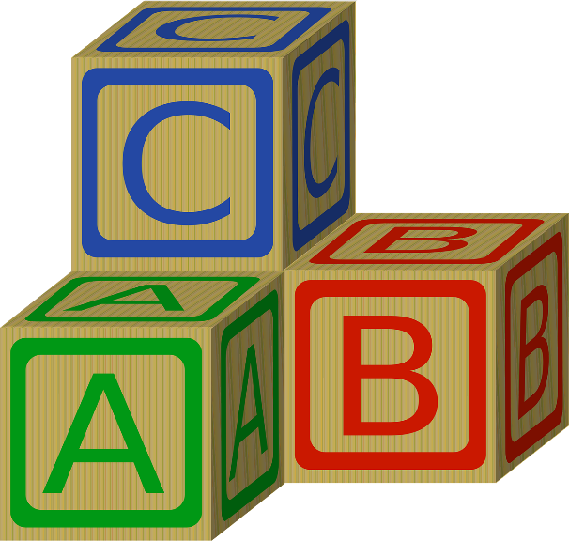
Data Types
Photocopiable/digital resources may only be copied by the purchasing institution on a single site and for their own use
© ZigZag Education, 2021

Slide 2
Data Types
When you create a variable, many programming languages require you to state the type of data you want to store in it.
Different types of data require different amounts of memory and, therefore, the computer needs to know how much memory to allocate to a particular variable.
The main data types are:
Integer
Real
Boolean
Char
String
© ZigZag Education, 2021

Slide 3
Integer
An integer is a whole number without a fractional part (decimal place).
5
.75
Here are some examples of integers:
Age = 14
Score = 75
People = 4
© ZigZag Education, 2021

Slide 4
Real
Real numbers (also known as floating point) can have a fractional part (decimal place).
5
.75
Here are some examples of real numbers:
Temperature = 18.5
Price = 1.84
Height = 1.85
© ZigZag Education, 2021

Slide 5
Boolean
The Boolean data type supports only two different values: TRUE and FALSE.
These values are represented using binary.
0 = FALSE
1 = TRUE
Overdue = FALSE
Authorised = TRUE
© ZigZag Education, 2021

Slide 6
Character
The character data type stores a single alphanumeric character.
This could be a letter, number or symbol.
Here are some examples of characters:
Gender = F
Grade = B
Initial = H
© ZigZag Education, 2021

Slide 7
String
A string is a group of alphanumeric characters.
Strings are usually enclosed within quote marks “ ”.
Here are some examples of strings:
Name = “Alex”
Postcode = “N1 5BH”
City = “London”
© ZigZag Education, 2021

Slide 8
END

