Slide 1

Error Detection and Correction
Photocopiable/digital resources may only be copied by the purchasing institution on a single site and for their own use
© ZigZag Education, 2021

Slide 2
Check Digits
Check digits are often added to ID numbers to detect errors made during data entry by humans, like transposing and incorrect digits.
To check an ID number using the check digit we start by multiplying each digit by its position.
Position | 5 | 4 | 3 | 2 | 1
ID Number | 4 | 1 | 0 | 3 | 3
 | 20 | 4 | 0 | 6 | 3
Check Digit
Next we add the results of the multiplication together and divide the answer by 11.
20 + 4 + 0 + 6 + 3 = 33
33 / 11 = 3
If the remainder is 0, the ID number is valid.
© ZigZag Education, 2021

Slide 3
Calculating Check Digits
In order to calculate the check digit for an ID number we use a similar process.
Starting at position 2, multiply each digit by its position.
Position | 5 | 4 | 3 | 2 | 1
ID Number | 3 | 0 | 2 | 5 | 2
 | 15 | 0 | 6 | 10
Check Digit
Next we add the results of the multiplication together.
15 + 0 + 6 + 10 = 31
To calculate the check digit we work out what needs to be added to the result to make it divisible by 11. In this case it is 2
© ZigZag Education, 2021

Slide 4
Parity Checks
Parity checks are a simple method of checking for errors in data transmission.
They work by adding an extra bit to a string of binary digits to either make the number of 1s odd or even.
Odd Parity | 0 | 1 | 1 | 0 | 1
Even Parity | 0 | 1 | 1 | 0 | 0
Parity Bit
Odd Parity
Even Parity
A digit is added to the end make the number of 1s in the number odd.
A digit is added to the end make the number of 1s in the number even.
© ZigZag Education, 2021

Slide 5
Checksums
Checksums are used to check the integrity of a file after transmission over a network or transfer between storage devices.
An algorithm is used to generate a sequence of characters based on the contents of the file. This sequence is the checksum.
If the file contents change in any way, the checksum will change. This way errors in transmission or other changes can be detected.
Below is a simple text message and its checksum calculated by the CheckSum 8 Xor algorithm.
Hello World
Hello World
Checksum: 20
Checksum: 6C
© ZigZag Education, 2021

Slide 6
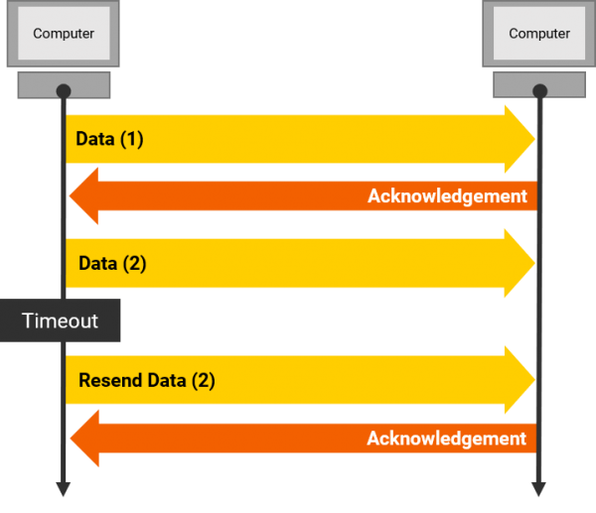
Automatic Repeat reQuest
The Automatic Repeat request (ARQ) is a protocol used to handle errors in data transmission.
If an error is detected in a data packet when it is received, the ARQ protocol automatically sends a request for the transmitting device to resent the packet.
© ZigZag Education, 2021

Slide 7
END

