Slide 1

HTML
Photocopiable/digital resources may only be copied by the purchasing institution on a single site and for their own use
© ZigZag Education, 2021
Notes:
87770410

Slide 2
HTML
HTML (HyperText Markup Language) is used to create webpages designed to be accessed through the World Wide Web (WWW).
The focus on HTML is on creating the structure of webpages. This refers to the use of HTML tags to structure the content of the page.
This is the basic structure of an HTML document:
<!DOCTYPE html>
<html>
<head>
</head>
<body>
</body>
</html>
All the information about the document is placed within the <head> section.
All content that is visible on screen is placed within the <body> section.
© ZigZag Education, 2021

Slide 3

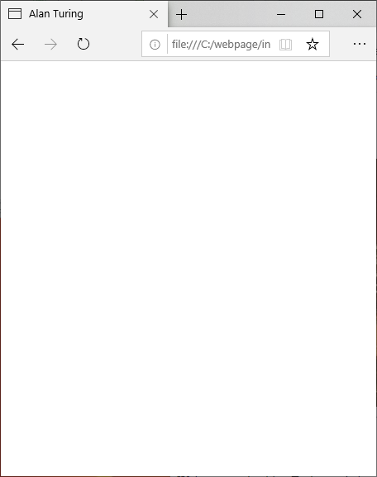
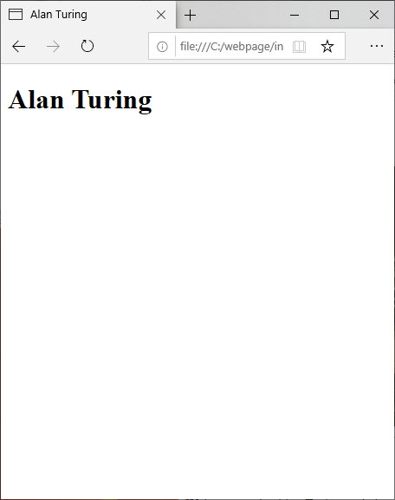
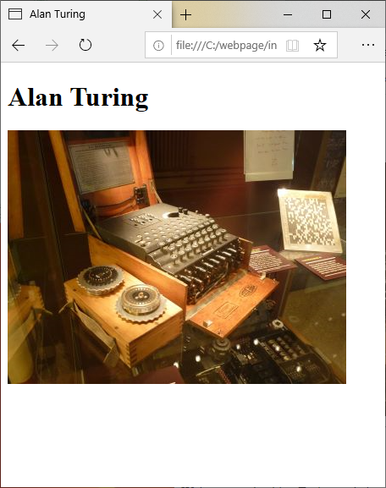

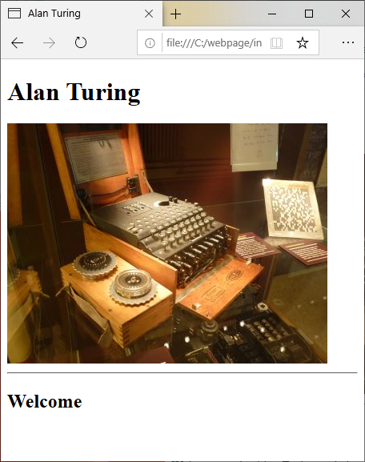

Example Webpage
Below shows some HTML and how it would display in a browser.
<!DOCTYPE HTML>
<html>
<head>
<title>Alan Turing</title>
</head>
<body>
<h1>Alan Turing</h1>
<img src=”enigma.jpg”>
<hr>
<h2>Welcome</h2>
<p>Welcome to the Alan
Turing website.</p>
</body>
</html>
© ZigZag Education, 2021

Slide 4
HTML Tags
HTML documents are structured using tags.
Each HTML tag describes different document content.
<p>This is a paragraph.</p>
The example above uses the paragraph tag. HTML tag normally come in pairs.
The first tag is the start (or opening) tag and the second tag is the end (or closing) tag.
© ZigZag Education, 2021

Slide 5
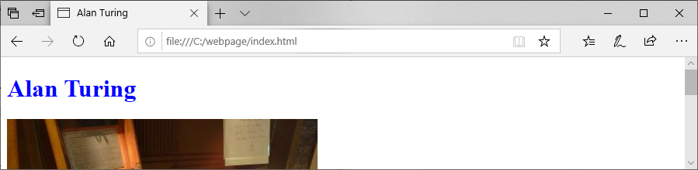
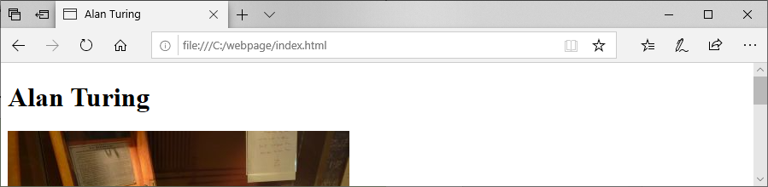
Presentation
Presentation refers to the styling of the webpage. This includes properties like colour, fonts and text size.
One way of styling content is include style information inline with the HTML content.
<h1 style="color:blue;">Alan Turing</h1>
© ZigZag Education, 2021

Slide 6

CSS
If styles are included inline they have to be defined individually to every tag.
For this reason it’s considered good practice to separate the structure and presentation
This enables individual styles to be created in one place and applied to multiple tags and even across web pages.
Cascading Style Sheets (CSS) are usually separate files that define the styles for a webpage or website.
© ZigZag Education, 2021
Notes:
53556271

Slide 7

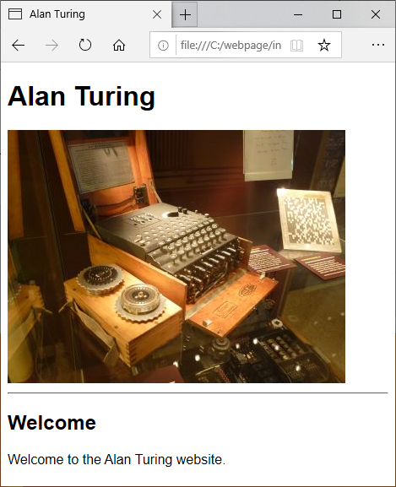
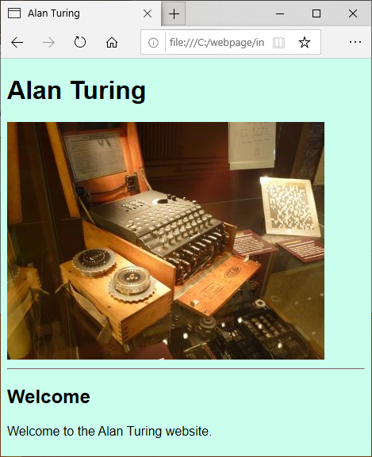
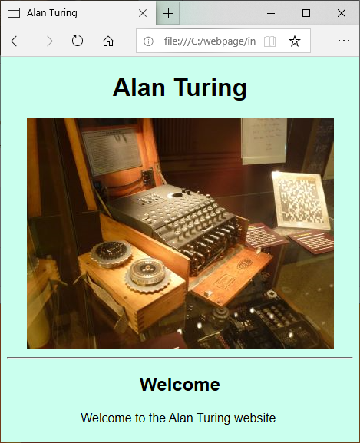
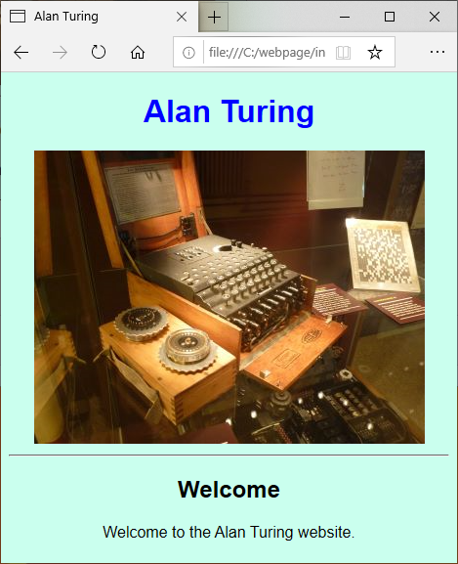
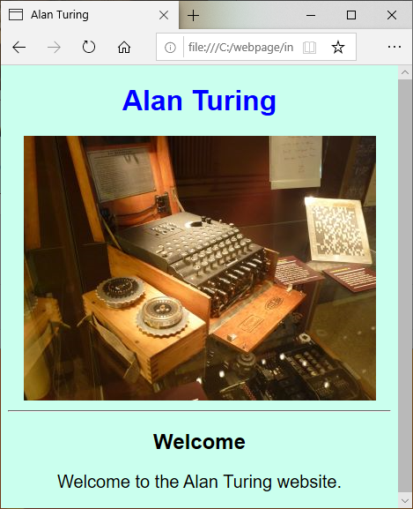
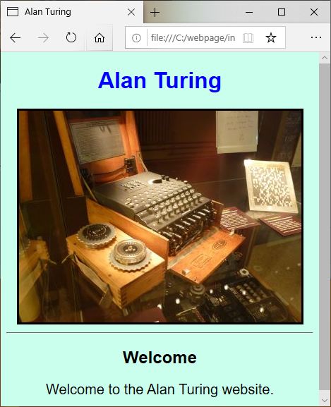
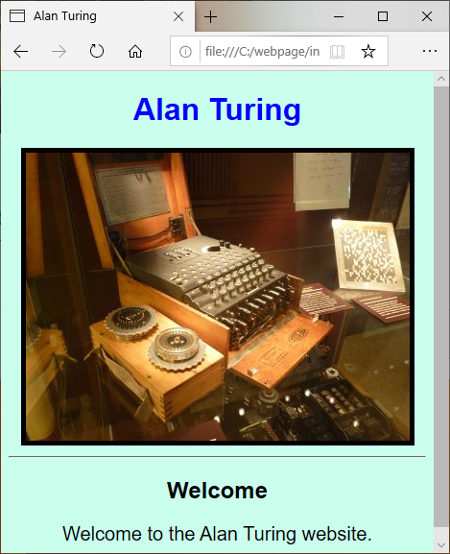
Example CSS
body {
font-family: "Arial";
background-color: #CAFFEE;
text-align: center;
}
h1 {
color: blue;
}
p {
font-size: 20px;
}
img {
border-style: solid;
border-width: 5px;
}
© ZigZag Education, 2021

Slide 8
Linking Stylesheets
External stylesheets need to be linked to the webpages we wish to apply them to.
We place with linking HTML in the <head> section of the file.
<head>
<title>Alan Turing</title>
<link rel="stylesheet" type="text/css" href=“styles.css">
</head>
© ZigZag Education, 2021

Slide 9
END

