Slide 1

Number Representation
Photocopiable/digital resources may only be copied by the purchasing institution on a single site and for their own use
© ZigZag Education, 2021

Slide 2
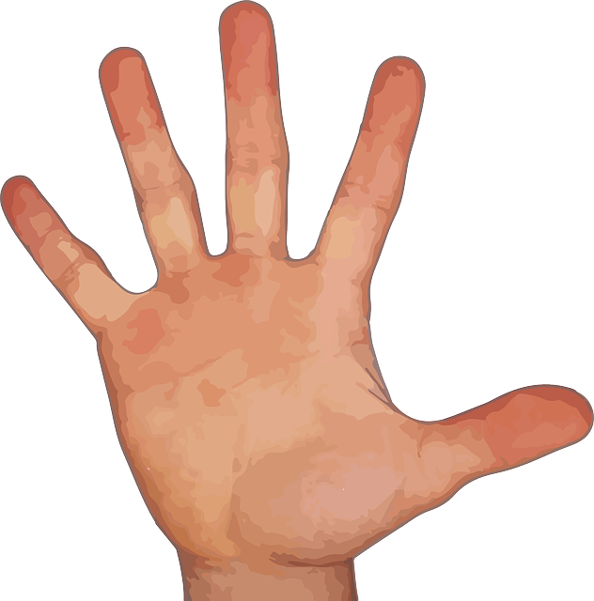
Denary
The denary number system (also known as decimal) uses 10 symbols (0–9) to represent numbers. It is a base-10 number system.
Humans use it because we have 10 fingers.
© ZigZag Education, 2021
Notes:
46240557

Slide 3
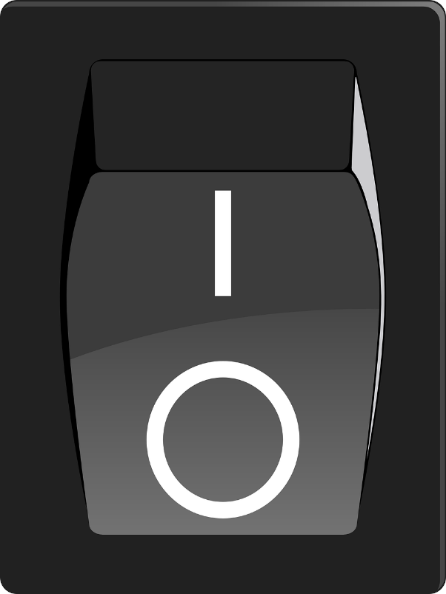
Binary
Computers don’t have fingers, they have circuits. These circuits can be in one of two states: on or off. So, they use a base-2 number system.
On = 1
Off = 0
© ZigZag Education, 2021
Notes:
8483766

Slide 4
Counting in Binary
Each place in a binary number has a value.
These go up in multiples of 2.
128 | 64 | 32 | 16 | 8 | 4 | 2 | 1
0 | 0 | 0 | 0 | 1 | 0 | 0 | 0
128 | 64 | 32 | 16 | 8 | 4 | 2 | 1
0 | 0 | 0 | 0 | 0 | 0 | 0 | 1
128 | 64 | 32 | 16 | 8 | 4 | 2 | 1
0 | 0 | 0 | 0 | 0 | 0 | 1 | 0
128 | 64 | 32 | 16 | 8 | 4 | 2 | 1
0 | 0 | 0 | 0 | 0 | 0 | 1 | 1
128 | 64 | 32 | 16 | 8 | 4 | 2 | 1
0 | 0 | 0 | 0 | 0 | 1 | 0 | 0
128 | 64 | 32 | 16 | 8 | 4 | 2 | 1
0 | 0 | 0 | 0 | 0 | 1 | 0 | 1
128 | 64 | 32 | 16 | 8 | 4 | 2 | 1
0 | 0 | 0 | 0 | 0 | 1 | 1 | 0
128 | 64 | 32 | 16 | 8 | 4 | 2 | 1
0 | 0 | 0 | 0 | 0 | 1 | 1 | 1
= 8
= 7
= 1
= 2
= 3
= 4
= 5
= 6
To convert a binary number to decimal we add up the place values of the columns with a 1 in.
© ZigZag Education, 2021
Notes:
7664518

Slide 5
Denary to Binary
Start by writing out the place values.
128 | 64 | 32 | 16 | 8 | 4 | 2 | 1
0 | 0 | 0 | 0 | 1 | 0 | 1 | 0
128 | 64 | 32 | 16 | 8 | 4 | 2 | 1
 |  |  |  | 1 |  | 1
10 =
Then write a 1 underneath the place values that add up to the denary number.
Finally, fill in the remaining spaces with 0s.
© ZigZag Education, 2021
Notes:
7664518

Slide 6
16-bit Example
255 is the highest value that can be stored in 8-bit binary.
By increasing the number of bits to 16 we can store a maximum value of 65,535.
32,768 | 16,384 | 8,192 | 4,096 | 2,048 | 1,024 | 512 | 256 | 128 | 64 | 32 | 16 | 8 | 4 | 2 | 1
1 | 0 | 0 | 0 | 0 | 0 | 0 | 0 | 0 | 0 | 0 | 0 | 0 | 0 | 1 | 0
32,768 + 2 =
32,770
© ZigZag Education, 2021
Notes:
7664518

Slide 7
Hexadecimal
Hexadecimal is often used as a shorthand for binary as it is quicker for humans to write.
Hexadecimal is a base-16 number system, which means it uses 16 symbols.
0 | 1 | 2 | 3 | 4 | 5 | 6 | 7 | 8 | 9 | A | B | C | D | E | F
0 | 1 | 2 | 3 | 4 | 5 | 6 | 7 | 8 | 9 | 10 | 11 | 12 | 13 | 14 | 15
It starts by using the symbols 0–9 and then switches the letters A–F. This is so that only single digits are used.
F = 15
© ZigZag Education, 2021
Notes:
7664518

Slide 8
Hexadecimal to Binary
Hexadecimal numbers usually consist of pairs of digits as this is equivalent to 1 byte (8 bits).
Converting between hexadecimal and binary is simple. You just take each character and convert it into the equivalent binary number.
Hex | D |  |  |  | A
Decimal | 13 |  |  |  | 10
Binary | 1 | 1 | 0 | 1 | 1 | 0 | 1 | 0
Finally, you join the two binary numbers together.
DA = 11011010
© ZigZag Education, 2021
Notes:
7664518

Slide 9
Binary to Hexadecimal
To convert from binary to hexadecimal we simply reverse the process.
Binary | 1 | 1 | 0 | 1 | 1 | 0 | 1 | 0
Decimal | 13 |  |  |  | 10
Hex | D |  |  |  | A
The easiest way to convert a hexadecimal number to denary is to convert it to binary first and then from binary into denary.
© ZigZag Education, 2021
Notes:
7664518

Slide 10
16-bit Example
Here is an example of the conversion of a 16-bit binary number.
Binary | 1 | 1 | 0 | 1 | 1 | 0 | 0 | 1 | 1 | 0 | 1 | 0 | 0 | 0 | 0 | 1
Decimal | 13 |  |  |  | 9 |  |  |  | 10 |  |  |  | 1
Hex | D |  |  |  | 9 |  |  |  | A |  |  |  | 1
A 16-bit binary number becomes a 4 digit hexadecimal number.
D9A1
© ZigZag Education, 2021
Notes:
7664518

Slide 11
END

