Slide 1
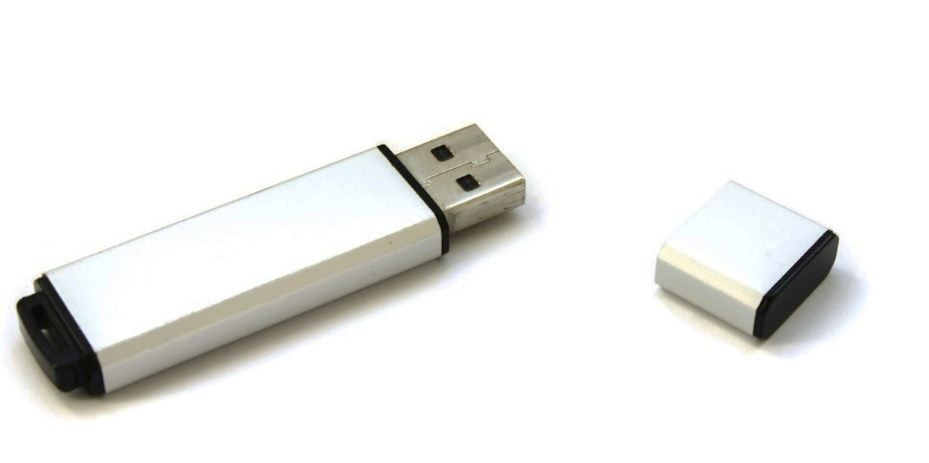
Data Storage Units
Photocopiable/digital resources may only be copied by the purchasing institution on a single site and for their own use
© ZigZag Education, 2021

Slide 2
Storage Units
It is important for you to understand the storage units used in computer science.
The smallest unit of storage is the bit. This can store a single 0 or 1.
The byte consists of 8 bits and is the unit used to measure the size of computer memory.
We can use prefixes to indicate multiple bytes (kilo, mega, giga, tera).
© ZigZag Education, 2021

Slide 3
Prefixes
We can use prefixes to indicate multiple bytes (kilo, mega, giga).
Depending on the definition the prefixes can increase in powers of 2 or 10.
Powers of 10
Powers of 2
byte
x 1000 or 10³ bytes
Kilobyte (KB)
x 1024 or 2¹⁰ bytes
x 1000 or 10⁶ bytes
Megabyte (MB)
x 1024 or 2²⁰ bytes
x 1000 or 10⁹ bytes
Gigabyte (GB)
x 1024 or 2³⁰ bytes
Powers of 2 are often used when measuring memory capacity.
© ZigZag Education, 2021

Slide 4
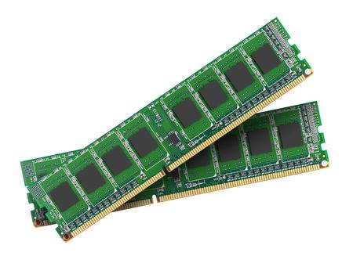
Memory Locations
Main memory in computers contains multiple memory locations, each of which can store a value in binary.
Each memory location can store one or multiple bytes and the capacity of memory is measured by adding together the number of bytes it can store.
Memory capacity is usually measured in powers of 2 as each memory location is addressed in hardware which is based on binary.
For example 4GB memory would have a 4 x 2³⁰ byte capacity.
© ZigZag Education, 2021
Notes:
54301161

Slide 5
END

